Slide 1
Tester
BSI

Slide 2
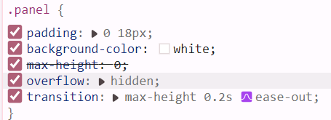
Tester
BSI

