Slide 1
Gold Rate Prediction
RESHMA KR
25/02/2024

Slide 2

Introduction
Introduction to the Project:
Gold Rate Prediction is a machine learning project aimed at forecasting the price of gold based on historical data and relevant economic indicators.
The project leverages data science techniques and predictive modeling to provide insights into future gold prices.
Importance of Predicting Gold Prices:
Predicting gold prices is crucial for investors, traders, and policymakers to make informed decisions and mitigate risks in financial markets.
Gold serves as a safe-haven asset and a hedge against inflation, making its price movement a key indicator of market sentiment and economic stability.
Brief Overview of Project Objectives:
The primary objective of the project is to develop an accurate predictive model that can forecast gold prices with high precision.
By analyzing historical data and economic factors, the project aims to provide valuable insights for stakeholders to optimize investment strategies and manage financial risks effectively.

Slide 3
Work Flow
Data Collection
&
Understanding
Data Cleaning
&
Manipulation
Exploratory
Data
Analysis

Slide 4
Data Collection & Understanding
Data The dataset, which includes ten years’ worth of data, is taken from the Kaggle website, dated from January 2008 to May 2018. It has six characteristics, such as gold rates, given as date, silver price, stock profit exchange, gold price, US dollar rate, and United States oil ETF. This dataset consists of 2290 records.
Data pre-processing
The dataset used should be cleaned at the very first step, in order to remove the noise, the null values, void values, etc.… to avoid the errors at the end. In order to do this firstly, the data should be normalized, next Feature extraction is done, where the attributes are identified as dependent and independent, and the unnecessary attributes should be removed, if any. In this paper ‘Date’ variable is dropped, as it is not important for the calculations.

Slide 5
Data checking & Understanding missing/null values
Checking null or missing values in the data set
Checking the size of the data set
gold_data.shape
gold_data.isnull(.sum)

Slide 6
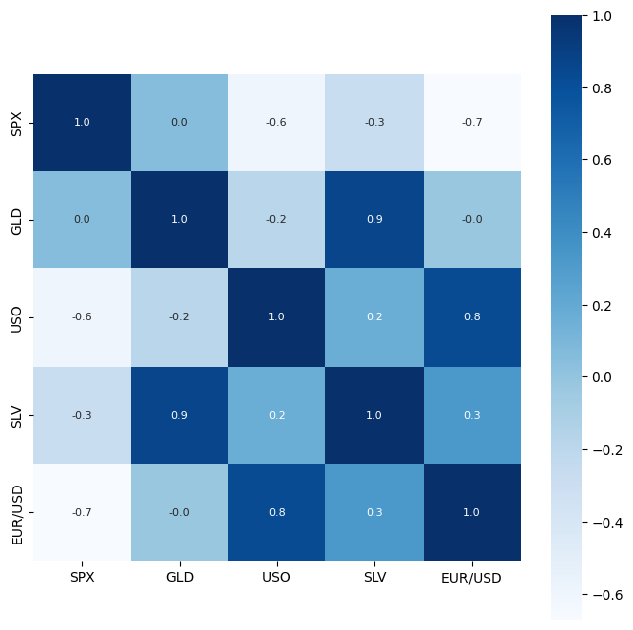
Correlation Analysis
Correlation analysis is utilized to assess the relationships among the various variables present in our dataset. In this paper, the results of the correlation analysis are depicted in Figure 1.

Slide 7
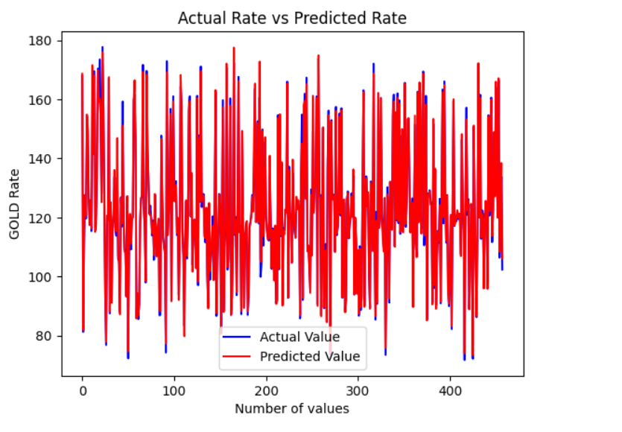
Comparison
Compare the Actual Values and Predicted Values in a Plot

Slide 8
Thank you

