Slide 1

Activity Recognition using gestures
Group No: E3 Date : 26/08/2014

Slide 2
TEAM MEMBERS:
Gopi Thulasinathan T - CB.EN.U4CSE11414
Sravanthi N - CB.EN.U4CSE11428
Narasimha Prasath K - CB.EN.U4CSE11429
Rahul E - CB.EN.U4CSE11439
Varun Kumar A - CB.EN.U4CSE11458
PROJECT GUIDE :
Ms. Padmavathi S.

Slide 3
Domain : Image processing
Sub Domain : Activity Recognition

Slide 4
Problem Statement
To develop Articulated human body model by using the limbs and joints, and to track the human motion in a video sequence.

Slide 5
Overview
1. Background Subtraction
2. Modeling the object being tracked
3. Tracking
4. Gesture Detection and Analysis

Slide 6
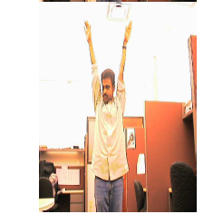
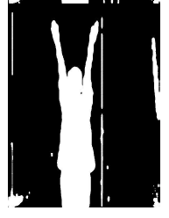
Background Subtraction

Slide 7
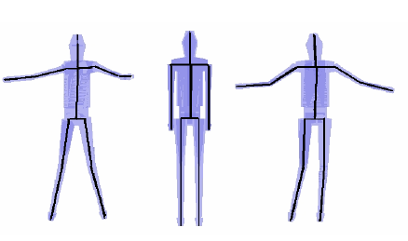
Modeling the object being tracked

Slide 8
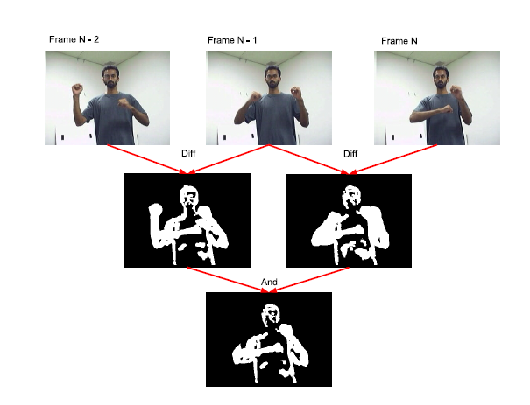
Tracking

Slide 9
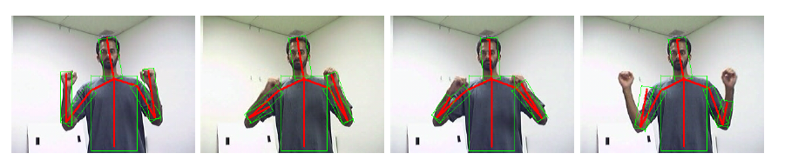
Gesture Detection and Analysis

Slide 10
Applications
Can detect various movements involved in
Video Surveillance
Exercise Postures
Yoga Asanas
Dance movements

Slide 11
References
Mun Wai Lee and Isaac Cohen, “Human Upper Body Pose Estimation in Static Images”, T. Pajdla and J. Matas (Eds.): ECCV 2004, LNCS 3022, pp. 126–138, 2004, Springer-Verlag Berlin Heidelberg 2004.
Li, Jing-Feng, Xu, Yi-Hua; Chen, Yang; Jia, Yun-De “A Real-Time 3D Human Body Tracking and Modeling System” IEEE International Conference on Image Processing, 2006
MANIMALA S & C. N. RAVI KUMAR, ENVISAGING TORSO AND FOOT FEATURES OF HUMAN BODY USING TOPINARD’S CANON SYSTEM, International Journal of Management, Information Technology and Engineering, Vol. 2, Issue 1, Jan 2014, 91-96
http://www.cvpapers.com/eccv2004.html

