Slide 1

Progressive Website Application
Gender Equality Awareness

Slide 2
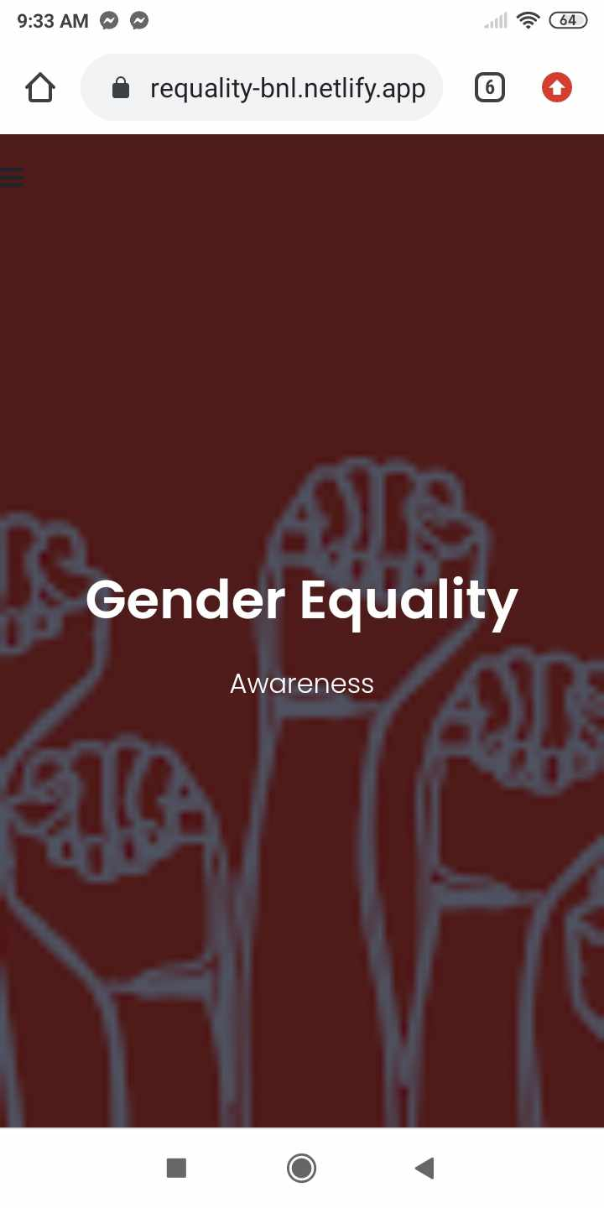
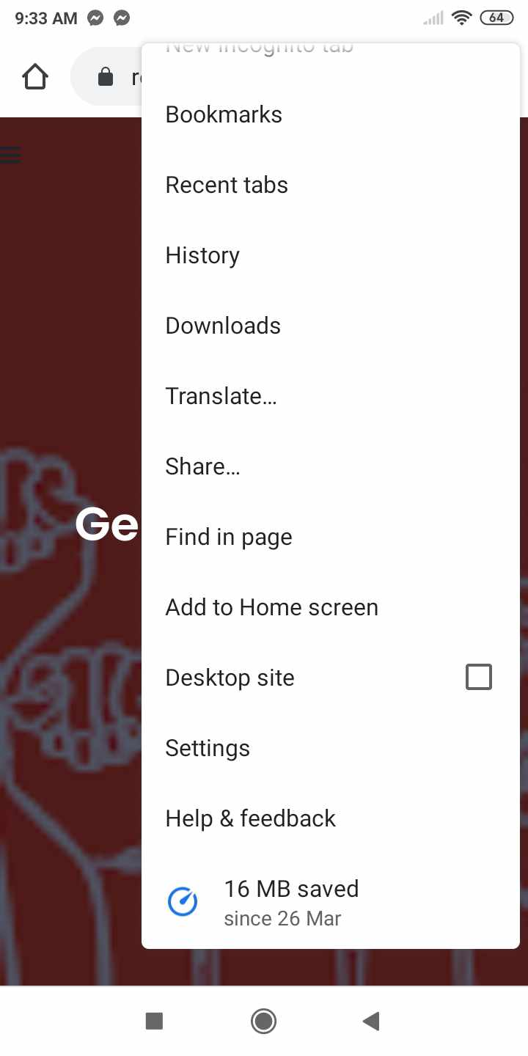
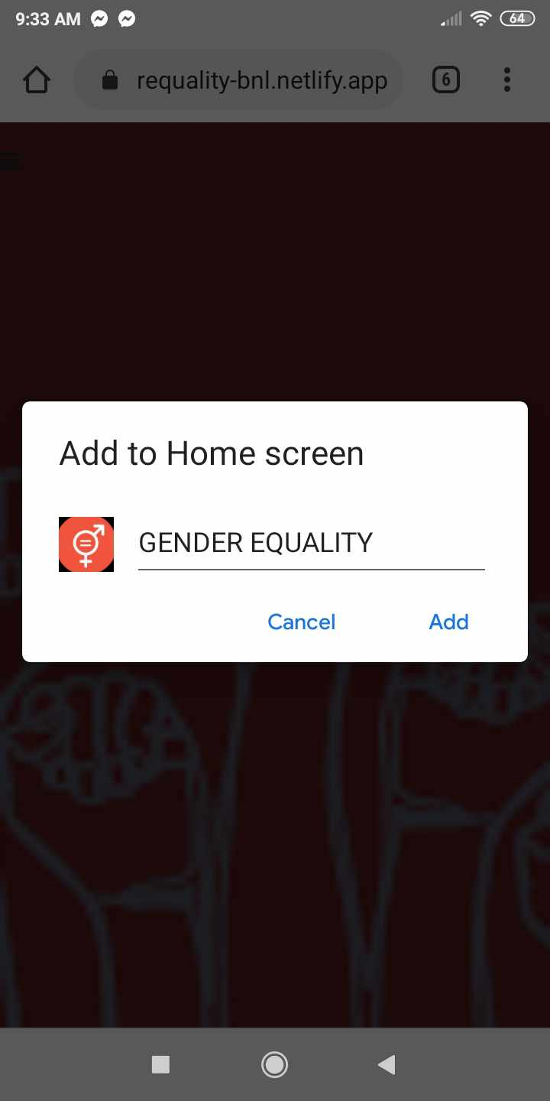
Web App Install

Slide 3
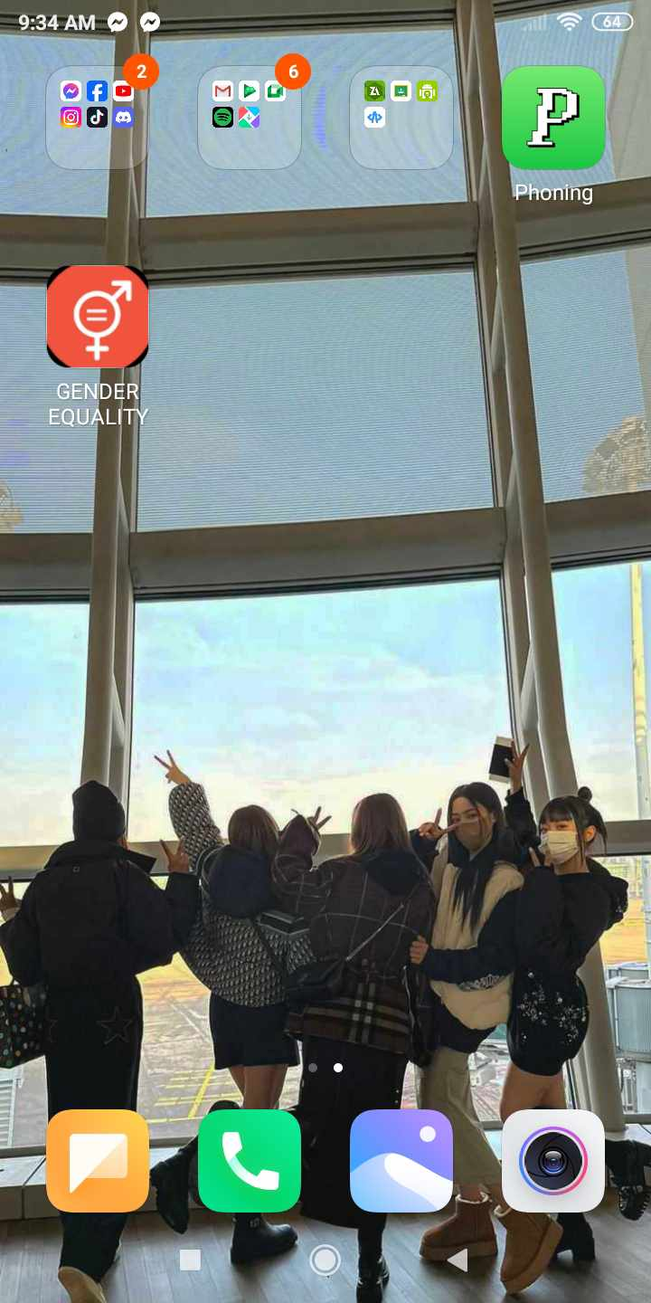
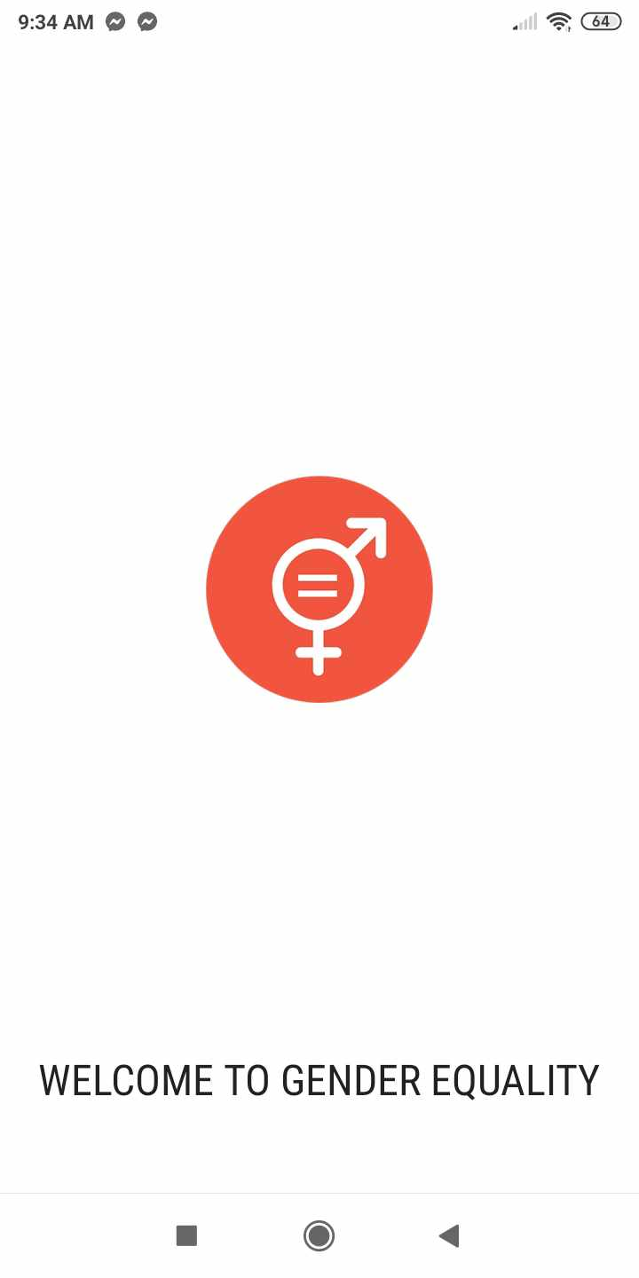
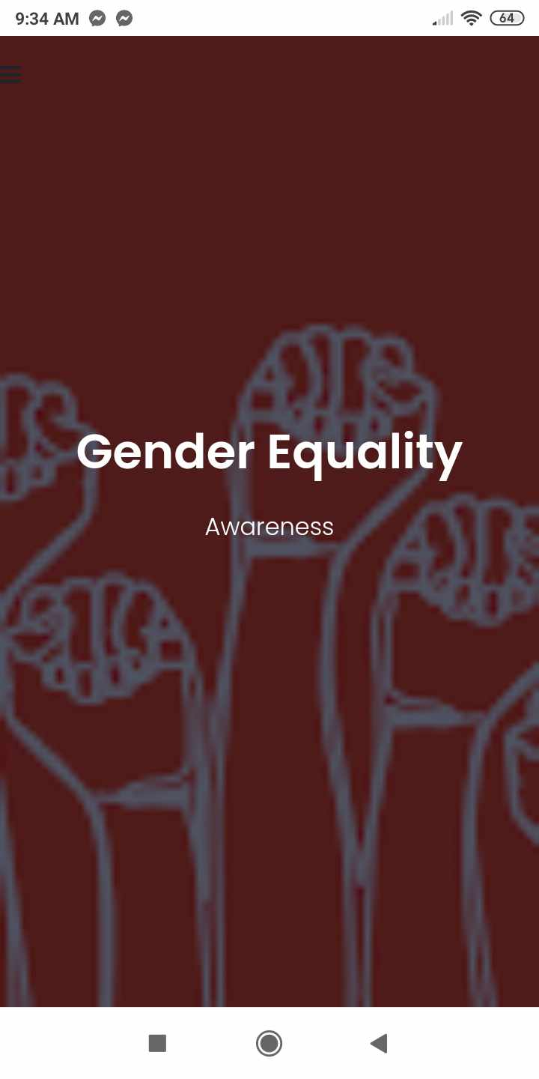
Web App Install

Slide 4
Key Features

Slide 5
Key Features
Responsive Design:
The application is designed to be responsive, ensuring that it looks and works well across various devices and screen sizes.
Offline Support:
The Service Worker implementation allows the application to work offline by caching essential files (index.html, style.css, etc.).

Slide 6
Key Features
App-like Experience:
The PWA is configured to be installable on users' devices, allowing them to add it to their home screens like a native app.
Manifest File:
The manifest.json file provides metadata about the PWA, including its name, icons, start URL, display mode, background color, and theme color.

Slide 7
Key Features
Service Worker Caching:
The Service Worker caches specified files during installation (install event) to improve performance and offline accessibility.
Cached files include the application's HTML, CSS, and JavaScript files, ensuring that the core functionality is available even without an internet connection.
Dynamic Content Loading:
The fetch event listener in the Service Worker intercepts network requests, allowing the app to serve cached responses when offline and fetch new content when online.

Slide 8
Functionality

Slide 9
Functionality
Content Presentation:
The application presents information about gender equality, including its importance, challenges, and actions that individuals can take to promote equality.
Content is organized into sections such as "GOAL 5," "Question," and "Development Goals Infographic."

Slide 10
Functionality
Visual Appeal:
The application features a visually appealing design with typography, colors, and images to enhance readability and engagement.
It uses external libraries like Bootstrap, Font Awesome, and Google Fonts to style and decorate the interface.

