Slide 1

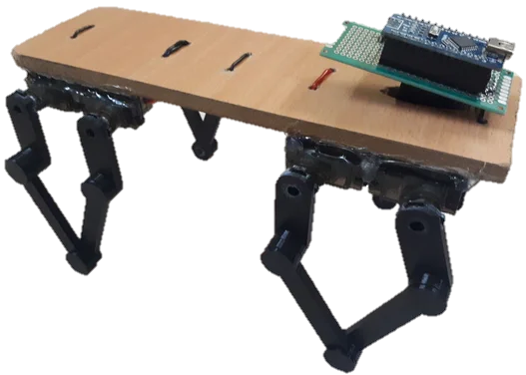
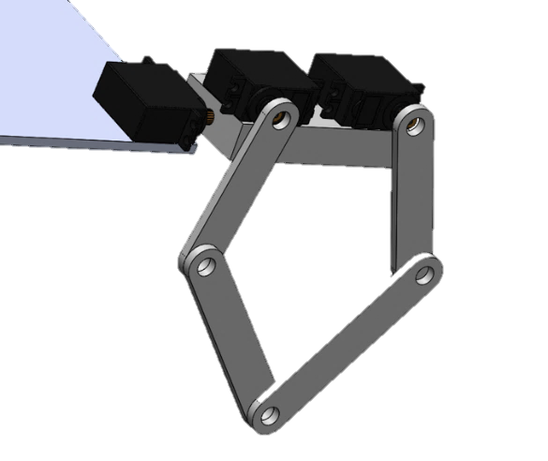
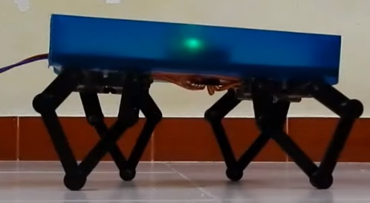

시스템 개략도
Body, hardboard(250$×$50mm)
Arduino
HC-05 Bluetooth
Printed Circuit Board
Bluetooth Control
MG-90S Servo
Up/down Motion
+ 4 DOF (1*4)
By adjusting the link angle,
Various motion implemented
4-legged walking robot using 5 link section
(5절 링크 구조를 이용한 4족 보행 로봇)

