Slide 1

Internet Addressing
Internet Addressing
[7:29 PM]
Internet Addressing
[7:29 PM]
Internet Addressing
[7:29 PM]
Internet Addressing
[7:29 PM]
Internet Addressing
[7:29 PM]
Internet Addressing
[7:29 PM]
Internet Addressing
[7:29 PM]
By Rafael

Slide 2
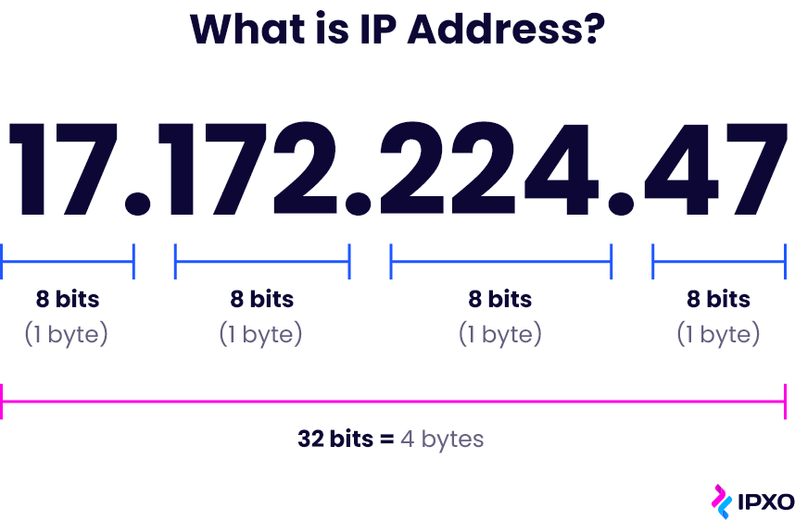

Slide 3
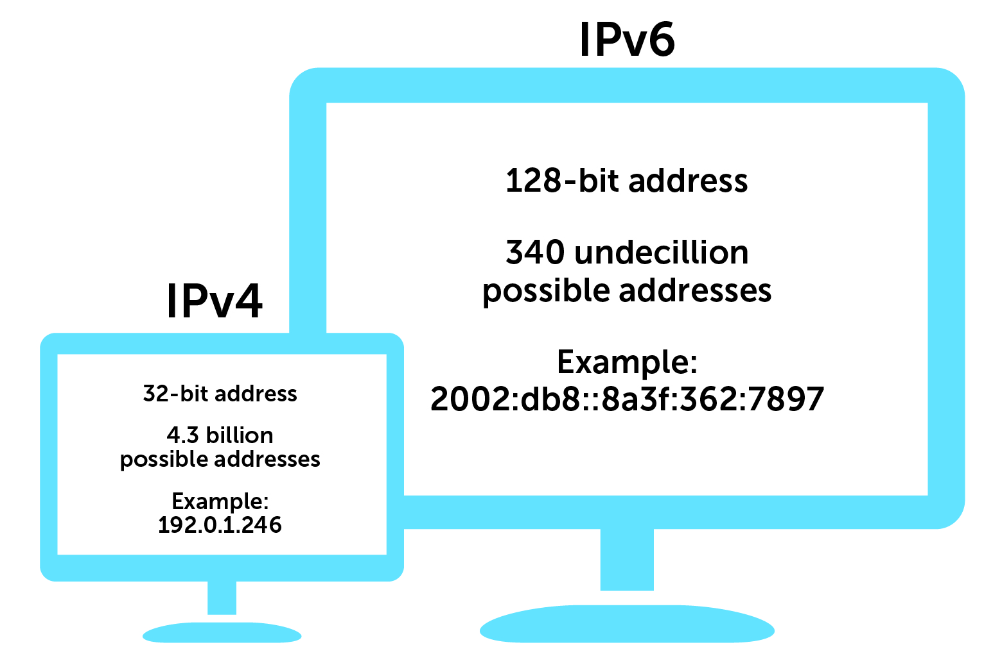
IPv4 vs IPv6

Slide 4
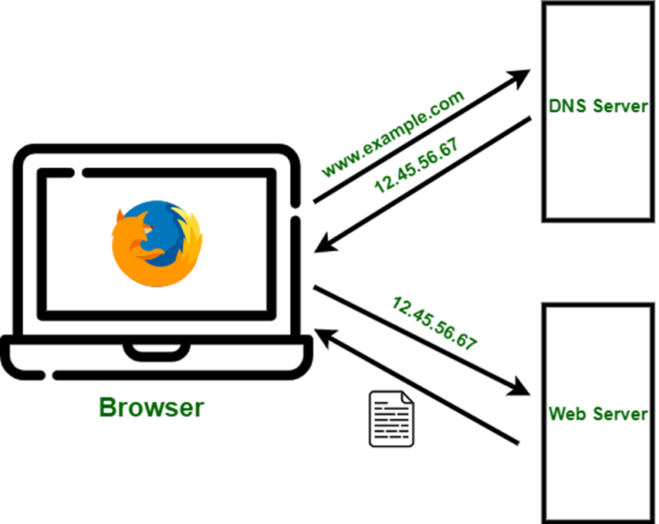
Domain Name System

Slide 5
Summary
In summary, Internet addressing is the foundation of the Internet, enabling devices and services to communicate with one another by using IP addresses and human-readable domain names. It is a complex system that underpins the structure and functionality of the global network.

