Slide 1
Apresentação de Projeto de Aprendizado de Máquina 2:
Um Classificador de Renda para o Adult Data Set
Luis Felipe Müller
Rafael Reis
Prof. Ruy Milidiu

Slide 2
Problema
Predizer se a renda anual de um indivíduo excede $50K, baseado em dados do Censo Americano de 1994
Classificar: é maior ou menor/igual do que $50K?

Slide 3
Data Set
Número de instâncias: 48.842 ( treino = 32.561, teste = 16.281)
Número de atributos: 14
Característica dos atributos: Categorias, Inteiros
Disponibilizado: 1996
Fonte: https://archive.ics.uci.edu/ml/datasets/Adult

Slide 4
Data Set
Probabilidade >50K: 23.93%
Probabilidade <=50K: 76.07%

Slide 5
Data Set: Atributos
Atributo | Valor
age | continuous
workclass | Private, Self-emp-not-inc, Self-emp-inc, Federal-gov, Local-gov, State-gov, Without-pay, Never-worked.
fnlwgt | continuous
education | Bachelors, Some-college, 11th, HS-grad, Prof-school, Assoc-acdm, Assoc-voc, 9th, 7th-8th, 12th, Masters, 1st-4th, 10th, Doctorate, 5th-6th, Preschool.
education-num | continuous
marital-status | Married-civ-spouse, Divorced, Never-married, Separated, Widowed, Married-spouse-absent, Married-AF-spouse.
occupation: | Tech-support, Craft-repair, Other-service, Sales, Exec-managerial, Prof-specialty, Handlers-cleaners, Machine-op-inspct, Adm-clerical, Farming-fishing, Transport-moving, Priv- house-serv, Protective-serv, Armed-Forces.
relationship | Wife, Own-child, Husband, Not-in-family, Other-relative, Unmarried.
race | White, Asian-Pac-Islander, Amer-Indian-Eskimo, Other, Black.
sex | Female, Male.
capital-gain | continuous.
capital-loss | continuous.
hours-per-week | continuous.
native-country | United-States, Cambodia, England, Puerto-Rico, Canada, Germany, Outlying-US(Guam-USVI-etc), India, Japan, Greece, South, China, Cuba, Iran, Honduras, Philippines, Italy, Poland, Jamaica, Vietnam, Mexico, Portugal, Ireland, France, Dominican-Republic, Laos, Ecuador, Taiwan, Haiti, Columbia, Hungary, Guatemala, Nicaragua, Scotland, Thailand, Yugoslavia, El-Salvador, Trinadad&Tobago, Peru, Hong, Holand-Netherlands.

Slide 6
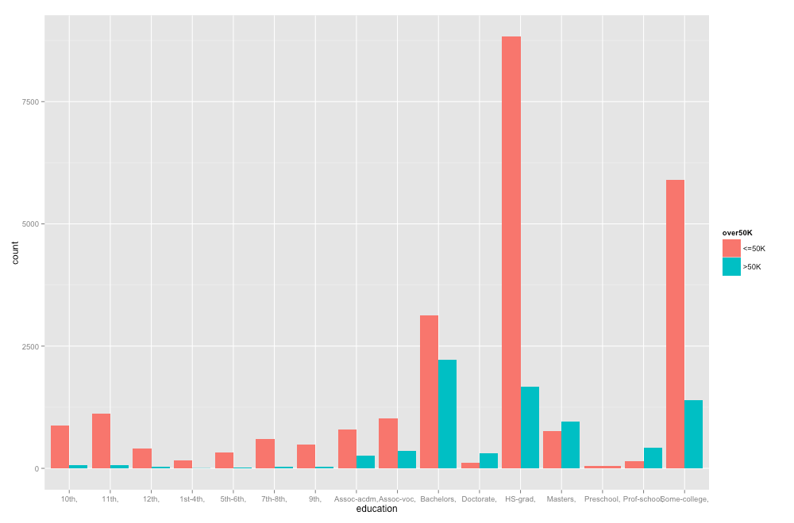
Data Set: Atributos

Slide 7
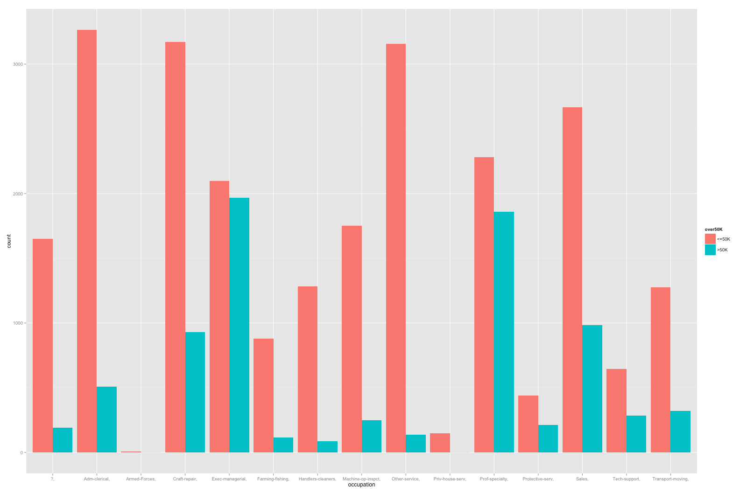
Data Set: Atributos

Slide 8
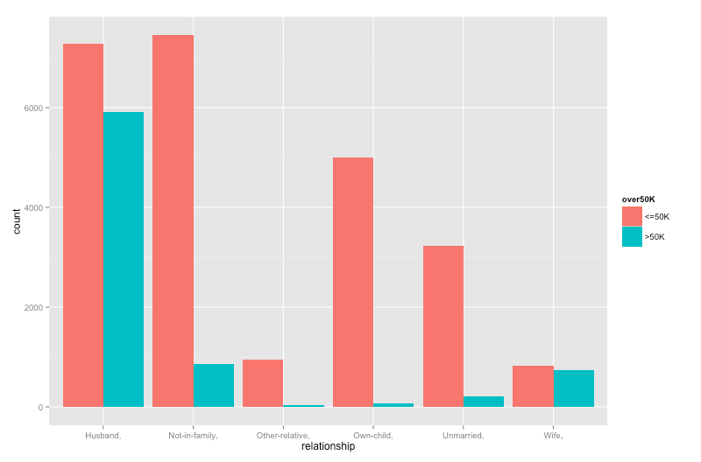
Data Set: Atributos

Slide 9
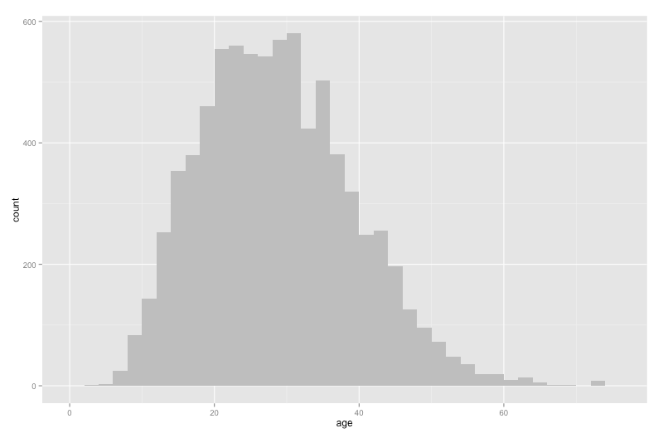
Data Set: Atributos

Slide 10
Trabalhos Relacionados
Algo | %
DECISION TREE* | 84.46
NAIVE-BAYES* | 83.88
NBTREE* | 85.90
BASE LINE estatístico | 76.07
* Ron Kohavi, 1996

Slide 11
Resultados : Naive Bayes
Detailed Accuracy By Class
 | TP Rate | FP Rate | Precision | Recall | F-Measure | ROC Area
 | 0.935 | 0.482 | 0.859 | 0.935 | 0.896 | 0.893
 | 0.518 | 0.065 | 0.716 | 0.518 | 0.601 | 0.893
Weighted Avg. | 0.834 | 0.382 | 0.825 | 0.834 | 0.825 | 0.893
Confusion Matrix
<=50K | >50K
23112 | 1608 | <=50K
3782 | 4059 | >50K
Accuracy | 83.4465 %

Slide 12
Resultados : NB-Tree
Detailed Accuracy By Class
 | TP Rate | FP Rate | Precision | Recall | F-Measure | ROC Area
<=50K | 0.932 | 0.339 | 0.897 | 0.932 | 0.914 | 0.921
>50K | 0.661 | 0.068 | 0.755 | 0.661 | 0.705 | 0.921
Weighted Avg. | 0.867 | 0.274 | 0.862 | 0.867 | 0.864 | 0.921
Confusion Matrix
<=50K | >50K
23037 | 1683 | <=50K
2658 | 5183 | >50K
Accuracy | 86.6681 %

Slide 13
Resultados : Random Tree
Detailed Accuracy By Class
 | TP Rate | FP Rate | Precision | Recall | F-Measure | ROC Area
<=50K | 0.999 | 0.006 | 0.998 | 0.999 | 0.999 | 1
>50K | 0.994 | 0.001 | 0.997 | 0.994 | 0.996 | 1
Weighted Avg. | 0.998 | 0.005 | 0.998 | 0.998 | 0.998 | 1
Confusion Matrix
<=50K | >50K
24697 | 23 | <=50K
46 | 7795 | >50K
Accuracy | 99.7881 %

Slide 14
Resultados : Random Forest
Detailed Accuracy By Class
 | TP Rate | FP Rate | Precision | Recall | F-Measure | ROC Area
<=50K | 1 | 0.004 | 0.998 | 1 | 0.999 | 1
>50K | 0.994 | 0 | 1 | 0.994 | 0.997 | 1
Weighted Avg. | 0.999 | 0.004 | 0.999 | 0.999 | 0.999 | 1
Confusion Matrix
<=50K | >50K
24697 | 3 | <=50K
44 | 7795 | >50K
Accuracy | 99.8557 %

Slide 15
Resultados : Random Commettee
Detailed Accuracy By Class
 | TP Rate | FP Rate | Precision | Recall | F-Measure | ROC Area
<=50K | 1 | 0.002 | 0.999 | 1 | 1 | 1
>50K | 0.998 | 0 | 1 | 0.998 | 0.999 | 1
Weighted Avg. | 0.999 | 0.002 | 0.999 | 0.999 | 0.999 | 1
Confusion Matrix
<=50K | >50K
24697 | 1 | <=50K
18 | 7795 | >50K
Accuracy | 99.9416 %

Slide 16
Referências
[1] Gareth James et al.
An Introduction to Statistical Learning: With Applications in R
Springer Publishing Company, Incorporated, 2014.
[2] Barry Becker.
Adult Data Set
url: https://archive.ics.uci.edu/ml/
datasets/Adult

Slide 17
Referências
[3] M. Lichman.
UCI Machine Learning Repository
url: http://archive.ics.uci.edu/ml
[4] Ron Kohavi.
Scaling Up the Accuracy of Naive-Bayes Classiers: a Decision-Tree Hybrid".
Em : Proceedings of the Second International Conference on Knowledge Discovery and Data Mining. 1996, to appear.

Slide 18
Referências
[5] Dmitry Pavlov, Jianchang Mao e Byron Dom.
Scaling-up support vector machines using boosting algorithm".
Em: Pattern Recognition, 2000. Proceedings. 15th International Conference on. Vol. 2. IEEE. 2000, pp. 219 a 222.
[6] Jose Ramon Cano, Francisco Herrera e Manuel Lozano.
Using evolutionary algorithms as instance selection for data reduction in KDD: an experimental study".
Em: Evolutionary Computation, IEEE Transactions on 7.6 (2003), pp. 561{575.

Slide 19
Referências
[7] Moritz Hardt, Katrina Ligett e Frank McSherry.
A simple and practical algorithm for dierentially private data release".
Em: Advances in Neural Information Processing Systems. 2012, pp. 2339 a 2347.

