Slide 1
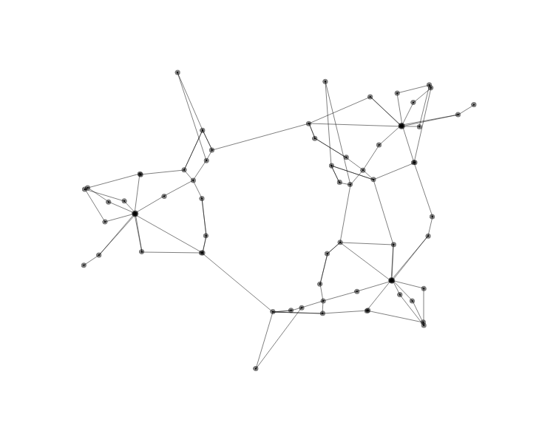
Zone 2
Zone 3
Zone 1

