Slide 1







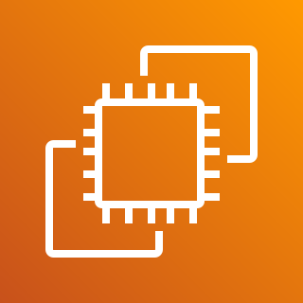

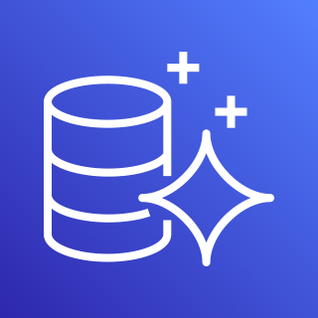
AWS Cloud
VPC
Public subnet
Internet gateway
Kubernet Server
Client
Availability Zone
Availability Zone
Availability Zone
Private subnet
Availability Zone
Availability Zone
Availability Zone

