Slide 1
Smart Hydroponic Greenhouse
Analysis
Embedded Systems
Bruno Silva – A88289
Rafael Pedro – A88271

Slide 2
Agenda
Project plan alterations
Events;
Use cases;
State diagrams;
Sequence diagrams;
Budget estimation;

Slide 3
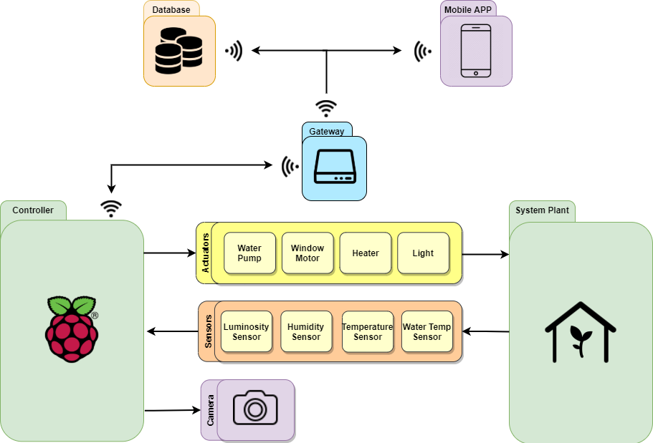
System Overview

Slide 4
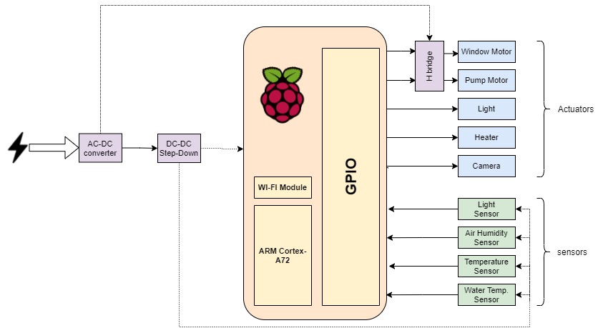
Hardware Architeture

Slide 5
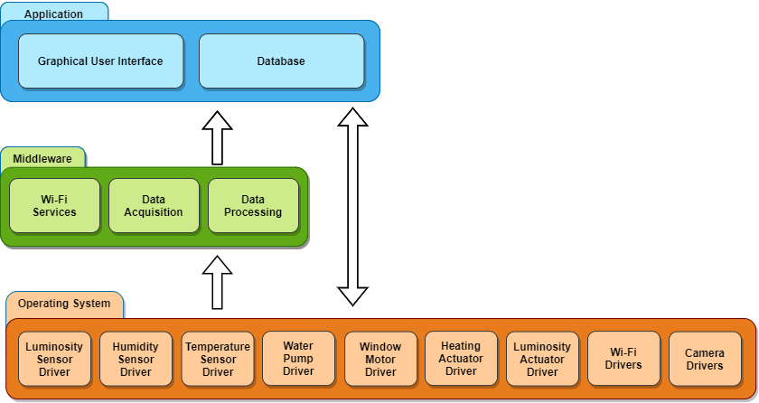
Software Architeture

Slide 6
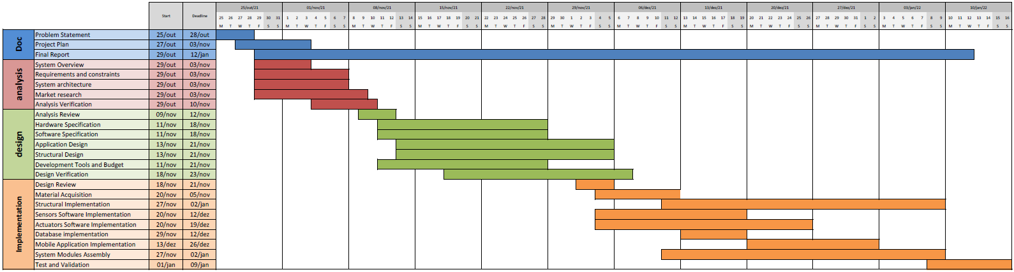
Gantt Diagram

Slide 7
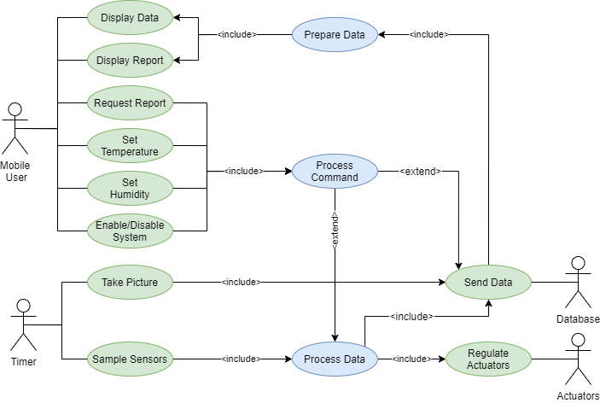
Use cases

Slide 8
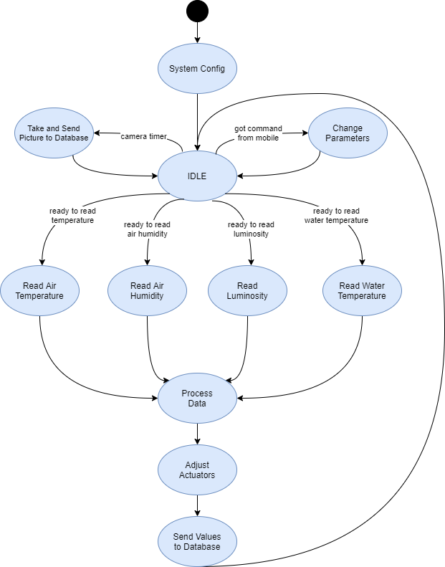
State diagram

Slide 9
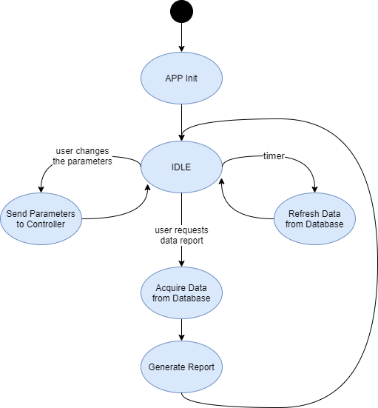
State diagram

Slide 10
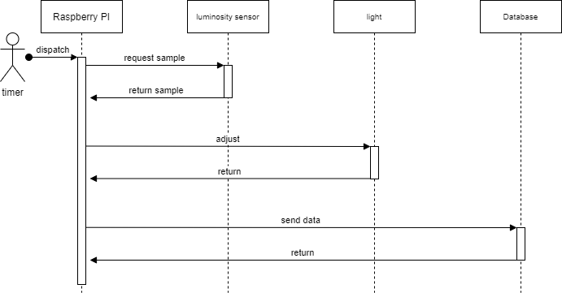
Sequential diagram
Light control

Slide 11
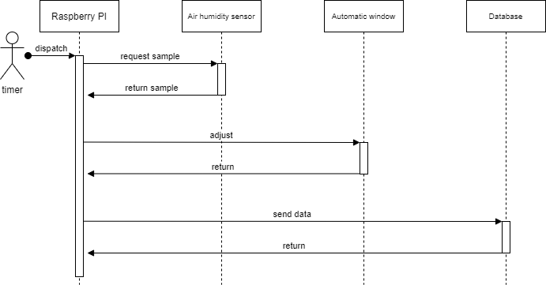
Sequential diagram
Air humidity control

Slide 12

Sequential diagram
Air temperature control

Slide 13
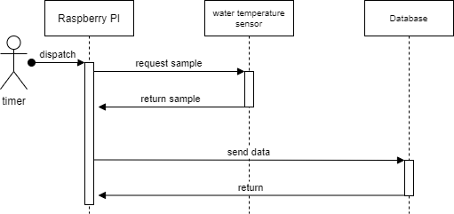
Sequential diagram
Water temperature control

Slide 14
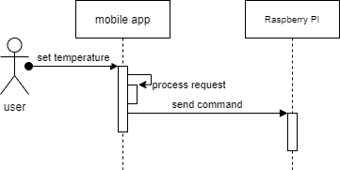
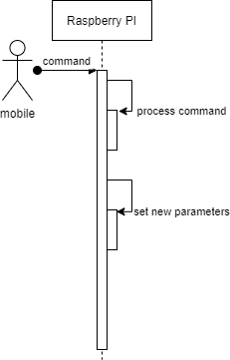
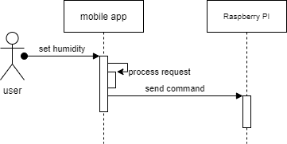
Sequential diagram
Change control parameters

Slide 15
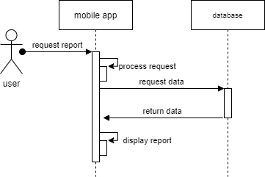
Sequential diagram
Request report

Slide 16
Events
 | Event name | Trigger condition | Response | Category
greenhouse | Sample air temperature | Timer | Collect data | Synchronous
 | Sample air humidity | Timer | Collect data | Synchronous
 | Sample water temperature | Timer | Collect data | Synchronous
 | Sample luminosity | Timer | Collect data | Synchronous
 | Take picture | Timer | Collect data | Synchronous
 | Adjust heater | Event sample air temperature | Turn heater ON/OFF | Asynchronous
 | Adjust Window | Event sample air humidity | Control window opening angle | Asynchronous
 | Adjust light | Event sample luminosity | Turn light ON/OFF | Asynchronous
 | Adjust water pump | Light On/Off | Turn pump ON/OFF | Asynchronous
 | Set temperature | Mobile command | change target temperature | Asynchronous
 | Set humidity | Mobile command | change target humidity | Asynchronous
 | Send data to database | Sampling event | Send data to database | Asynchronous
mobile | Recieve data from database | Timer | Recieve data from database | Synchronous
 | Change system parameters | User | Send new parameters to database | Asynchronous

Slide 17
Budget
Materials | Rough cost
Water pump | 8 €
Heater | 7 €
Window motor | 5 €
Light | 6€-8€
Water temperature sensor | 2 €
Air humidity and temperature sensor | 10 €
LDR | 1 €
Structure | 30€-40€
Raspberry Pi | 50 €
Camera | 10€-20€
Misc materials | 1€-2€
Estimated material cost | 130€-153€

