Slide 1
Smart Hydroponic Greenhouse
Analysis
Embedded Systems
Bruno Silva – A88289
Rafael Pedro – A88271

Slide 2
Agenda
Project plan alterations
Events;
Use cases;
State diagrams;
Sequence diagrams;
Budget estimation;

Slide 3
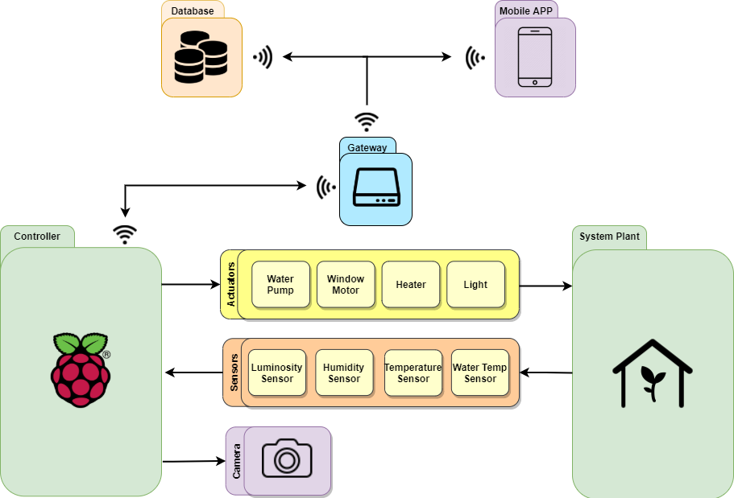
System Overview

Slide 4
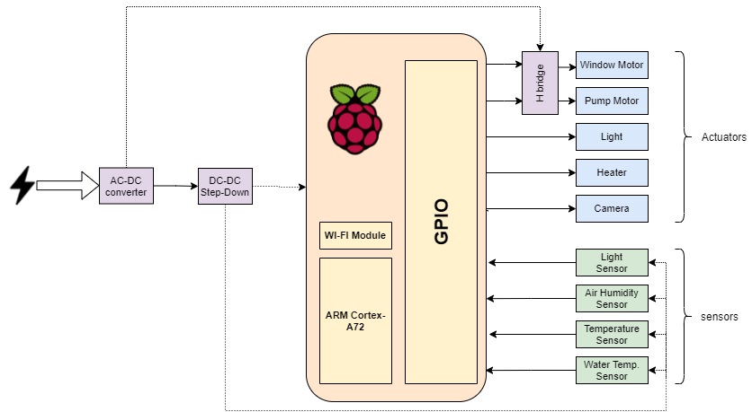
Hardware Architeture

Slide 5
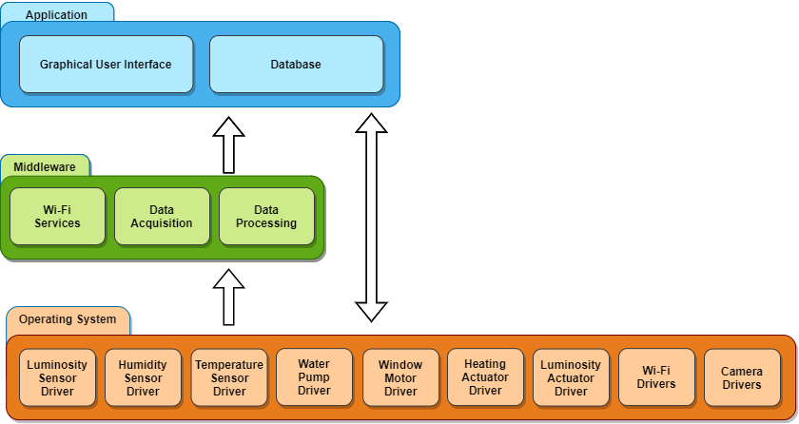
Software Architeture

Slide 6
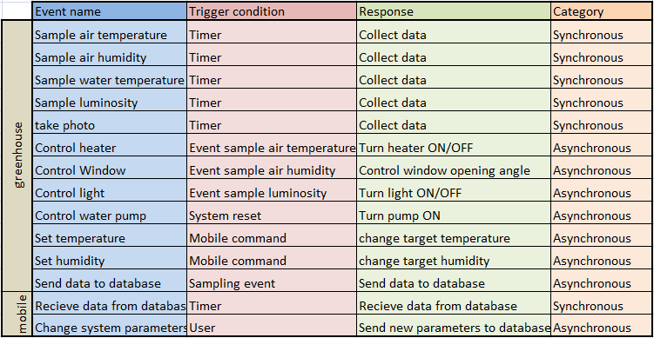
Events

Slide 7
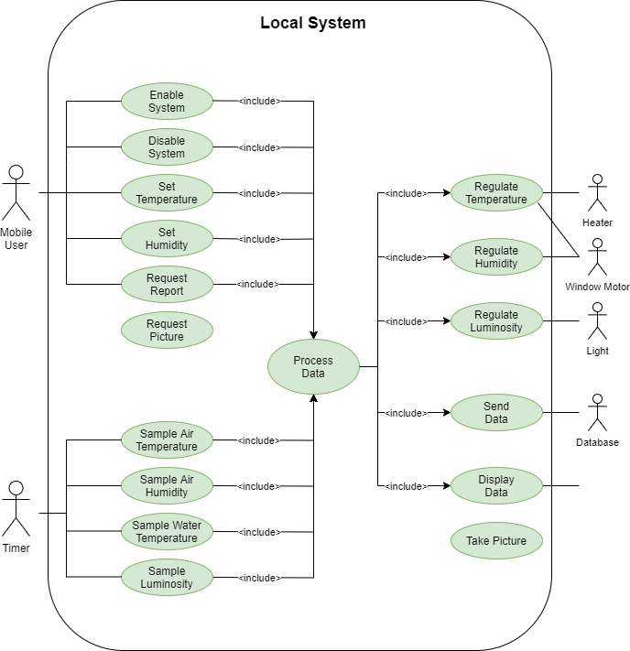
Use cases

Slide 8
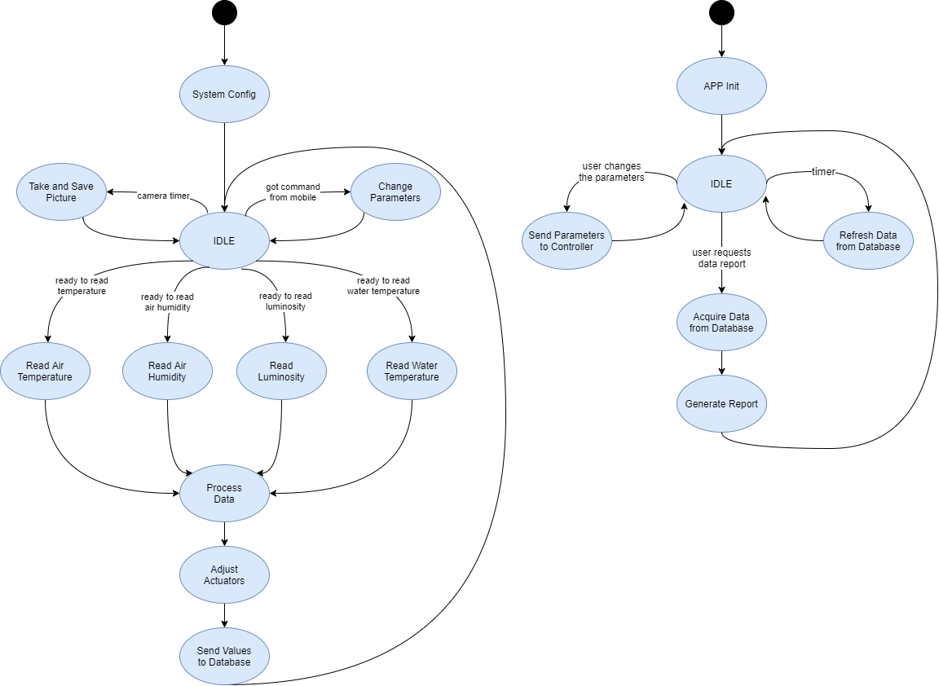
State diagram

Slide 9
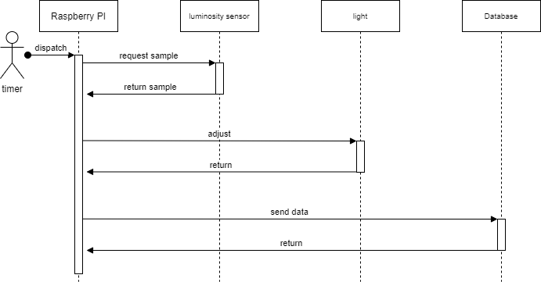
Sequential diagram
Light control

Slide 10
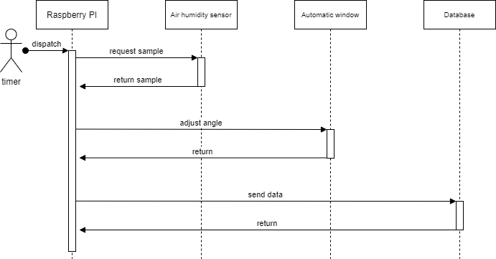
Sequential diagram
Air humidity control

Slide 11
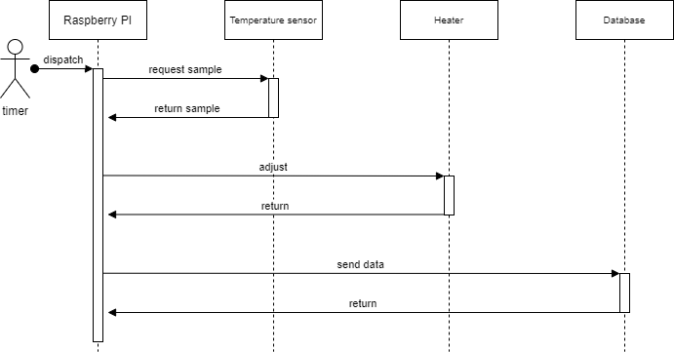
Sequential diagram
Air temperature control

Slide 12
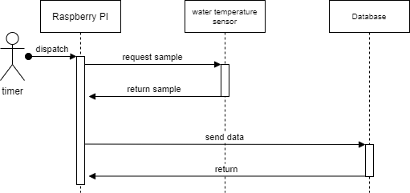
Sequential diagram
Water temperature control

Slide 13
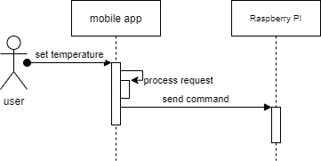
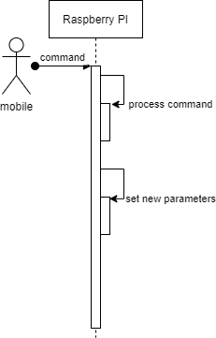
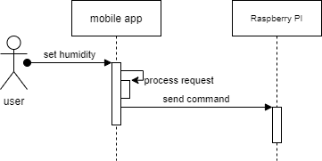
Sequential diagram
Change control parameters

Slide 14
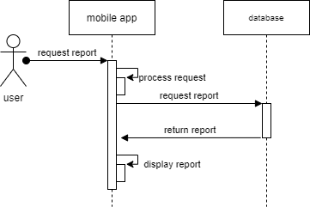
Sequential diagram
Request report

Slide 15
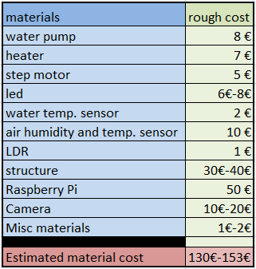
Budget

Slide 16
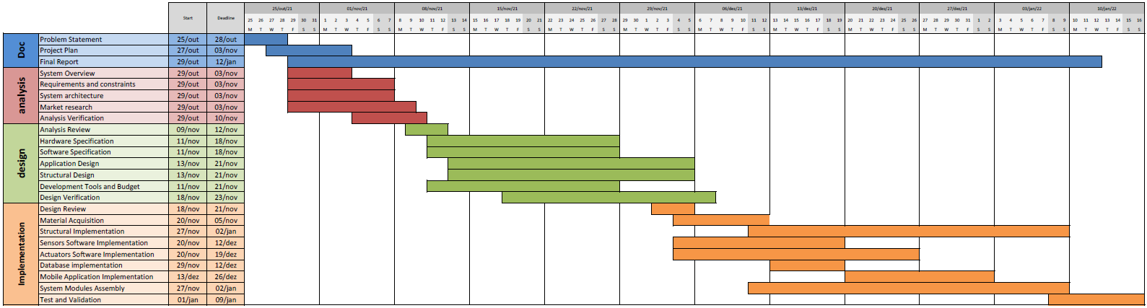
Gantt Diagram

