Slide 1

Flight Delays Prediction
By Rafaela and Zara

Slide 2
Project Introduction
Flight delays are a big concern in the commercial aviation sector. It leads to customer dissatisfaction, poor carrier reputation, financial loss and fuel loss.
In case of connecting flights, delays of one flight may create a significant impact on the chain of flights that use the connection.
The motivation of this study is to understand and predict flight delays. It is critical for air carriers to estimate flight delays so that they can either prevent it from happening or are better equipped to manage them.
This can help airlines to improve customer satisfaction and enable a positive revenue generation.

Slide 3
Project Objectives
Exploration of data;
Identify attributes that affect flight delay;
Develop machine learning models that classify flight outcomes (either delayed or not delayed) with selected features;
Evaluate the performance of different machine learning models.

Slide 4
Project Workflow
Load Database (PgAdmin)
Extract Data using SQL Query
Split Data (Train/Test)
EDA
Feature Engineering
Model Development
Prediction

Slide 5
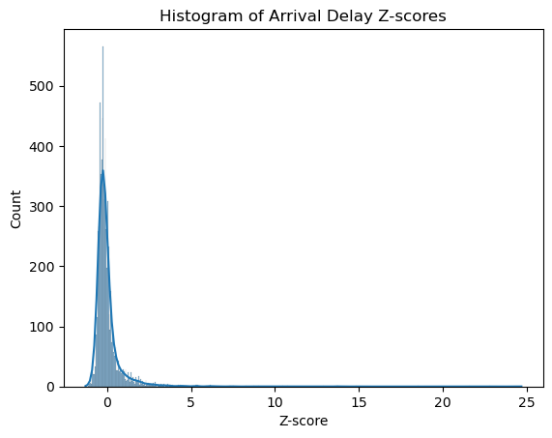
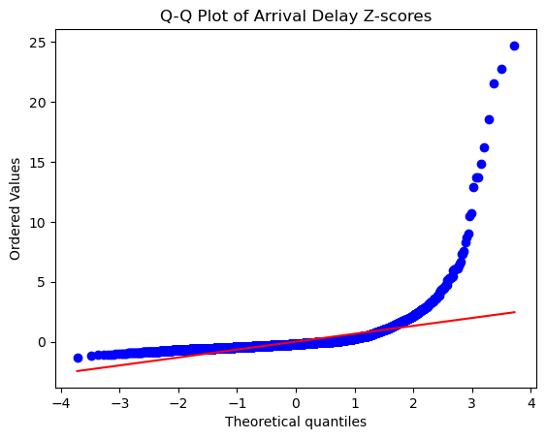
Are delays from Normal distribution and mean of the delay is 0?
The flight delays are centered around negative values and the data doesn't follow a normal distribution. Also, the points on the Q-Q plot follow a straight line in the most part and only present a variation at the end of the graph.
This means that most of the flights are not late.

Slide 6
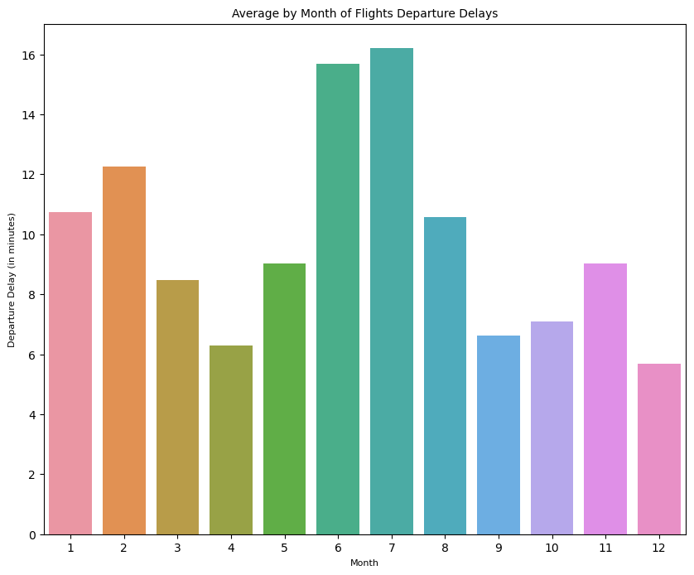
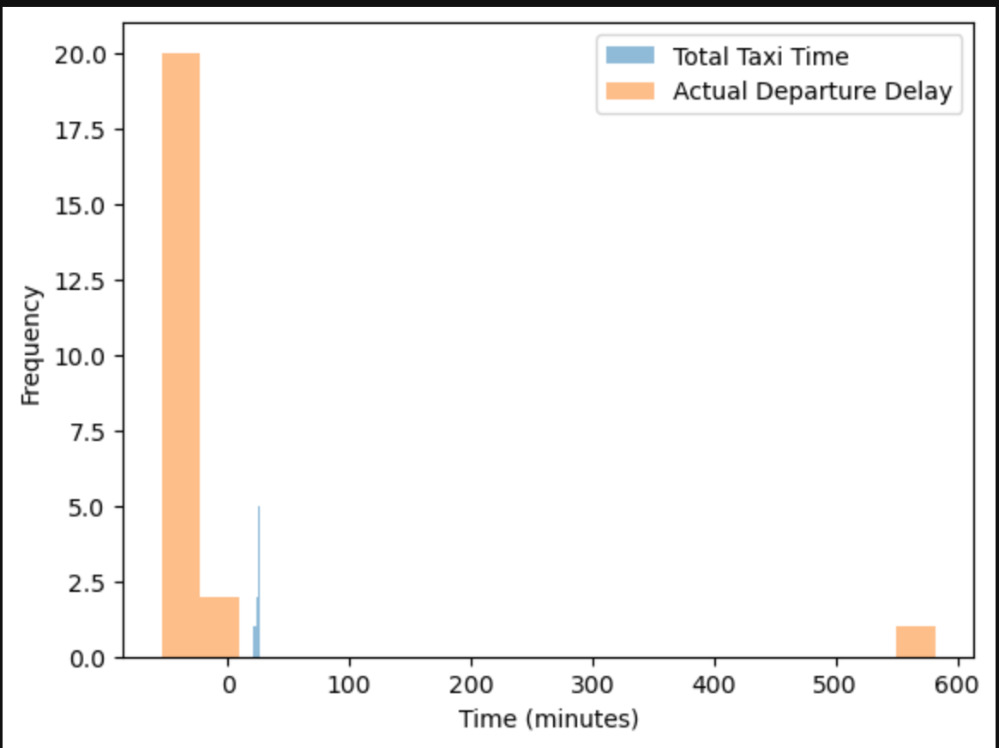
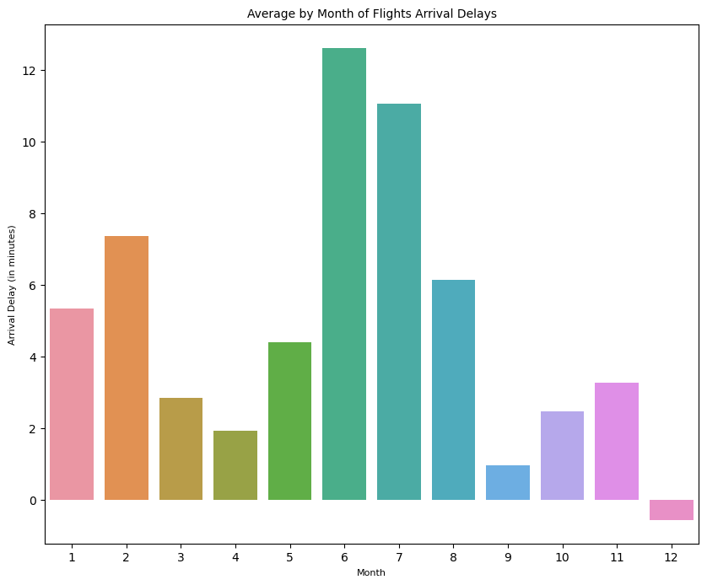
Is average/median monthly delay different during the year?
June and July = higher count of flights delays
How does taxi times change during the day?
By analyzing the total taxi time in relationship with the actual departure delay, we can notice that the actual departure delay takes longer in the morning and evening time.

Slide 7
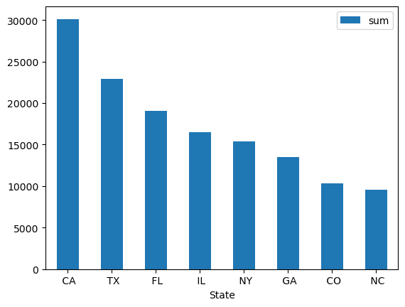
What is the average percentage of delays for each airline?
On the other hand, the carriers AA, DL, UA are the airlines that have most of the flights made up on time.
How many states cover 50% of US air traffic?
Percentage of delays for each airline
WN | 41.07 %
F9 | 41.00 %
VX | 40.00 %
B6 | 37.93 %
G4 | 37.50 %
AA | 34.22 %
UA | 33.82 %
AS | 31.78 %
HA | 31.76 %
NK | 31.55 %
DL | 30.68 %

Slide 8
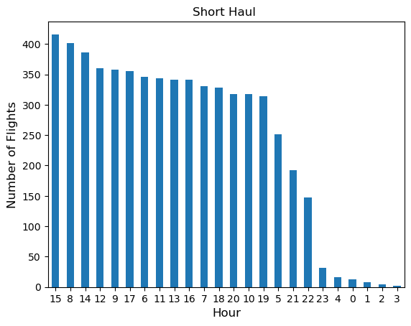
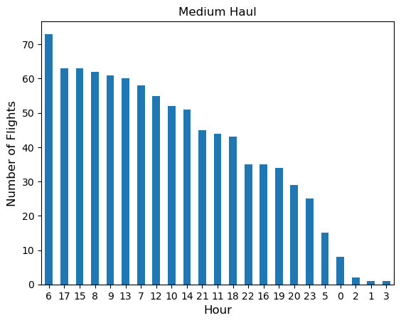
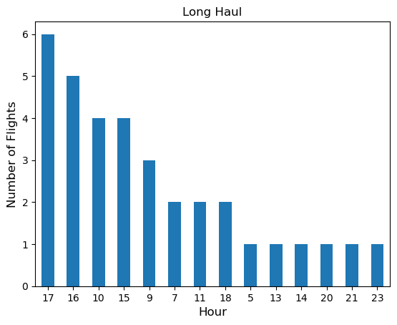
Do planes fly faster when there is a departure delay?
Speed with departure delay |Speed without departure delay
H₀: The group means are equal
H₁: The group means are not equal
In both test the p-value is less than 0.05 hence we would reject the null hypothesis. This implies that we have sufficient proof to say that there exists a difference in the speed of flights that have delayed departure and those that have on time departure
Which hour do most 'LONG', 'SHORT', 'MEDIUM' haul flights take off?
Test | F-Statistics | P-Value | Sig. level
One way Anova | 10.91764 | 0.0009574 | 0.05
T-Test | 3.30418 | 0.0009574 | 0.05
Notes:
One-Way ANOVA in Python: One-way ANOVA (also known as “analysis of variance”) is a test that is used to find out whether there exists a statistically significant difference between the mean values of more than one group.
H0 => µ1 = µ2 (population mean of dataset1 is equal to dataset2)
HA => µ1 ≠µ2 (population mean of dataset1 is different from dataset2)

Slide 9
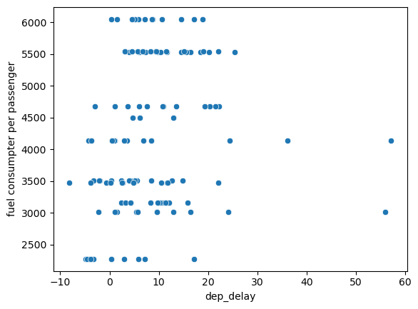
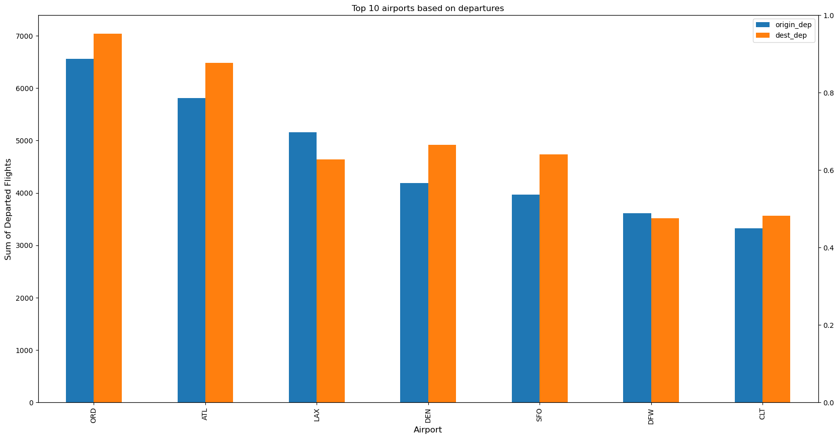
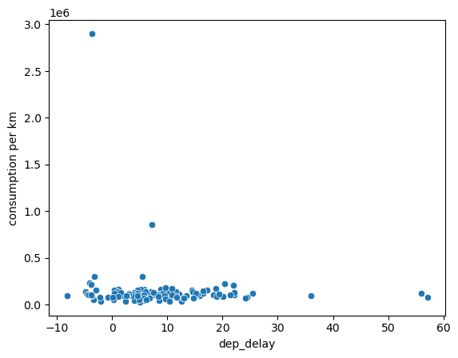
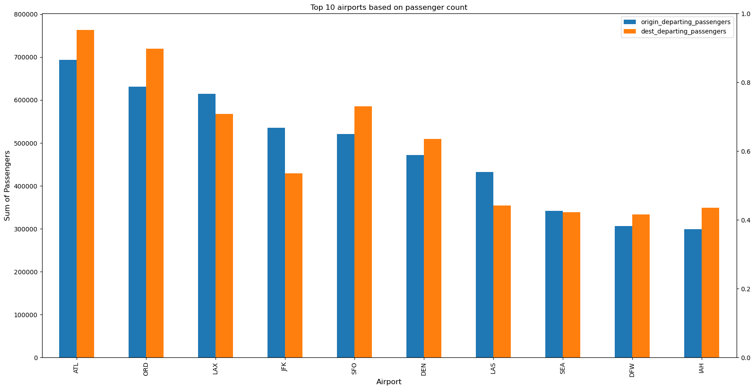
Find the top 10 the busiest airports. How much traffic do these 10 airports cover?
Average fuel consumption per passenger per km. Is this higher for the airlines with bigger average delays?
Notes:
One-Way ANOVA in Python: One-way ANOVA (also known as “analysis of variance”) is a test that is used to find out whether there exists a statistically significant difference between the mean values of more than one group.
H0 => µ1 = µ2 (population mean of dataset1 is equal to dataset2)
HA => µ1 ≠µ2 (population mean of dataset1 is different from dataset2)

Slide 10
Feature Engineering
Checking for missing and NaN values and replacing them with mean;
Dropping columns not needed for analysis;
Explored date time variable (splitting it into year, month, day, day of month and day of week);
Added columns like yearly quarter, semester and time of day (night, morning, afternoon and evening).

Slide 11
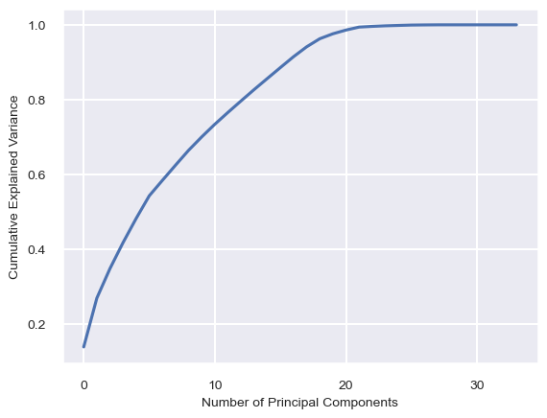
PCA
Extracted the components that explain 95% variance.
Got 19 components.

Slide 12
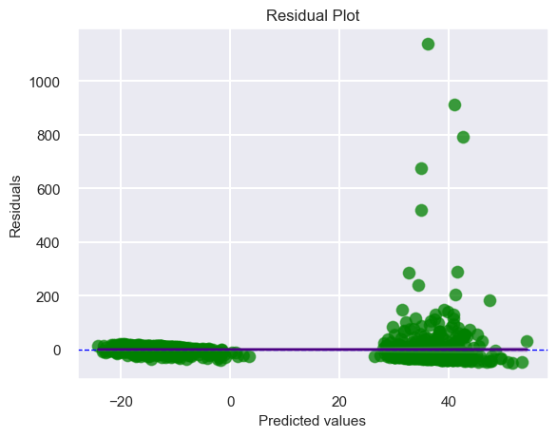
Modeling with Linear Regression Mode (Ridge added)
Low Mean Absolute Error (MAE) of 18.87: On average, the model's predictions are off by around 18.87 minutes from the actual arrival delay times.
Mean Squared Error (MSE) of 3218.57: on average, the squared difference between the model's predictions and the actual arrival delay times is very large.
Low R-Adjusted Square of 0.16. This means that around 16% of the variance in the target variable (arrival delay times) is explained by the model.
Root Mean Squared Error (RMSE) of 56.73: indicates a medium/high result, we should consider other models to see if we can find better performance as the MSE provides an estimate of the standard deviation of the residuals (prediction errors).

Slide 13
Modeling with Decision Tree
Modeling with Random Forest
The Decision Tree Regressor Results are: Mean Absolute Error (MAE) is 26.71. Mean Squared Error (MSE) is 7308.00. Root Mean Squared Error (RMSE) is 85.49. R-squared is -0.91.
This performed even worse with the linear regression model in terms of MSE and MAE. The MSE and RMSE values are higher for the decision tree regressor, which means that the model's predictions are more spread out from the actual values and the linear model is still offering a better performance than this one.
The Random Forest Regressor Results are: Mean Absolute Error (MAE) is 26.71. Mean Squared Error (MSE) is 7308.00. Root Mean Squared Error (RMSE) is 85.49. R-squared (R2) is -0.91.
Based on the metrics of the Random Forest Regressor, we got the same results of the decision tree which makes sense as the random forest is an aggregation of a group of decision trees.
Modelling with XGBOOST
The XGBoost Model Results are: Mean Absolute Error (MAE) is 19.78. Mean Squared Error (MSE) is 3417.40. Root Mean Squared Error (RMSE) is 58.46. R2_score is 0.11.

Slide 14
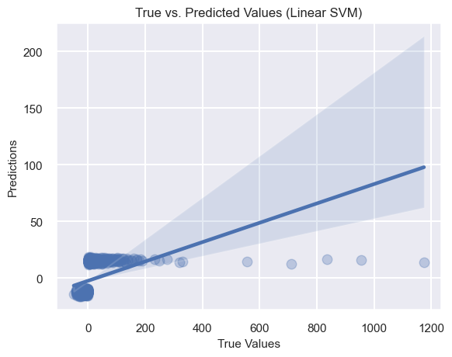
Modeling with Support Vector Machine (SVM)
SCM is also not offering a got fit for our predictions. It looks like its performance is similar to the one offered by the Ridge Regression Model, but with a higher MSE, and a lower R-squared value (value of 0.11).
However, in an overall, the values looked very similar to the linear model and the MAE is a little bit lower than the linear model (it is 15.93) so its predictions are off only 15.93 minutes from the actual arrival delay times.

Slide 15
Some Considerations (but not final!)
From these metrics, we can conclude that the Linear Regression Model or the Ridge Regression Model provides the best fit for our predictions.
In the future it would be needed new insights and approach to our feature engineering as this step can help us to improve the performance of our models.
From those results, the considerations about:
the airport trajectories with origin in (1) Cincinnati (CVG) to Illinois (ORD), (2) Newark (EWR) to Minneapolis (MSP) and (3) El Paso (ELP) to California (LAX);
the week days of Monday, Friday and Sunday;
the time of the day as afternoon and evening;
are the ones with the higher counts of total arrival delays, therefore they have a higher count of flight arrival delay predictions.

