Slide 1

Loan Prediction model
By Rafaela Cordeiro

Slide 2
Project steps
Research-question (Problem Statement)
Hypothesis Generation
EDA (Exploratory Data Analysis)
Data Cleaning and Preparation (preprocessing)
Build the Baseline Model
Pipeline
Hyperparameter Tunning (GridSearchCV)
Model Deployment

Slide 3
introduction
The research question (problem) of our project was:
Which applicants or group of applicants are more likely to get a loan?
If we can create a model with a good accuracy of loan prediction, this can give us several benefits, such as:
anticipate or minimize risks (lenders make informed decisions and avoid approving loans that are likely to result in default),
save time and resources (a model can automate the loan approval and analyze the risk factors very fast),
Improve customer experience and satisfaction (the results of the approval will be given faster).
Focus on a classification problem and in the precision and recall as important metrics.

Slide 4
Hypothesis generated
Applicants having a credit history;
Applicants with higher applicant and co-applicant incomes;
Applicants with higher education level;
Applicants who have properties in urban areas with high growth perspectives;
I added 5 more:
Applicants who are from a mature age, such as from 40s on;
Applicants who hold a full-time job;
Applicants who requested a smaller amount of loan;
Applicants who requested a shorter loan term contract;
Applicants who are male.

Slide 5
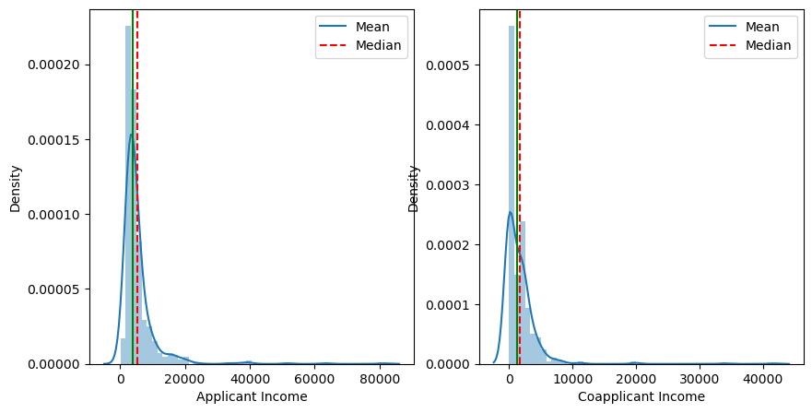
Distribution of the income data

Slide 6
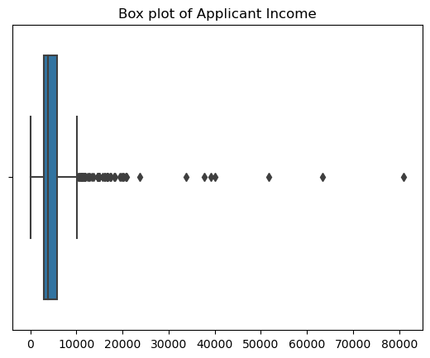
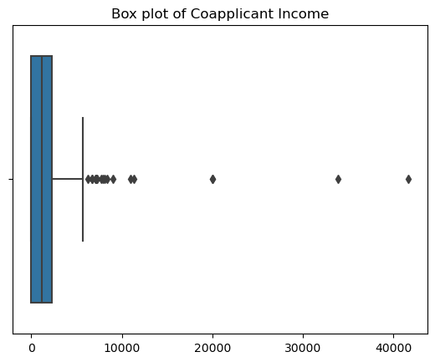
Boxplot of applicant and co-applicant income

Slide 7
Hypothesis test

Slide 8
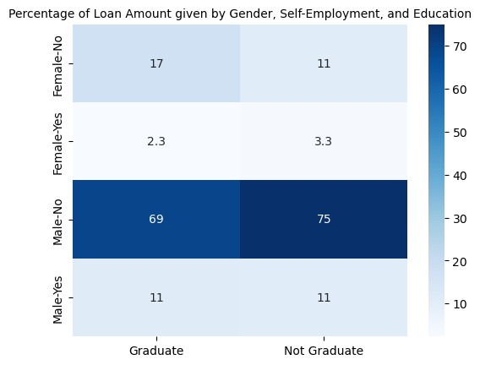
loan amount per group
75% of the loan amount was given to applicants and co-applicants who are male, not self-employed and not graduated (with a higher income).

Slide 9
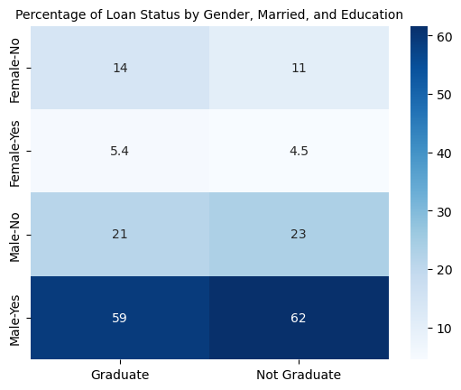
Loan status per group (1)
62% of the loan approval was given to applicants and co-applicants who are male, not graduated and married.

Slide 10
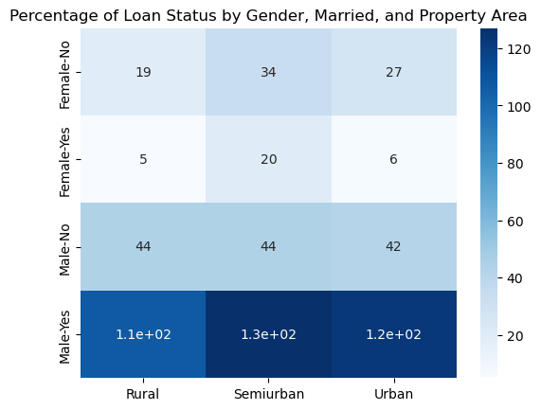
Loan status per group (2)
By living in a semiurban or urban area (values very closer to each other), the applicant/co-applicant is more likely to be approved to receive a loan.

Slide 11
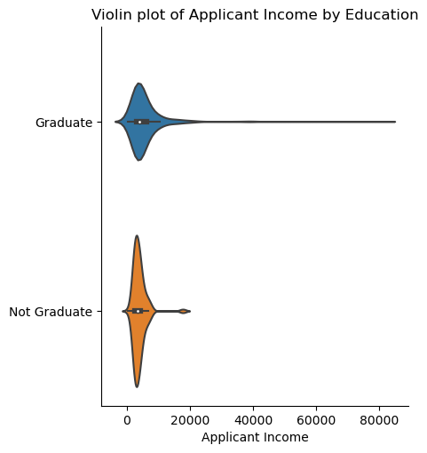
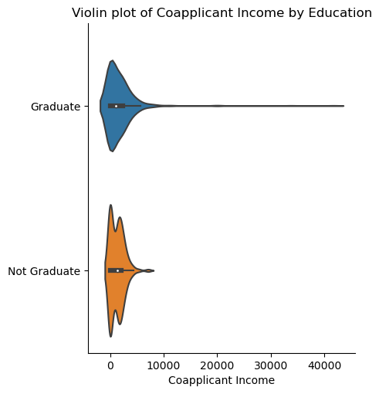
Income by education group of applicants and co-applicants who have High income are also graduated.

Slide 12
Data preprocessing
Analyzed null values and filled them with some specific statistics measurements (mean, mode, 0…).
Converted categorical variables to numerical ones (also used one hot encoding);
Dropped the rows of the ‘Gender’ column with the missing values (15 rows) to not make the model even more biased toward male;
Applied the log to get rid of the extreme values.

Slide 13
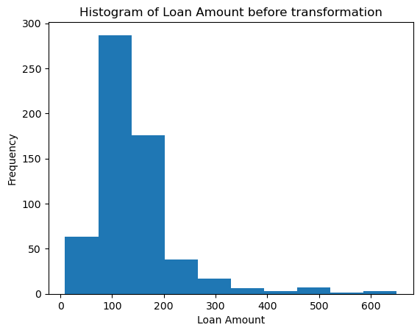
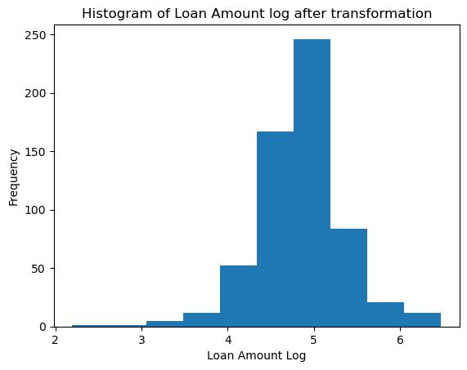
Loan Amount log

Slide 14
Machine learning models
Base line models x pipeline

Slide 15
Metrics | Base Line Model 1 Logistic Regressor | Base Line Model 1 with Grid Search CV Logistic Regressor | Pipeline Logistic Regressor | Base Line Model 2 Random Forest | Base Line Model 2 with Grid Search CV Random Forest | Pipeline Random Forest
Accuracy | 0.721 | 0.728 | 0.708 | 0.675 | 0.728 | 0.682
Precision | 0.704 | 0.710 | 0.689 | 0.669 | 0.703 | 0.672
Recall | 0.910 | 0.910 | 0.921 | 0.887 | 0.932 | 0.898
F1-Score | 0.794 | 0.798 | 0.788 | 0.763 | 0.801 | 0.769

Slide 16
challenges
Not enough time to spend during the EDA, but I consider this is a fundamental step to test the hypothesis and evaluate the features to be engineered of our model;
Understand better about the metrics to be evaluated and which models to be chosen as your base line models;
How to combine different models in a same pipeline and choose estimators (still in progress).

Slide 17
Thank you

