Slide 1

Loan Prediction model
By Rafaela Cordeiro

Slide 2
Project steps
Research-question (Problem Statement)
Hypothesis Generation
EDA (Exploratory Data Analysis)
Data Cleaning and Preparation (preprocessing)
Build the Baseline Model
Pipeline
Hyperparameter Tunning (GridSearchCV)
Model Deployment

Slide 3
introduction
The research question (problem) of our project was:
Which applicants or group of applicants are more likely to get a loan?
If we can create a model with a good accuracy of loan prediction, this can give us several benefits, such as:
anticipate or minimize risks (lenders make informed decisions and avoid approving loans that are likely to result in default),
save time and resources (a model can automate the loan approval and analyze the risk factors very fast),
Improve customer experience and satisfaction (the results of the approval will be given faster).
Focus on a classification problem and in the accuracy as one of the most important metrics.

Slide 4
Hypothesis generated
Applicants having a credit history;
Applicants with higher applicant and co-applicant incomes;
Applicants with higher education level;
Applicants who have properties in urban areas with high growth perspectives;
I added 5 more:
Applicants who are from a mature age, such as from 40s on;
Applicants who hold a full-time job;
Applicants who requested a smaller amount of loan;
Applicants who requested a shorter loan term contract;
Applicants who are male.

Slide 5
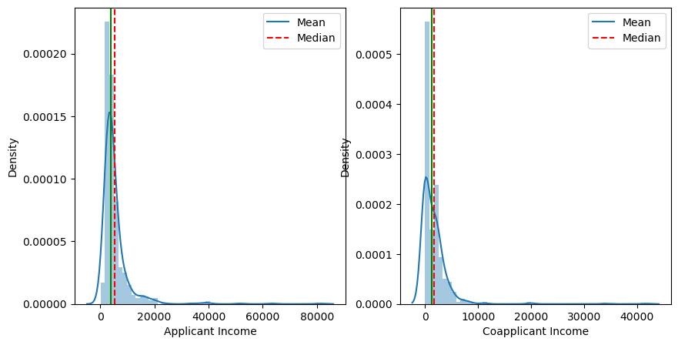
Distribution of the income data

Slide 6
Hypothesis test
1. Loan amount status approval 2. average of loan amount requested

Slide 7
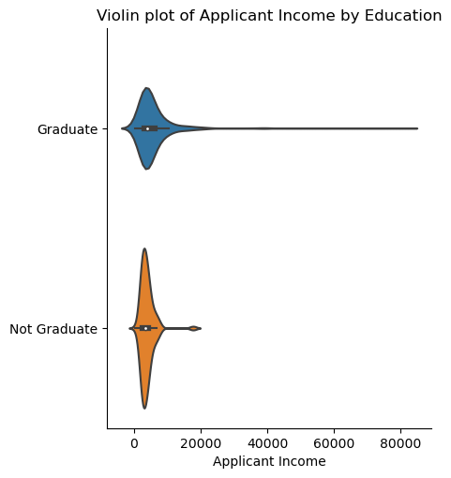
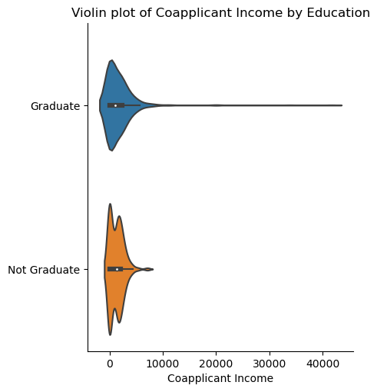
Income by education group of applicants and co-applicants who have High income are also graduated.

Slide 8
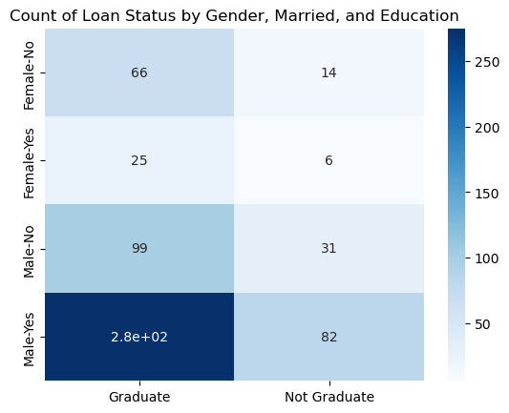
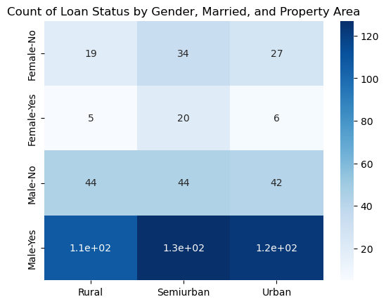
Loan amount status
Group most likely to get the loan status approval: male, with a high level of education, married (count of applicant and co-applicant income together) and living in a semiurban area.

Slide 9
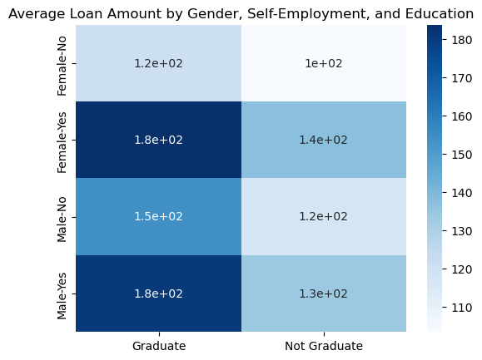
Average loan amount
As a curiosity, in regards of the loan amount approval, we have the same demographics, but we have basically a tie between female and male.

Slide 10
Classification problem/model
Logistic Regressor
Random Forest
Baseline model 1
Evaluation metrics
Accuracy: 0.7218543046357616
Precision: 0.7043478260869566
Recall: 0.9101123595505618
F1-score: 0.7941176470588236
Baseline model 2
Evaluation metrics
Accuracy: 0.6754966887417219
Precision: 0.6694915254237288
Recall: 0.8876404494382022
F1-score: 0.7632850241545893

Slide 11
Metrics | Base Line Model 1 Logistic Regressor | Base Line Model 1 with Grid Search CV Logistic Regressor | Pipeline Logistic Regressor | Base Line Model 2 Random Forest | Base Line Model 2 with Grid Search CV Random Forest | Pipeline Random Forest
Accuracy | 0.721 | 0.728 | 0.708 | 0.675 | 0.728 | 0.668
Precision | 0.704 |  |  | 0.669
Recall | 0.910 |  |  | 0.887
F1-Score | 0.794 | 0.784 |  | 0.763 | 0.773

