Slide 1

Loan Prediction model
By Rafaela Cordeiro

Slide 2
Project steps
Research-question (Problem Statement)
Hypothesis Generation
EDA (Exploratory Data Analysis)
Data Cleaning and Preparation (preprocessing)
Build the Baseline Model
Pipeline
Hyperparameter Tunning (GridSearchCV)
Model Deployment

Slide 3
introduction
The research question (problem) of our project was:
Which applicants or group of applicants are more likely to get a loan?
If we can create a model with a good accuracy of loan prediction, this can give us several benefits, such as:
anticipate or minimize risks (lenders make informed decisions and avoid approving loans that are likely to result in default),
save time and resources (a model can automate the loan approval and analyze the risk factors very fast),
Improve customer experience and satisfaction (the results of the approval will be given faster).
Focus on a classification problem and in the accuracy as one of the most important metrics.

Slide 4
Hypothesis generated
Applicants having a credit history;
Applicants with higher applicant and co-applicant incomes;
Applicants with higher education level;
Applicants who have properties in urban areas with high growth perspectives;
I added 5 more:
Applicants who are from a mature age, such as from 40s on;
Applicants who hold a full-time job;
Applicants who requested a smaller amount of loan;
Applicants who requested a shorter loan term contract;
Applicants who are male.

Slide 5
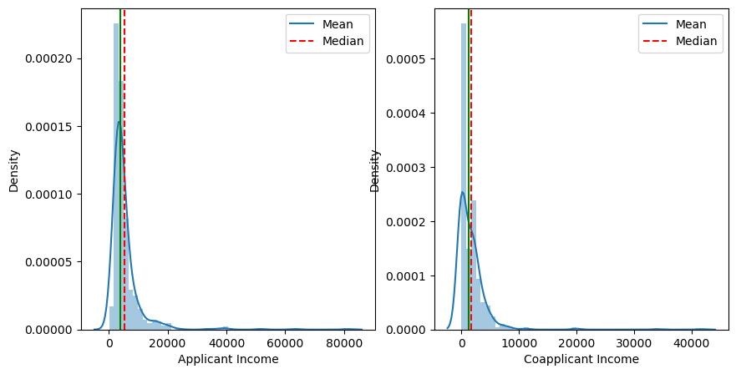
Distribution of the income data

Slide 6
Hypothesis test
Group most likely to get the loan status approval: male, with a high level of education, married (sum of applicant and co-applicant income together) and living in a semiurban area;
As a curiosity, in regards of the group most likely to get a high loan amount approval, we have the same demographics, but we have basically a tie between female and male.

Slide 8
Classification problem/model
Baseline model 1
Logistic Regressor
Evaluation metrics
Accuracy: 0.7218543046357616
Precision: 0.7008547008547008
Recall: 0.9213483146067416
F1-score: 0.7961165048543689
ROC-AUC score: 0.6784160927872418
Baseline model 2
Random Forest
Evaluation metrics
Accuracy: 0.7019867549668874
Precision: 0.6929824561403509
Recall: 0.8876404494382022
F1-score: 0.7783251231527094
ROC-AUC score: 0.661562160202972

