Slide 1
A Comparative Study of LLM Prompting Techniques on Brazilian University Entrance Exams
Rafaela Rolim Santana
Computer Science Bachelor Thesis – Quality Gate 2
02.04.2025

Slide 2
Contents
Motivation
Research Questions
Research Methods
Results

Slide 3

Background and Motivation
Widespread integration of LLM assistance into education.
Potential for hallucinations: plausible but incorrect responses.
Vulnerability to absorb incorrect information with full confidence
How can we reduce hallucinations in LLMs in a way that is simple and accessible to students?
Image generated by DALL-E

Slide 4
Research Questions
RQ1: How does the application of Chain-of-Thought, Chain-of-Verification and Self-Refine prompting techniques affect LLM response accuracy on Brazilian University Entrance Exams?
RQ2: How does the effectiveness of Chain-of-Thought, Chain-of-Verification, and Self-Refine prompting techniques vary across different subject areas?
RQ3: How consistent are the predictions of Chain-of-Thought, Chain-of-Verification, and Self-Refine methods across repeated runs?

Slide 5
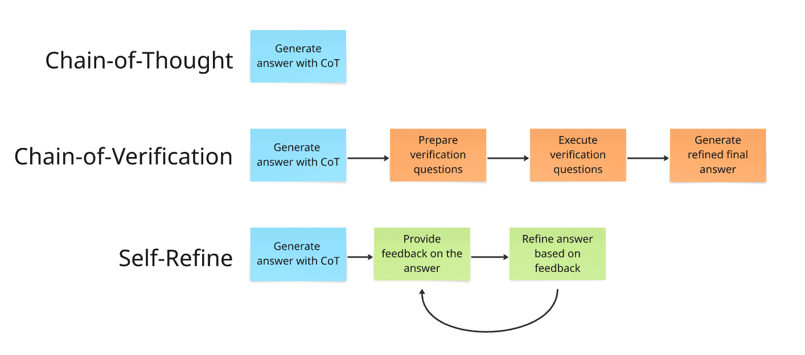
Research Methods – Prompting Techniques

Slide 6
Research Methods
Collect questions from Brazilian University Entrance Exam (ENEM 2024)
Multiple-choice questions with ground truth
Define templates for CoT, CoVe and Self-Refine prompts
Define feedback iteration rules for CoVe and Self-Refine
Test each prompting technique several times
Using the same 180 ENEM questions
Store results, including feedback iterations and intermediate answers
Compare methods’ accuracy across test runs
Look for statistically significant difference between the methods
Compare accuracy across different subjects
Languages, Mathematics, Human Sciences and Natural Sciences
Compare the methods’ answer consistency test across runs

Slide 7
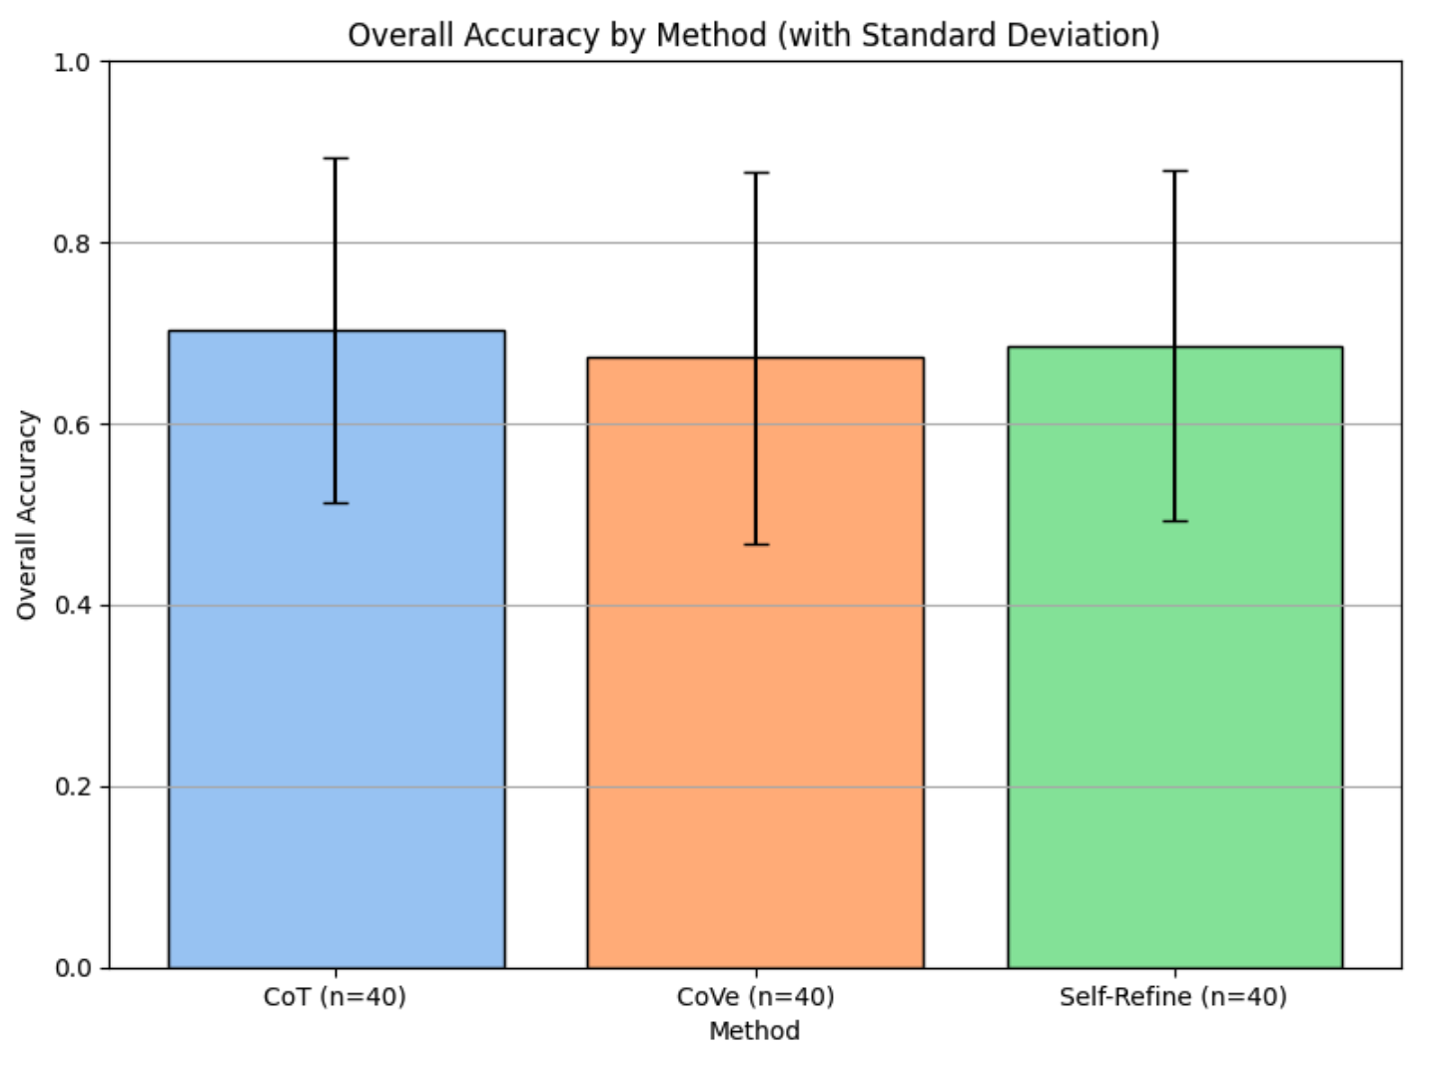
Results: General Accuracy
H₀ (Null Hypothesis):
The distributions of accuracy scores across the three prompting methods (CoT, CoVe, and Self-Refine) are the same.
H₁ (Alternative Hypothesis):
At least one method’s distribution differs significantly from the others.
Result: Fail to Reject H₀
No statistically significant evidence to suggest that the three prompting methods differ in their accuracy performance across runs.

Slide 8
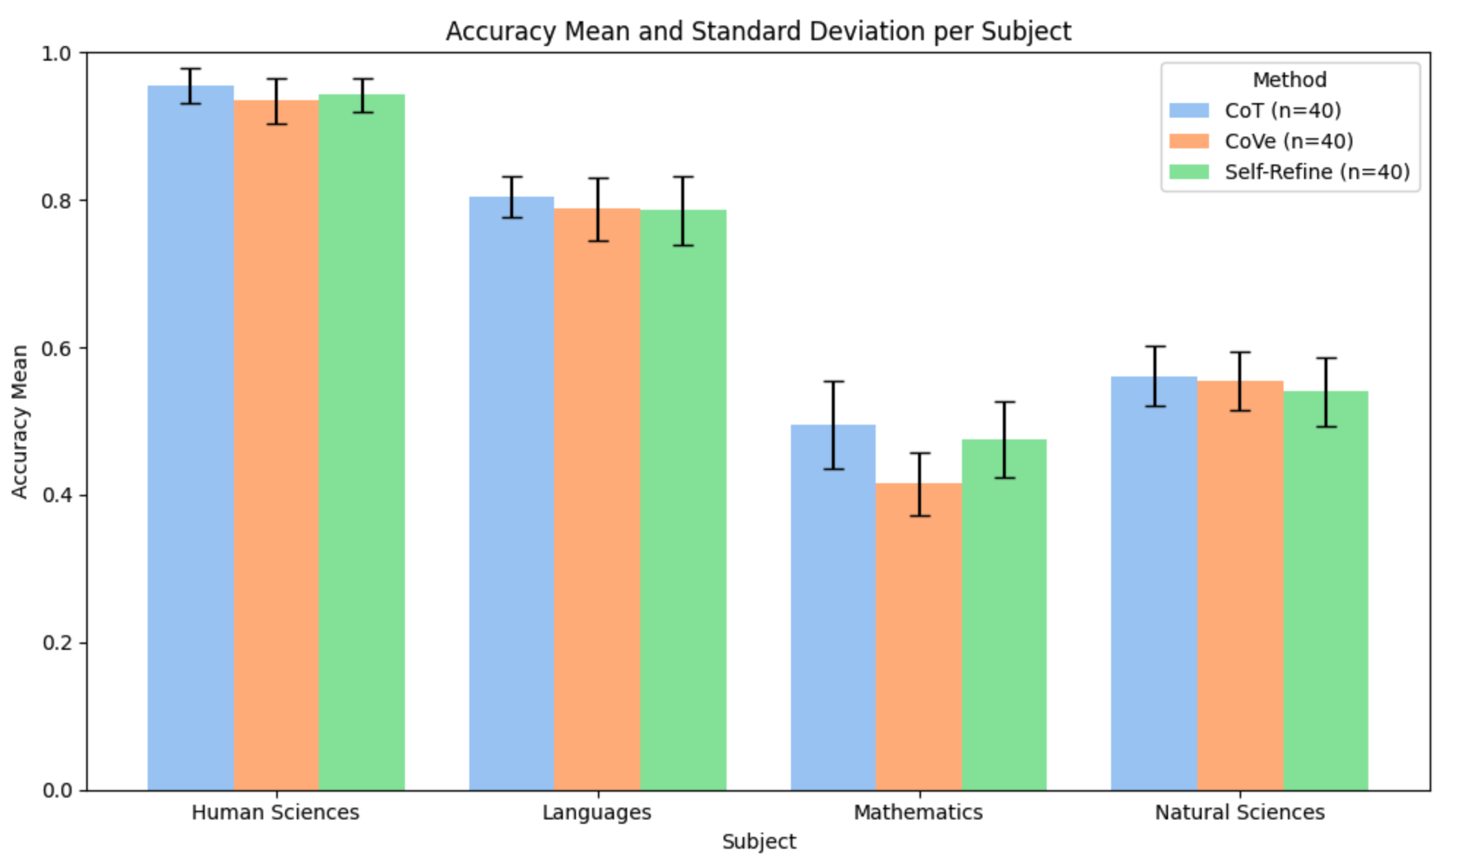
Results: Accuracy by Subject
Comparison by subject
H₀ (Null Hypothesis):
The distributions of accuracy scores across the three prompting methods (CoT, CoVe, Self-Refine) are statistically indistinguishable.
H₁ (Alternative Hypothesis):
At least one method differs significantly in accuracy from the others.
Result: Reject H₀
Significant differences were observed for Mathematics and Human Sciences. In both cases, Chain-of-Thought achieved the highest average accuracy.

Slide 9
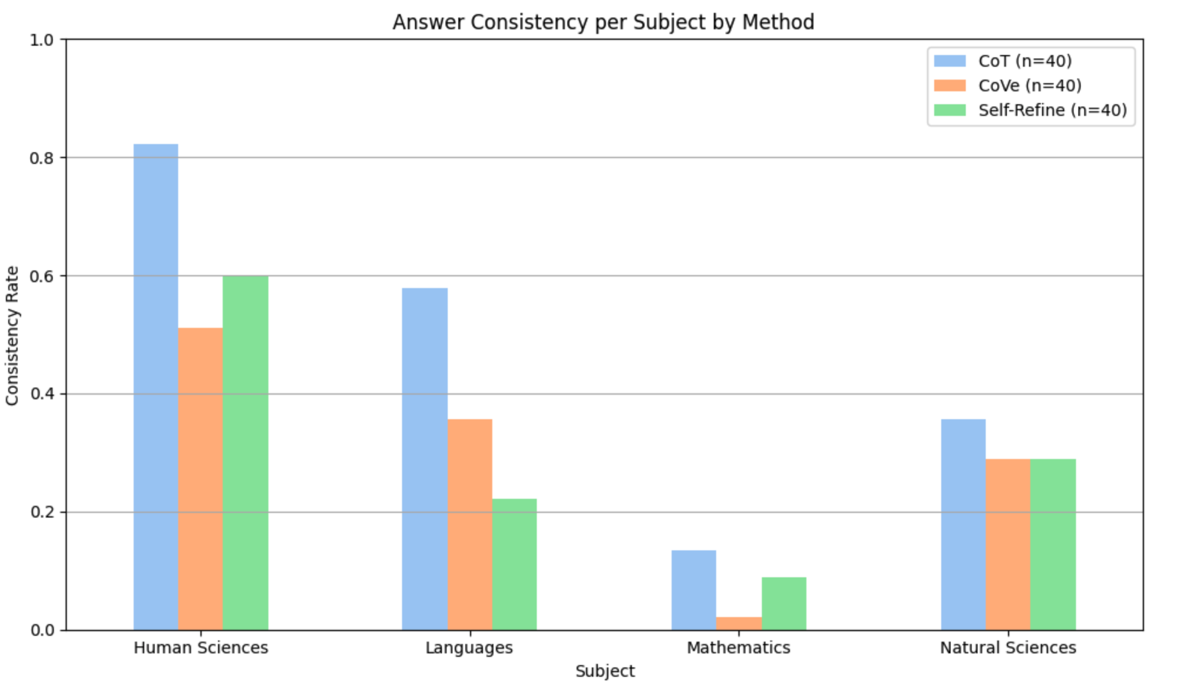
Results: Answer Consistency
Pair-wise method comparison for each subject
H₀ (Null Hypothesis):
The consistency proportions of the two methods being compared are equal (no difference in consistency).
H₁ (Alternative Hypothesis):
The consistency proportions differ between the two methods.
Result: Reject H₀
Chain-of-Thought yields more stable predictions than both Chain-of-Verification and Self-Refine, both overall and within specific subject areas like Human Sciences and Languages.

Slide 10
Conclusion
RQ1: How does the application of Chain-of-Thought, Chain-of-Verification and Self-Refine prompting techniques affect LLM response accuracy on Brazilian University Entrance Exams?
Result: No significant difference was found in general accuracy across the methods.
RQ2: How does the effectiveness of Chain-of-Thought, Chain-of-Verification, and Self-Refine prompting techniques vary across different subject areas?
Result: CoT outperforms CoVe and Self-Refine in Mathematics and Human Sciences.
RQ3: How consistent are the predictions of Chain-of-Thought, Chain-of-Verification, and Self-Refine methods across repeated runs?
Result: CoT is significantly more consistent overall, as well as in Human Sciences and Languages.

Slide 11
Thank you!
Rafaela Rolim Santana

