Slide 1
A Comparative Study of LLM Prompting Techniques on Brazilian University Entrance Exams
Rafaela Rolim Santana
Computer Science Bachelor Thesis – Quality Gate 2
02.04.2025

Slide 2
Contents
Motivation
Research Questions
Research Methods
Preliminary Results
Discussion

Slide 3

Background and Motivation
Widespread integration of LLM assistance into education.
Potential for hallucinations: plausible but incorrect responses.
Incorrect answers may confuse students and hinder their learning outcomes
Image generated by DALL-E

Slide 4
Research Questions
RQ1:
How does the application of Chain-of-Thought, Chain-of-Verification and Self-Refine affect LLM response accuracy on Brazilian University Entrance Exams?
RQ2:
How does the effectiveness of Chain-of-Thought, Chain-of-Verification and Self-Refine vary across different subject areas?

Slide 5
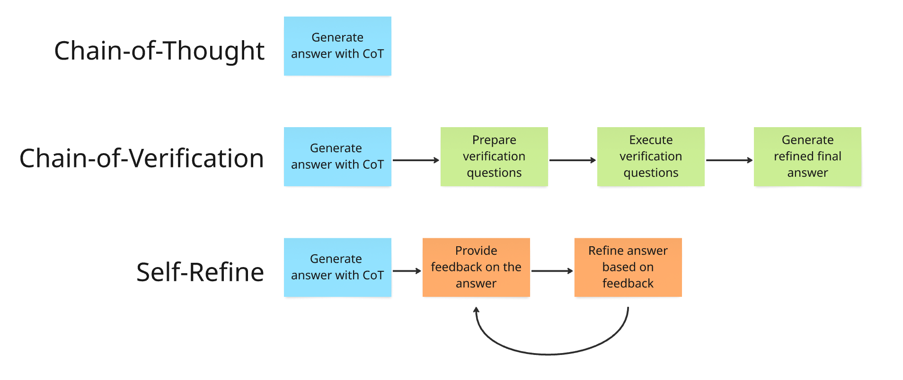
Research Methods – Prompting Techniques

Slide 6
Research Methods
Collect questions from Brazilian University Entrance Exam (ENEM 2024)
Multiple-choice questions with ground truth
Define templates for CoT, CoVe and Self-Refine prompts
Define feedback iteration rules for CoVe and Self-Refine
Test each prompting technique several times
Using the same 180 ENEM questions
Store results, including feedback iterations and intermediate answers
Compare methods’ accuracy across test runs
Look for statistically significant difference between the methods
Compare accuracy across different subjects
Languages, Mathematics, Human Sciences and Natural Sciences

Slide 7
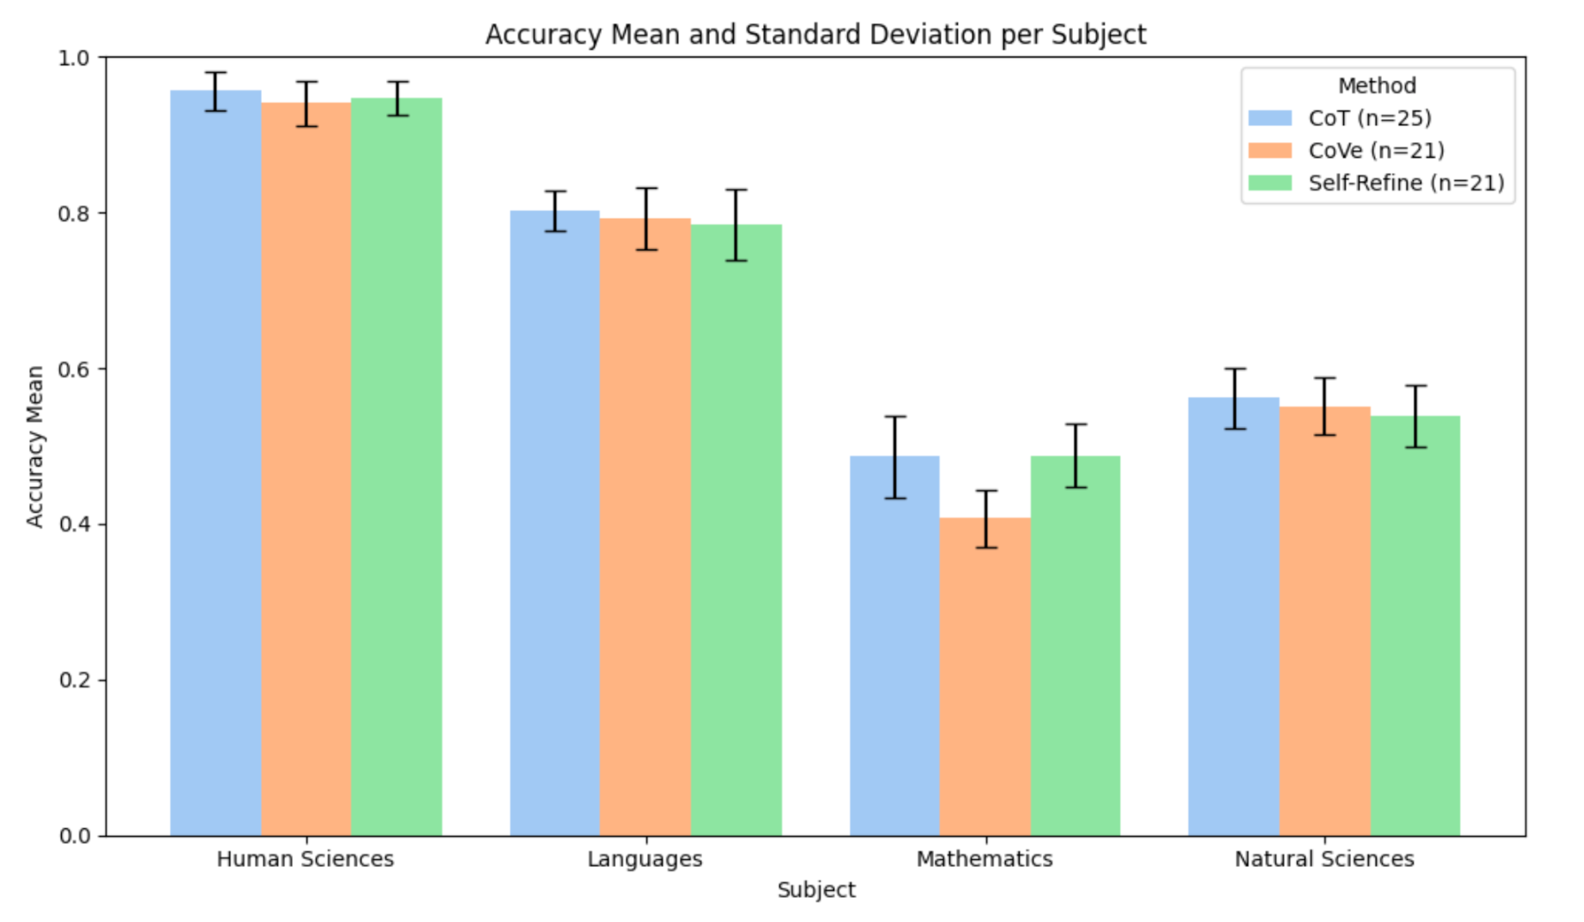
Primary Results: Accuracy mean and std

Slide 8
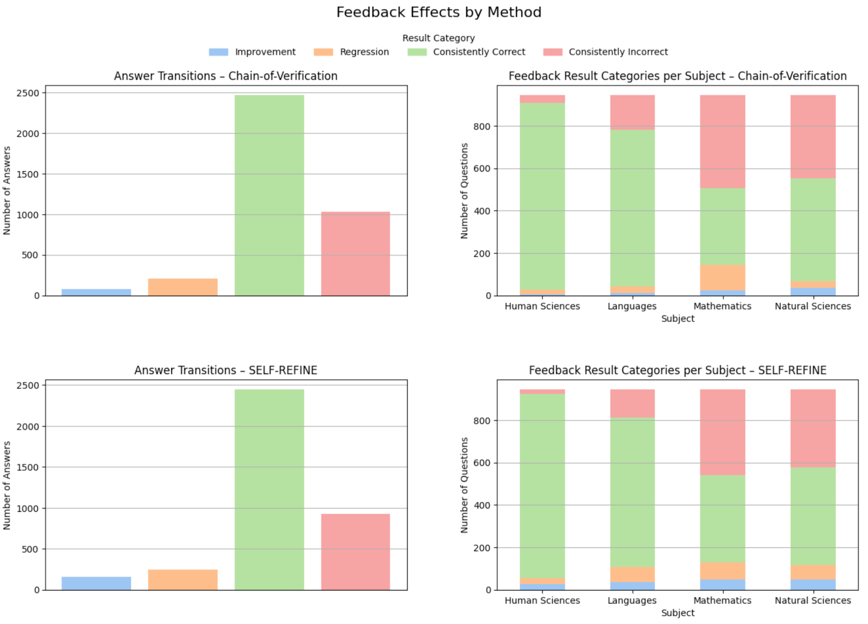
Primary Results: Feedback effects

Slide 9
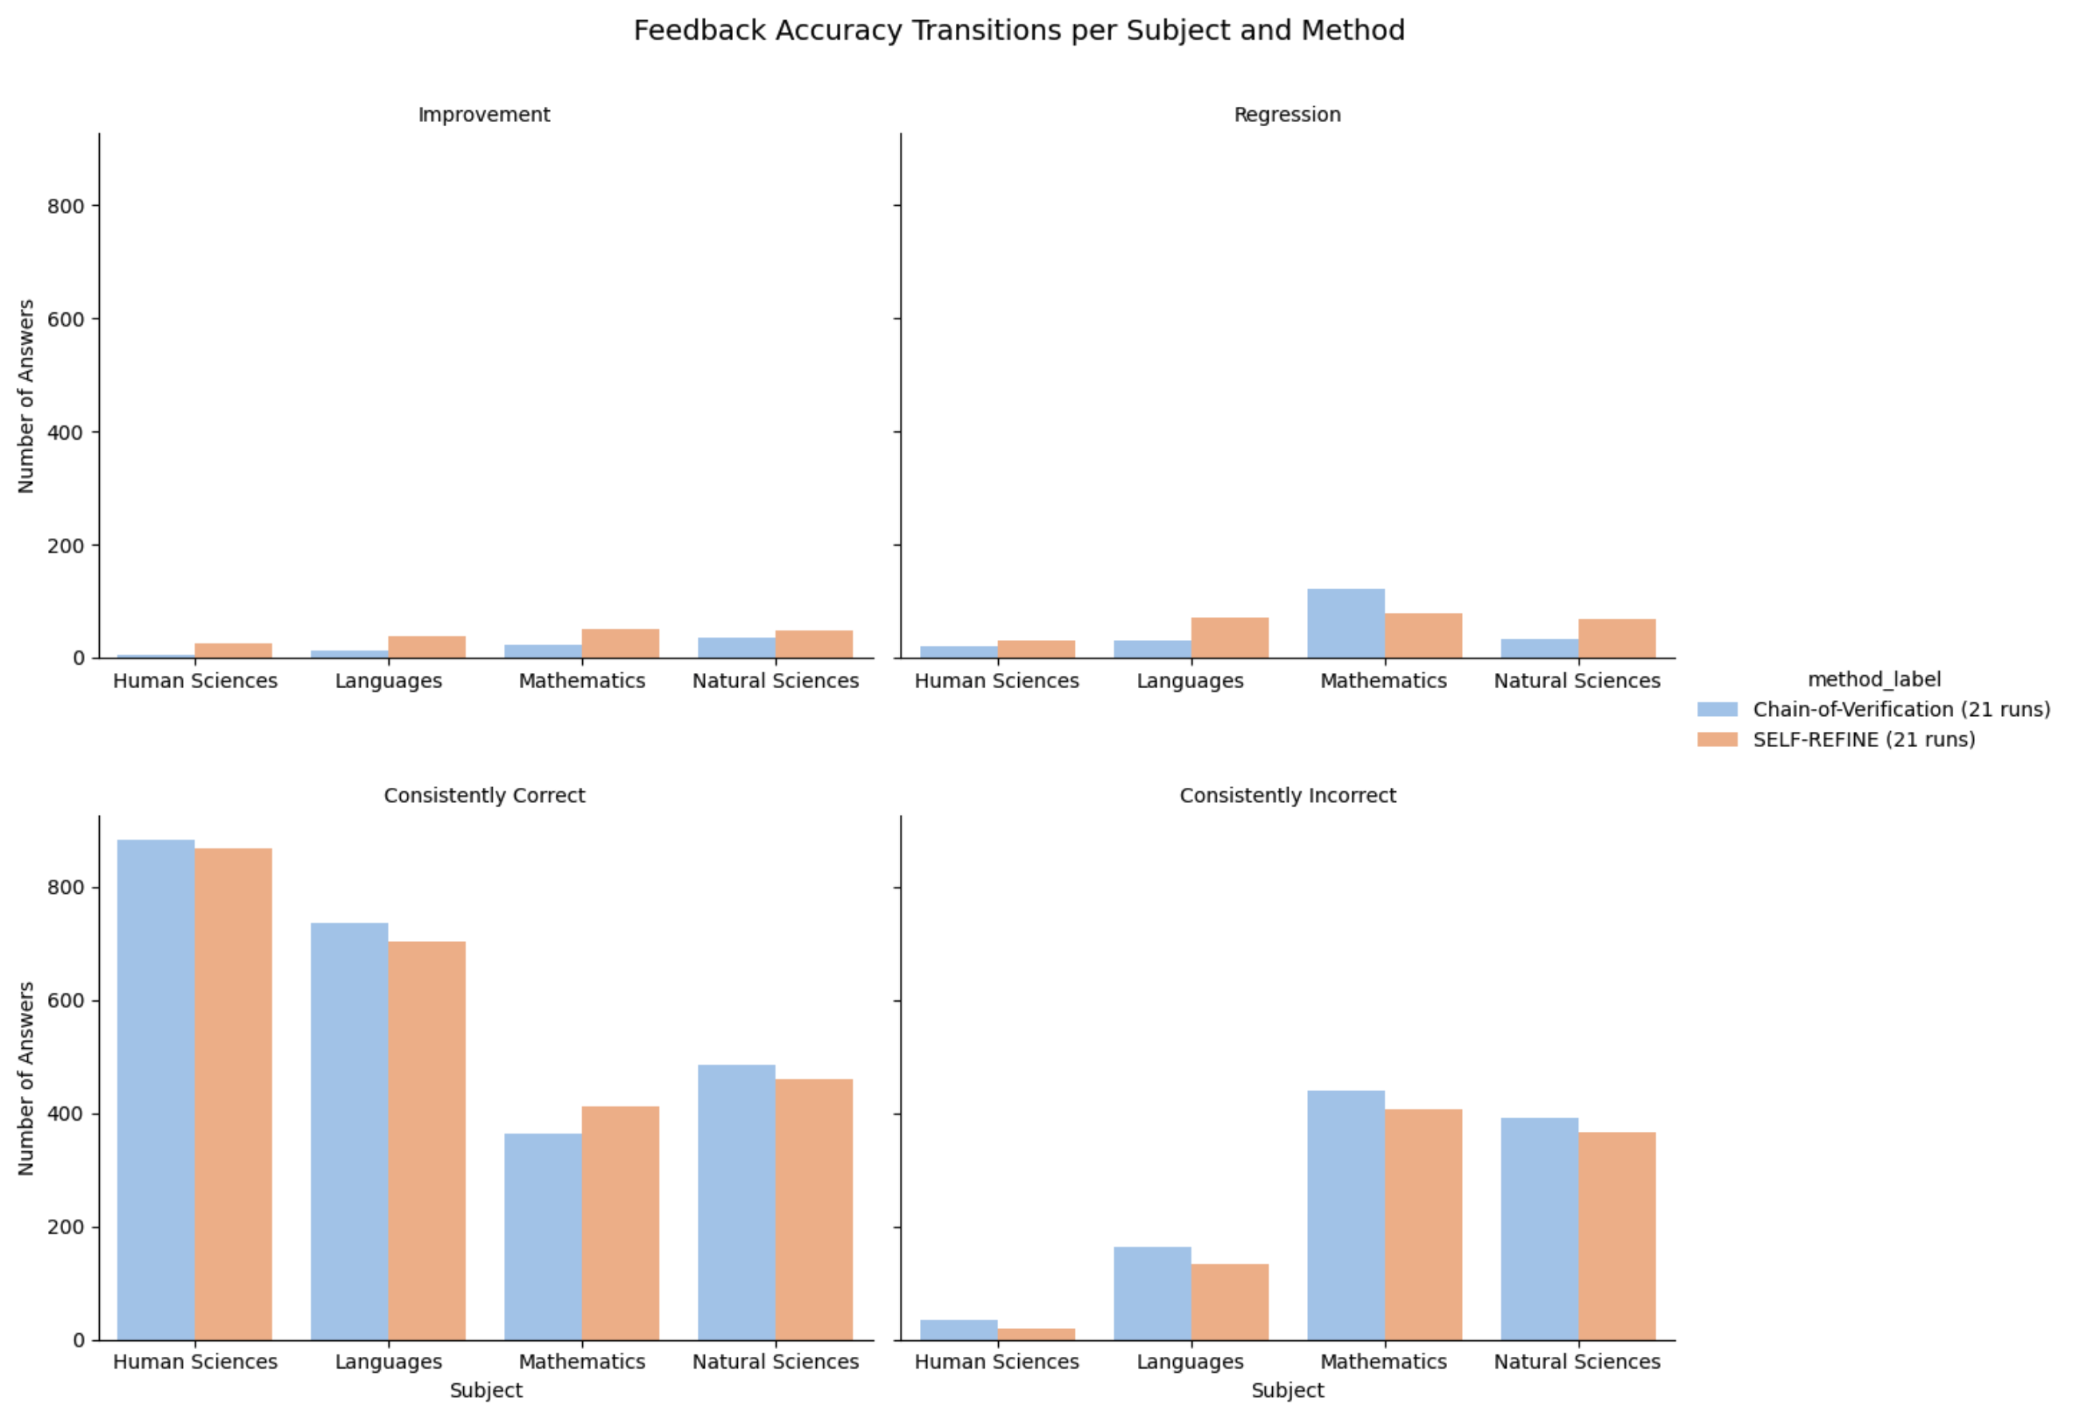
Primary Results: Feedback accuracy

Slide 10
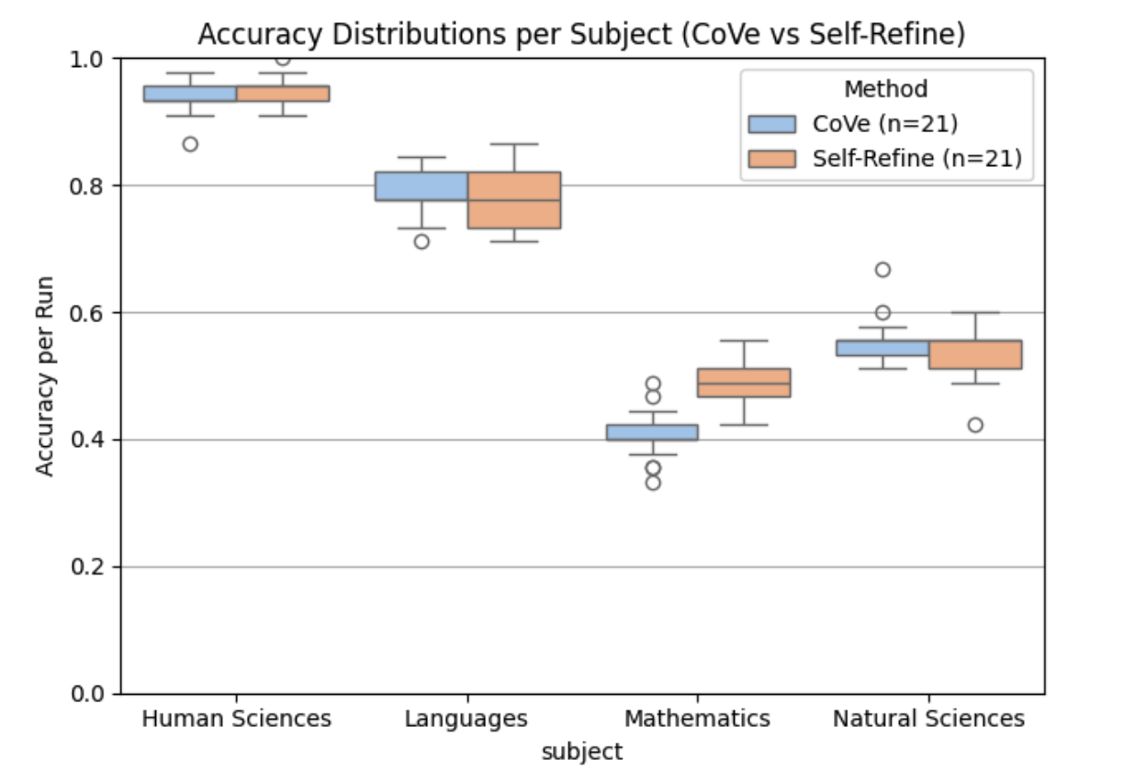
Primary Results: CoVe vs Self-Refine

Slide 11
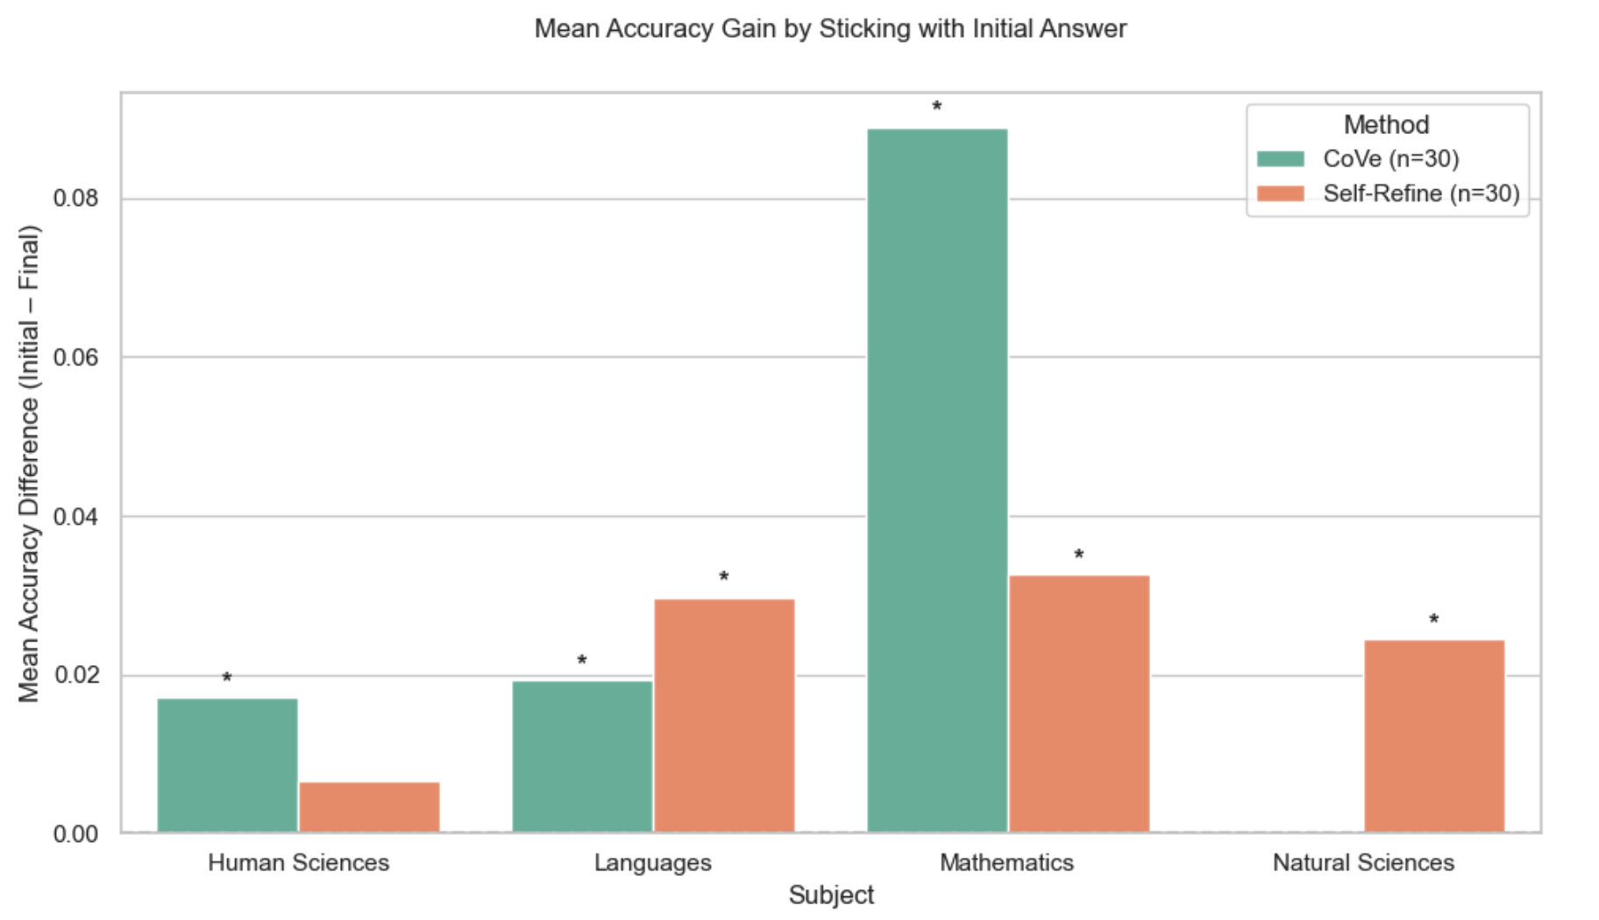
Primary Results: Initial vs Final Answer Performance

Slide 12
Conclusion
Expected Contribution: Recommendations about the use of prompting techniques in educational settings
Aimed Impact: Supporting the reliable use of AI in education.

Slide 13
Thank you!
Rafaela Rolim Santana

