Slide 1
A Comparative Study of LLM Prompting Techniques on Brazilian University Entrance Exams
Rafaela Rolim Santana
Computer Science Bachelor Thesis – Quality Gate 2
02.04.2025

Slide 2
Contents
Motivation
Research Questions
Research Methods
Preliminary Results
Discussion

Slide 3
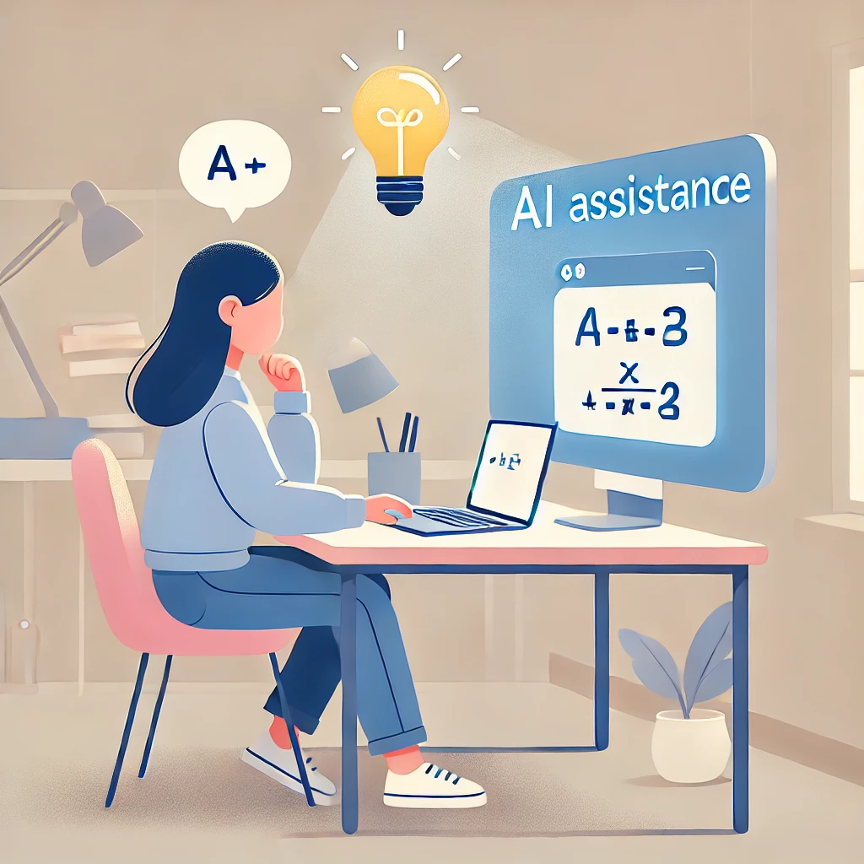
Background and Motivation
Widespread integration of LLM assistance into education.
Potential for hallucinations: plausible but incorrect responses.
Factual accuracy is crucial for academic integrity and effective learning.
Image generated by DALL-E

Slide 4
Research Questions
RQ1
How does the application of
Chain-of-Thought, Chain-of-Verification and Self-Refine
affect LLM response accuracy on Brazilian University Entrance Exams?
RQ2
How does the effectiveness of
Chain-of-Thought, Chain-of-Verification and Self-Refine
prompting vary across different subject areas?

Slide 5
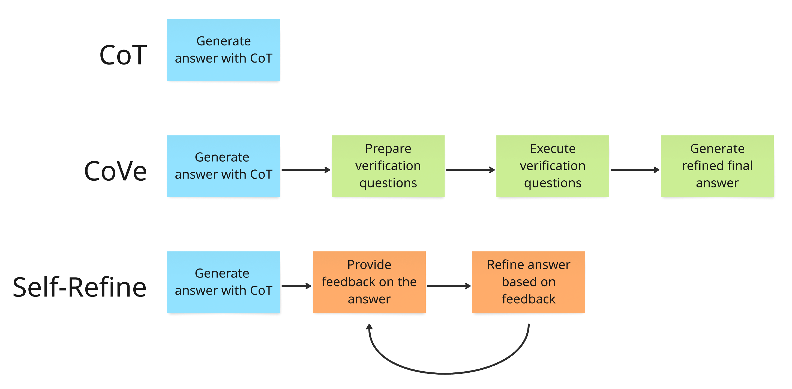
Research Methods Overview

Slide 6
Research Methods
Collect multiple-choice Computer Science questions
With the ground-truth correct option and reference explanation
Prompt LLM for each question
Select the correct option and explain why it is correct
Check for Correctness
Compare LLM’s choice with ground-truth answer
Flag LLM’s response as “Correct” or “Incorrect”
Apply Hallucination Detection Methods to LLM’s explanation
Cosine Similarity, MNLI Classification, Semantic Entropy
Store Results and Compare
For each question, record: Correctness (yes/no), Hallucination flags (Cosine, MNLI, Entropy)

Slide 7
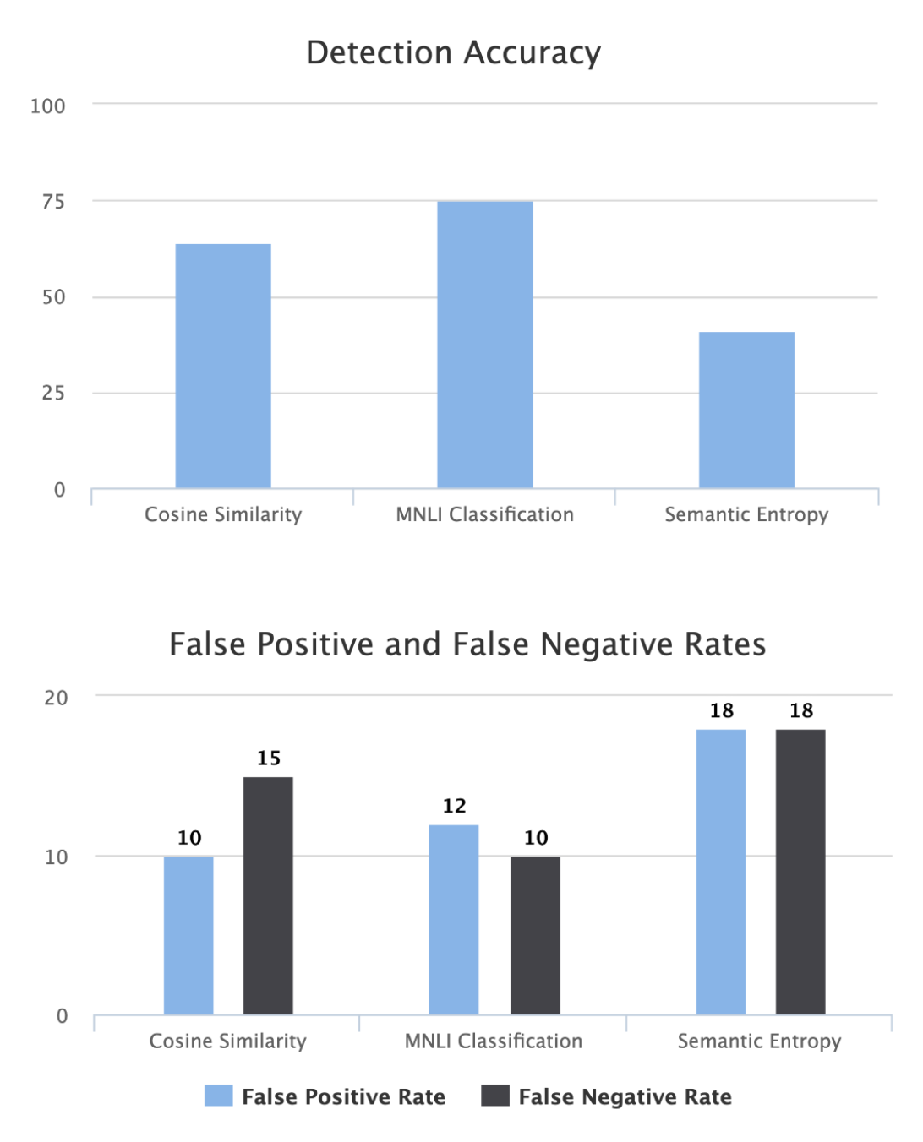
Expected Results
Quantitative Results
Detection Accuracy per Method
False Positives/Negatives
Processing Time Comparison
Threshold Sensitivity
Qualitative Results
Types of Hallucinations Detected/Missed
Method Strengths and Weaknesses
Edge Cases and Limitations

Slide 8
Conclusion
Expected Contribution: Actionable insights into detecting hallucinations in LLMs.
Aimed Impact: Supporting trust in AI for education.
"AI in education is powerful, but understanding its boundaries ensures its true potential."

Slide 9
Thank you!
Rafaela Rolim Santana

