Slide 1

Finite State Machine
Team Members:
Rafael Bezerra
Jiabin Xiang
Xiaotian Zhang
Pengpeng Ge
Project link: https://github.com/Terrence1005/Finite-State-Machine

Slide 2
Overview:
Introduction
Software Structure
Finite State
Algorithm Analysis

Slide 3
Introduction
1. Develop a regex stack-based grammar parser that can receive the regular expression patterns, valid them and output them in post order.
2. Create a state machine that can search for the string patterns, apply the method of transferring nondeterministic finite automaton to deterministic finite automaton.

Slide 4
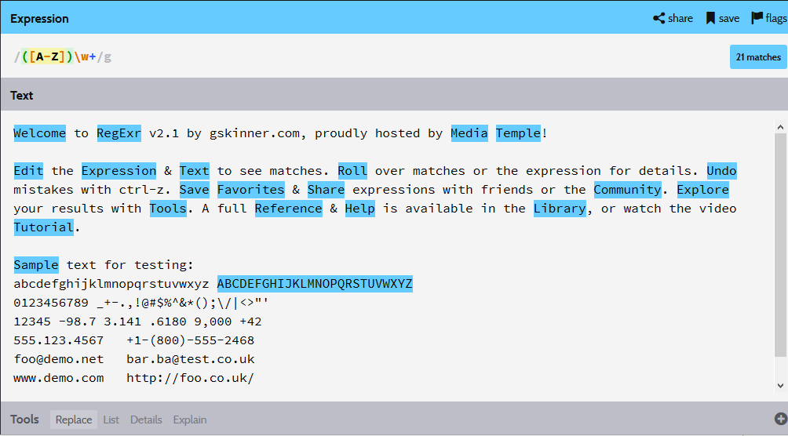
Introduction
Online example:

Slide 5
Software Structure
Reference
Input Regular
expression
Parser
Data type : string
Output data type: vector<string>
Output in order
Shungting-Yard
Transfer in order output to
post order output
data type: vector<string>
Applied Thompson construction Algorithm
Transfer regex to NFA states
Transition
States
NFA
Applied Powerset construction Algorithm
DFA
Transfer NFA to DFA states
Output data type:
vector<unordered_map<char, int>>
Input text file
Matcher function
Output
Highlight on Text

Slide 6
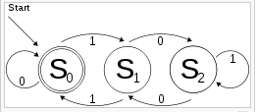
Finite State Machine
DFA
In theory of computation, a branch of theoretical computer science, a deterministic finite automaton (DFA)—also known as deterministic finite accepter (DFA) and deterministic finite state machine—is a finite state machine that accepts/rejects finite strings of symbols and only produces a unique computation (or run) of the automaton for each input string.
Example:
An example of a deterministic finite automaton that accepts only binary numbers that are multiples of 3. The state S₀ is both the start state and an accept state.

Slide 7
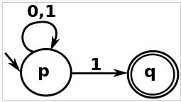
Finite State Machine
NFA
In automata theory, if each of its transitions is uniquely determined by its source state and input symbol, and reading an input symbol is required for each state transition. It is DFA as introduced on last page.
A nondeterministic finite automaton (NFA), or nondeterministic finite state machine, does not need to obey these restrictions. In particular, every DFA is also an NFA.
Example:
In this example, it is not deterministic since in state p reading a 1 can lead to p or to q.

Slide 8
Algorithm Analysis
Shunting-yard algorithm
In computer science, the shunting-yard algorithm is a method for parsing mathematical expressions specified in infix notation. It can be used to produce either a postfix notation string, also known as Reverse Polish notation (RPN), or an abstract syntax tree (AST).
We applied this algorithm to make the in order out put of the parser into post order, so that it can be applied to our finite state machine. Because it can automatically recognize the priority of each symbol.

Slide 9
Algorithm Analysis
Thompson’s construction Algorithm
We applied this algorithm to transfer our regular expression into NFA. In computer science, Thompson's construction is an algorithm for transforming a regular expression into an equivalent nondeterministic finite automaton (NFA). This NFA can be used to match strings against the regular expression.

Slide 10
Algorithm Analysis
Powerset Construction (subset construction) Algorithm
We applied this formal algorithm to convert NFA to DFA. In the theory of computation and automata theory, the powerset construction or subset construction is a standard method for converting a nondeterministic finite automaton (NFA) into a deterministic finite automaton (DFA) which recognizes the same formal language.

Slide 11
Next steps:
Code Review
Final outcome of the project

