Slide 1


DCM Uploader: um sistema de informação para garantia de
confidencialidade, integridade e disponibilidade no tráfego de
imagens médicas baseadas no padrão DICOM
Licença de Software do Orthanc 26/09/2023

Slide 2
Introdução
Estudo da licença de software do Orthanc
Responder à questão: É viável utilizar o Orthanc como base para o produto iLIKA Uploader?
Vantagens e desvantagens de utilizar o Orthanc como tecnologia base para desenvolvimento do iLIKA Uploader

Slide 3
A Licença do Orthanc
“…Orthanc is provided as free and open-source software to the benefit of the worldwide community of medical imaging.”
O ecossistema do Orthanc está sob a licença GPLv3+
Plugins desenvolvidos para prover escalabilidade ou funcionalidades em nuvem (e.g. PostgreSQL e visualizadores Web que são necessários para a distribuição em larga escala) estão sob a licença mais forte AGPLv3+.

Slide 4
A Licença do Orthanc
 |  | Mode of distribution of the third-party system, or of the third-party plugin/script
Usage of the Orthanc ecosystem |  | Permissive (MIT, BSD, Apache...) | GPLv3 | AGPLv3 | Internal use | Proprietary software distributed to clients | Prop. cloud platform or Web portal
Using Orthanc as such, even if some AGPL-licensed plugin is installed |  | N/A | N/A | N/A | Yes | Yes | Yes
Calling Orthanc from a third-party system (using REST API or DICOM protocol), even if some AGPL-licensed plugin is installed |  | Yes | Yes | Yes | Yes | Yes | Yes
Creating a C/C++ plugin, creating a Lua script, or creating a Python plugin. 2 possible cases:
 | Case 1: No AGPL-licensed plugin is in use | No | Yes | Yes | Yes | Dual license | Yes
 | Case 2: Some AGPL-licensed plugin is in use | No | Yes | Yes | Yes | Dual license | Dual license
Using a derived version of the GPL-licensed code of Orthanc, or using a derived version of some GPL-licensed plugin, or reusing their original code in a third-party system |  | No | Yes | Yes | Yes | Dual license
Third-party system - it is very broad, as it encompasses many possibilities. It can for instance be a Web application, a heavyweight desktop application, an automated script, or more generally any system that takes advantage of Orthanc as a service in its global architecture. Dual Licensing - If your use case falls in a “Dual license” cell, please get in touch with Osimis, the commercial partner of the Orthanc project that is the only entity entitled to grant a license exception to your company for the Orthanc core and its associated official plugins.

Slide 5
A Licença do Orthanc
Contributed vs. internal code
It is important to make the distinction between contributed code and internal code:
Contributed code refers to source code that takes advantage of Orthanc and/or that extends Orthanc, such as new plugins, Lua scripts, or any higher-level application that uses the REST API of Orthanc. This code can live outside of the official source repositories of the Orthanc ecosystem. External contributors can distribute such contributed code on whatever platform they prefer, in a way that is fully uncoupled from the Orthanc project, and keep the intellectual property of their developments. Such contributors are however kindly invited to index their contributions in the dedicated repository on GitHub, and contributed plugins should also be indexed in the Orthanc Book.
Internal code refers to source code that only makes sense if embedded within the Orthanc core or within one of the official plugins. This includes new features and bugfixes. The way to contribute to the internal code of the Orthanc ecosystem is described in the sections below.

Slide 6
A Licença do Orthanc
Contributor License Agreement
Para contribuir como pessoa física ou jurídica para o desenvolvimento do Orthanc é necessário assinar um Contributor License Agreement. Há tipos distintos de CLA para cada um desses casos.
Toda a gestão da propriedade intelectual do Orthanc é centralizada no Hospital Universitário de Liège, na companhia Osimis e na Universidade UCLouvain. Eles atuam como os guardiões oficiais do ecossistema Orthanc.

Slide 7
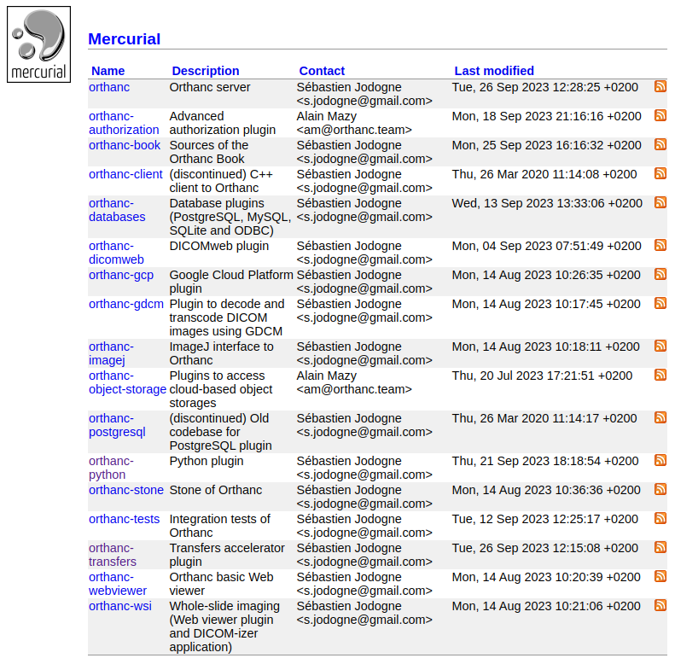
Vantagens e desvantagens
Desenvolvimento ativo
O tipo de uso que fazemos hoje da plataforma nos permite utilizá-la livremente, inclusive em uma aplicação comercial
Bem documentado
Extenso suporte de plugins
Dependência de terceiros
falta de aderência a algum padrão
necessidade de uma funcionalidade crítica não contemplada no core do Orthanc

