Slide 1
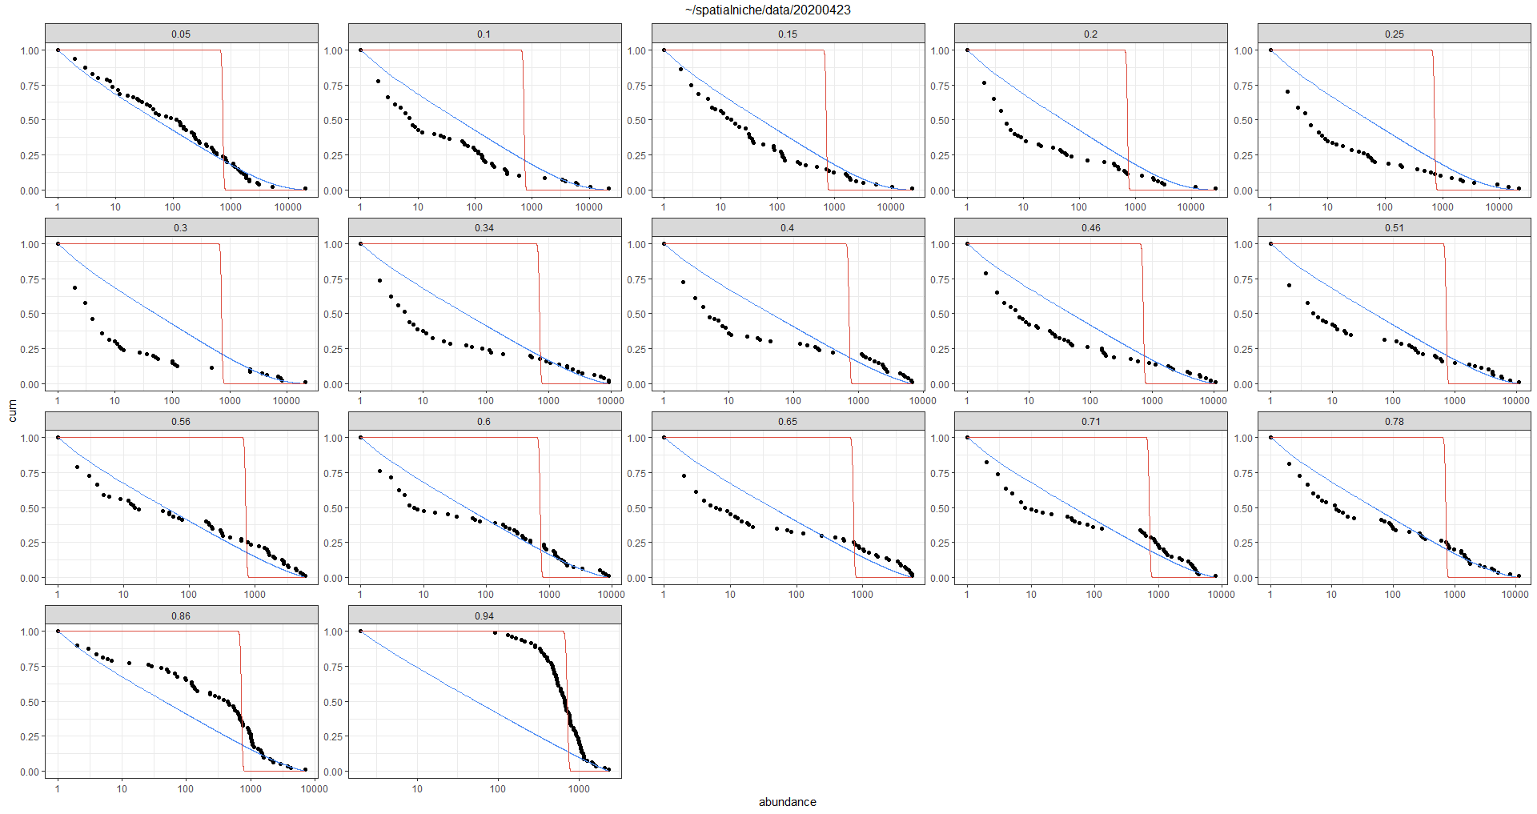
Beta noise 1e3
60 species

Slide 2
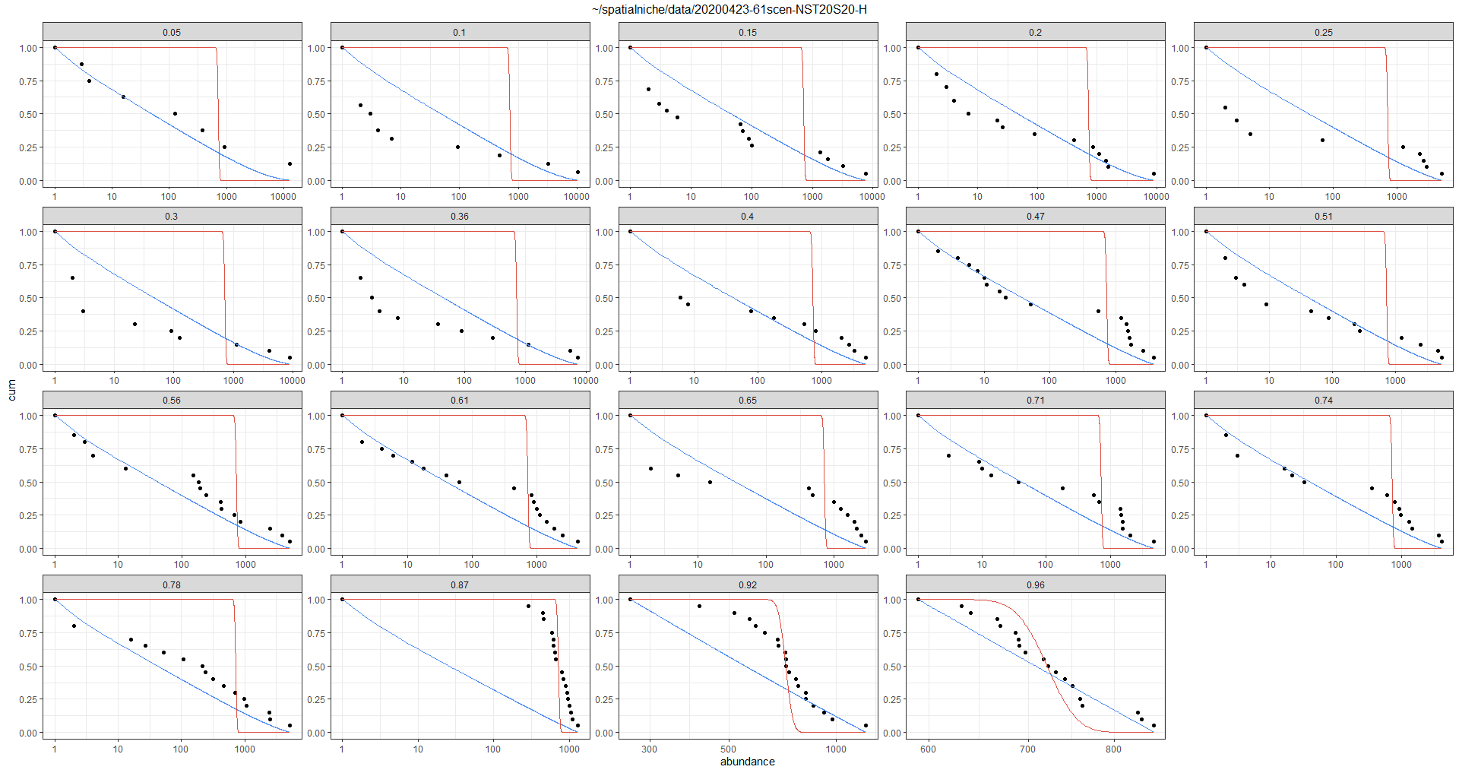
Beta noise 1e3
20 species

Slide 3
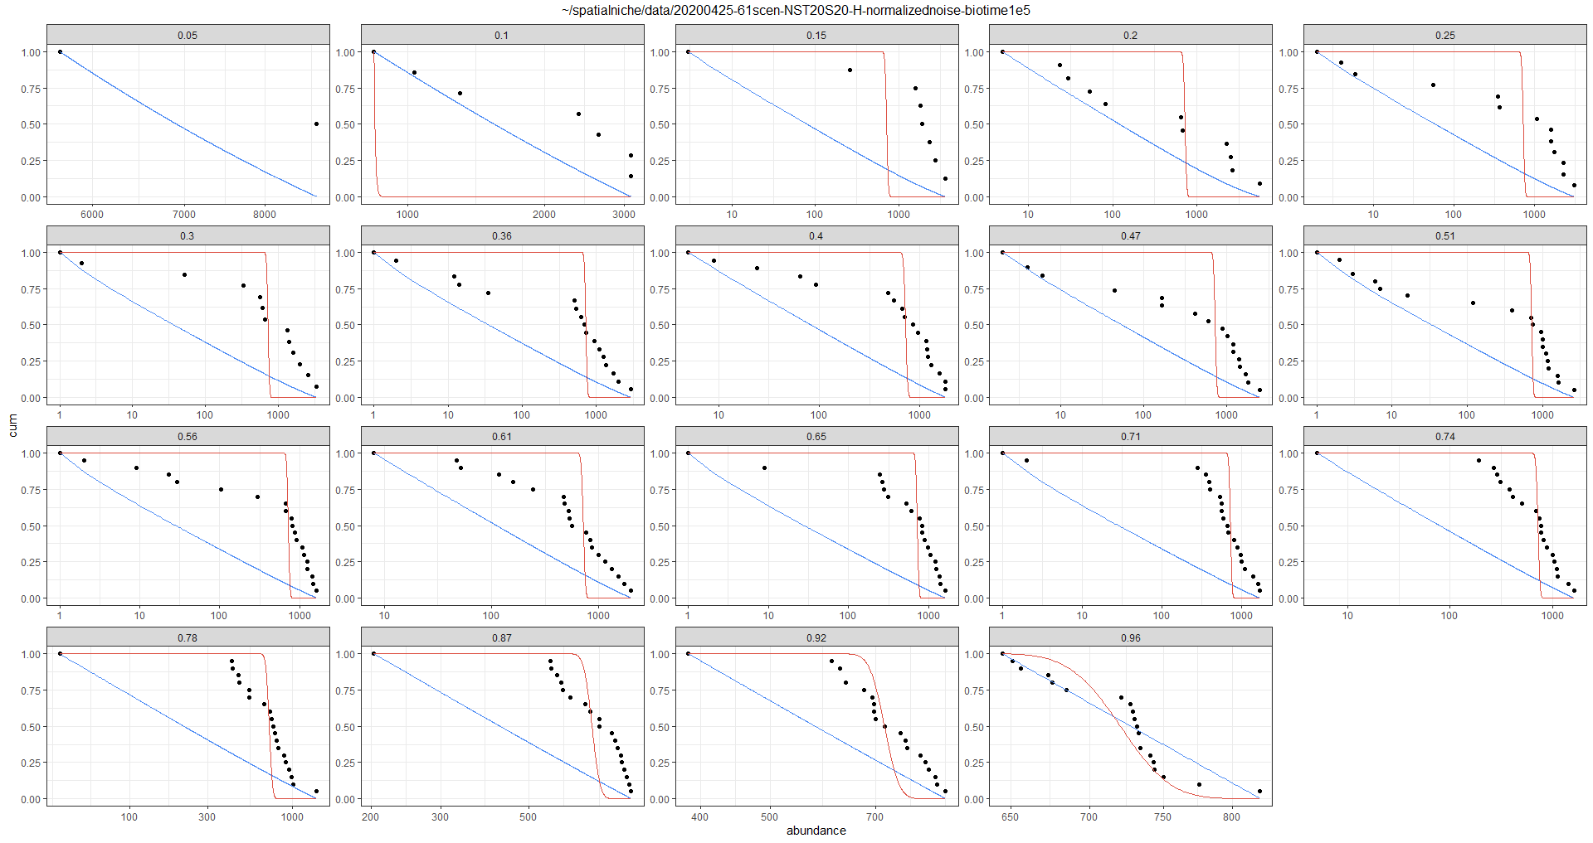
Normalized noise 1e5

Slide 4
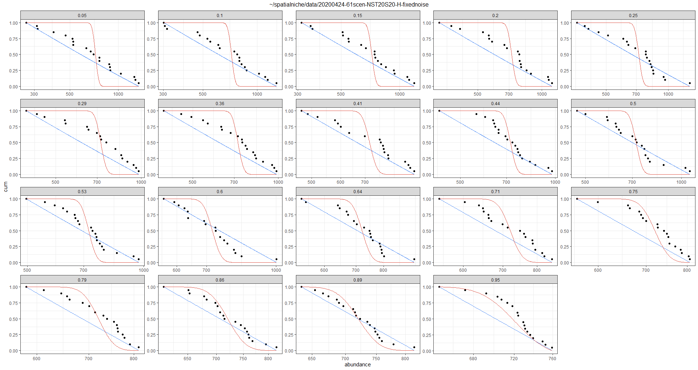
Fixed noise 1e3

Slide 5
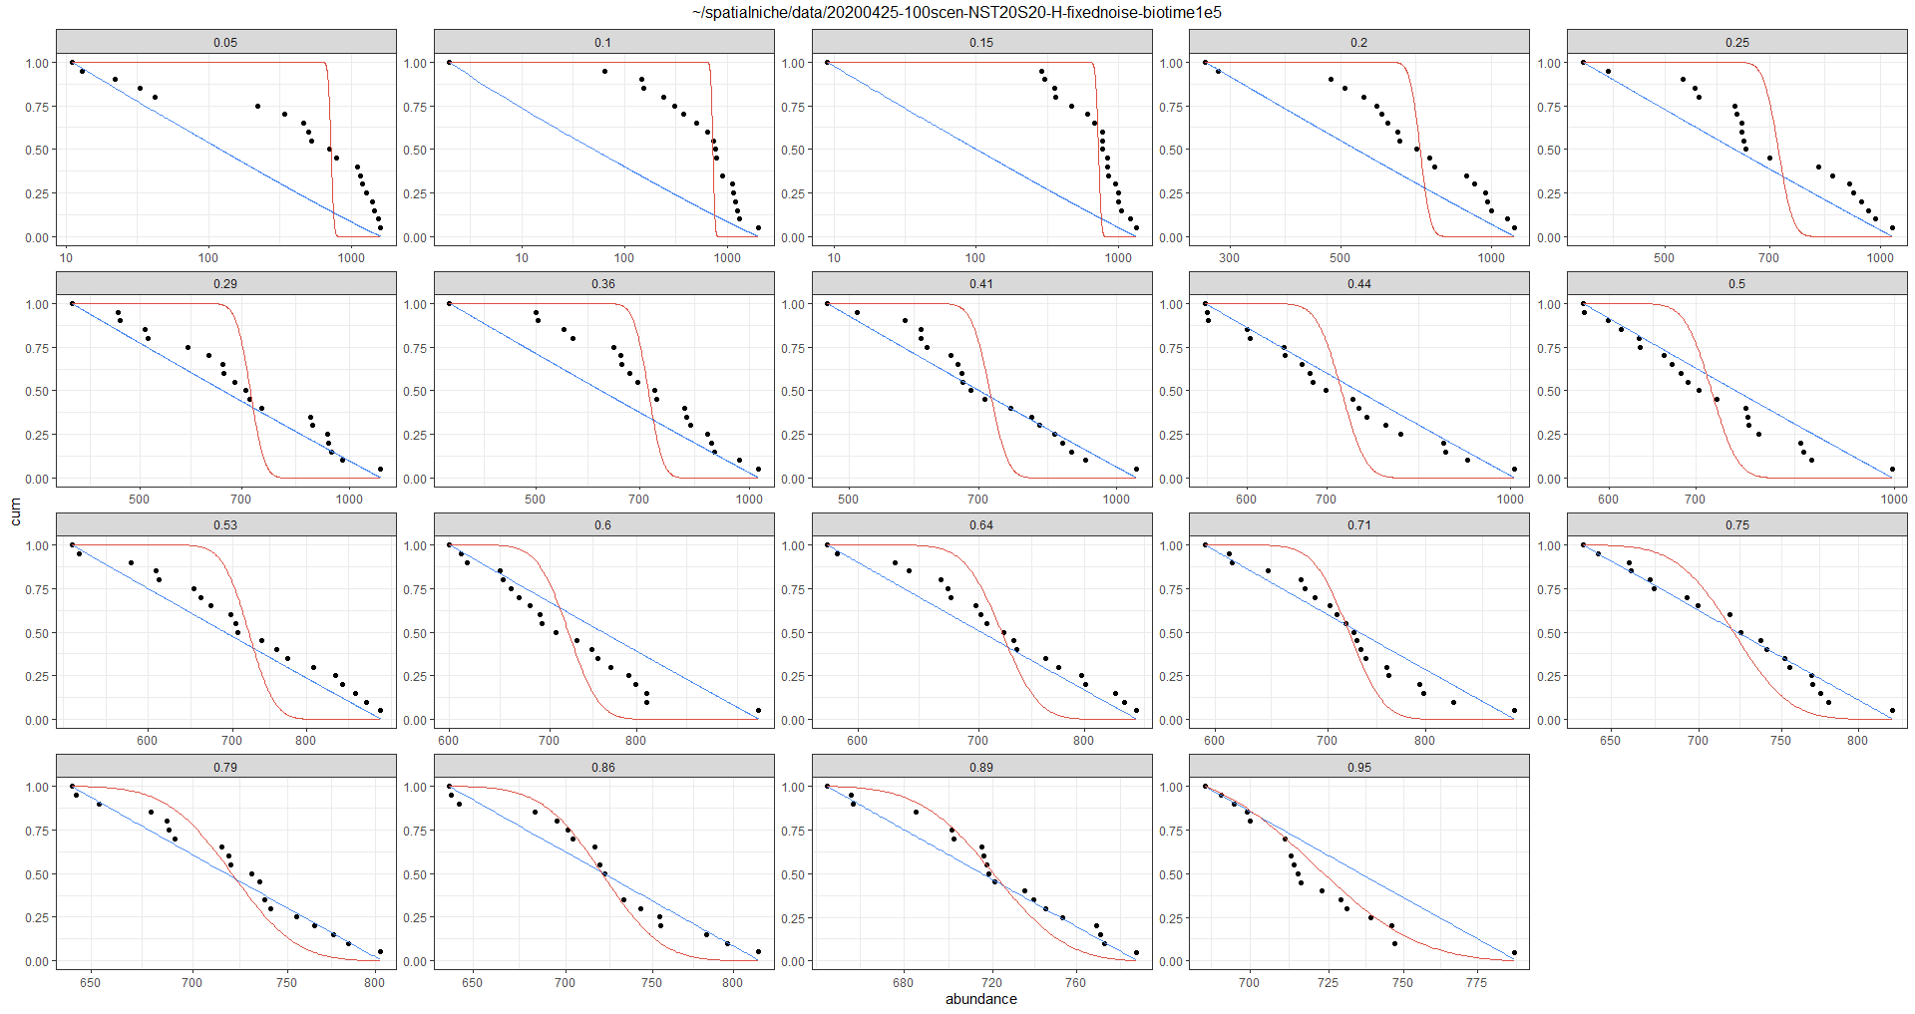
Fixed noise 1e5

Slide 6
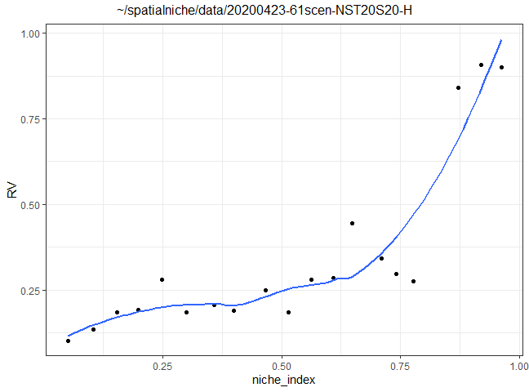
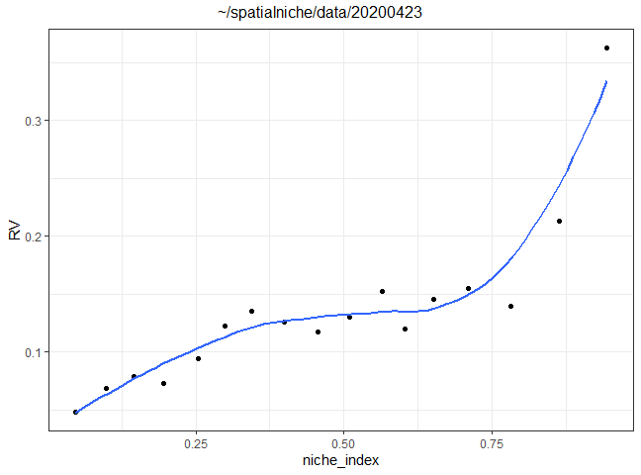
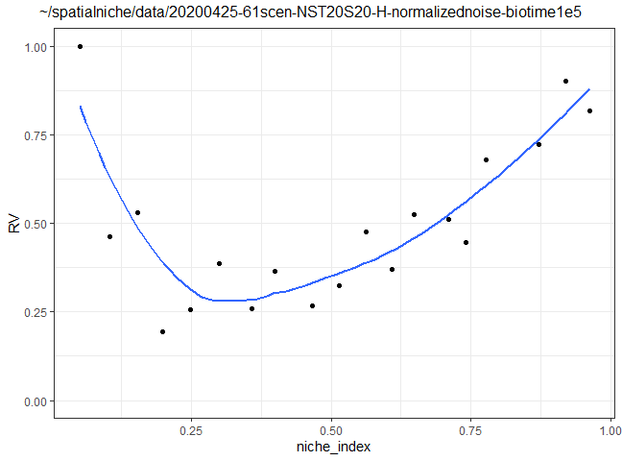
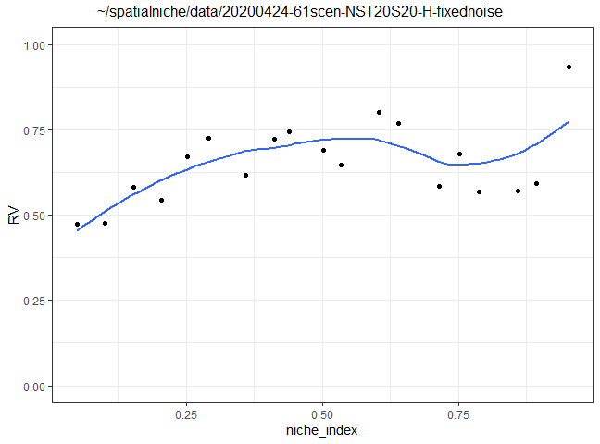
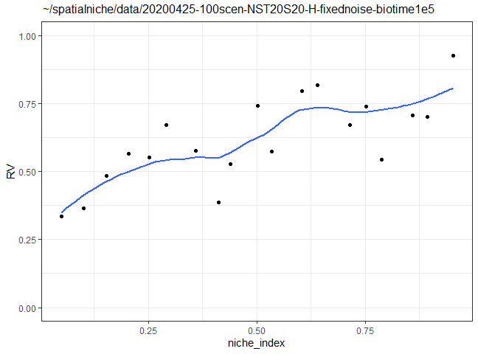

Slide 7
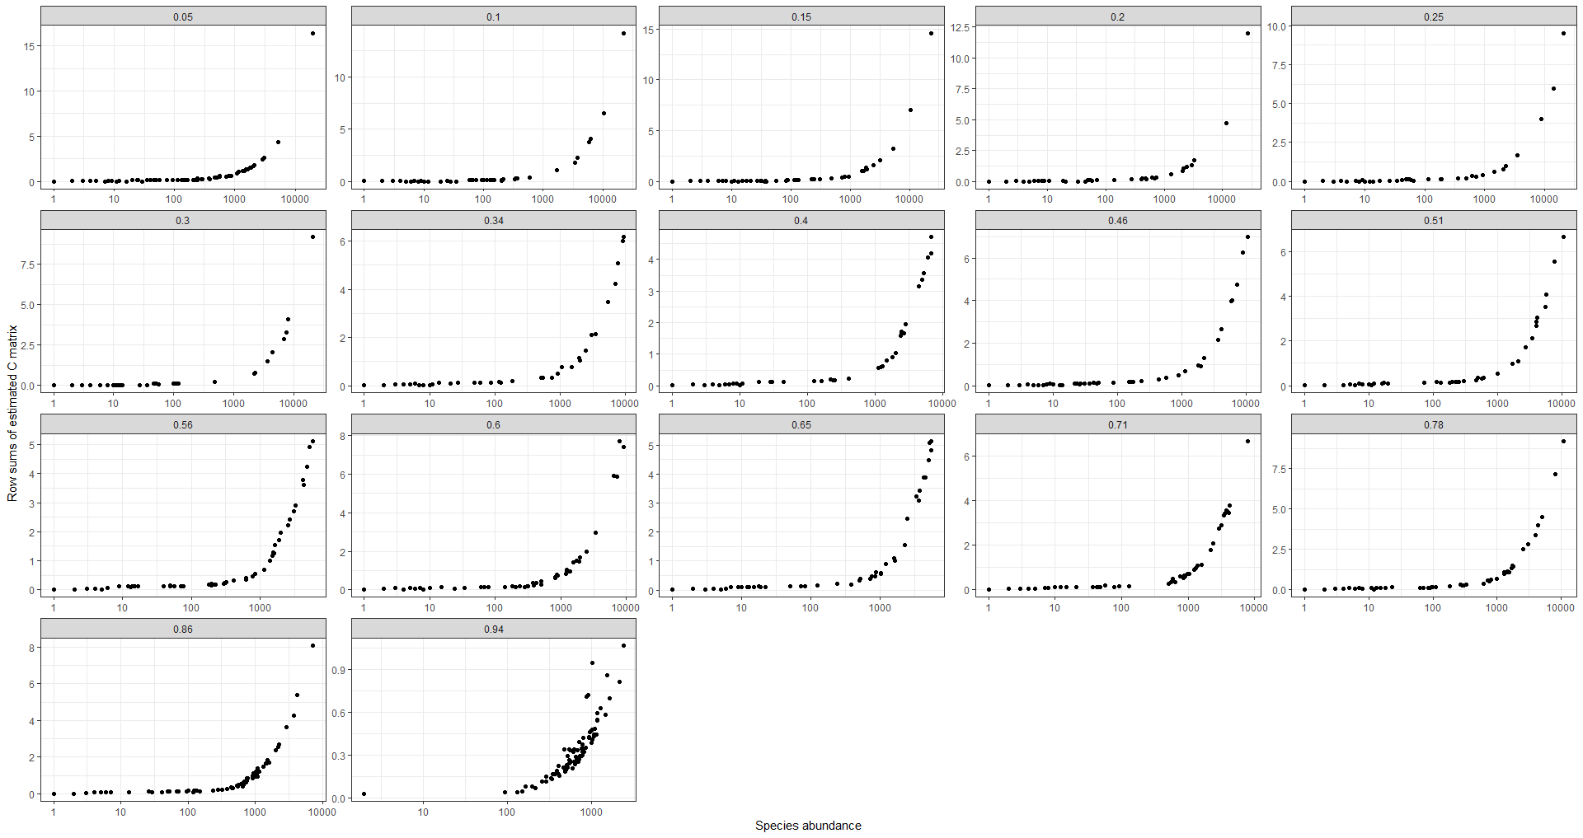

Slide 8
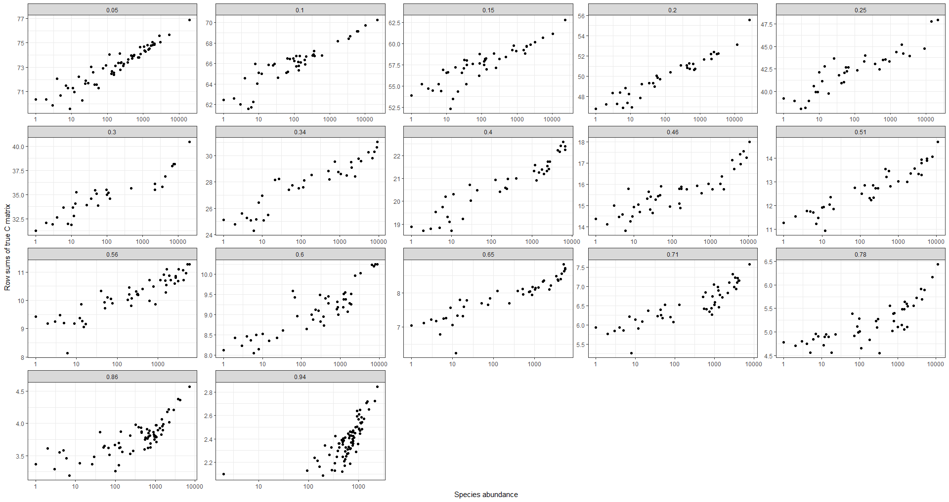

Slide 9
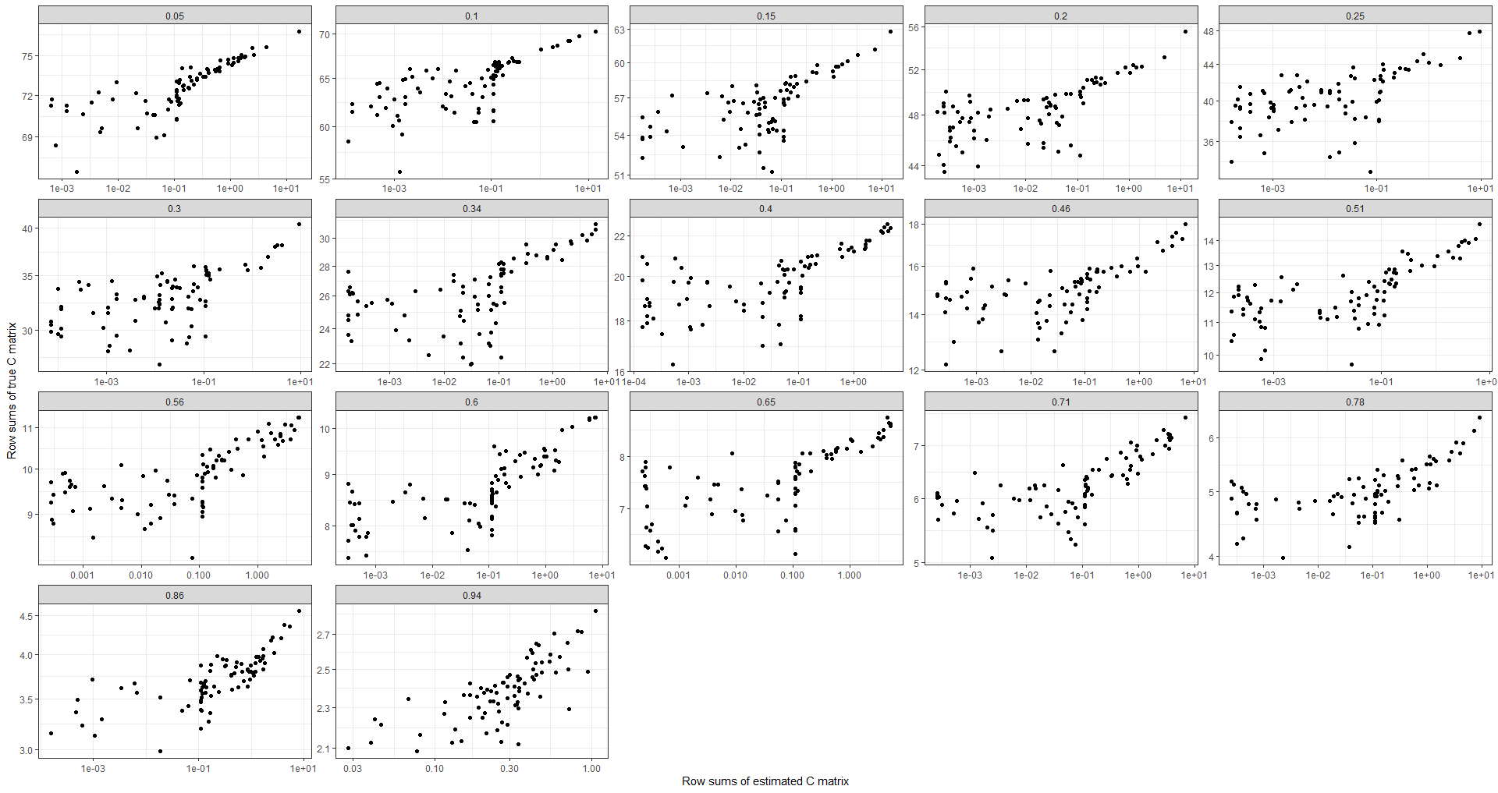

Slide 10
20 species, 20 soil types, 1 million years of simulation

Slide 11
Stationarity: Variance over time

Slide 12
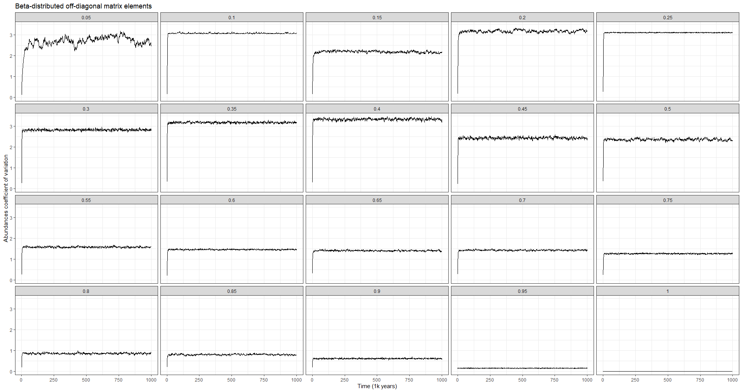

Slide 13
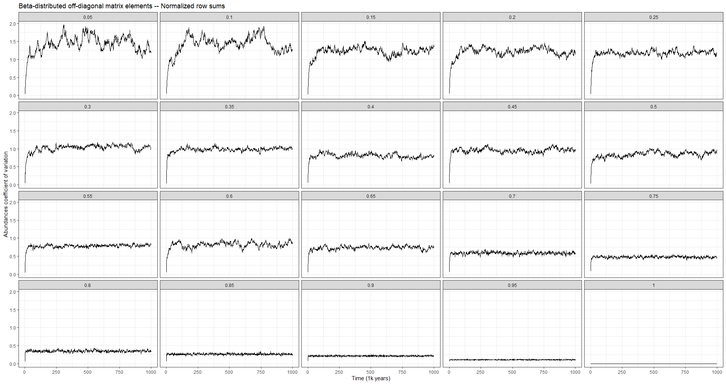

Slide 14
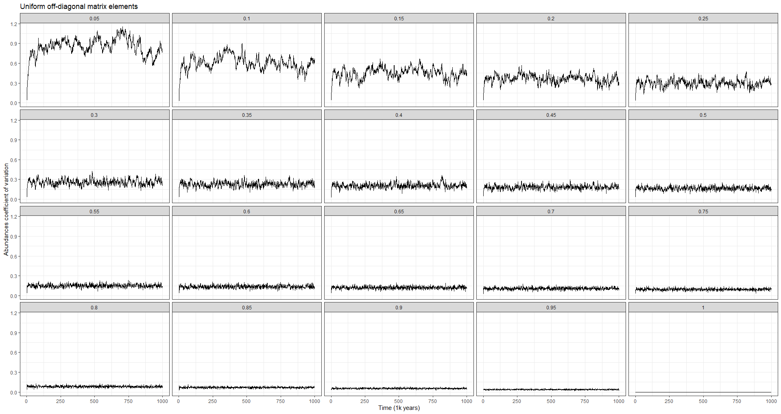

Slide 15
C row sums as predictors of abundance

Slide 16
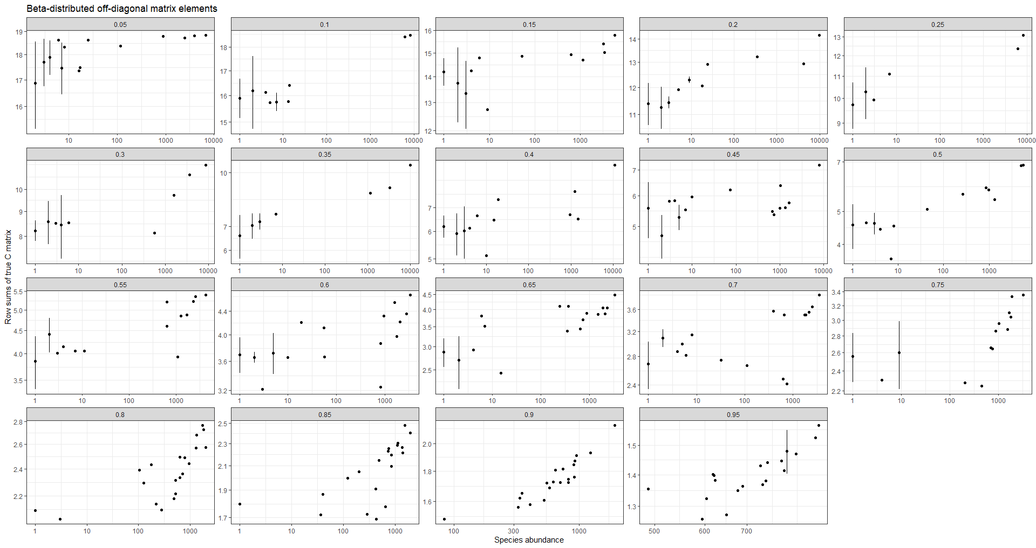

Slide 17
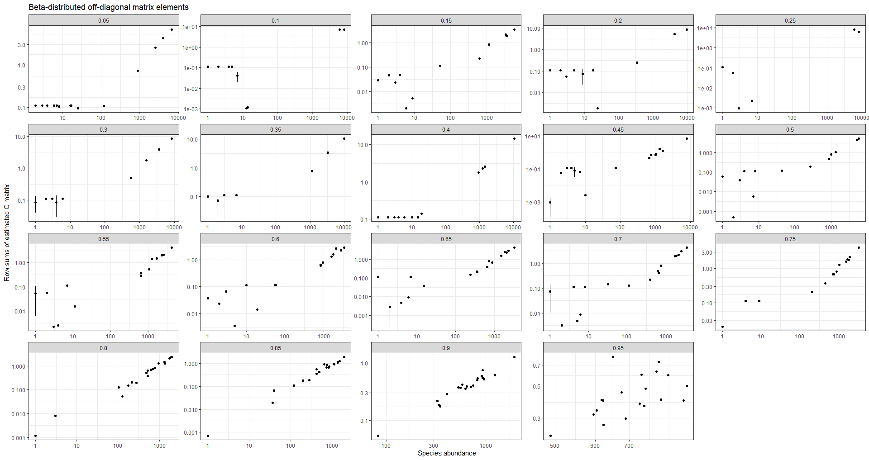

Slide 18
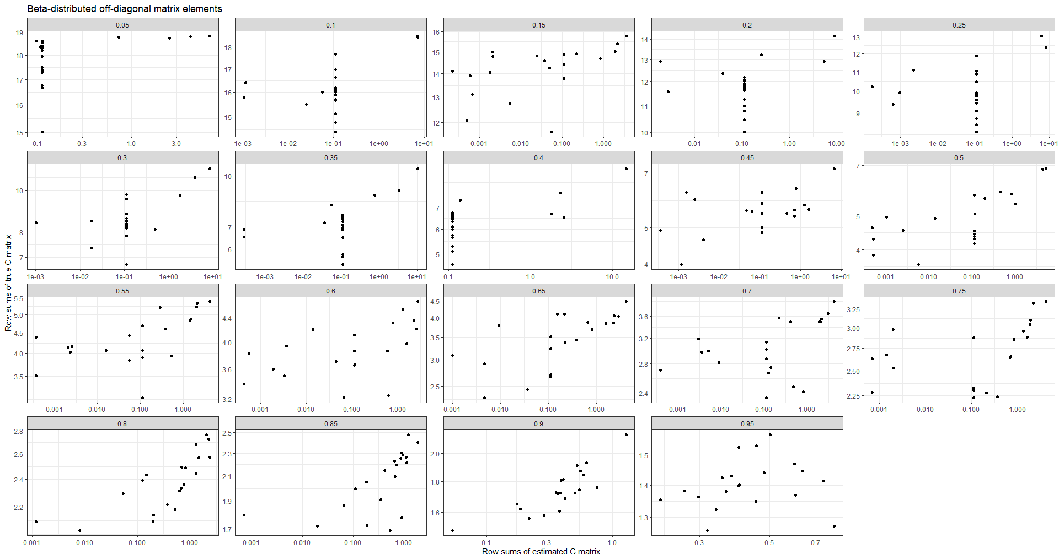

Slide 19
C row sums vs niche index

Slide 20
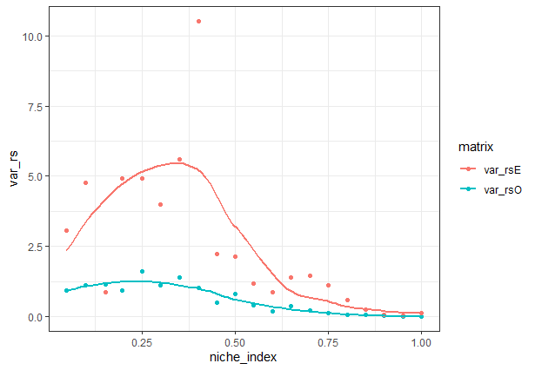

Slide 21
SADs

Slide 22
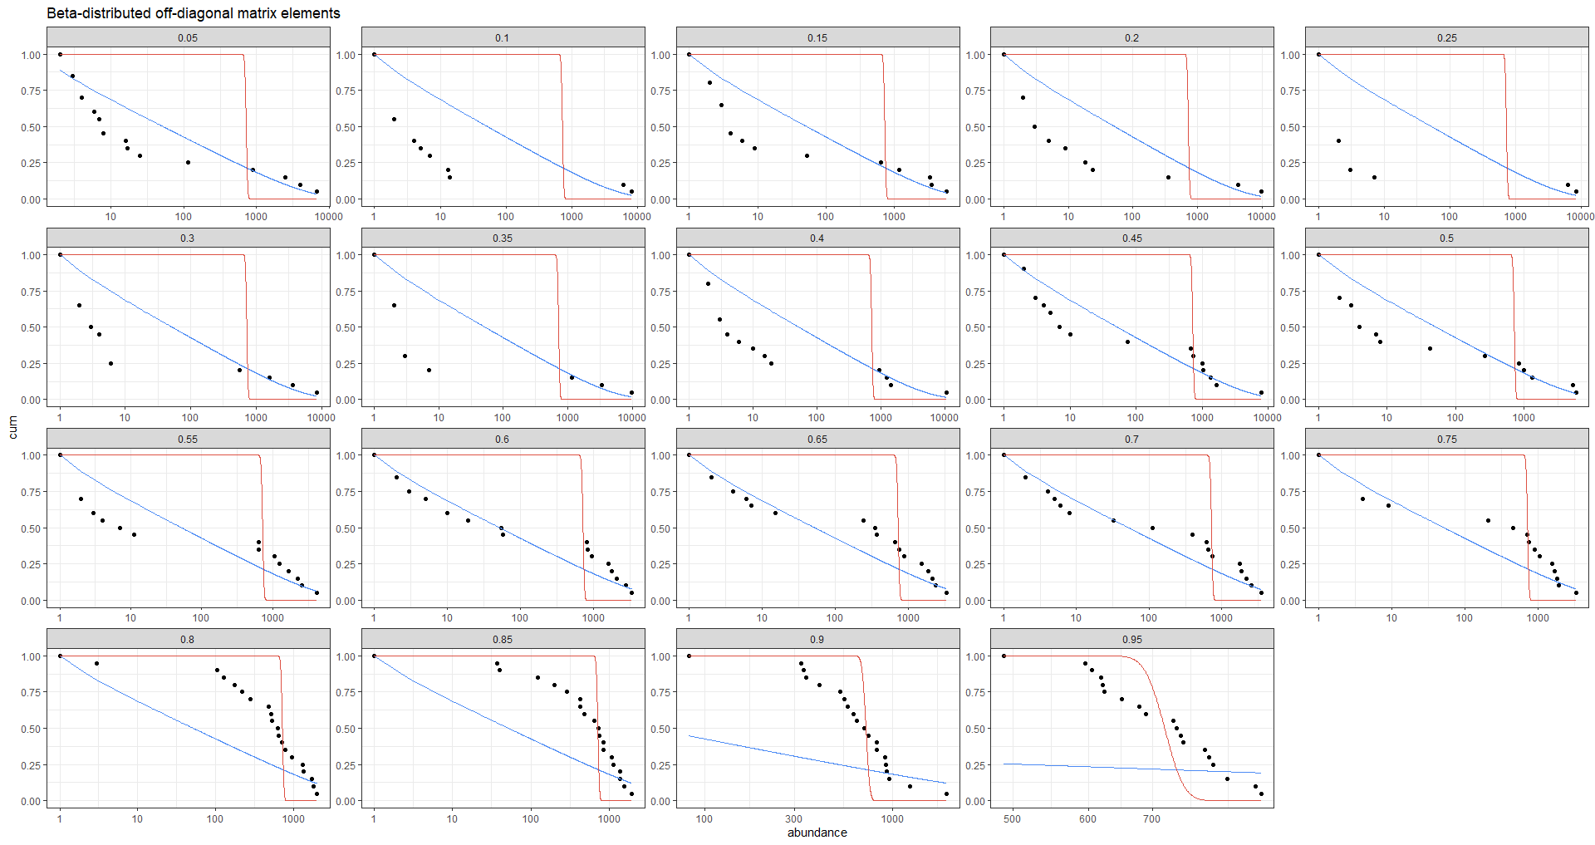

Slide 23
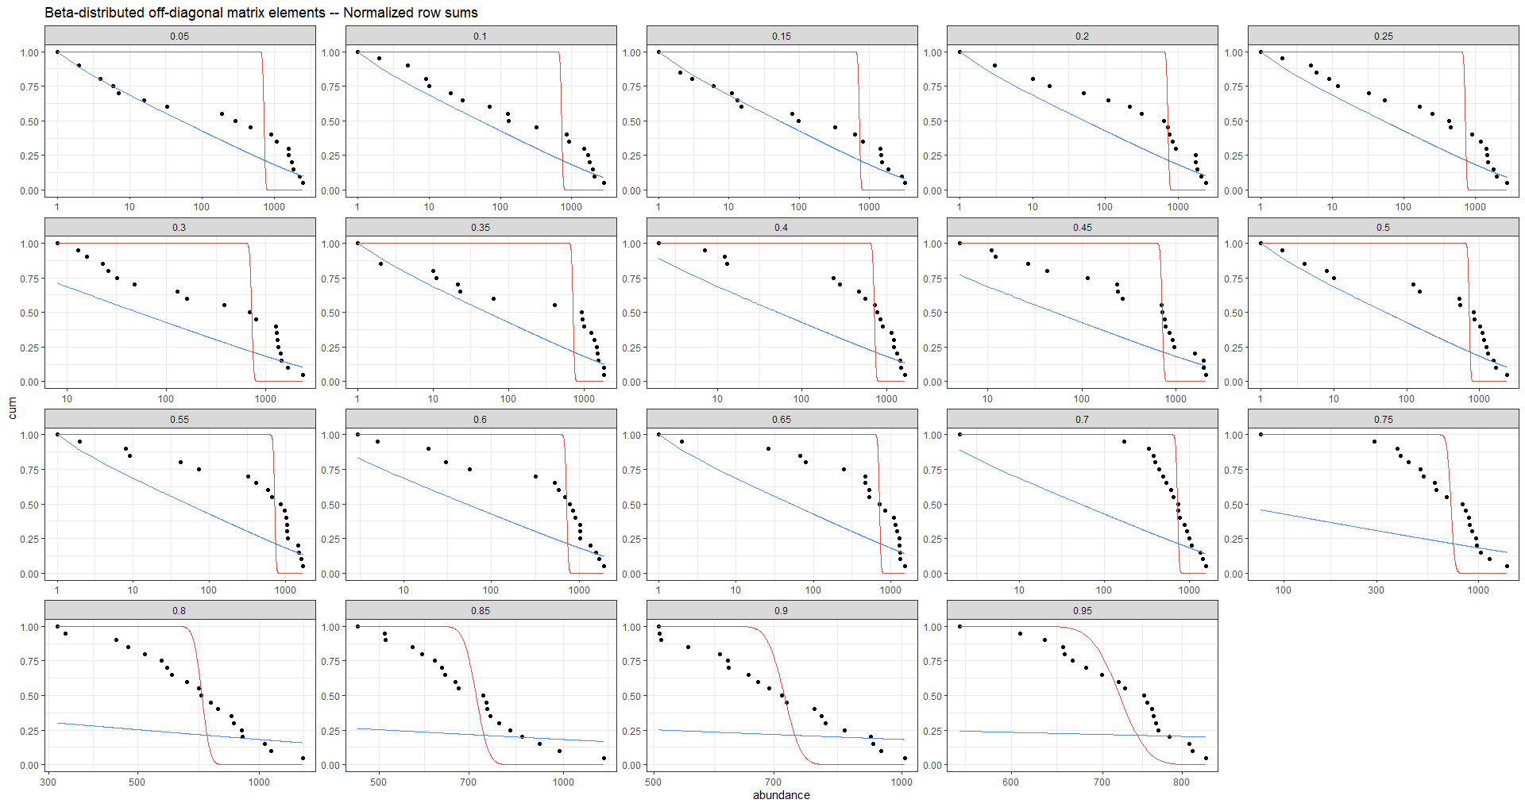

Slide 24
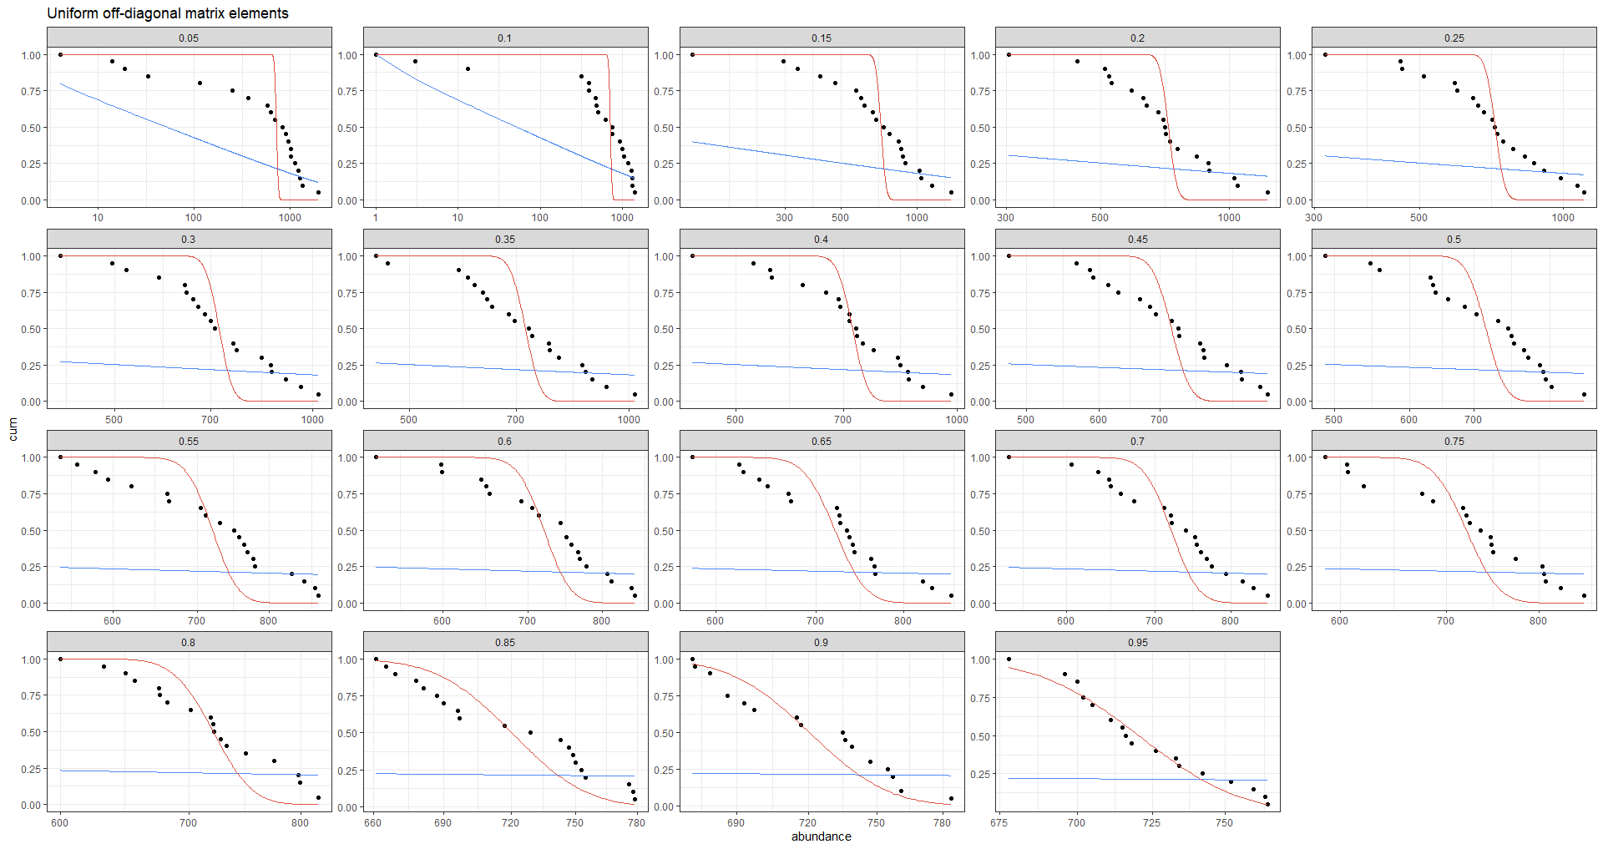

Slide 25
RV coefficient vs niche index

Slide 26
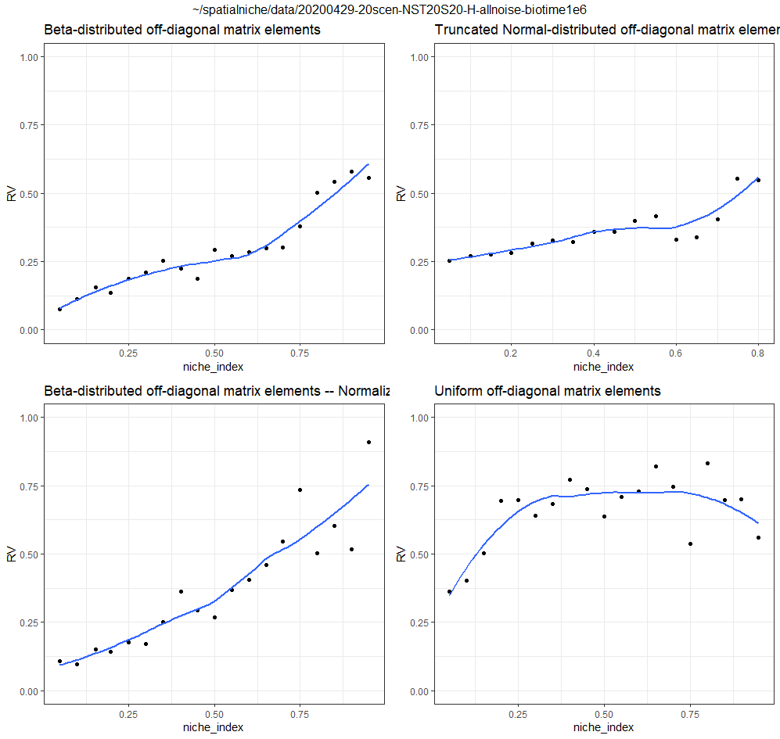

Slide 27
SADs longitudinally collated data

Slide 28
Slides 28 – 31: SADs for the three noise distributions on the C matrix. While slides 22 – 24 showed the SADs for a single snapshot, these show the SAD when abundances through snapshots are collated into a single mega-community. This collation more clearly shows the SAD that snapshots are sampling from.
Note on methodology: Censuses are taken every 1,000 years for a total of 1 million simulated years, where each year 1% of the community die and are replaced. To make sure the community is stationary, I plotted the variance of the SAD across time and determined that a burn-in of the first 50,000 years was sufficient. From the rest of the data, I collected censuses that are sufficiently spaced apart for abundances to not be autocorrelated (as determined using the Ljung-Box test), leading to a total of 190 censuses.
While the cases of Beta dbn with normalized C row sums (slide 29) and the fixed off-diagonal cases (slide 30) show a transition between Poisson in the high niche regime and logseries in the purely neutral regime, the Beta case (slide 28) seems different because there is a surplus of rare species relative to the logseries (compare to slide 35, which shows an example mega-community drawn from a logseries).
The fact that the normalization of row sums removes this effect observed with the Beta dbn suggests that this excess of rarity comes from fitness differences (i.e. row sums) being magnified by demographic stochasticity.
Also notice that in the normalized row sums and fixed off diagonal noise scenarios, we don’t get good fits to the logseries even down to very low niche index. This suggests that in this model, where resources are not stochastic, it is easier to reject neutrality than in the stochastic resource-consumer model in our preprint.

Slide 29
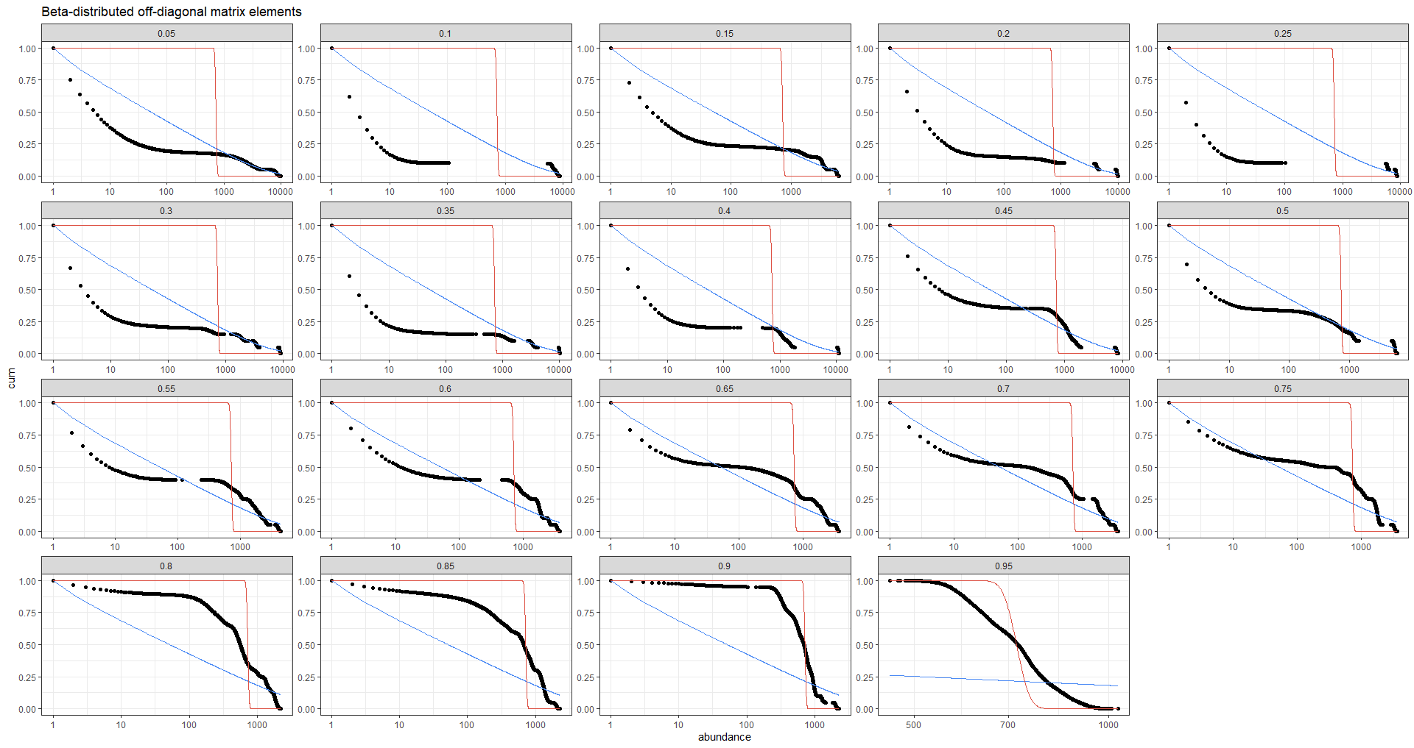

Slide 30
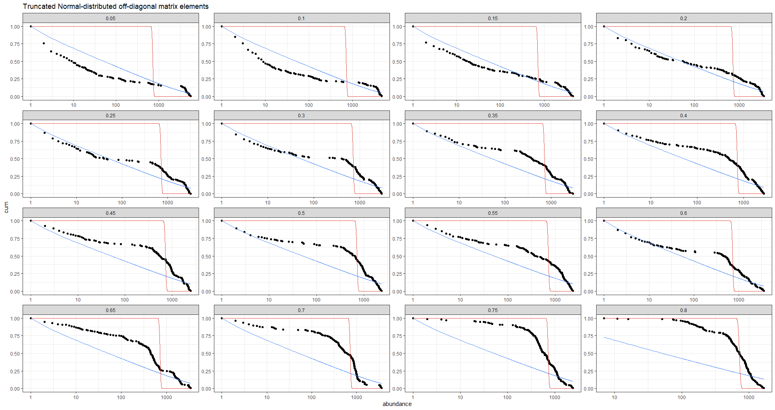

Slide 31
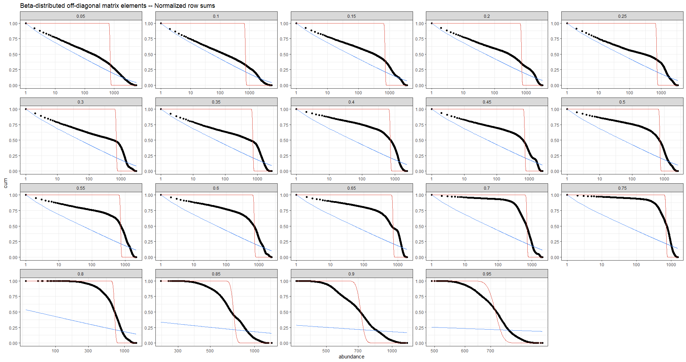

Slide 32
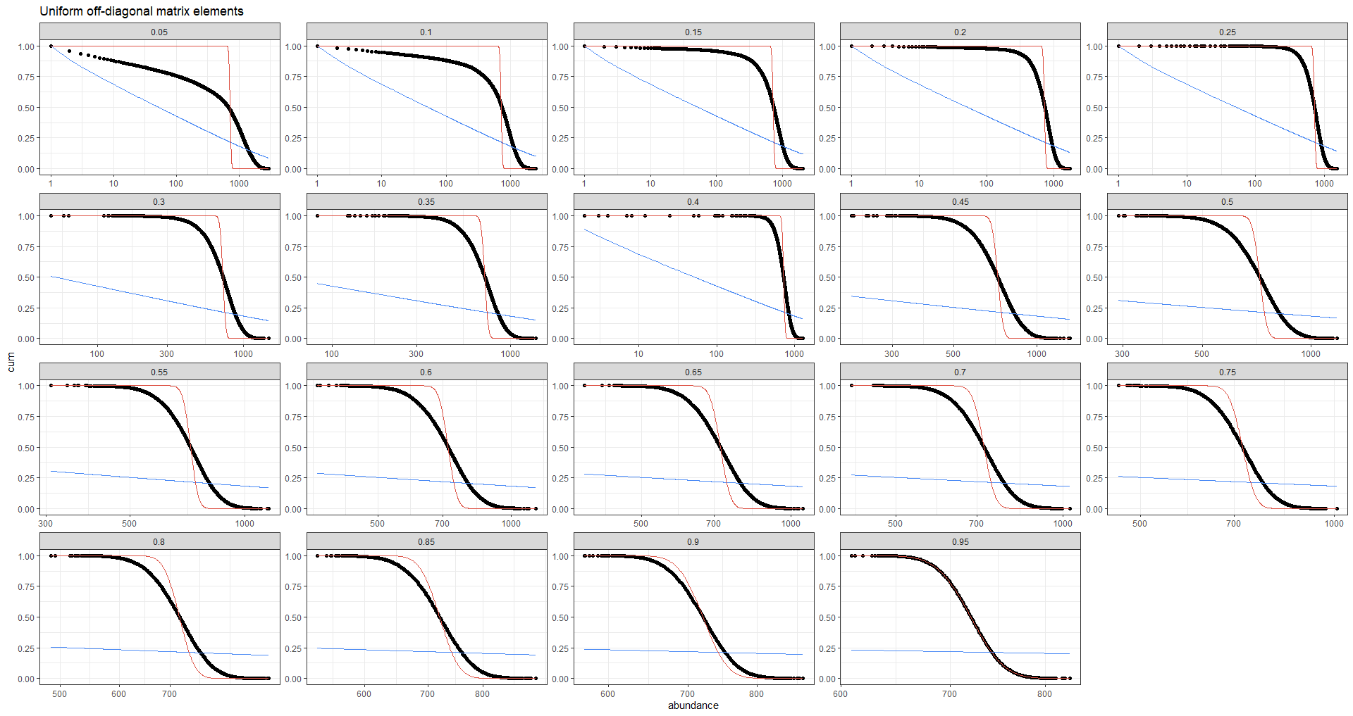

Slide 33
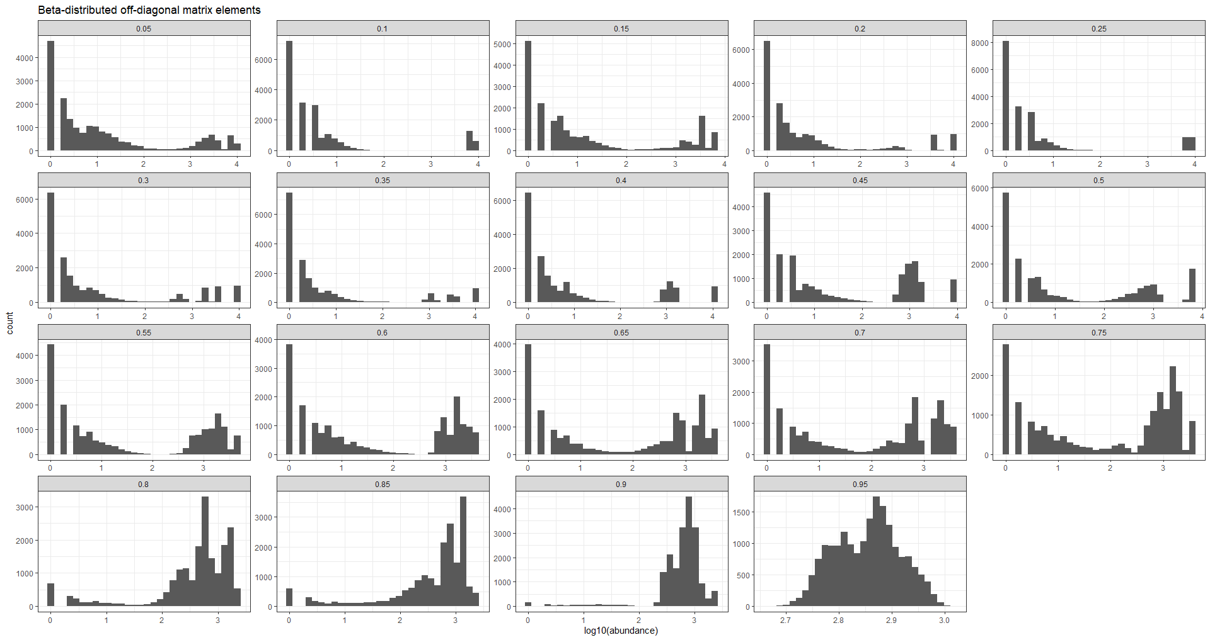

Slide 34
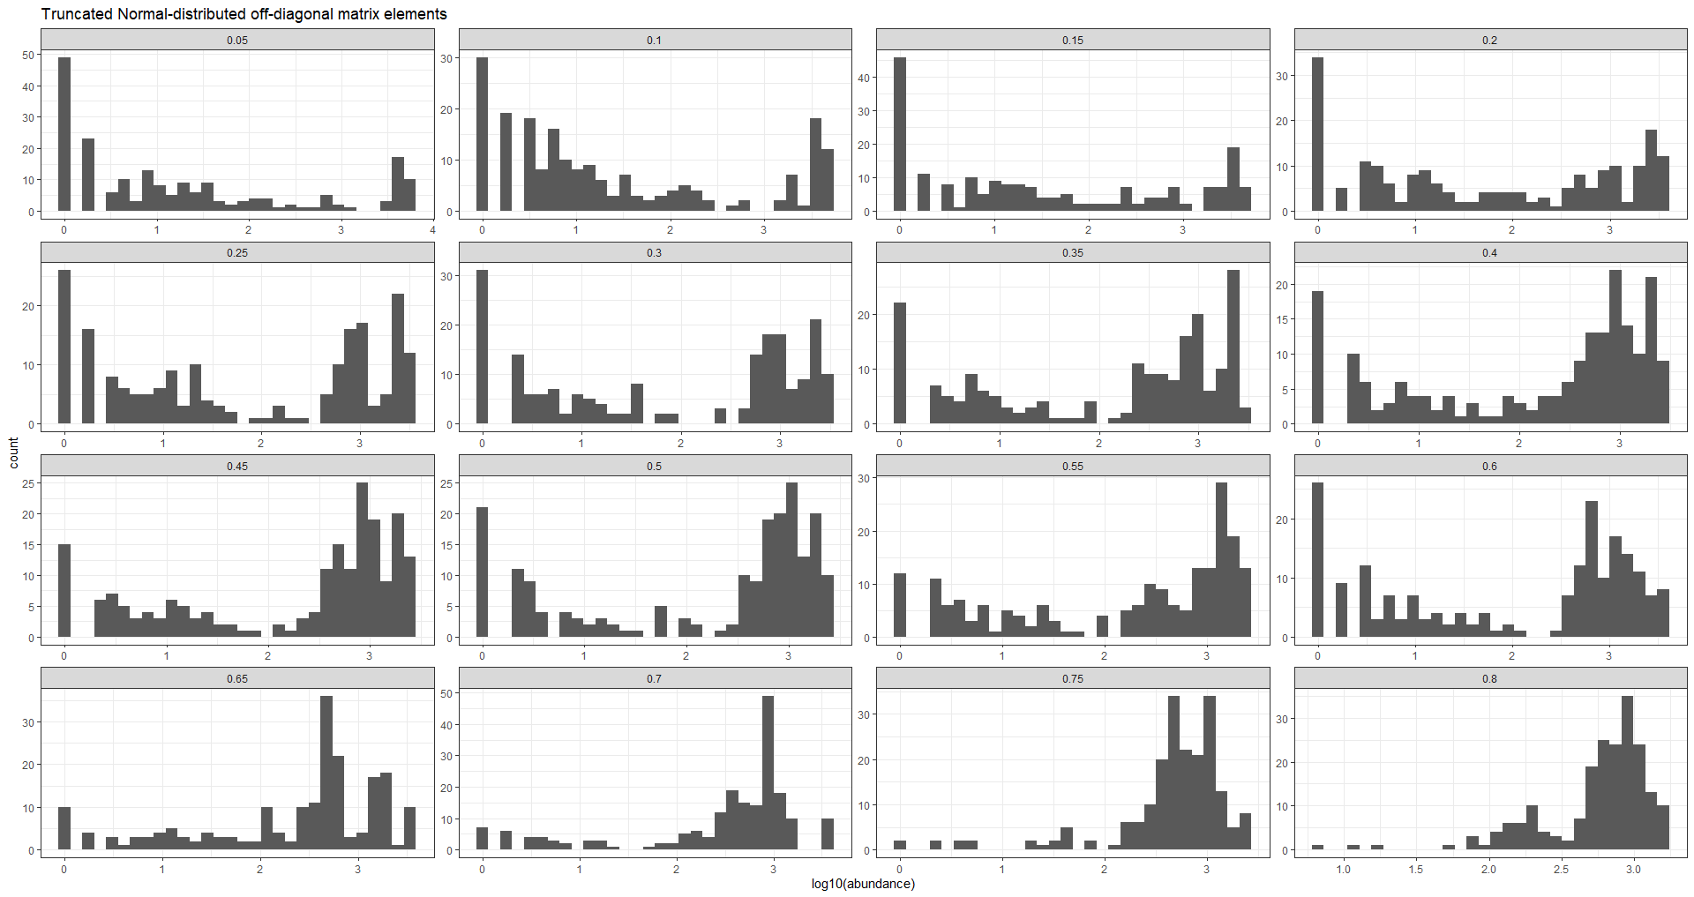

Slide 35
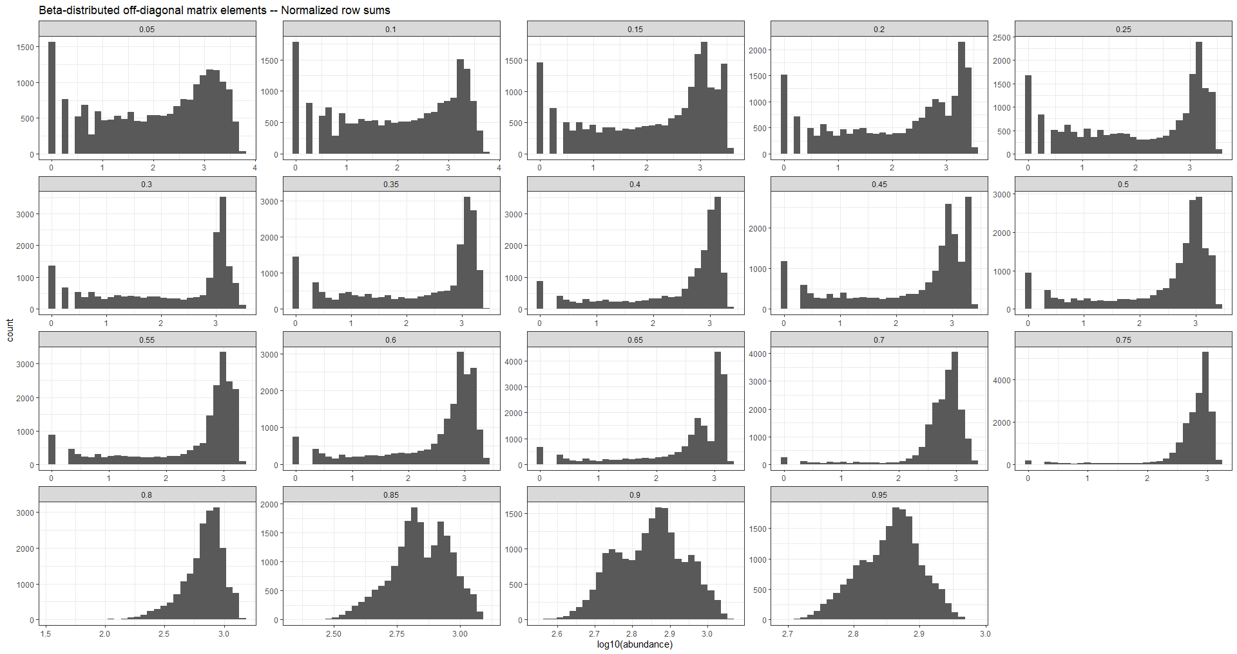

Slide 36
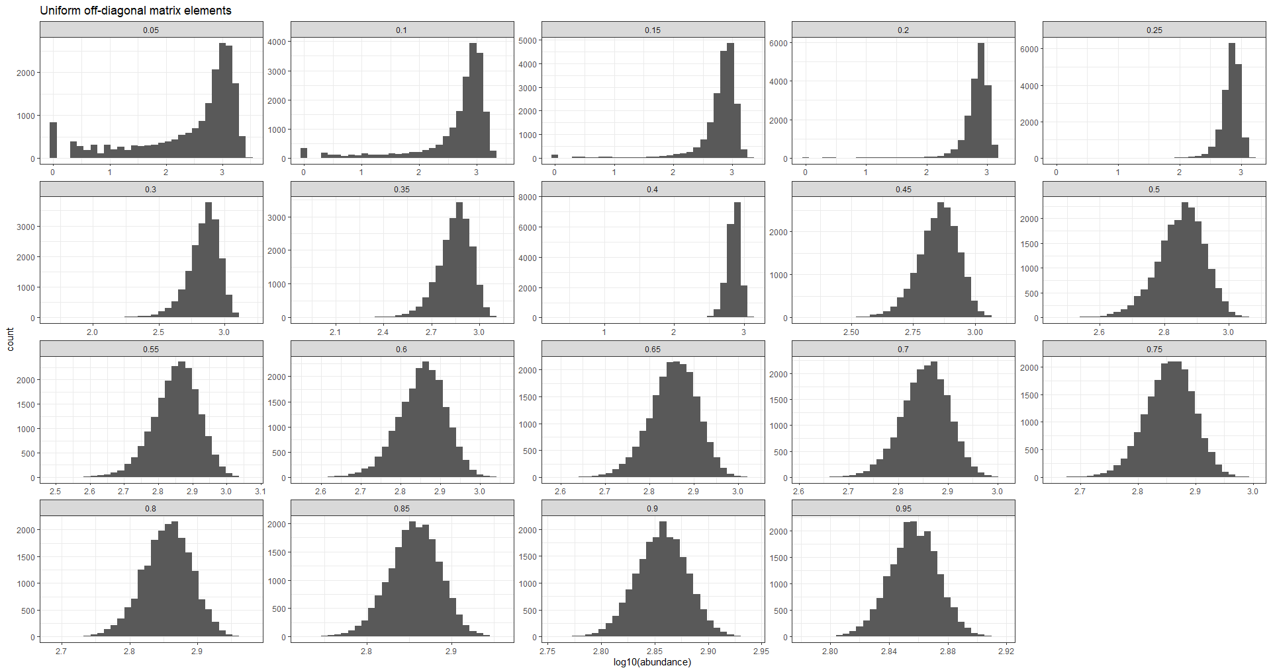

Slide 37
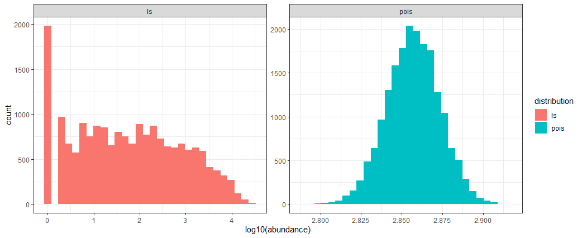

Slide 38
Temporal analysis

Slide 39
Slides 38 – 39: Logseries and Poisson fits to the abundances of each species across time.
Slide 38: Aggregated results across species show that the logseries fit (red) is better in cases with low niche index, whereas the opposite is true of the Poisson fit (blue, top plot). I define the MLE “fit deficit” as the negative of the fit statistic from the Cramer-von Mises g.o.f. test. The less negative this deficit (ie closer to 0) the better the fit. The data points are averages across species, and the curves are loess regressions with R default smoothness parameters.
However, essentially no species undergo Poisson dynamics -- as determined by an MLE fit p-value higher than 0.05 -- except for our highest niche index data (bottom plot). By contrast, the logseries is a good fit to temporal fluctuations in the abundances of ¾ of the species at low niche index in the Beta noise case, with this percentage gradually dropping to 0 as we increase the niche index.
The logseries is a good fit for a much higher proportion of species under the Beta noise scenario than either of the other two noise scenarios. The average statistic isn’t much different (top plot), but the p-value is > 0.05 for ¾ of the species (bottom plot). I think this is explained by the fact that the Beta scenario has a bimodal abundance distribution, such that a large proportion of the species are rare and undergo near-LS dynamics, while another group of common species undergo dynamics very far from the LS.
Slide 39: this idea is corroborated when we plot the MLE fit deficit against the species average abundance across the censuses. Species with low abundance have a low LS fit deficit (close to 0), whereas high-abundance species have a high fit deficit (very negative). It is less clear what is going with the Poisson fit, as the fit seems better for common or rare species than for species with intermediate abundance.

Slide 40
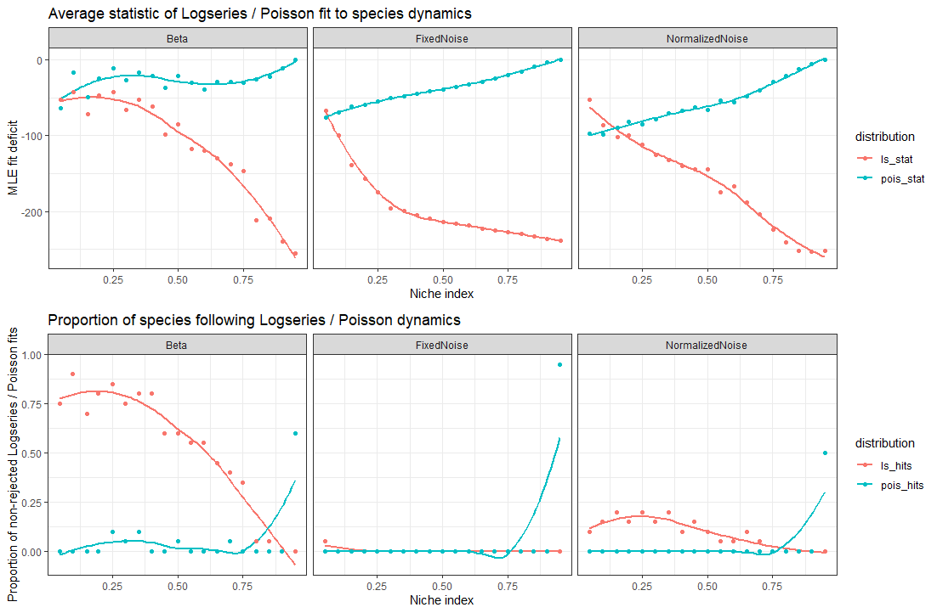

Slide 41
