Slide 1
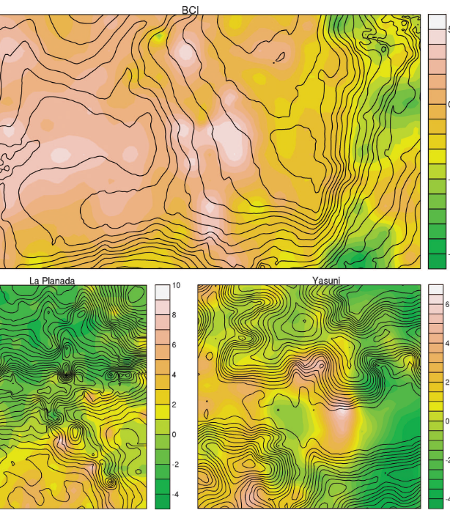
Spatial niche
Rafael D’Andrea
Dianzhuo (John) Wang
James P O’Dwyer

Slide 2

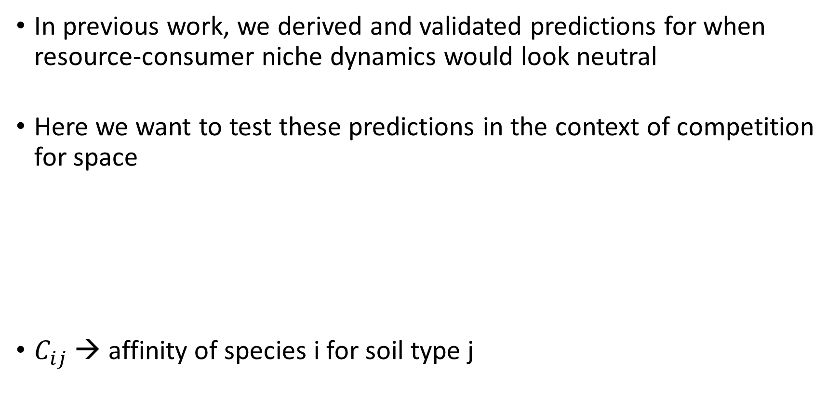
Context
In previous work, we derived and validated predictions for when resource-consumer niche dynamics would look neutral
Here we want to test these predictions in the context of competition for space
$C_{ij}$ → affinity of species i for soil type j
$$\frac{dN_{ij}}{dt}=−mN_{ij}+b_{i}C_{ij}R_{j}\sum_{k}{N_{ik}} \\ R_{j}=P_{j}−\sum_{i}{N_{ij}}$$

Slide 3
Estimating C from Species(x,y)

Slide 4
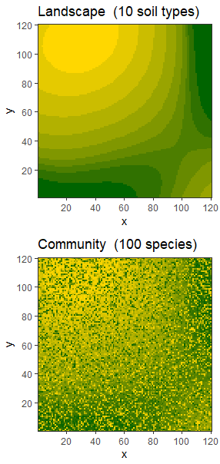
Approach
Generate a landscape, SoilType(x,y)
Generate a community, Species(x,y)

Slide 5
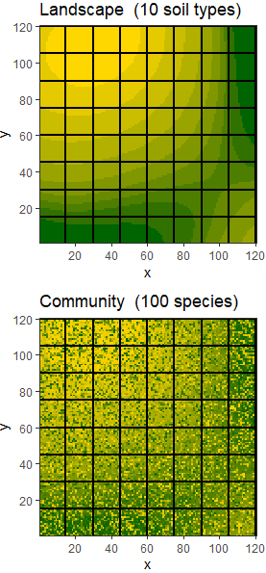
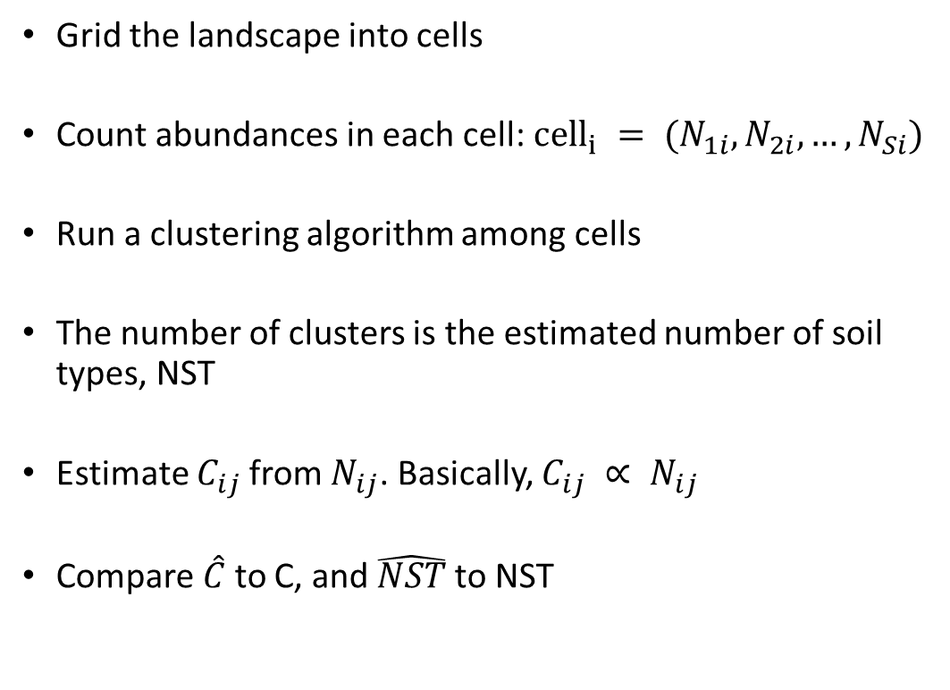
Approach
Grid the landscape into cells
Count abundances in each cell: $cell_{i} = (N_{1i}, N_{2i}, …, N_{Si})$
Run a clustering algorithm among cells
The number of clusters is the estimated number of soil types, NST
Estimate $C_{ij}$from $N_{ij}$. Basically, $C_{ij} ∝ N_{ij}$
Compare $\hat{C}$to C, and $\hat{NST}$to NST

Slide 6
Accuracy increases with the envt grain-to-cell size ratio
Smaller cells relative to environment grain is better

Slide 7
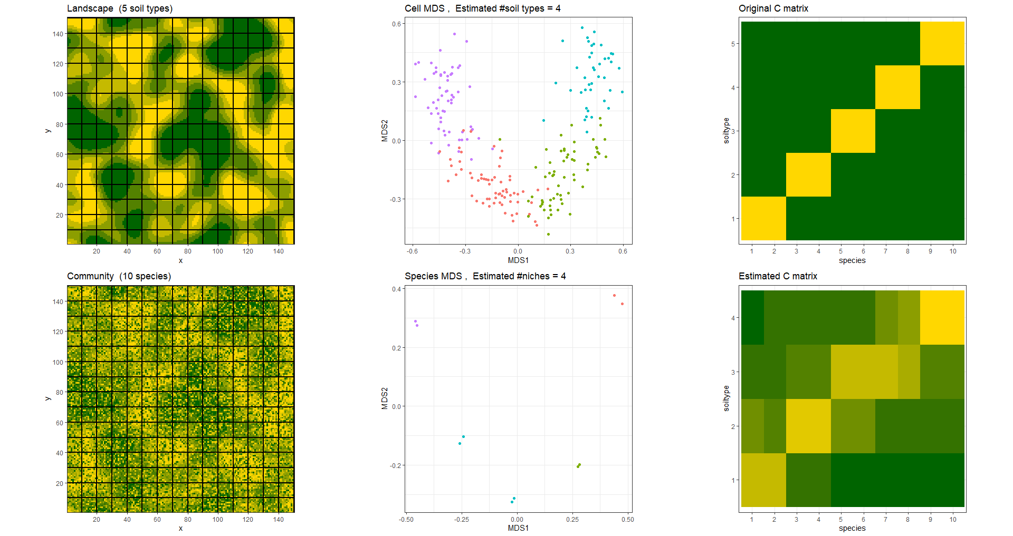
22.5k sites
225 cells
5 soil types
10 species

Slide 8
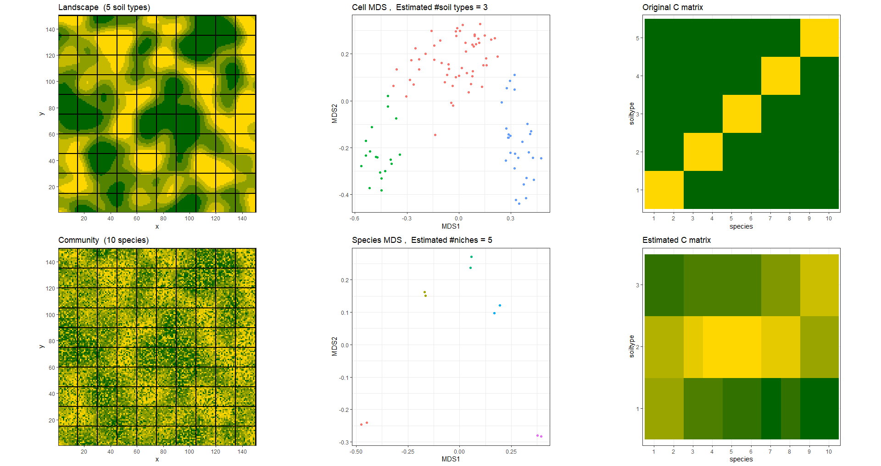
22.5k sites
100 cells
5 soil types
10 species

Slide 9
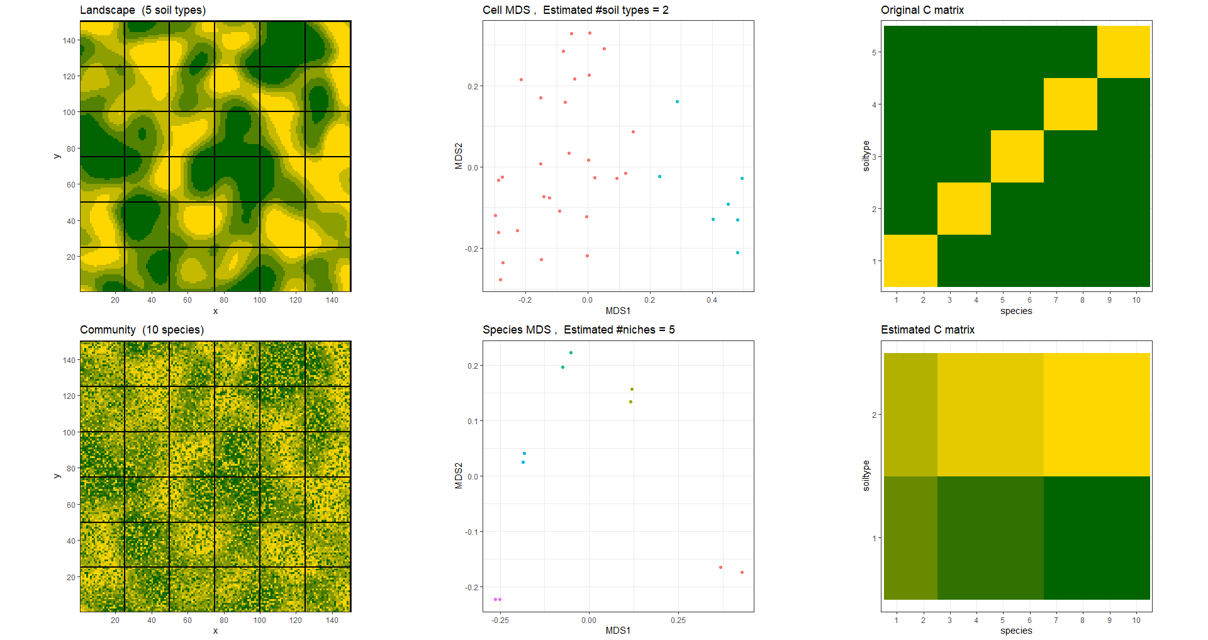
22.5k sites
25 cells
5 soil types
10 species

Slide 10
Accuracy decreases with the number of soil types and/or species
More soil types or more species is worse

Slide 11
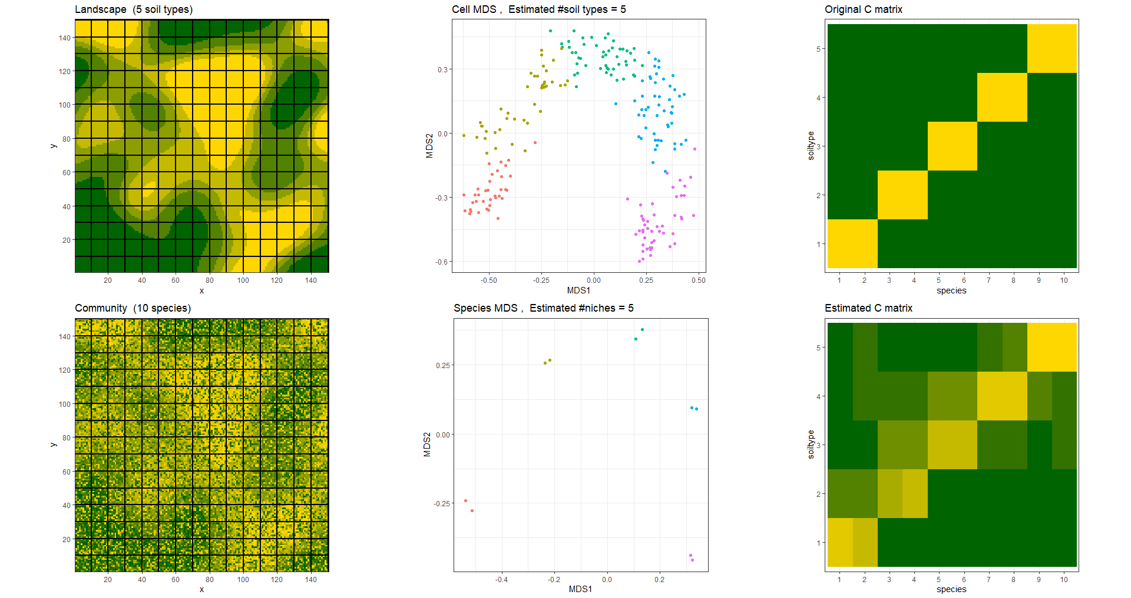
22.5k sites
225 cells
5 soil types
10 species

Slide 12
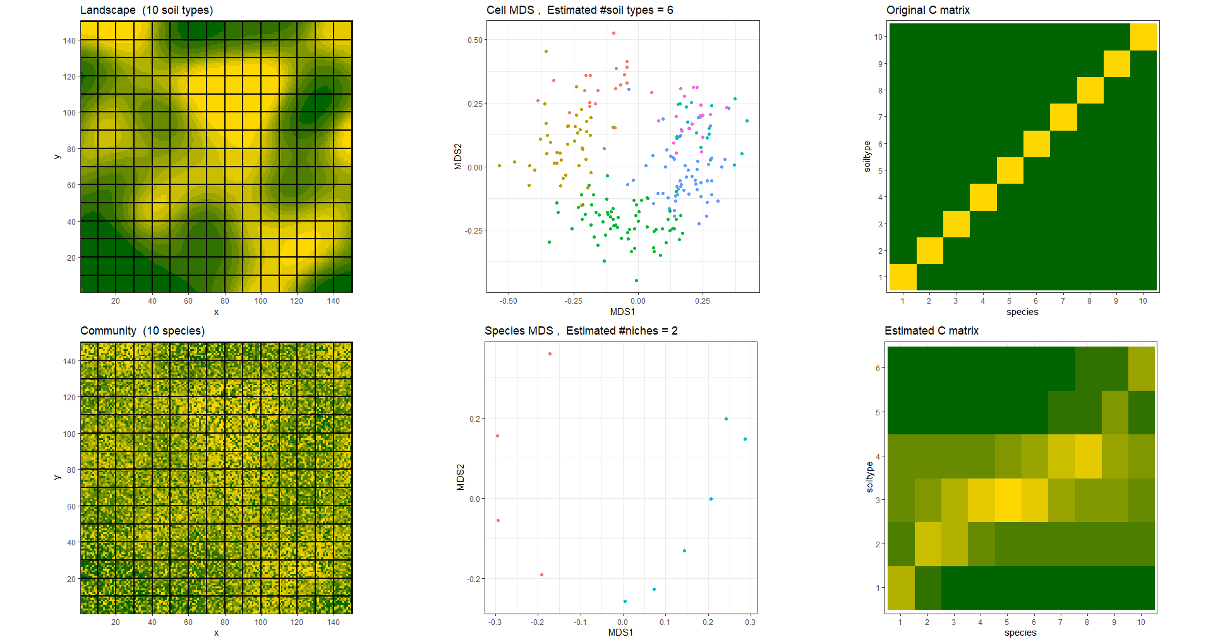
22.5k sites
225 cells
10 soil types
10 species

Slide 13
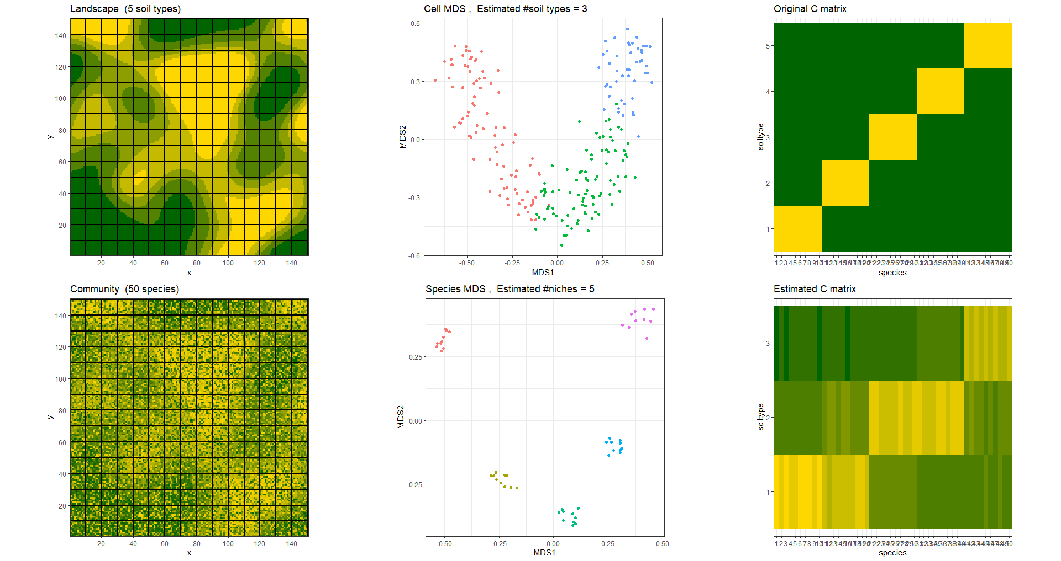
22.5k sites
225 cells
5 soil types
50 species

Slide 14
Looking for the best clustering algorithm
In multidimensional space

Slide 15
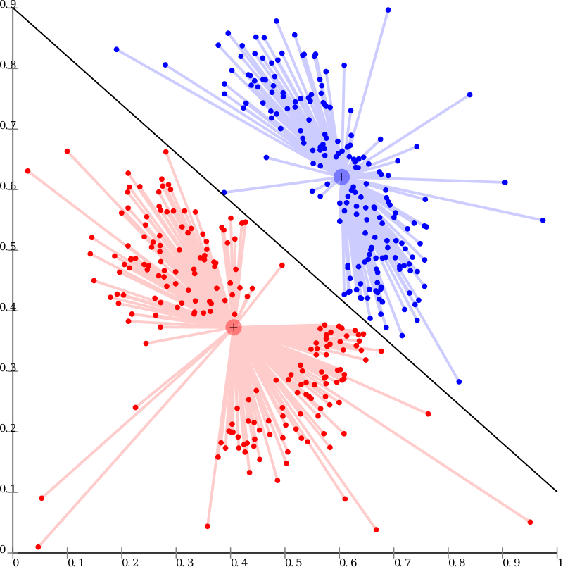
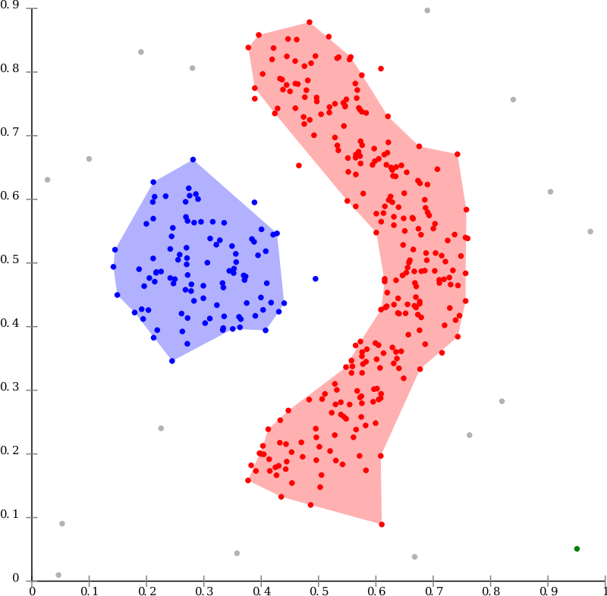
Centroid-based clustering algorithm
e.g. PAM
Density-based clustering algorithm
e.g. DBSCAN

Slide 16
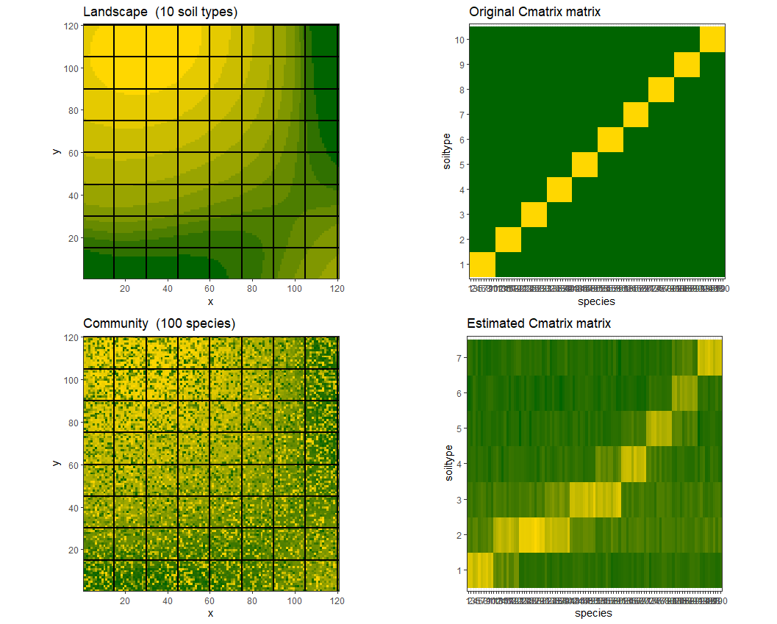
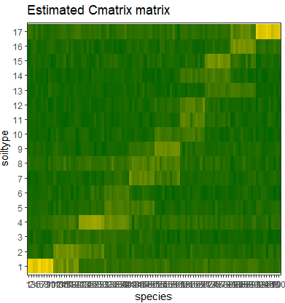
PAM = partitioning around medoids
DBSCAN = Density-based spatial clustering of applications with noise
PAM
DBSCAN

Slide 17
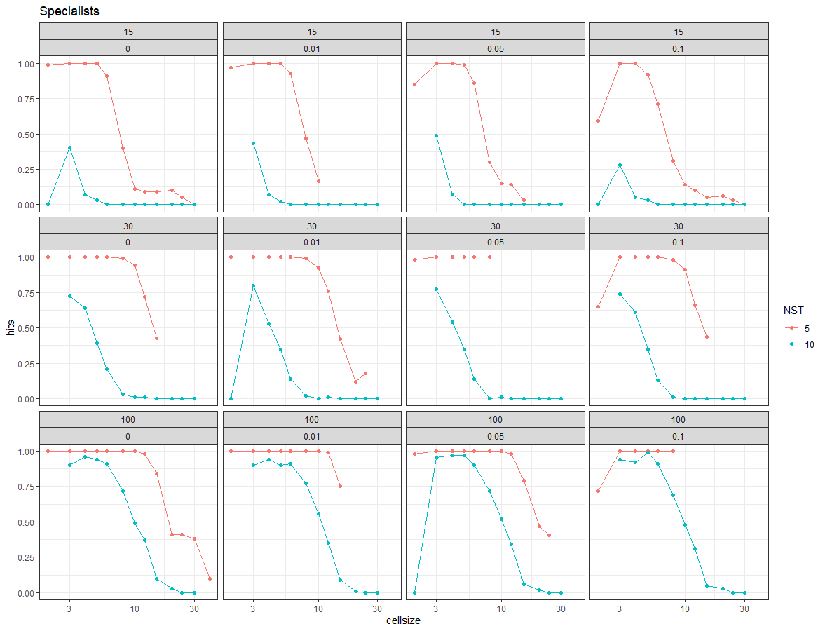
PAM

Slide 18
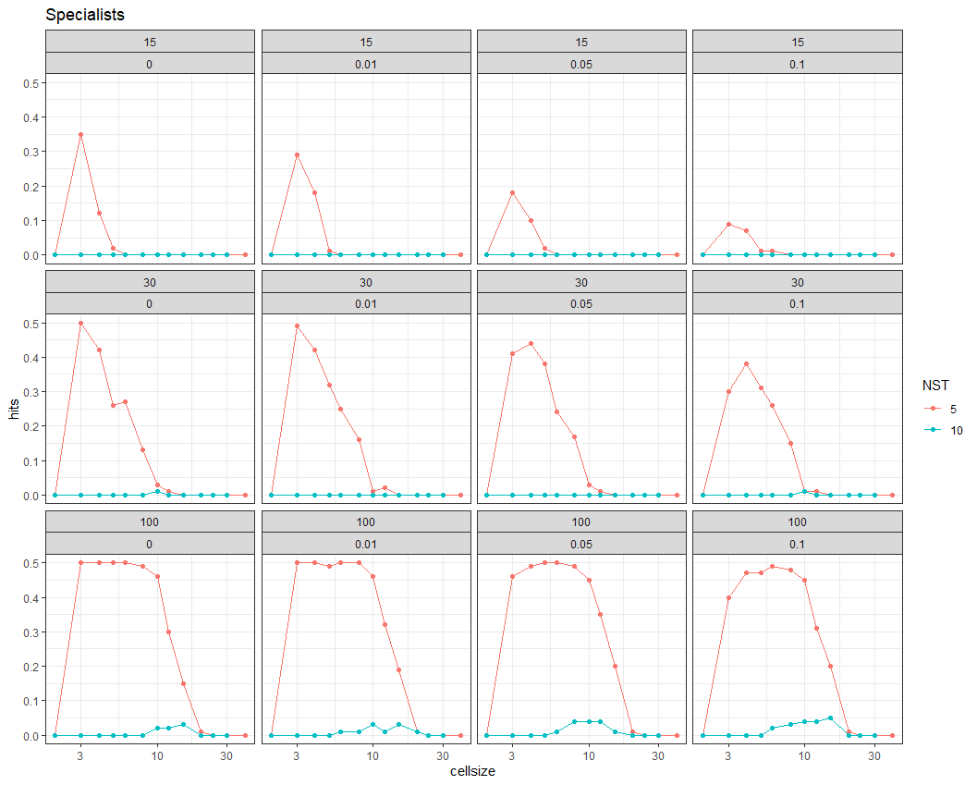
DBSCAN

