Slide 1
t-sne and NMDS

Slide 2
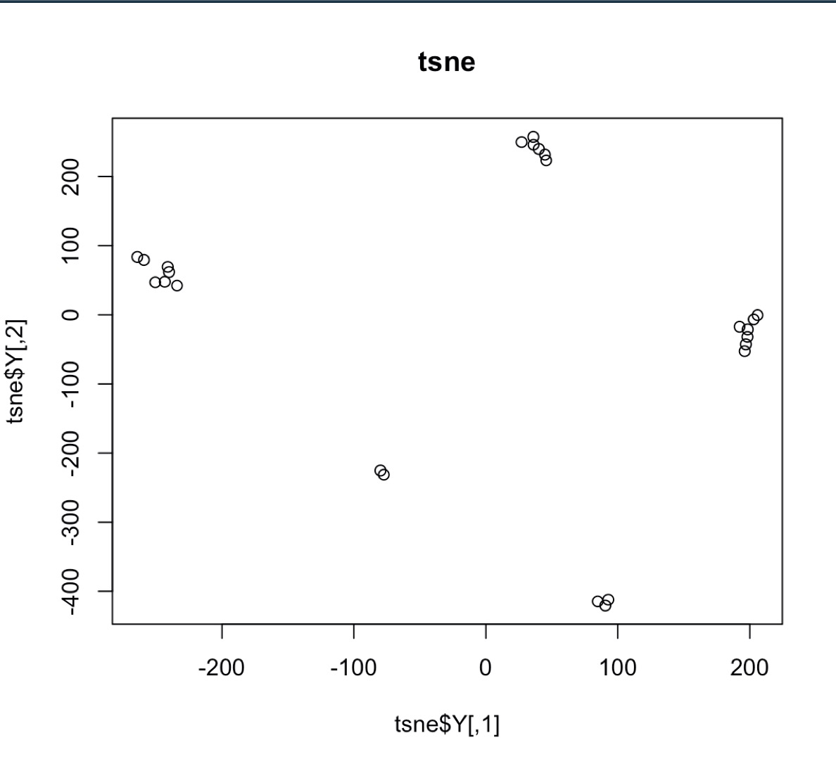
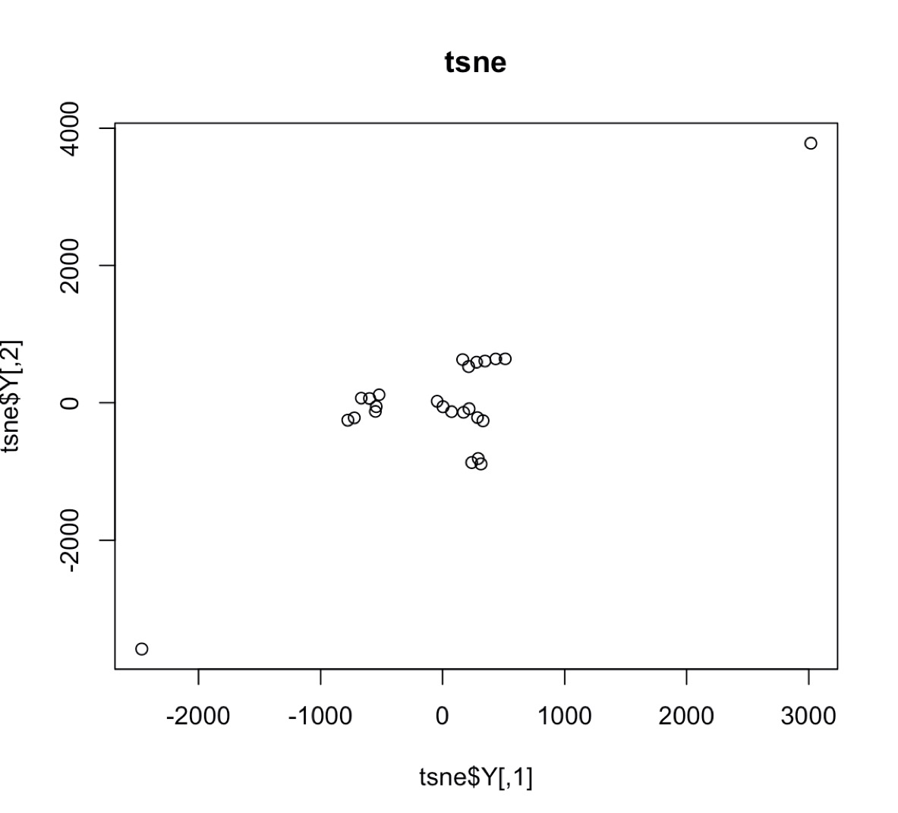
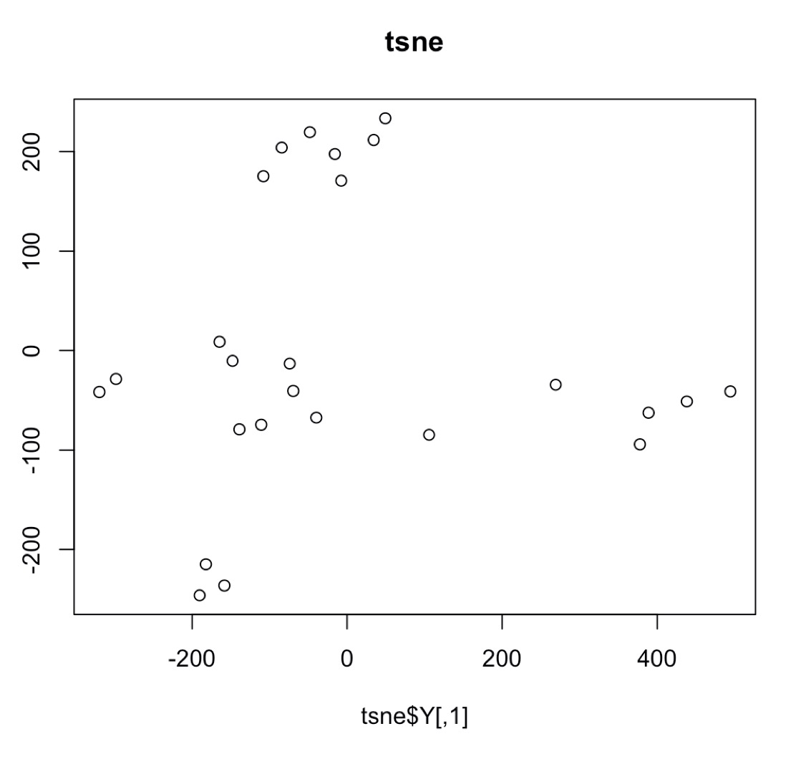
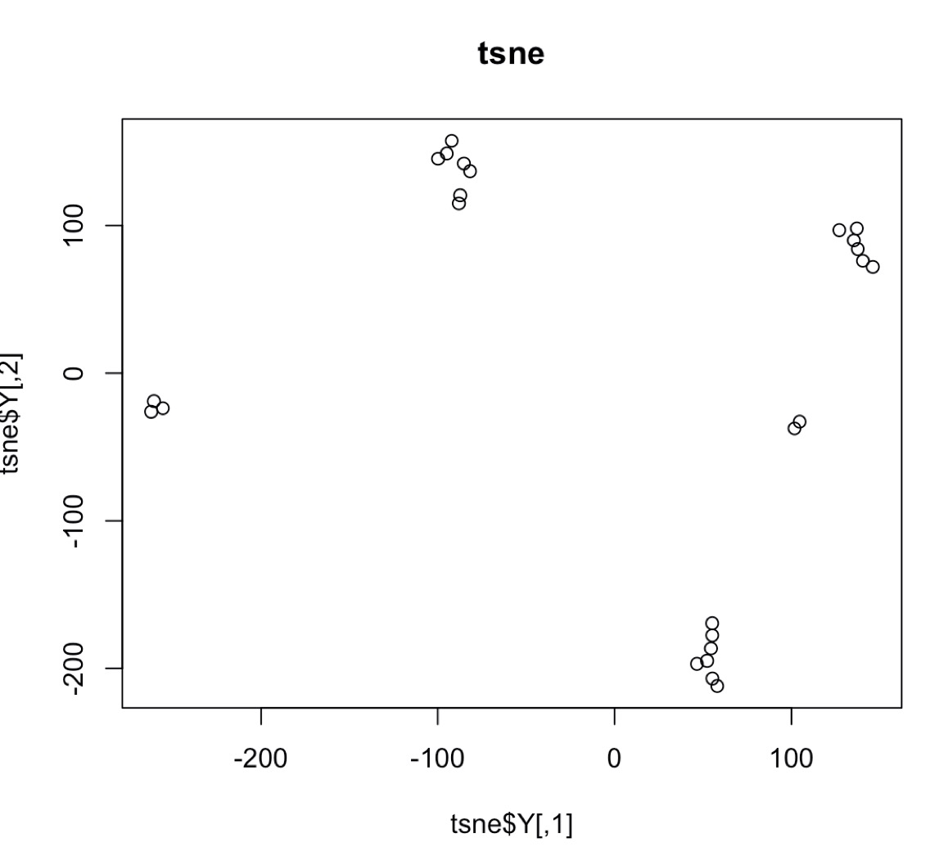
T-sne projection results differ from each iteration
Cells=25, S=10, NST =5, dims = 2, perplexity = 2, it = 5000
Also cannot go beyond 3D

Slide 3

Tunable parameter “Perplexity” balance local and global aspects. Tsne is sensitive to parameters. We wouldn’t have this a priori
Taken from: https://distill.pub/2016/misread-tsne/

Slide 4
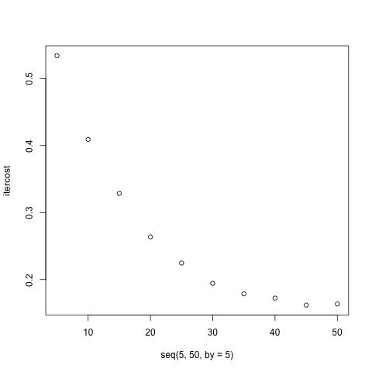
KL-divergence vs. Perplexity

Slide 5
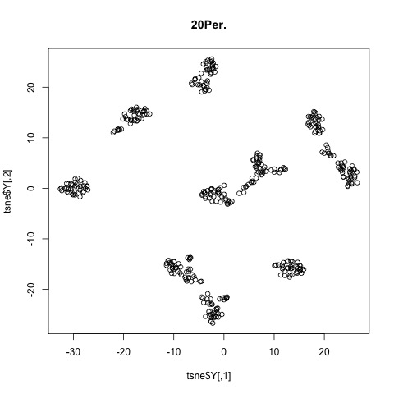
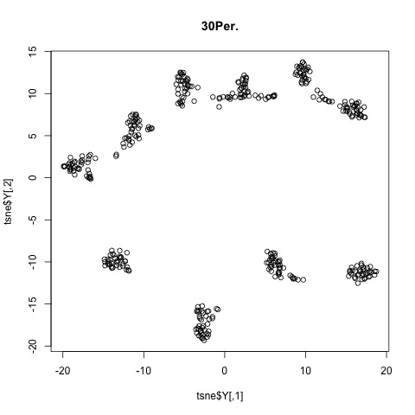
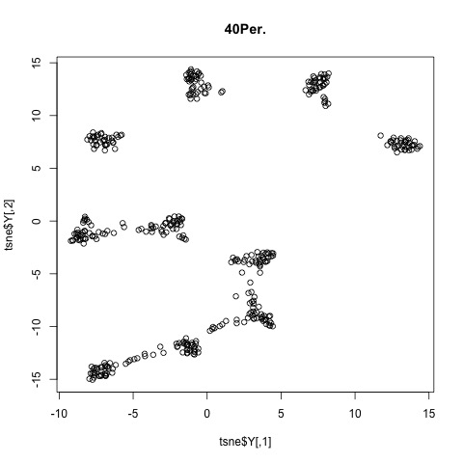
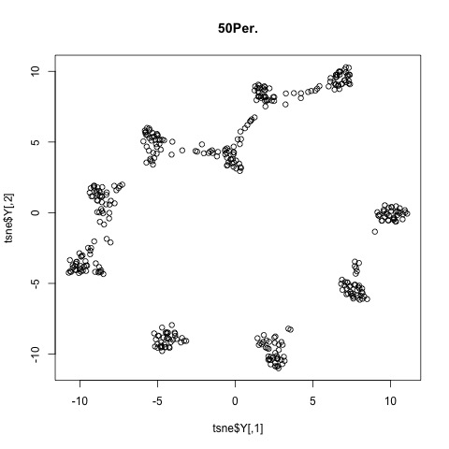

Slide 6
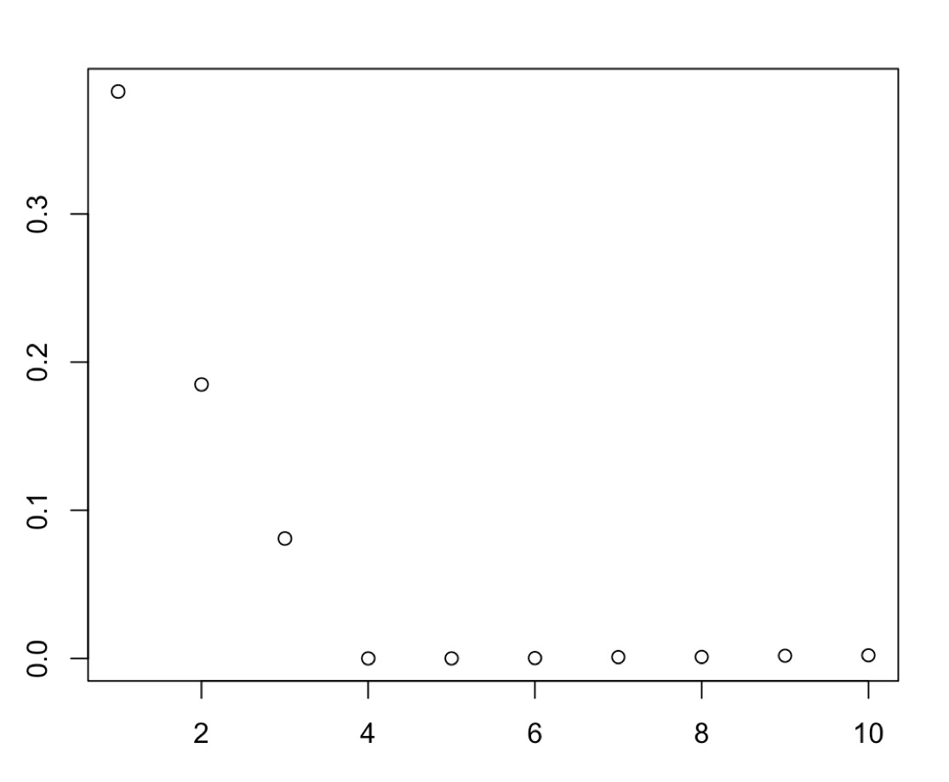
NMDS stress vs. dimension
stress < 0.05 provides an excellent representation in reduced dimensions
< 0.1 is great
< 0.2 is okay
< 0.3 provides a poor representation.
Cells=25, S=10, NST =5

Slide 7
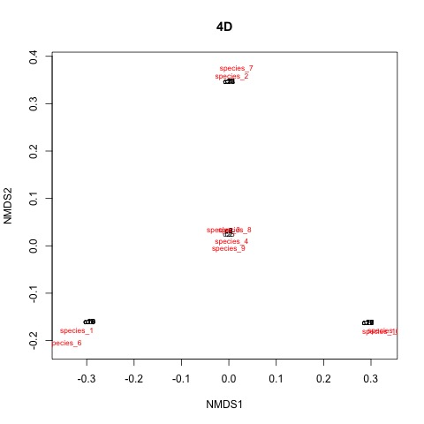


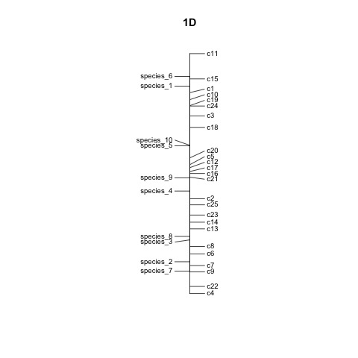
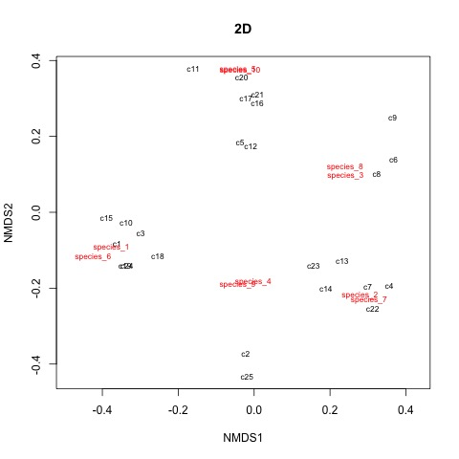
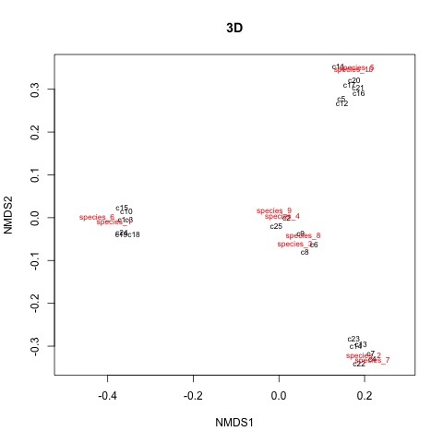

Slide 8
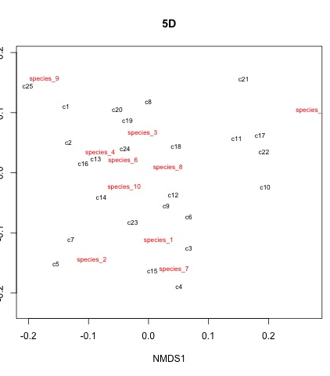
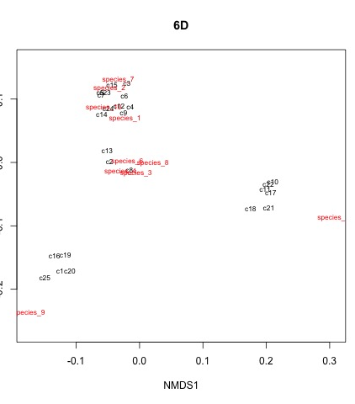
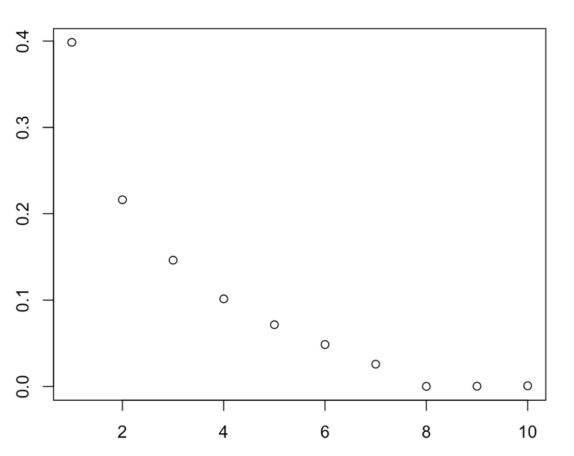
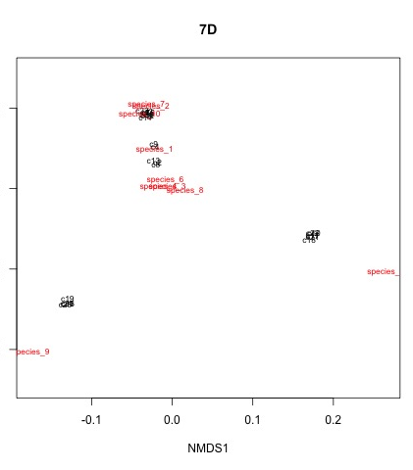
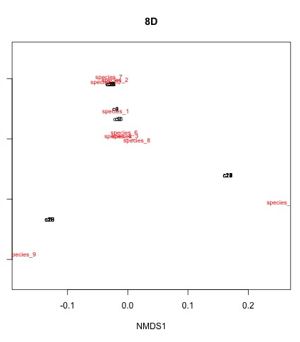

Cells=25, S=10, NST =5

