Slide 1
Project: Effects of soil-borne resources on the structure and dynamics of lowland tropical forests
Principal Investigators:
James Dalling Dept. of Plant Biology, 505 S Goodwin Ave. University of Illinois, Urbana, IL 61801, USA dallingj@life.uiuc.edu | Kyle Harms Dept. of Biological Sciences, Louisiana State University, 202 Life Sciences Bldg., Baton Rouge, LA 70803, USA kharms@lsu.edu | Joseph Yavitt Dept. of Natural Resources, 16 Fernow Hall, Cornell University, Ithaca, NY 14853, USA jby1@cornell.edu | Robert Stallard U.S. Geological Survey-WRD, 3215 Marine Street, Boulder, CO 80303, USA stallard@colorado.edu
Post-doctoral Associate:
Collaborating Colleague (Colombia sub-project):
Robert John-Chandran Dept. of Plant Biology, 505 S Goodwin Ave. University of Illinois, Urbana, IL 61801, USA robertjc@life.uiuc.edu
Martha Isabel Vallejo Instituto Alexander von Humboldt Bogota, Colombia mvallejo@humboldt.org.co

Slide 2
Data sharing policy:
Collection and analyses of these soils data has been made possible by the combined efforts of many collaborating researchers and with funding provided by the National Science Foundation (DEB - 0212828), STRI and CTFS.

Slide 3
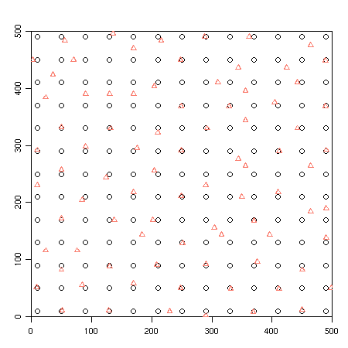
Sample locations:
Figure: A total of 253 locations were sampled. Circles represent base points. Over half the number of these base
points was paired with a sample point at a distance of 2m, 8m, or 20m (Triangles).

Slide 4
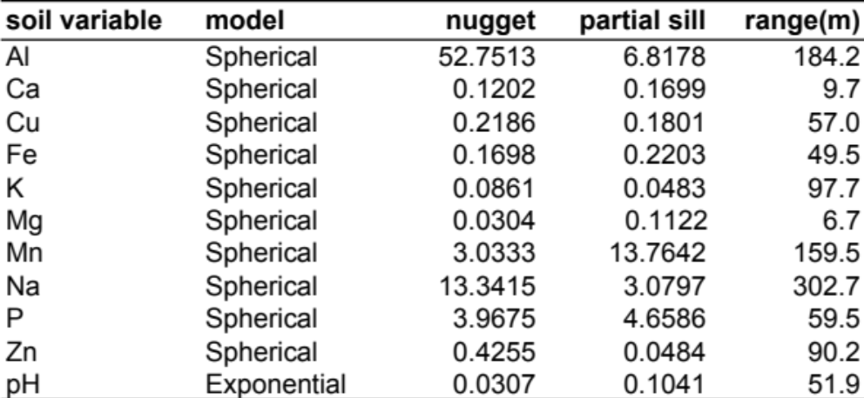
The following slides contain contour maps of soil nutrient distributions in the La Planada 25-ha plot. In
each slide the map in the left panel is a contour map plotted using measured data, while the map in the right panel was plotted using block estimates for 20m X 20m quadrats. Block estimates were obtained by Universal Kriging using fitted variogram models.
Soil nutrient concentrations are in mg/kg of dry soil.
Table. Variogram model fit parameters. The data values were first transformed using Box-Cox transformation,
and then a trend surface polynomial regression fitted. The residuals from the trend surface regression were used to compute empirical variograms, to which variogram models were fitted.

Slide 5
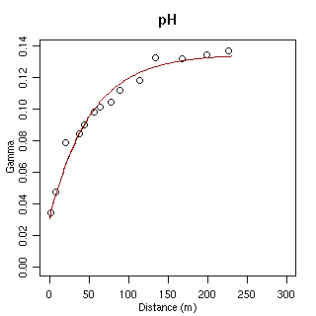
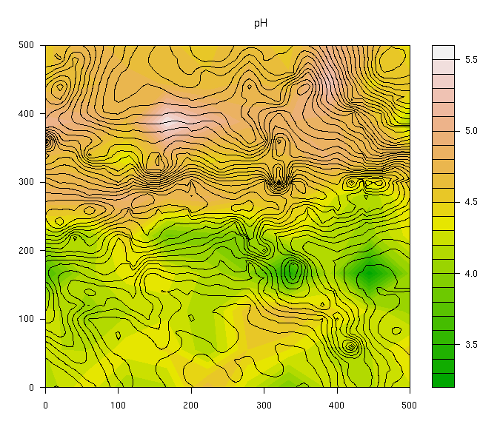
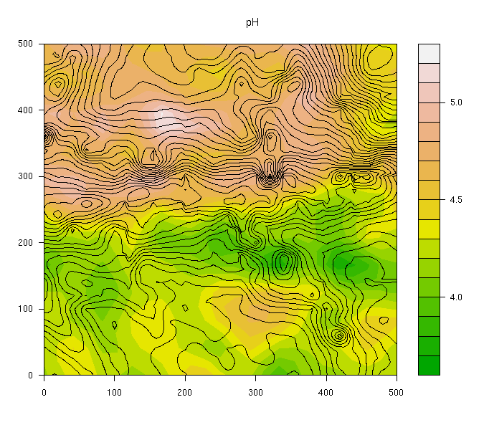
pH:

Slide 6
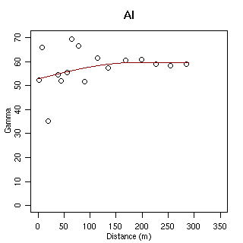
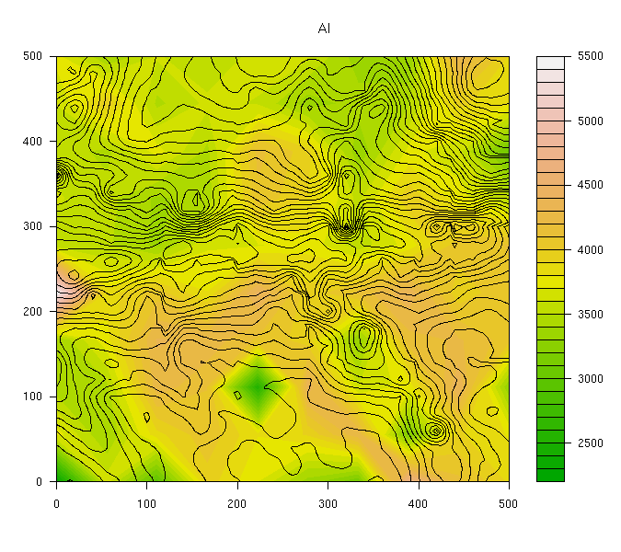
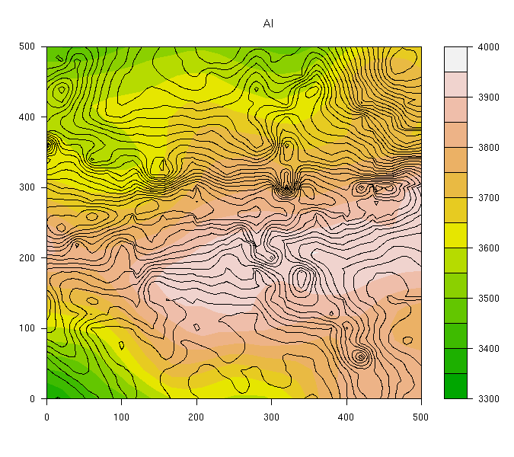
Aluminum:

Slide 7
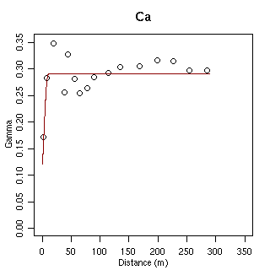
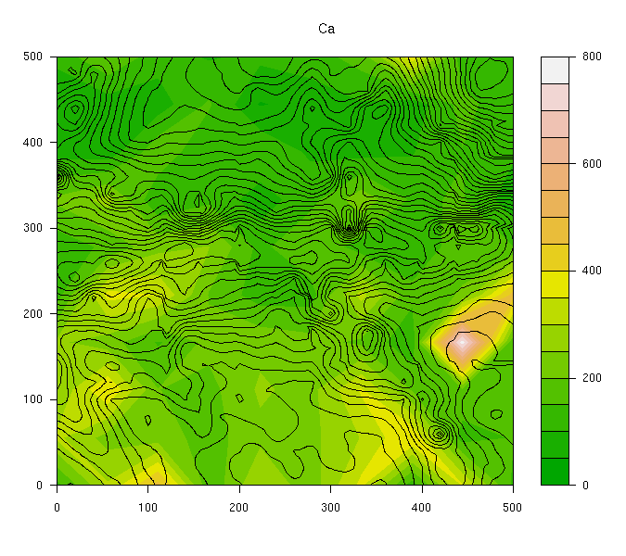
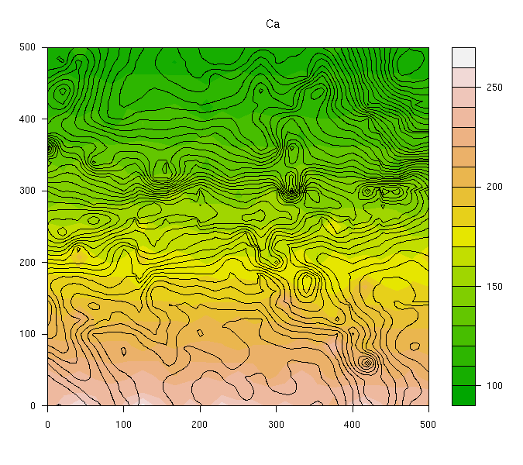
Calcium:

Slide 8
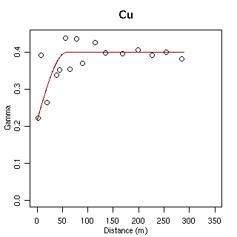
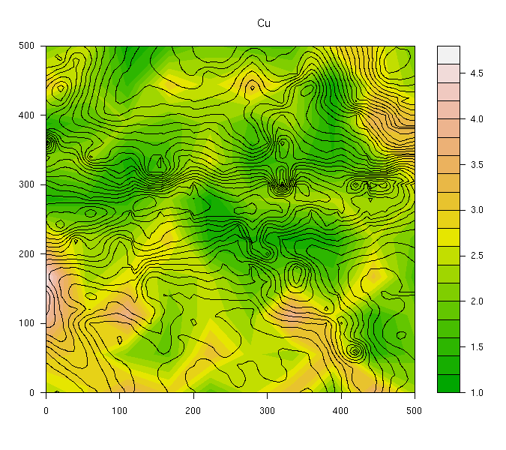
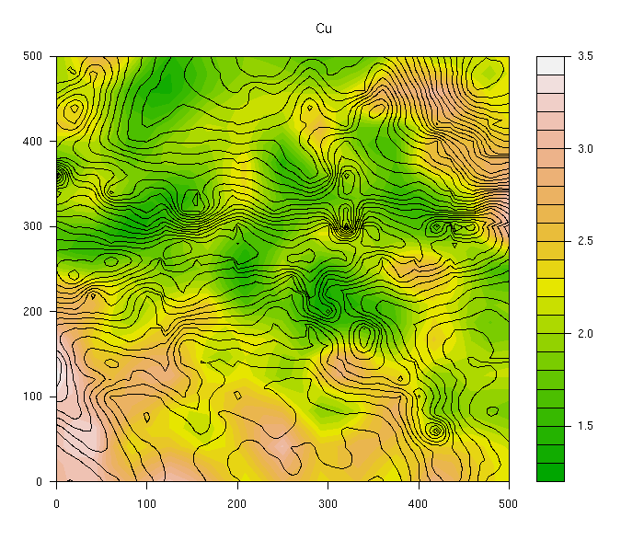
Copper:

Slide 9
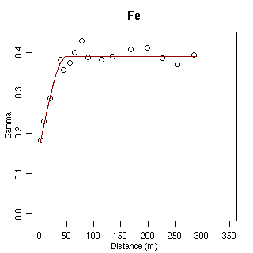
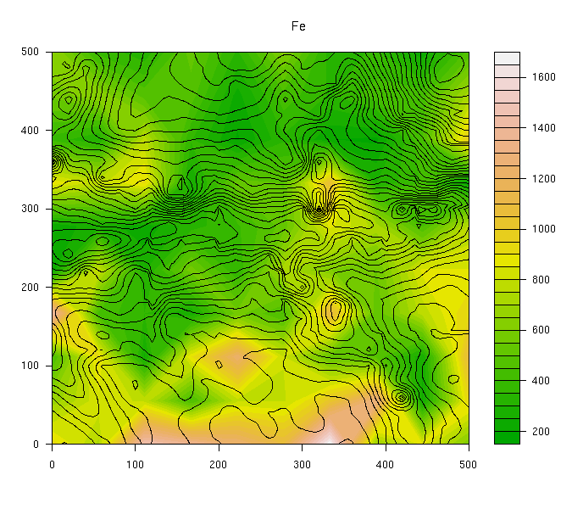
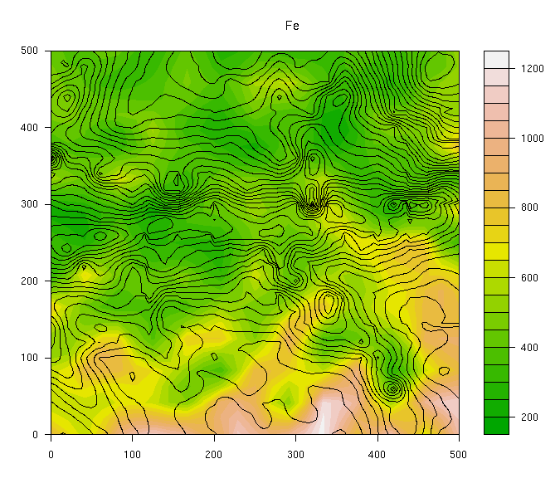
Iron:

Slide 10

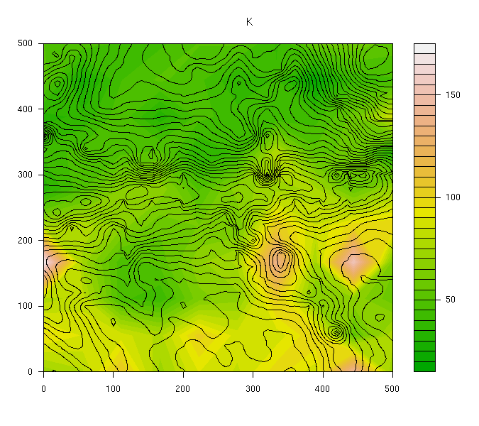
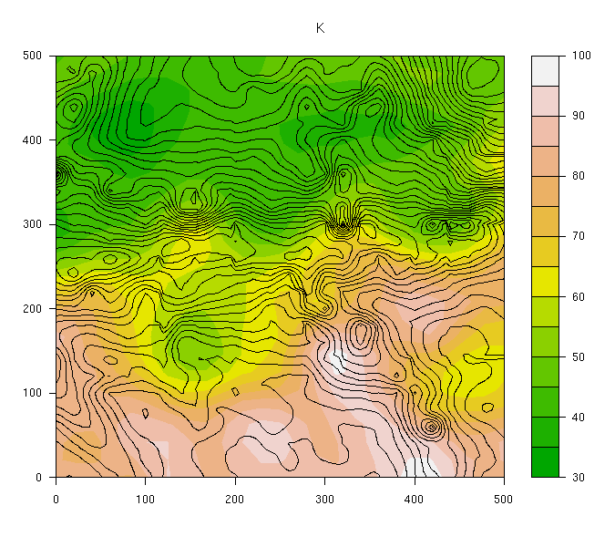
Potassium:

Slide 11
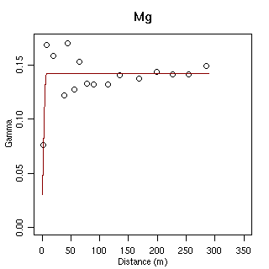
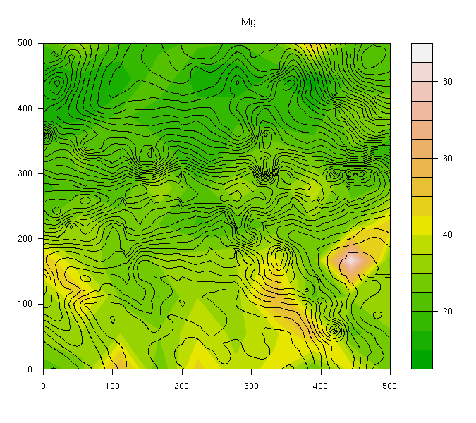
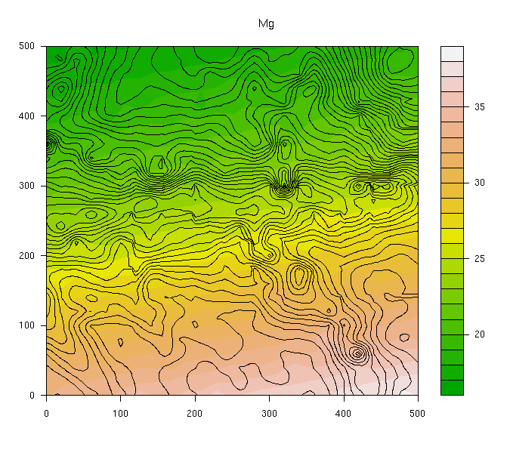
Magnesium:

Slide 12
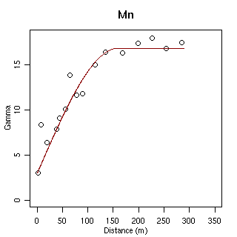
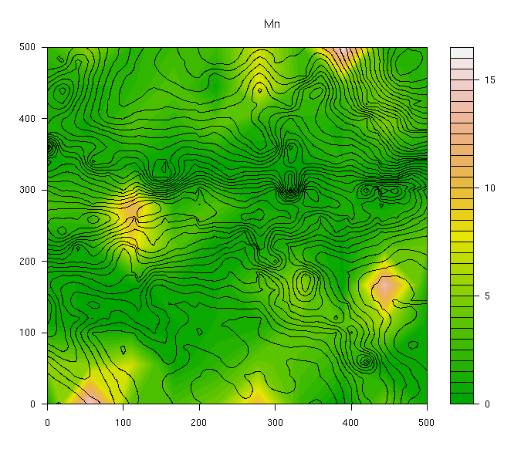
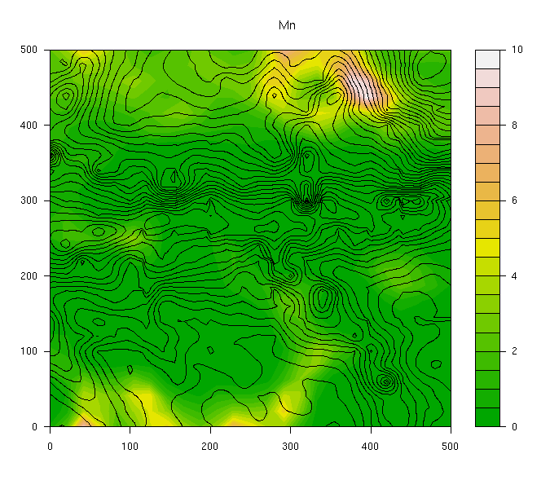
Manganese:

Slide 13
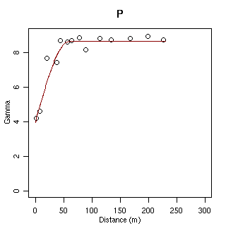
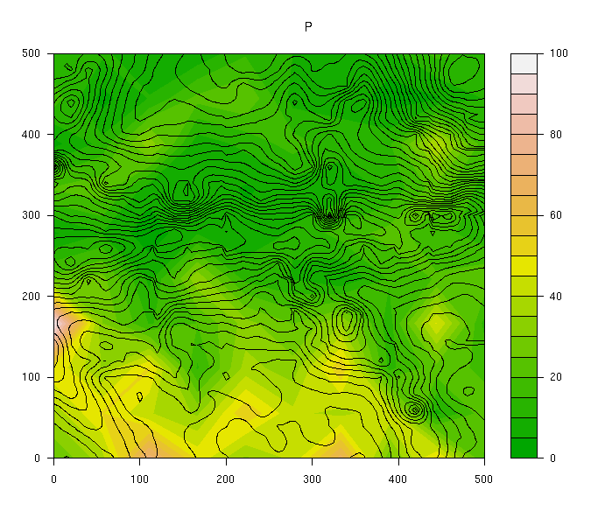
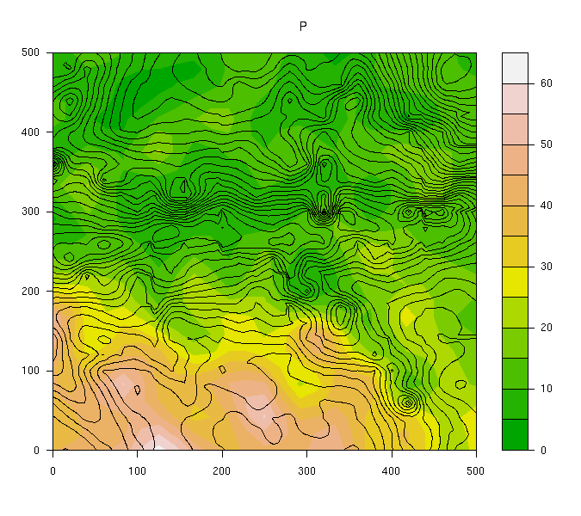
Phosphorus:

Slide 14
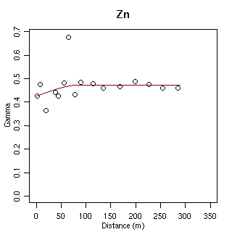
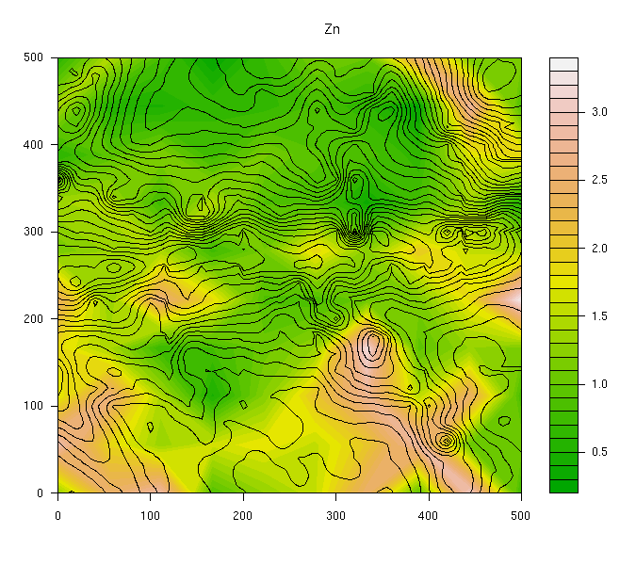
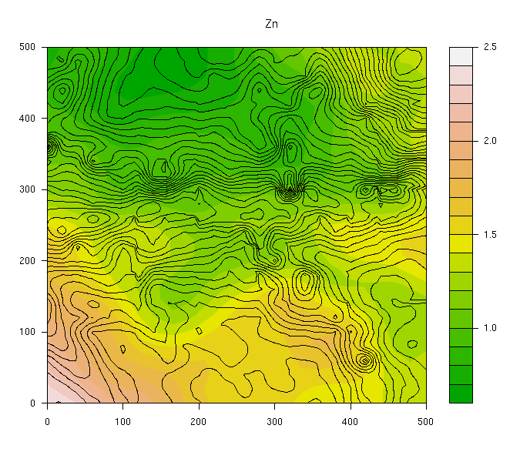
Zinc:

