Slide 1
Project: Effects of soil-borne resources on the structure and dynamics of lowland tropical forests
Principal Investigators:
James Dalling Dept. of Plant Biology, 505 S Goodwin Ave. University of Illinois, Urbana, IL 61801, USA dallingj@life.uiuc.edu | Kyle Harms Dept. of Biological Sciences, Louisiana State University, 202 Life Sciences Bldg., Baton Rouge, LA 70803, USA kharms@lsu.edu | Joseph Yavitt Dept. of Natural Resources, 16 Fernow Hall, Cornell University, Ithaca, NY 14853, USA jby1@cornell.edu | Robert Stallard U.S. Geological Survey-WRD, 3215 Marine Street, Boulder, CO 80303, USA stallard@colorado.edu
Post-doctoral Associate:
Collaborating Colleague (Ecuador sub-project):
Robert John-Chandran Dept. of Plant Biology, 505 S Goodwin Ave. University of Illinois, Urbana, IL 61801, USA robertjc@life.uiuc.edu
Renato Valencia Pontifica Universidad Católica del Ecuador Quito, Ecuador lrvalencia@puce.edu.ec
Hugo Navarrete Pontifica Universidad Católica del Ecuador Quito, Ecuador hnavarrete@puce.edu.ec

Slide 2
Data sharing policy:
Collection and analyses of these soils data has been made possible by the combined efforts of many collaborating researchers and with funding provided by the National Science Foundation (DEB - 0212828), STRI and CTFS.
These are currently unpublished data. At present, access to these data can only be given with the approval of project principal investigators and collaborating colleagues. Please do not distribute these data.
All requests for access to these data should be made directly to Jim Dalling (dallingj@life.uiuc.edu). Please also check with Jim periodically for updated versions of these files.

Slide 3
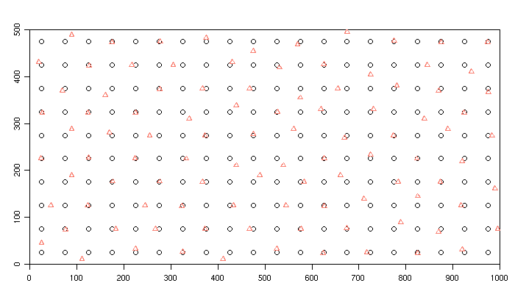
Sample locations:
Figure: A total of 300 locations were sampled. Circles represent base points which form a regular grid
with one sample point in every 50m X 50m quadrat. Every other of these base points was paired
with a sample point at a distance of 2m, 8m, or 20m (Triangles).

Slide 4
The following slides contain contour maps of soil nutrient distributions in the Yasuni 50-ha plot. In
each slide the map in the upper panel is a contour map plotted using measured data, while the map in the lower panel was plotted using block estimates for 20m X 20m quadrats. Block estimates were obtained by Universal Kriging using fitted variogram models.
Soil nutrient concentrations are in mg/kg of dry soil.
Table. Variogram model fit parameters. The data values were first transformed using Box-Cox transformation,
and then a trend surface polynomial regression fitted. The residuals from the trend surface regression were used to compute empirical variograms, to which variogram models were fitted.

Slide 5
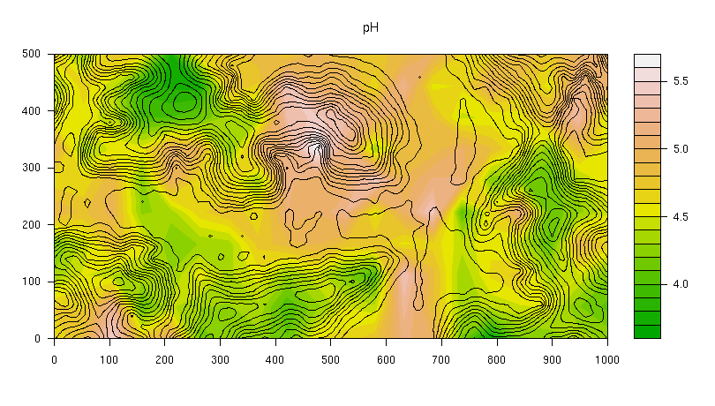
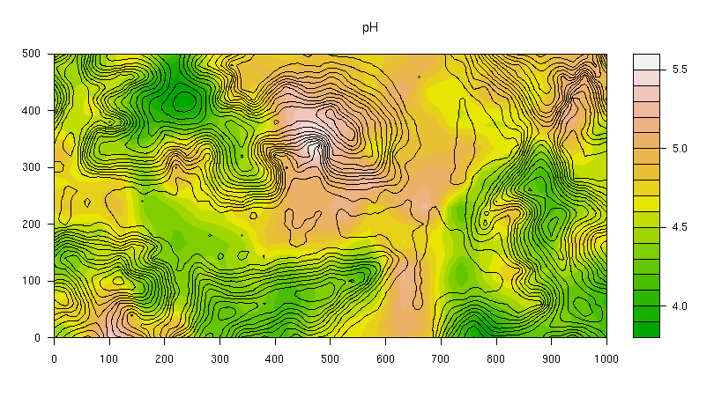
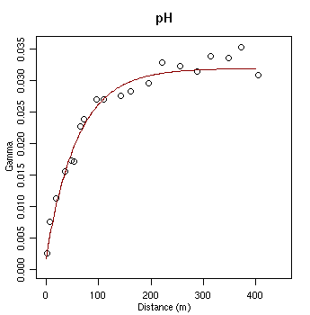
pH:

Slide 6
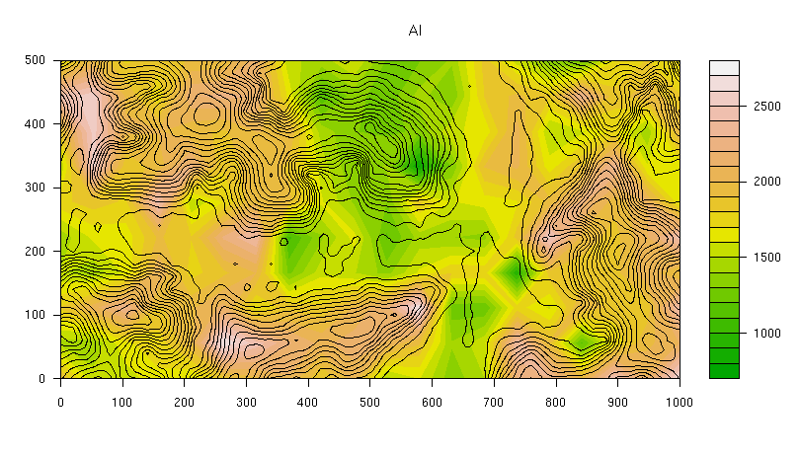
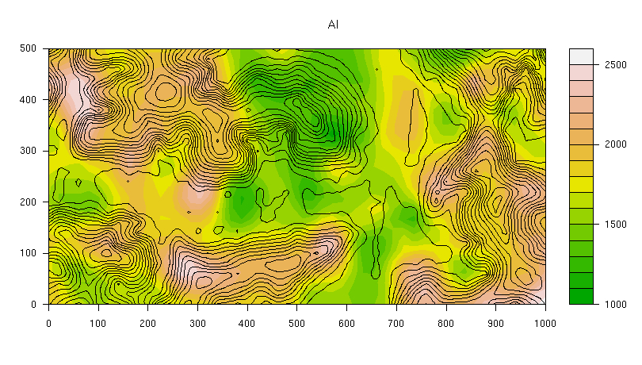
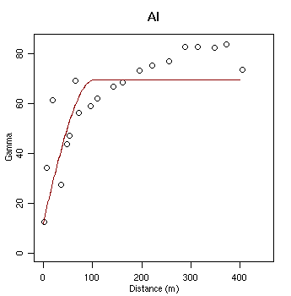
Aluminum:

Slide 7
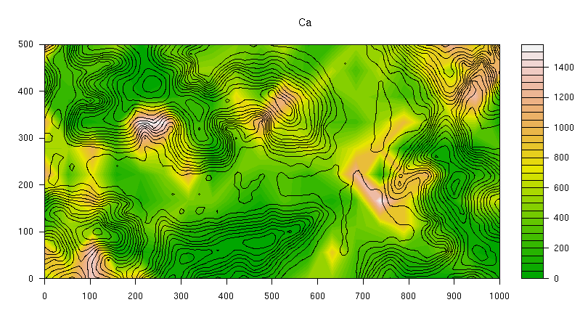
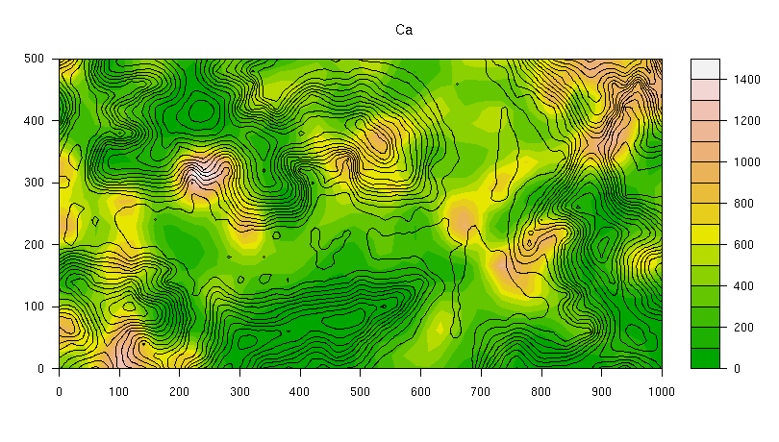
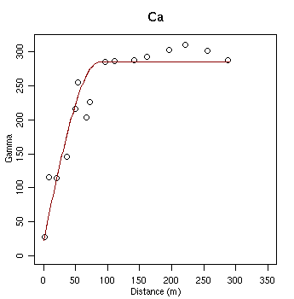
Calcium:

Slide 8
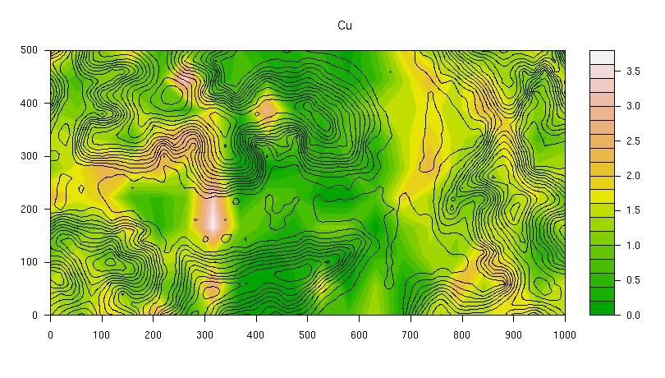
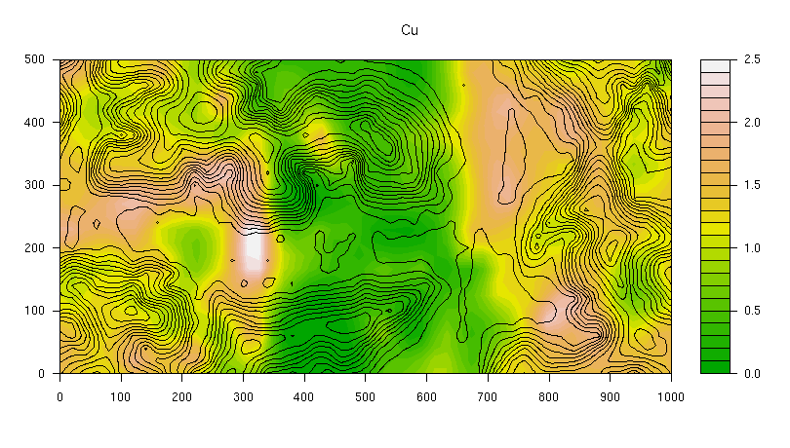
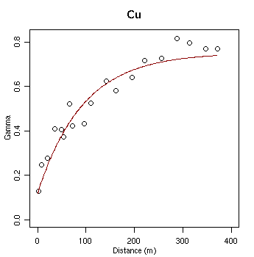
Copper:

Slide 9
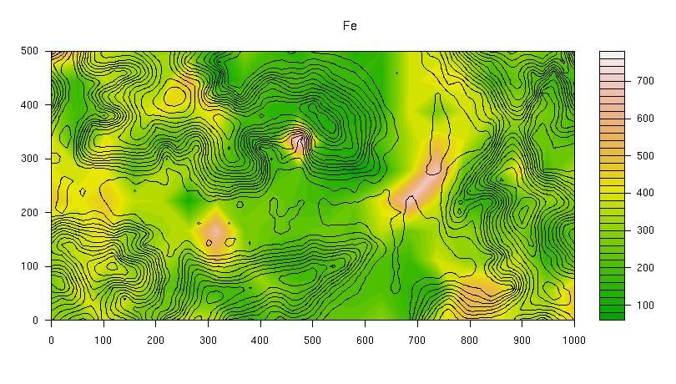
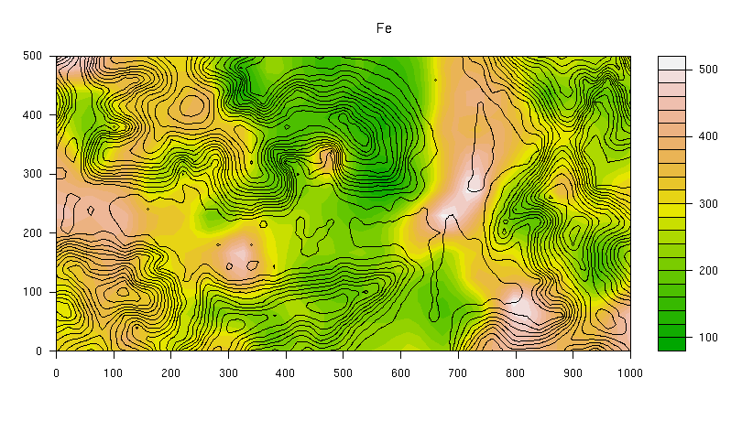
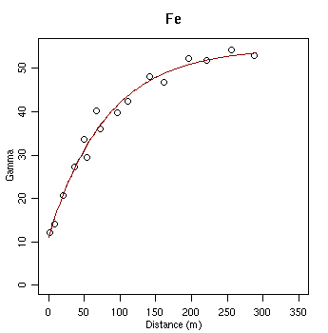
Iron:

Slide 10
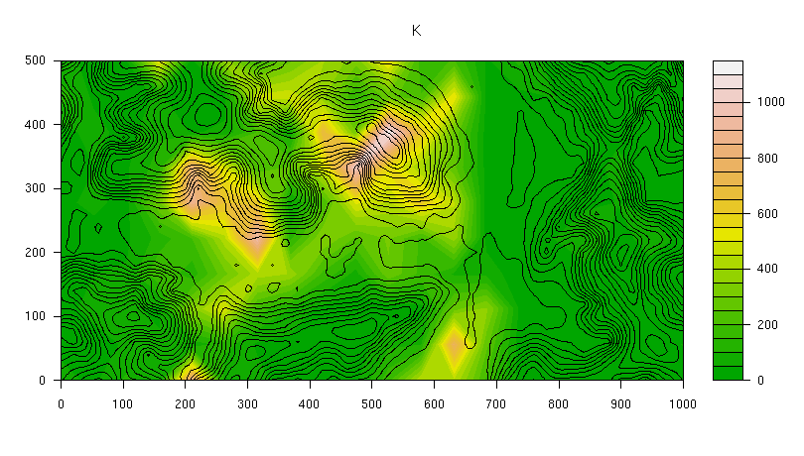
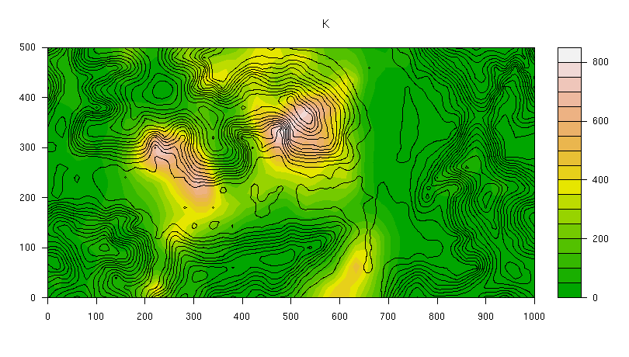
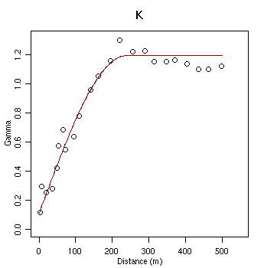
Potassium:

Slide 11
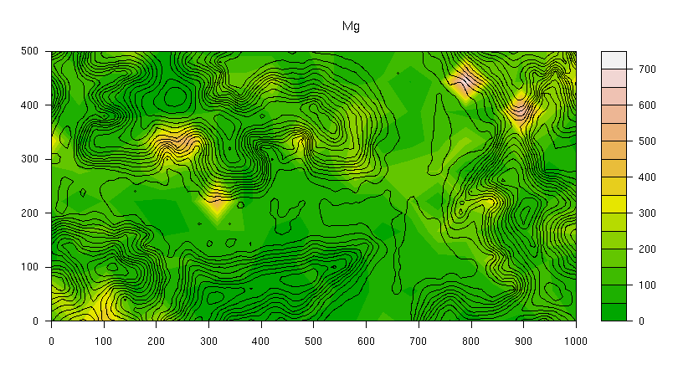
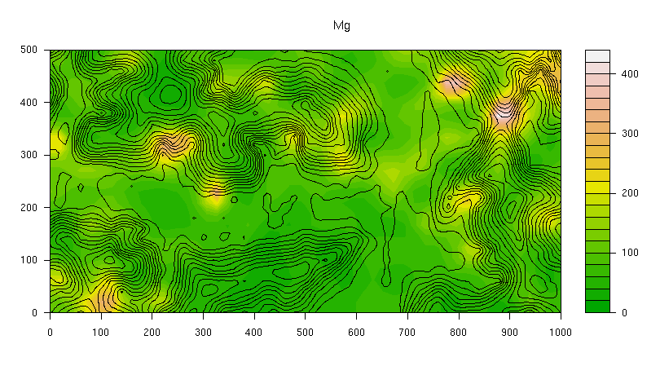
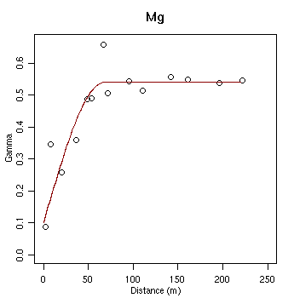
Magnesium:

Slide 12
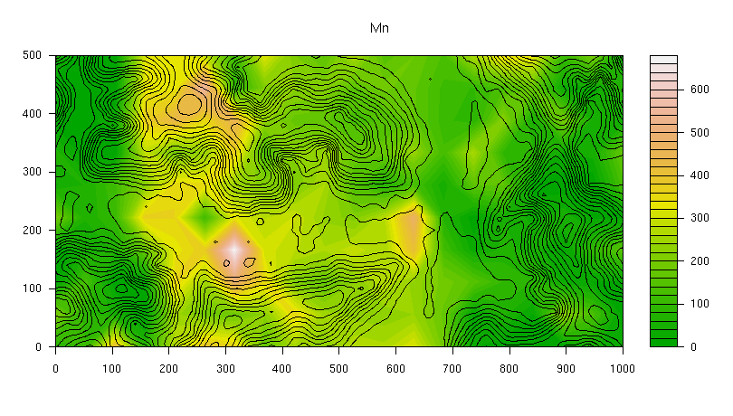
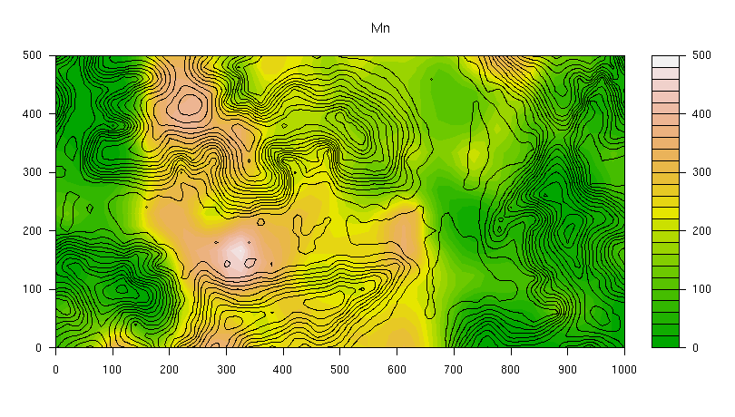
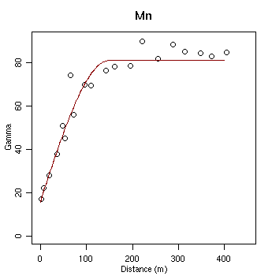
Manganese:

Slide 13
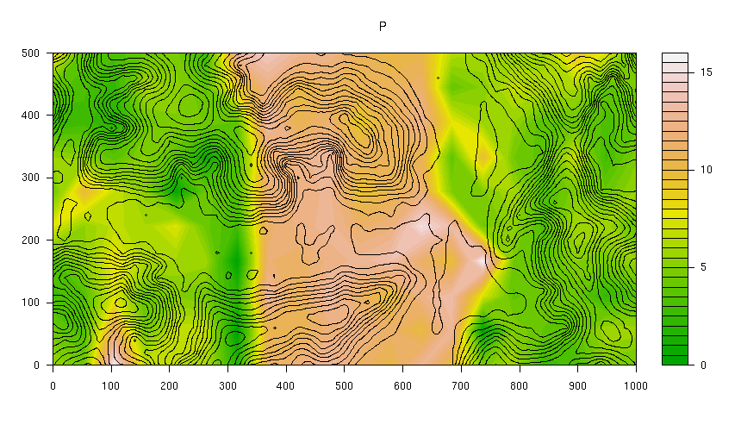
Phosphorus:

Slide 14
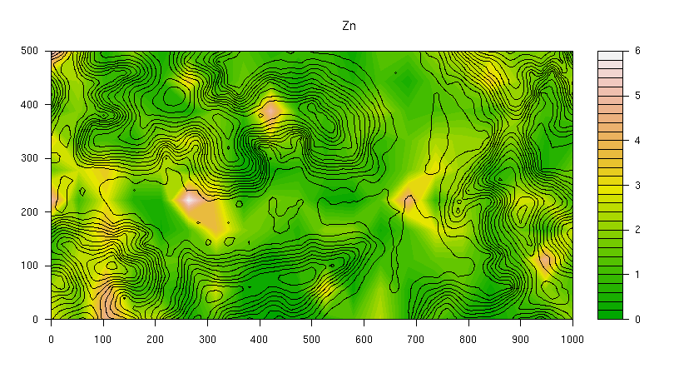
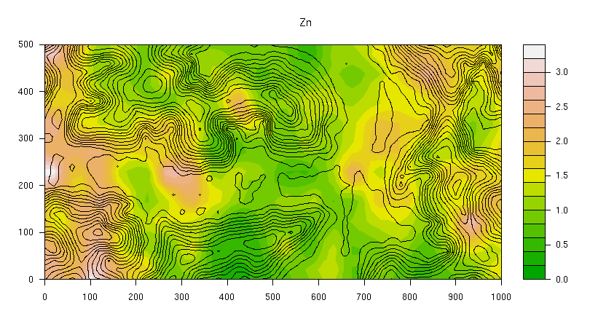
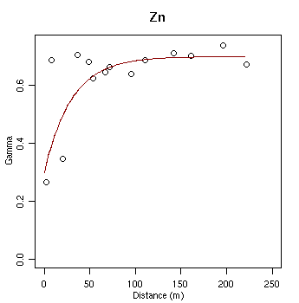
Zinc:

