Slide 1

Business
Intelligence
DataMarts
A importância de um Escopo
bem definido...
Notes:
Cognos presents business intelligence for the data warehouse.
Throughout this presentation we’ll introduce you to our unique approach to the data warehouse -- an approach that benefits both users and IS. And we will show you how to deliver a fast return on your warehouse investment with our proven solution, The 24 Ways.

Slide 2
Um breve Histórico
Distribuição de Software
1989
Informações Gerenciais
Data Mart
Data Warehousing
Consultoria e Treinamento

Slide 3
O Desafio
Necessidade imediata da informação;
Dados em bases corporativas, planilhas, etc...;
Várias pessoas envolvidas;

Slide 4
O Processo Decisório
Geração de arquivos texto;
Digitação em planilhas;
Formatação de relatórios;
Muitas horas de trabalho;
Planilhas Excel

Slide 5
Business Intelligence
Business intelligence é um processo que disponibiliza o conjunto de aplicativo para relatórios e análise multidimensional;
Disponibiliza informações no contexto do negócio;
Utilizado por todos os profissionais da Empresa;
Warehouse armazena/mantem os dados;
Warehouse
Data mart
Business
Intelligence
Consolidação,
Limpeza,
Modelagem
Dados Operacionais
Dados na visão do Negócio
Notes:
While the warehouse is an excellent place to store and manage data assets if not one can access them it isn’t very useful. It doesn’t deliver any value to the organization until users can actually report and analyze the data in it. It takes Cognos business intelligence tools to let user do this. The present data in a business context (not how the data is organized in the warehouse) to the end user so they can do reporting and analysis they way that they want. And because Cognos tools allow reporting and analysis to be deployed over the Web it is accessible to every user in the organization.

Slide 6
A visão da Uniplace para Business Intelligence
Warehouse
(Base Relacional)
Data Marts
(Base Multidimensional)
Notes:
So basically in order to deliver the complete value from the warehouse, the warehouse equals relational and OLAP data. This will enable the delivery of the reporting and analysis that all of your users need. The relational data for reporting is in the relational database and from this data, PowerPlay will create the OLAP structure called a PowerCube for your users to do multidimensional analysis from. And we have the best tools for creating and managing OLAP.

Slide 7
Acesso controlado à Base Relacional
O usuário identifica seu objeto de análise na Base Multidimensional (OLAP) e obtém detalhes na Base Relacional
Estabelece as regras de Acesso
  filtros automáticos;
  visões pré-formatadas;
  limitação quanto ao número de linhas e tabelas do relatório;
Minimiza o tráfego de rede;
Otimiza Recursos;
Analyze-then-Query
Notes:
Now that we’ve seen how easy it is to create PowerCubes with Transformer, let’s take a look at how they streamline warehouse queries.
When users query the database by “drilling through” to detail, PowerPlay passes a filter to Impromptu. Impromptu launches a controlled query to get the details related to the analysis.
With the controlled access with analyze then query PowerPlay automatically creates dimensional filters to pass to the relational database. The most expensive summary queries are handled by OLAP and therefore don’t impact the warehouse. Only the simplest of queries reach the warehouse after they have had a filter applied.
These queries are pre-planned because the reports that users drill through to have already been pre-defined by the administrator. In this way, access to the warehouse is protected. Impromptu’s query governors also limit the rows, columns, and joins that users can access.
And Impromptu’s user class security is maintained so that users only access information from the warehouse that they are supposed to see.
This minimizes uncontrolled query traffic, optimize resources.

Slide 8
Acesso controlado à Base Relacional
1 total
5 regiões
50 estados
500 cidades
500.000 clientes
Fonte : Cognos Inc.

Slide 9
Administração Centralizada
BI Application Servers
Browser ou Cliente/Servidor
Segurança
Administrador
Data marts
and Data Warehouses
Stand Alone
Notes:
You can manage your entire reporting and analysis environment centrally.
We have robust authoring tools (both Impromptu and PowerPlay) that let you create report centrally and deploy them to servers to be accessed. As well, all the administration is done centrally - security with user profiles, modeling of the catalog and dimensionality, governors.
All reporting and analysis is controlled through the server. And with the Web server-based processing means zero client and no software to deploy.
Pull
Cubes are stored in the database to be pulled to the desktop for analysis and status reports (scheduled or not) can be stored on the BI server again to be pulled by users either using a Windows client or the Web. User can also use Impromptu client to do adhoc reporting. User need to be connected to pull this information. However, based on there user profile security they will only see the information they are supposed to.
Push
Reporting and analysis can also be pushed to the desktop where they can be viewed connected or disconnected (mobile). Users can subscribe to reports that will then be pushed to them on a regular basis. They can save these reports and look at them at their leisure even when disconnected. And cubes for analysis can be saved to the PC or emailed so mobile users can do analysis. Again all based on security.
And cubes can be anywhere - in the relational database to be access pulled for analysis, LAN to be pulled, or pushed out by email for mobile users.

Slide 10
Data Marts
$
Custo para disponibilizar a informação
Data Marts
0
100%
abrangência
Notes:
So what do you deliver to user? First, we have identified, with the help of our customers, the right information. That information is what we call the information sweet-spot. Essentially, some of the information you have in your data stores is more important and will have a greater impact on the your bottom line than others. We have identified the ‘sweet-spot’, that piece of information that will have the greatest impact.
As you can see from the graph, we have found that delivering all the information to everyone all of time brought very little extended value past a certain point. Basically, everyone does not need all of the information all of the time. A 100% of data all the time is is hugely expensive and not necessarily a sound investment… because the additional value is usually marginal, at best.
The project that will really make a difference in corporations today is one that delivers the information that will have the greatest impact in the shortest period of time.
As you saw earlier in the presentation we have identified the best practices or sweet spots by department that will let you be successful.

Slide 11
What to Deliver -
The Information Sweet Spot
Value to corporation slows
while costs continue to increase
Value
to
Corporation
Information Sweet-Spot:
Most critical information
to individual responsibility
No data
100%
of data
Amount and Cost of Data Delivery
Notes:
So what do you deliver to user? First, we have identified, with the help of our customers, the right information. That information is what we call the information sweet-spot. Essentially, some of the information you have in your data stores is more important and will have a greater impact on the your bottom line than others. We have identified the ‘sweet-spot’, that piece of information that will have the greatest impact.
As you can see from the graph, we have found that delivering all the information to everyone all of time brought very little extended value past a certain point. Basically, everyone does not need all of the information all of the time. A 100% of data all the time is is hugely expensive and not necessarily a sound investment… because the additional value is usually marginal, at best.
The project that will really make a difference in corporations today is one that delivers the information that will have the greatest impact in the shortest period of time.
As you saw earlier in the presentation we have identified the best practices or sweet spots by department that will let you be successful.

Slide 12
A Disponibilização da Informação
Organização
Departamento
extended enterprise
Valor Agregado da Informação
Individuo
1
2
3
Disponibilização da Informação
Notes:
3
When you deliver these sweet spots to individual throughout the organization you will immediately start to see better decisions. The goal within your organization is to get everyone working with information and making decisions based on a common measures and business dimensions. Organizations move rapidly through the three general phases of data warehouse deployment: individual wins, departmental coordination, and ultimately, the coordinated organization.
1. Individual Wins: In the first stage, business intelligence is deployed to the individuals with the greatest need: those who will derive immediate benefit and affect the bottom-line in a short period of time. And because business intelligence is easy to deploy, these individual users can be impacting the company within 90 days.
2. Departmental Coordination: In the second stage, the organization minimizes risk and maximizes bottom-line impact by deploying business intelligence tools throughout entire departments or across business functions that will derive substantial and immediate benefits in cost reduction, quality, customer satisfaction, or profitability. In this way, the enterprise gains immediate returns from the value of multidimensional analysis spread across key areas of the organization. When several of these departmental wins have been achieved, an organization gains a days-to-minutes productivity increase from a high percentage of its employees.
3. The Coordinated Organization: In the third stage, departmental data marts are fed into a central data warehouse, so departments can share facts generated from departmental wins. As a result, each department is better informed about key issues that can affect their performance, and ultimately their results. With the facts at hand from other business functions, managers are better able to align their perspectives across the organization, based upon a vocabulary of common indicators. At this point, the organization becomes truly coordinated.
At any point in deployment, business intelligence tools can be used to extend access to common indicators contained within the enterprise data warehouse to key suppliers and customers. Managers across this integrated supply chain can instantly share information, dynamically adjusting to changing market conditions. The result is closely coordinated action that reduces overall transaction costs, and creates a strategic cost advantage.
The coordinated organization is the ultimate goal.

Slide 13
A Disponibilização da Informação
Passo 1.
  Definir o escopo do projeto
Passo 7.
Avaliação do Resultado
Status: “OK”
7
1
6
2
Passo 2.
Origem dos Dados
Passo 6.
Regras de Segurança
5
3
4
Passo 3.
Modelagem
Passo 5.
Visões
Passo 4.
Cargas
Notes:
So you now what you need to deliver and what the end goal is but how. Well, that’s where the 7 step cycle comes in. In our book the Multidimensional Organization we lay out the 7 steps that it takes to deploy the best practices to your users. One of the key items to note is that up front planning and a partnership between IS and business users is the key to success.

Slide 14
Benefícios
Para T.I.
Monitoração do tempo e custo de impementação do warehouse;
Envolvimento do usuário em todo o processo de desenvolvimento;
Identifica o real valor da informação no processo decisório;
Para o usuário
Administração do Investimento;
Envolvimento total no projeto;
Aumento da Produtividade;
Vantagem Competitiva;
Notes:
Our best practices show how companies have had success using BI to impact their business and they have benefits to both business users and IT.
For business users the best practices identifies the specific information that will drive out costs and have immediate impact. It also increases productivity, since users don’t have to search for important information. Finally, once users understand what business intelligence can do for their business, it generates a level of urgency for implementation. Everyone will want this capability.
For IS, best practices hold other benefits. Since it offers departmental “wins” it decreases the risk in a warehouse project. You are implementing a solution that has been proven successful. The deployment of the best practices is based on a straight-forward 7-step implementation cycle. The 7-step cycle is the basis for an enterprise-wide implementation plan. And it shows IS how to establish an effective partnership with end users. This partnership ensures that all of the data that’s delivered is validated and provides maximum impact.
With best practices, you can deliver a return on your warehouse investment in 90 days.

Slide 15




24 Ways: Sweet Spots
Finanças
Admin/HR
Income Statement (1)
Gross Profit (2)
Balance Sheet (3)
Key Ratios (4)
Cash Flow (5)
HR/Admin (21)
Core Competence Inventory (22)
BI Deployment (23)
24 Ways ROI (24)
Vendas
Marketing
Compras
Produção
Shipping
Customer
Service
Anal.Vendas/ (6)
Rentab. Cli/Prod (7)
Sales Plan/ Forecast (8)
Sales Pipeline (9)
Strategic Marketing(10)
Tactical
Marketing (11)
Inventory Turnover (12)
Supplier Scorecard(13
Capacity Management (14)
Standard Cost & Quality (15)
Cause of Poor Quality(16)
Carrier Scorecard (17)
On-Time Delivery (18)
Complaints, Returns & Claims (19)
Cost of Service
Relationship (20)
Notes:
The 24 Ways are the information “sweet-spots” by department. This diagram represents the departments of a typical manufacturing company. The 24 Ways are the packages of information that have the most impact on the financial statements in the shortest period of time.
How do we know? Well, the 24 Ways are the most successful applications across our customer base -- they are tried and true solutions discovered by leading-edge companies around the globe.
In finance for example, the ability to look at key indicators by divisions or product line adds a whole new perspective to financial analysis. While in customer service, the ability to quickly see trends in customer claims and returns sheds new insight into the cost of service relationships.

Slide 16
Análise das Implementações
Notes:
Our best practices show how companies have had success using BI to impact their business and they have benefits to both business users and IT.
For business users the best practices identifies the specific information that will drive out costs and have immediate impact. It also increases productivity, since users don’t have to search for important information. Finally, once users understand what business intelligence can do for their business, it generates a level of urgency for implementation. Everyone will want this capability.
For IS, best practices hold other benefits. Since it offers departmental “wins” it decreases the risk in a warehouse project. You are implementing a solution that has been proven successful. The deployment of the best practices is based on a straight-forward 7-step implementation cycle. The 7-step cycle is the basis for an enterprise-wide implementation plan. And it shows IS how to establish an effective partnership with end users. This partnership ensures that all of the data that’s delivered is validated and provides maximum impact.
With best practices, you can deliver a return on your warehouse investment in 90 days.

Slide 17
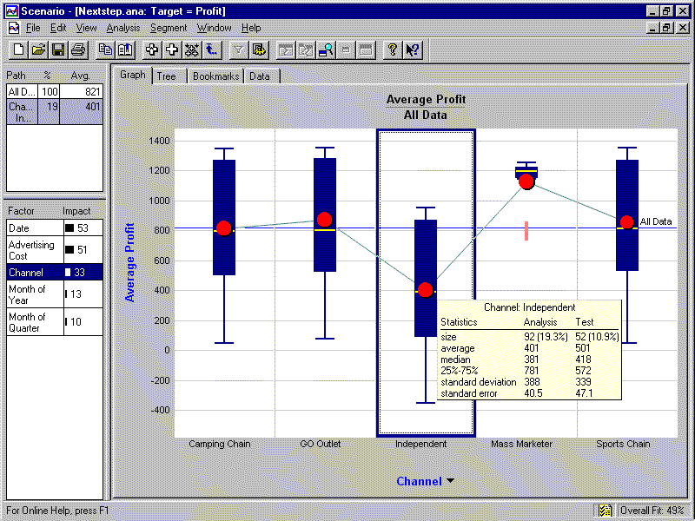
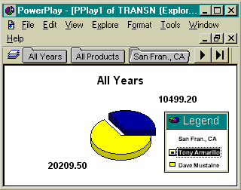
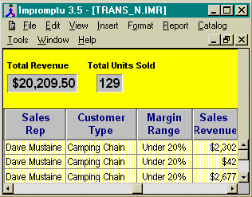
Arquitetura Básica
Cargas
Informações de Mercado
Front End
Aplicações Operacionais
Planilhas e Relatórios

Slide 18
Implementação 1
Cargas
Informações de Mercado
Front End
ERP

Slide 19
Implementação 2
Cargas
Front End
Aplic Internos
Planilhas

Slide 20
Implementação 3
Front End
ERP

Slide 21
Implementação 4
Cargas
ERP
Front End
ERP
Planilhas

Slide 22
Implementação 5
Cargas
Front End
ERP

Slide 23
Algumas Constatações
Processo patrocinado por T.I. sem envolvimento direto do usuário;
Disponibilização do ambiente operacional, sem Warehouse e sem previsão para isso;
Qualificação de T.I. apenas na tecnologia de front-end e armazenamento;
Detalhe no “Cubo”;
Performance;
Notes:
Our best practices show how companies have had success using BI to impact their business and they have benefits to both business users and IT.
For business users the best practices identifies the specific information that will drive out costs and have immediate impact. It also increases productivity, since users don’t have to search for important information. Finally, once users understand what business intelligence can do for their business, it generates a level of urgency for implementation. Everyone will want this capability.
For IS, best practices hold other benefits. Since it offers departmental “wins” it decreases the risk in a warehouse project. You are implementing a solution that has been proven successful. The deployment of the best practices is based on a straight-forward 7-step implementation cycle. The 7-step cycle is the basis for an enterprise-wide implementation plan. And it shows IS how to establish an effective partnership with end users. This partnership ensures that all of the data that’s delivered is validated and provides maximum impact.
With best practices, you can deliver a return on your warehouse investment in 90 days.

Slide 24
Análise das Implementações
Muitos usuários envolvidos no processo de levantamento;
Alteração do escopo durante o levantamento;
Falta de envolvimento direto do “usuário patrocinador”;
BI para substituir relatórios operacionais;
Nivel de expectativa;
Qualidade dos dados armazenados;
Prazos Longos;
Notes:
Our best practices show how companies have had success using BI to impact their business and they have benefits to both business users and IT.
For business users the best practices identifies the specific information that will drive out costs and have immediate impact. It also increases productivity, since users don’t have to search for important information. Finally, once users understand what business intelligence can do for their business, it generates a level of urgency for implementation. Everyone will want this capability.
For IS, best practices hold other benefits. Since it offers departmental “wins” it decreases the risk in a warehouse project. You are implementing a solution that has been proven successful. The deployment of the best practices is based on a straight-forward 7-step implementation cycle. The 7-step cycle is the basis for an enterprise-wide implementation plan. And it shows IS how to establish an effective partnership with end users. This partnership ensures that all of the data that’s delivered is validated and provides maximum impact.
With best practices, you can deliver a return on your warehouse investment in 90 days.

Slide 25
Análise das Implementações
O projeto de propriedade da Empresa;
Quebra dos paradigmas de T.I.
Prazos curtos e precisos;
Qualidade dos dados operacionais;
T.I. qualificado para suporte em tecnologia e negócio;
Usuário qualificado na sua função com conhecimento de T.I.;
Consciência que B.I. é um processo e não um projeto.
Notes:
Our best practices show how companies have had success using BI to impact their business and they have benefits to both business users and IT.
For business users the best practices identifies the specific information that will drive out costs and have immediate impact. It also increases productivity, since users don’t have to search for important information. Finally, once users understand what business intelligence can do for their business, it generates a level of urgency for implementation. Everyone will want this capability.
For IS, best practices hold other benefits. Since it offers departmental “wins” it decreases the risk in a warehouse project. You are implementing a solution that has been proven successful. The deployment of the best practices is based on a straight-forward 7-step implementation cycle. The 7-step cycle is the basis for an enterprise-wide implementation plan. And it shows IS how to establish an effective partnership with end users. This partnership ensures that all of the data that’s delivered is validated and provides maximum impact.
With best practices, you can deliver a return on your warehouse investment in 90 days.

Slide 26
Business Intelligence
“Não é a implentação de DataWarehouse, DataMarts, front-ends”

Slide 27
Business Intelligence
“Disponibiliza os indicadores para a correta tomada de decisão mas não toma a decisão; esta caberá sempre a um profissional treinado e com qualificação adequada para o cargo”

