Slide 1
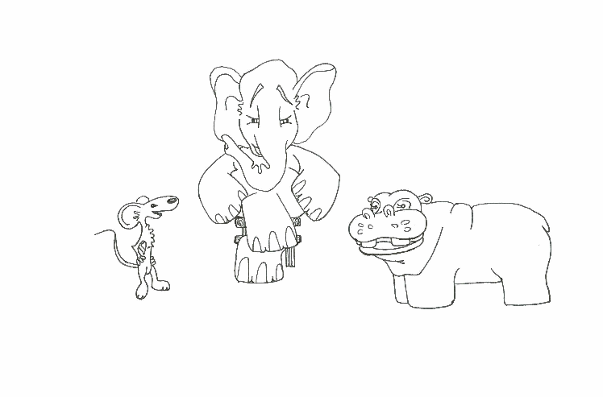
Foundations of Software Testing
Slides based on: Draft V1.0 August 17, 2005
Test Generation: Statecharts
Aditya P. Mathur
Purdue University
Fall 2005
These slides are copyrighted. They are intended for use with the Foundations of Software Testing book by Aditya Mathur. Please use the slides but do not remove the copyright notice.
UNDER CONSTRUCTION
Last update: September 24, 2005

Slide 2
Learning Objectives
What are Statecharts? When to use them? Applications? Industrial use?
How to generate tests from Statecharts?

Slide 3
Statecharts
A statechart is a notation for specifying the behavior of finite state systems.
Originally invented by David Harel in 1987, the notation is now a part of the UML standard. The original statechart notation differs from the one used in UML. However, the difference does effect the test generation algorithms we study.

Slide 4
Statecharts and FSMs
Configuration: FSM: Only one state can be active at any time instant. Statechart: Multiple states can be active at any time instant. While an FSM moves from a state to the next, a statechart moves from one configuration to the next.
Hierarchy: FSM: A state is an atomic entity. Statechart: A state can be further decomposed into another subchart.
Internal memory: FSM: No memory. Statechart: States have memory and actions associated with a state can modify it. Change in internal memory might trigger a transition.

Slide 5
Statecharts and FSMs: control/data view
Statechart: Consists of a control portion and a data portion. The control
The control portion of a statecharts that do not exhibit concurrency be transformed to an FSM. It is the data portion that makes it different from an FSM.
Internal memory: FSM: No memory. Statechart: States have memory and actions associated with a state can modify it. Change in internal memory might trigger a transition.

Slide 6
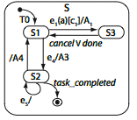
Sample Statecharts
Initial state
Basic states: S1, S2, S3
Composite state: S
substate(S)={S1, S2, S3}
State: name, entry action, exit action, do activity, internal transitions, deferred transitions
Final state
Each statechart has an initial state and a final state. There can be at most one initial state in a composite state.

Slide 7
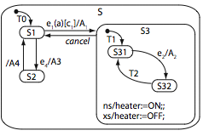
Sample Statecharts-OR state
S and S3 are composite states. S3 is an OR state as it can be in either S31 or in S32.
ns indicates an entry action, indicated by an assignment in this example.
xs indicates an exit action, indicated in this example by an assignment.
ns(S), xs(S), and do(S) indicate entry, exit, and do activities associated with state S. These activities are also known as static reactions.

Slide 8
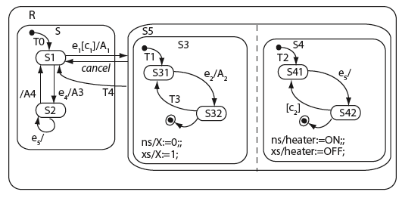
Sample Statecharts-AND state
S5 is an AND state and consists of S3 and S4 that are concurrent states.
Entry into S5 implies that S31 and S41 are entered simultaneously.

Slide 9
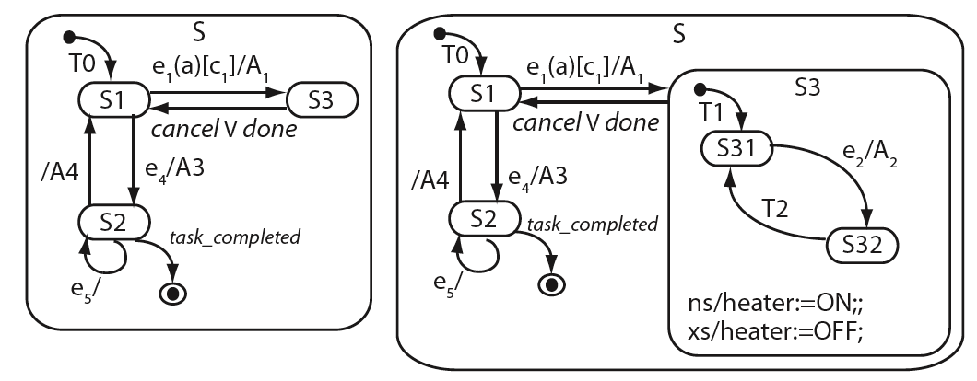
Transitions
Trigger: e₁(a)
Event: e1
Parameter: a
Guard: c₁
Action: A₁
Empty label
A transition specifies a relationship between a source and a target state. Each transition is associated with a label, and possibly a name, e.g. T0, T1, etc.
Label consists of: trigger, guard, and action. All components are optional.

Slide 10
Pseudo states
Allow combining transitions in various ways.
Pseudo states: Entry state, exit state, history state, selection, junction, join, and fork.

Slide 11
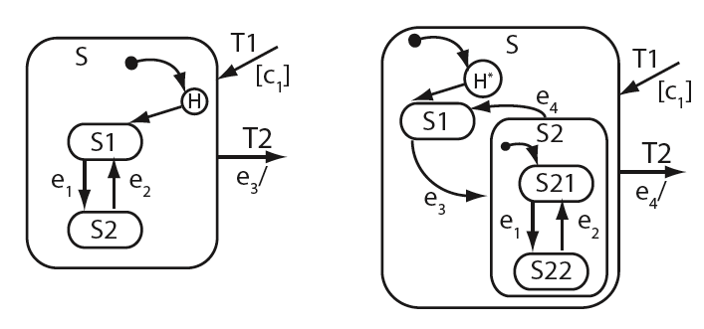
History state
Allows entry into a non-default state inside a composite state. The state entered (using H, shallow history) is the most recently visited substate. With H* (deep history) the most recently visited substate can be nested in a substate.

Slide 12
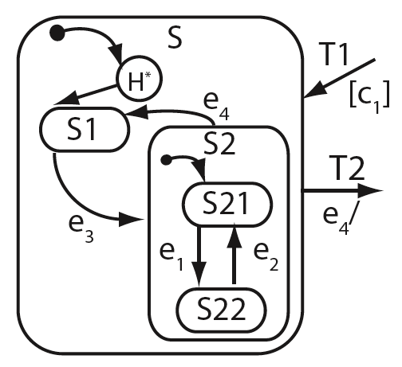
Deep History state: Example
First entry into S:
T1 enabled-->c1 is true--> S-->S1-->e3 occurs-->S2-->S21-->e1 occurs-->S22
Now e4 occurs.
S exited..-->T1 enabled-->c1 true--> S22 is entered.
However, any entry actions in S and S2 will be performed before S22 is entered.
If the entry into S were to be via a shallow history connector, then S2 would be entered followed by S21 and not S22.

Slide 13
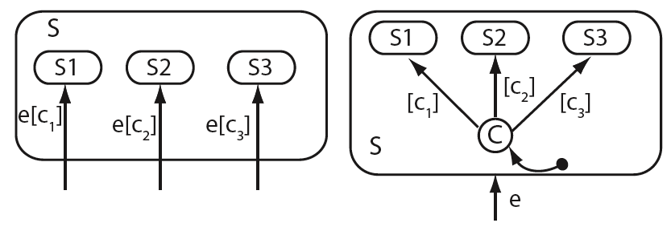
Conditional pseudo state
Incoming transitions corresponding to the same event e, but different guards, are replaced by one incoming transition labeled e entering a conditional pseudo state . This simplifies the statechart.
C

Slide 14
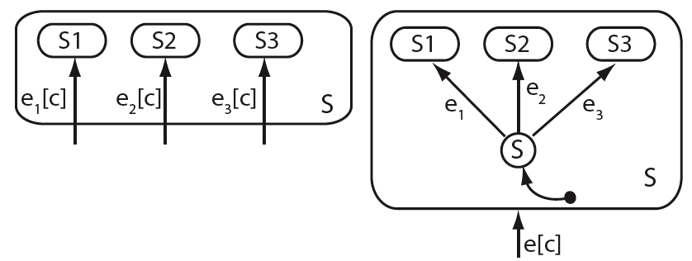
Selection pseudo state
Incoming transitions corresponding to the condition but different events are replaced by one incoming transition labeled e[c] entering a selection pseudo state . This simplifies the statechart.
S

Slide 15
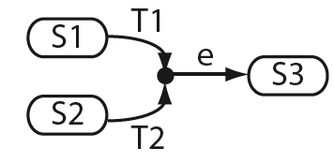
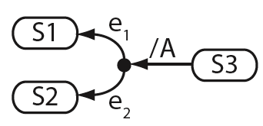
Junction connector
A junction connector allows joining two or more transitions, or splitting one transition into two or more transitions. T1 and T2 are completion transitions and e is a common event that triggers them.
In splitting, action A is split into two transitions that share the action but correspond to different events.

Slide 16
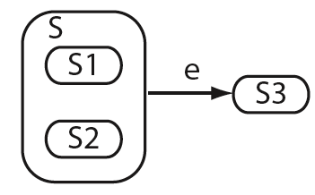
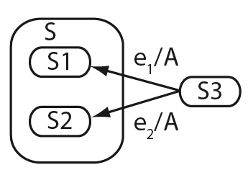
Junction connector: Equivalence
Equivalent to
Equivalent to

Slide 17
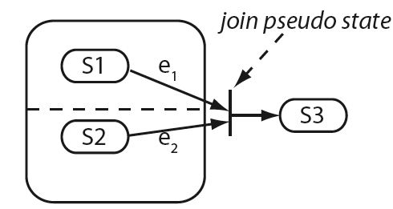
Join pseudo state
Merges two or more incoming transitions from concurrent states into an outgoing transitions. Transitions entering a join must not have guards.

Slide 18
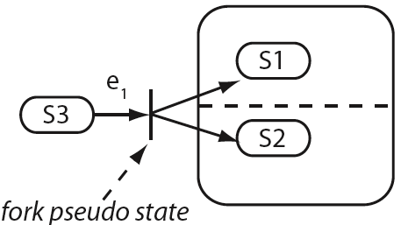
Fork pseudo state
Splits an incoming transition into two or more outgoing transitions that initiate concurrent processes. Forked transitions do not have a guard.
Fork and join connectors are often referred to as joint connectors.

Slide 19
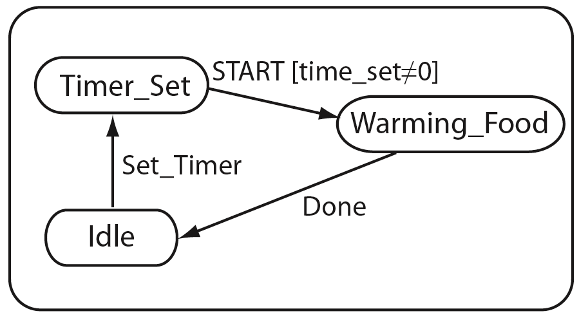
Events: External and internal
Start is an external event (user initiated).
T1
Done is an internal event (initiated by the oven when the timer reaches 0).
An event, and any associated guard, serves as a trigger. When a microwave oven is in Timer_Set state and the START event occurs and the time_set is not 0, then T1 is enabled and the oven enters the state Warming_Food.

Slide 20
Events that refer to states or variables
en(S) occurs when state S is entered.
ex(S) occurs when state S is exited.
in(S) indicates that the statechart is in state S. This status indicator is often used as a guard along a transition.
A change event occurs when some specified condition along a transition becomes true. For example, if a<b is specified as a trigger event, then a change event occurs when a becomes less than b. Variables a and b might be set in some state of the chart.

Slide 21
Signals
An asynchronous communication between two objects in a statechart is a signal.
For example, pressing the START button on the keypad of a microwave oven generates a signal event.
The communicating objects could be internal to the statechart or one of them could be internal and the other external.

Slide 22
Timer events
A timer event occurs when a specified length of time has elapsed.
A timer event is specified as tm(e, n) where e is an event that starts a timer and n is the length of the interval after which the timer event is to occur.
Example: tm(en(S), 30) causes a timer event to occur 30 time units after state S is entered.

Slide 23
Events with parameters
An event may have a parameter.
Example: Food_Cooked(10) indicates an event with parameter 10. This event specifies a cooking time of 10 time units after which the event occurs.

Slide 24
Actions
A transition is labeled as e[c]/A, where E, C, and A denote, respectively, event, guard, and action. All three are optional elements of a transition label.
Action A can be specified as as a sequence of actions as, for example, in A1; A2; A3;
A1; A2; A3; is a compound action consisting of three atomic actions that are executed concurrently.
Any action specified along a transition is executed only when the specified event occurs and any corresponding guard is true.

Slide 25
Actions: Concurrency
A1: X:=true;
A2: if X the Y=1 else Y=2;
There is no guarantee that Y will be set to 1. The value of X used in A2 is the one that exists prior to the execution of A1.

Slide 26
Sample actions
Action | Meaning
E | Generate event E
tr!C | Set C to true
fs!C | Set C to false
X:=exp | Assign value of exp to X
rd!X | Read value of X
wr!X | Write to X
dc!S | Clear deep history in S

Slide 27
Effect of actions
An action could trigger an event and hence cause a transition to be triggered.
Example: heating:=true; will trigger a transition labeled [heating]
Example: sc!(lights_Off, 600) will cause action lights_Off to occur after 600 time units.

Slide 28
Statechart behavior
Statechart models the collective behavior of a machine that might consist of several distinct though related components.
Assumption: There is a unique initial state at the highest level where the statechart execution begins..
Behavior of a statechart is a set of possible executions, often this set is large or even infinite.

Slide 29
Transition firing
A transition is said to fire when the event in its label occurs and the condition guarding it is true.
Firing of a transition activates the target state.
By default, the transition at the highest level of the statechart fires as soon after the statechart execution begins.
A state becomes inactive when it is exited due to the firing of an outgoing transition.

Slide 30
Entry and exit actions
Any specified entry action (en) is executed soon after the corresponding state becomes active.
Any specified exit action (ex) is executed immediately prior to exiting the corresponding state.
Self transitions cause a state to be entered each time the transition fires, and exited when the processing inside the state is complete or an external event causes an exit.
Firing of any internal transitions does not cause entry and exit actions to be executed.

Slide 31
Completion transitions and events
A completion transition is one without a trigger. It is fired when a completion event is generated.
A completion event is generated upon the completion of all activity inside a state.

Slide 32
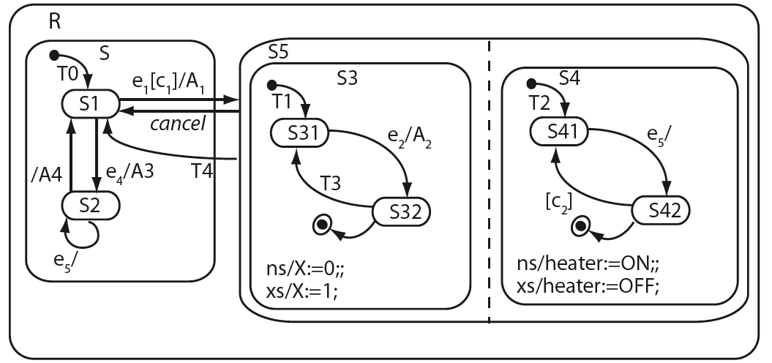
Completion transitions and events
Transition T4 fires when all activity inside the composite state S5 is completed.
Transition labeled cancel fires only upon the occurrence of the external event cancel.
In case of multiple completion transitions out of a state, the corresponding guards must be mutually disjoint.

Slide 33
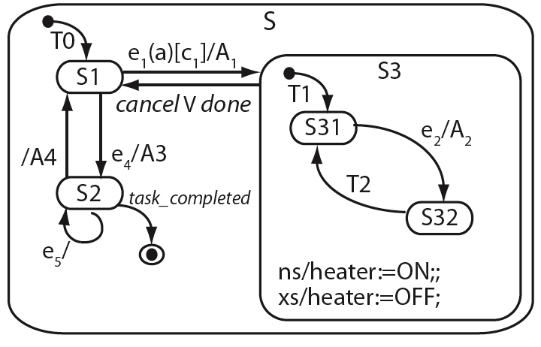
Example
Upon start, T0 fires S1 entered.
e1 occurs, c1 true, S1 exited, A1 performed.
S3 entered, ns performed.
T1 fires, S31 entered. Now S, S3, and S31 are active.
e2 occurs, S31 exited, A2 performed, and S32 entered.
Activity in S32 completes, T2 fires, S32 exited and S31 entered.
Done occurs, exit action is performed, S3 exited, S1 entered.

Slide 34
Statechart configuration
A configuration of a statechart is a set of simultaneously active states.
Two special configurations: initial and final. Initial configuration consists of the default start state. The final configuration consists of the final state.
Configurations are defined with respect to the root state of each statechart and each substate.
A statechart moves from one configuration to the next due to the firing of transitions.

Slide 35
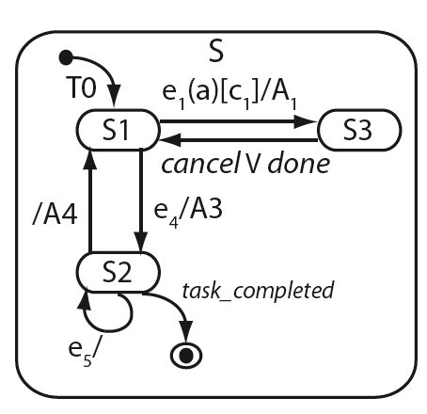
Statechart configuration: Example 1
Initial configuration: {S, S1}
Other configurations: {S, S2}, {S, S3}
Final configuration: {S, }

Slide 36
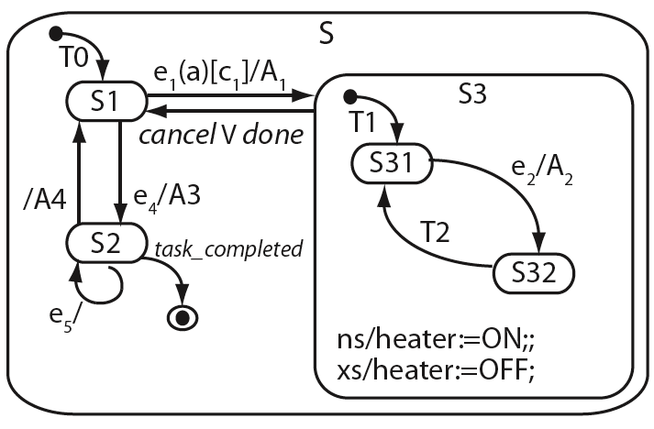
Statechart configuration: Example 2
Initial configuration: {S, S1}
Final configuration: {S, }
Other configurations: {S, S2}, {S, S3, S31}, (S, S3, S32}
Note that S3 is a substate of S. S31 and S32 are substates of S3.

Slide 37
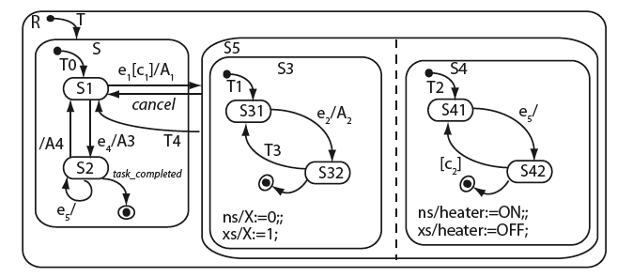
Statechart configuration: Example 3
Initial configuration: {R, S}
Final configuration: {R, }
Few other configurations: {R, (S5, S3, S31), (S5, S4, S42)}
{R, (S5, S3, S32), (S5, S4, S41)}
Note that S5 has two regions named S3 and S4; both can occur together in a configuration.

Slide 38
Compound transitions
A compound transition (CT) consists of a conjunction of labels along a sequence of transitions from a source to a target state.
A compound transition starts at a state and ends at a state and does not pass through any junctions or connectors.
A compound transition that starts at a basic state and terminates at a basic state is known as a full compound transition.

Slide 39
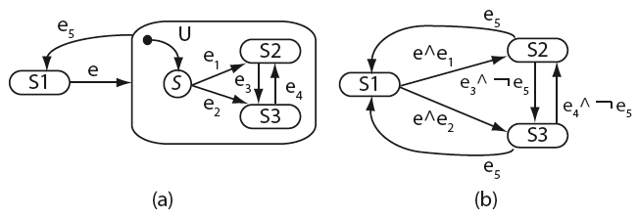
Compound transitions: Example
Statechart (a) is flattened to obtain (b) by removing connectors, relabeling transitions.
Notice that all transitions in (b) are full compound transitions.

Slide 40
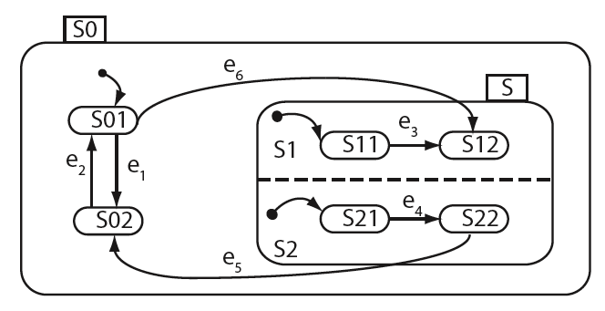
Scope of states and transitions
Common ancestor of the source and target states of T1 is S.
T1
Common ancestor of the source and target states of T2 is S0.
T2
T2 is at a higher level than T1 and hence has a higher priority.
Scope of S1 and S2 is limited to state S. S, S01, and S02 are at the same level. S1 and S2 are at a lower level than S. S0 is at the highest level.

Slide 41
Transition priority and firing
Suppose the statechart is in configuration {S0, S, S11, S22}. T2 and T5 are enabled.
T1
Suppose e3 and e5 occur simultaneously, then T2 fires due to its higher priority.
T2
Event e6 occurs in configuration {S0, S01}.. The new configuration is {S0, S12, S21}. Note that the default entry of S1 has been bypassed.

Slide 42
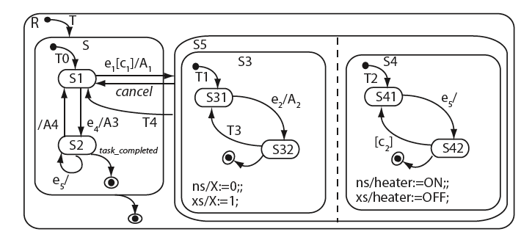
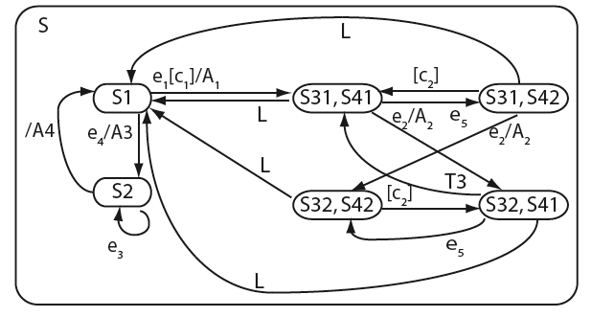
Flattening by replacing AND states
S3 x S4={(S31, S41), (S31, S42),
(S32, S41), (S32, S42)}

Slide 43
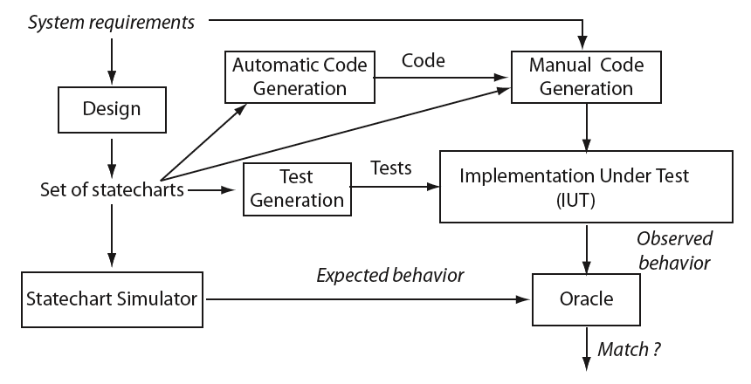
Test generation procedure
Likely test harness here

Slide 44
Distinguishing pairs of states
FSM: An input string s over X*, where X is the input alphabet, is used to distinguish two states.
Statechart: An input sequence of events is used to distinguish two states.
The action performed when a transition fires, is considered as the output of a statechart for the purpose of distinguishing two states.
In the absence of any output, when observed, can also be considered as a distinguishing element between two states.

Slide 45
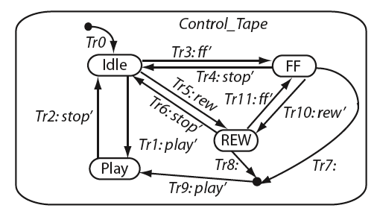
Example: Tape player
This chart shows the design of a simple tape player module. The module has the usual set of buttons.
It has 4 states and 12 transitions. Each transition is labeled by a function defined below.
ff’: [button_pressed=FF]/operation:=ff
What event sequence will distinguish the FF and REW states?
rew’: [button_pressed=REW]/operation:=rew
play’: [button_pressed=PLY]/operation:=play
stop’: [button_pressed=STOP]/operation:=stop

Slide 46
Statecharts with no compound states
It is relatively easy to generate test cases when a statechart does not contain any compound state or history connector. A test generation procedure follows.
Step 1: Determine the set of transitions _{q} , the transition cover set P_{q} , and the characterization set W_{q} for each main and substate statechart of non-basic state q .
Step 2: Generate the test sequence for S using the W-method described earlier . Other methods such as the Wp method or the UIO method, could also be used.

Slide 47
Step 1: Determine the set of transitions δ_{q}
This is done by inspecting the statechart.
Assumption: Each transition in a statechart has a name (e.g. T7) and a label. The label might be empty!
If the label is empty then simply use the name of the transition in δ_{q}, otherwise use a distinguishing portion of the label (e.g. an event.

Slide 48
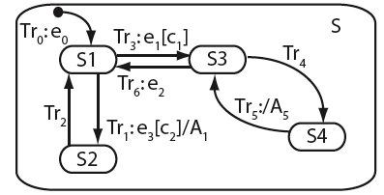
Step 1: Determine the set of transitions δ_{q}: Example
δ_{S}={e3, Tr2, e1, Tr4, e2}

Slide 49
Step 1: the transition cover set P_{q} and W_{q} sets
The transition cover set is determined using the testing tree as discussed in connection with FSMs.
The characterization set is also determined as with FSMs.
Step 2: Given P_{q} and W_{q} we obtain the test set as P_{q} . W_{q} assuming that the implementation has the same number of states as in the design.

Slide 50
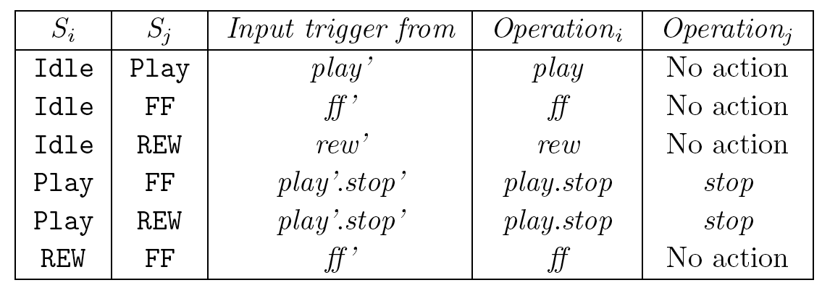
Example: Tape Player
δ_{Control_Tape}={play, stop, ff, rew}. We have ignored the tape_end event.
W_{Control_Tape}={play, ff, rew, play.stop}
Prime (‘) symbol ignored for simplicity.

Slide 51
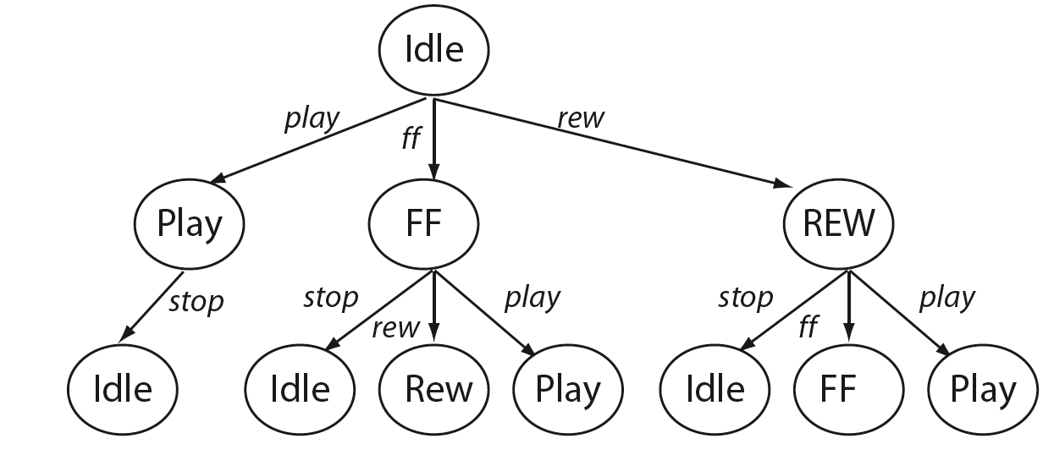
Example: Tape Player: Transition tree and Transition cover set
P_{Control_Tape}={ε, play, ff, rew, play.stop, ff.stop, ff.rew, ff.play, rew.stop, rew.ff, rew.play}
T= P_{Control_Tape} . W_{Control_Tape}. We obtain a total of 44 test inputs.

Slide 52
Test harness and internal events
Testing of the tape player requires applying external events (e.g. by pressing the PLAY button), handling internal events (e.g. a timer event), and observing the impact of external and internal events. In embedded systems, these tasks are often handled with the aid of a test harness.
In embedded systems, these tasks are often handled with the aid of a test harness. There is no general algorithm or rule for constructing test harness, its design depends on the hardware and software characteristics of the embedded system.
For the tape player we assume that events can be applied manually and their impact visually observed.

Slide 53
Testing the tape player
Consider the input: play.stop. Applying this input requires the following tasks to be performed in the order given: (a) set up the tape player (e.g. by inserting a tape), (b) press the play button and (c) press the stop button
Question: What should be the delay between (b) and (c) ?
Note that our test generation method does not answer this question. Nevertheless, one needs to answer the timing question based on requirements.
In addition to timing, are there other parameters that are not specified in the tests that we have generated?

Slide 54
Handling partial labels during test generation
Transitions in a statechart are labeled as:
event[guard]/actions
However, any one or more of the three components of a label can be omitted. Next we discuss how to handle transitions whose labels do not contain an event or an action or both.

Slide 55
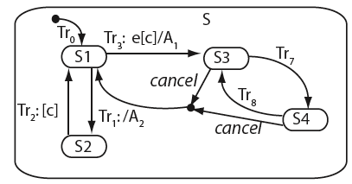
Handling partial labels: Example
While event e can be used to move from state S1 to S3, there is no explicit indication as to what input sequence will move the statechart, and its implementation, to S4 from S3.
Similarly, there is no explicit indication of what input sequence will take the statechart from S1 to S2 and what will distinguish S3 from S4.

Slide 56
Internal and external events
Events specified as triggers along a transition may be external or internal. External events can be applied through a test harness.
Internally generated events, such as a condition becoming true, or a state being entered, are dependent on the behavior of the statechart in response to an external event.
Both external and internal events are useful in determining transition sequences that distinguish a pair of states.

Slide 57
Test environment: assumptions
If a transition Tr from state S1 to S2 contains an empty label, then Tr is enabled, and fires, when all processing inside S1 is completed.
Given a pair of states that contain no labels in their outgoing transitions, it is possible to determine if and when IUT is in any of these states.
A lone guard along a transition specifies an internal event based on some condition.

Slide 58
Test environment: assumptions (contd)
Effects of all actions are observable. When possible, a pair of states are distinguished based on the action performed when a transition emanating from one of the two states is taken.
The statechart is complete. Thus, if an event e occurs while the statechart is in state S1 and no transition has been specified in S1 for e , then e is ignored and the state does not change.

Slide 59
Example
States S1 and S2 can be distinguished either by the end of processing in S1 or by condition c becoming true. [What if both happen together?]
When all processing in S2 is complete and condition c is true, Tr₂ is enabled and the IUT must move to S1.
Observing A₂ is sufficient to conclude that the IUT was in state S1 prior to A₂ being performed. Condition c also serves to distinguish between states S2 and S3, and states S2 and S4.

Slide 60
Example (continued)
States S3 and S4 can only be distinguished either by event S3_end or by event S4_end. In either case there is no unique externally specified action and hence one needs to know the next state to distinguish S3 from S4.
W_{S}={S1_end, [c], e[c], S3_end, S4_end}

Slide 61
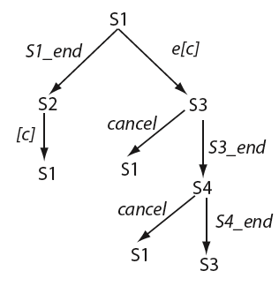
Example (continued): Testing tree
P_{S}={ε, S1_end, S1_end.[c], e[c], e[c].cancel, e[c].S3_end,
e[c].S3_end.cancel, e[c].S3_end.S4_end}

Slide 62
Discarding and pruning tests
A test case t derived from a statechart is considered feasible if each event in t is under the direct control of the tester via a test harness.
We use this definition to discard infeasible test cases and to reduce the length of a test case by pruning away portions that are not under the tester's control.

Slide 63

Strings and languages

Slide 64
Summary
Behavior of a large variety of applications can be modeled using finite state machines (FSM). GUIs can also be modeled using FSMs

Slide 65
Summary (contd.)
Automata theoretic techniques generate tests superior in their fault detection ability than their control-theoretic counterparts.

