Slide 1

Python scripts in LibreOffice Calc using the ScriptForge library
Rafael Lima
Notes:
Subject: Script + Forge
You know the meaning of Forge in SW Engineering
Basic + Python in square brackets: not for 1st release

Slide 2




Outline
What is ScriptForge?
Overview of the Calc service
Reading and Writing data to ranges
Clearing Cell Contents
Copying and Moving Ranges
Managing Sheets
Basic Calc functions
Loading CSV files
All examples use Python
Download examples at:
https://github.com/rafaelhlima/LibOCon_2021_SFCalc
+
+

Slide 3

What is ScriptForge?
The ScriptForge library provides a set of services that makes scripting easier and more accessible for LibreOffice users
Array
Dictionary
Exception
FileSystem
String
TextStream
Base
Calc
Database
Document
Dialog
DialogControl
UI
Form
FormControl
Basic
L10N
Platform
Services
Session
Timer
Currently there are 21 services related to various aspects of macro programming
ScriptForge is available since LibreOffice 7.1 for BASIC
Python support is available since LibreOffice 7.2

Slide 4
Why use ScriptForge?
The ScriptForge library hides API and UNO complexity, which is a challenge for those starting to write macros in LibreOffice
Example: Checking if the current document is a Calc document
# Gets the current document
doc = XSCRIPTCONTEXT.getDocument()
# Checks if it is a Calc document
isCalc = oDoc.supportsService(
"com.sun.star.sheet.SpreadsheetDocument")
if isCalc:
# do something
else:
return
# Gets the current document
doc = CreateScriptService(“Calc”)
# Checks if it is a Calc document
if doc.IsCalc:
# do something
else:
return
Usual approach
Using ScriptForge

Slide 5
ScriptForge Calc Service
The Calc service currently has 30 methods and 11 properties in addition to the methods and properties provided by the Document service
Activate
ClearAll
ClearFormats
ClearValues
CopySheet
CopySheetFromFile
CopyToCell
CopyToRange
DAvg
DCount
DMax
DMin
DSum
Forms
GetColumnName
GetFormula
GetValue
ImportFromCSVFile
ImportFromDatabase
InsertSheet
MoveRange
MoveSheet
Offset
RemoveSheet
RenameSheet
SetArray
SetValue
SetCellStyle
SetFormula
SortRange

Slide 6
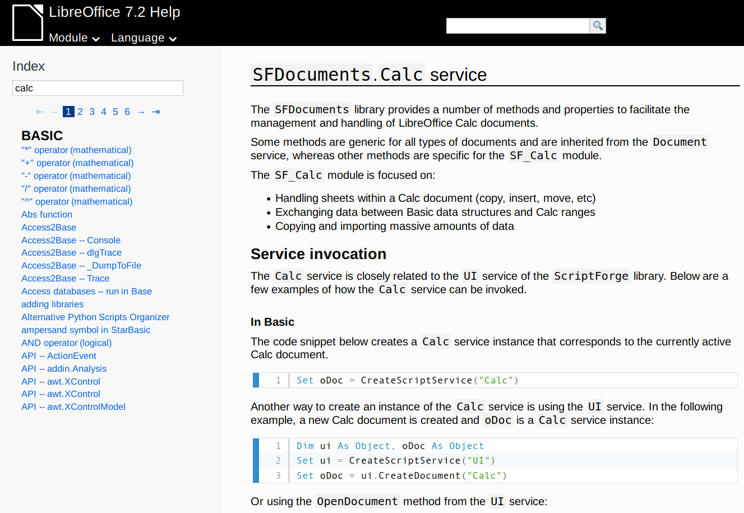
ScriptForge Calc Service
Documentation is provided in the Online Help
ScriptForge Library
https://help.libreoffice.org/latest/en-US/text/sbasic/shared/03/lib_ScriptForge.html
Calc Service
https://help.libreoffice.org/latest/en-US/text/sbasic/shared/03/sf_calc.html

Slide 7
Reading/Writing Values
The code below creates a 4x4 matrix starting at cell “A1” with random “ODD” and “EVEN” strings based on randomly generated data
import random as rnd
def create_random_matrix_v1(args=None):
doc = CreateScriptService("Calc")
for i in range(4):
for j in range(4):
target_cell = doc.Offset("A1", i, j)
r = rnd.random()
if r < 0.5:
doc.setValue(target_cell, "EVEN")
else:
doc.setValue(target_cell, "ODD")
Cell “A1” offset by i rows and j columns
Sets the value in the cell referred in target_range

Slide 8
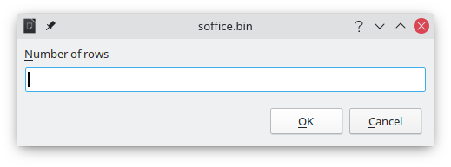
Reading/Writing Values
The code below creates a n x m matrix starting at cell “A1”. It uses the “Basic” service to ask the user about the desired size:
def create_random_matrix_v2(args=None):
doc = CreateScriptService("Calc")
bas = CreateScriptService("Basic")
n_rows = bas.InputBox("Number of rows")
n_cols = bas.InputBox("Number of columns")
for i in range(int(n_rows)):
for j in range(int(n_cols)):
target_cell = doc.Offset("A1", i, j)
r = rnd.random()
if r < 0.5:
doc.setValue(target_cell, "EVEN")
else:
doc.setValue(target_cell, "ODD")
The InputBox method belongs to the “Basic” service

Slide 9
Reading/Writing Values
It is always faster to use setArray!
def create_random_matrix_v3(args=None):
doc = CreateScriptService("Calc")
bas = CreateScriptService("Basic")
n_rows = bas.InputBox("Number of rows")
n_cols = bas.InputBox("Number of columns")
rnd_word = lambda : "EVEN" if rnd.random() < 0.5 else "ODD"
values = [[rnd_word() for _ in range(int(n_cols))]
for _ in range(int(n_rows))]
doc.setArray("A1", values)
The method setArray expands according to the size of the array

Slide 10
Reading/Writing Values
This code iterates over the current selection, replaces negative values with the string “INVALID” and sets a different cell style
Gets the address of the current selection
def mark_invalid(args=None):
doc = CreateScriptService("Calc")
# Gets address of current selection
cur_selection = doc.CurrentSelection
# Gets address of first cell in the selection
first_cell = doc.Offset(cur_selection, 0, 0, 1, 1)
for i in range(doc.Height(cur_selection)):
for j in range(doc.Width(cur_selection)):
cell = doc.Offset(first_cell, i, j)
value = doc.getValue(cell)
if value < 0:
doc.setValue(cell, "INVALID")
doc.setCellStyle(cell, "Bad")
Applies the “Bad” cell style

Slide 11
Clearing Cell Contents
There are three methods to clear cell values:
ClearAll(range: str)
All cell contents and formats
ClearFormats(range: str)
Cell formats (values are kept)
ClearValues(range: str)
Cell contents (formats are kept)
def clear_contents_v1(args=None):
doc = CreateScriptService("Calc")
doc.clearAll("H1:H5")
def clear_contents_v2(args=None):
doc = CreateScriptService("Calc")
doc.clearFormats("H1:H5")
def clear_contents_v3(args=None):
doc = CreateScriptService("Calc")
doc.clearValues("H1:H5")

Slide 12
Copying and Moving Ranges
There are three methods to copy or move ranges:
CopyToCell(source, destination)
All contents in source are copied into the destination. The size of the affected destination is equal to the size of source
CopyToRange(source, destination)
Equivalent to pasting contents when a range of cells is selected as destination and it is larger than source
MoveRange(source, destination)
All contents in source are moved into the destination. The size of the affected destination is equal to the size of the source

Slide 13
Copying and Moving Ranges
Examples using CopyToCell and CopyToRange
If the destination were a range (f.i. “B1:D10”, only the top-left cell would be considered”)
def copy_cells_v1(args=None):
doc = CreateScriptService("Calc")
doc.copyToCell("A1:A4", "C1")
def copy_cells_v2(args=None):
doc = CreateScriptService("Calc")
doc.copyToRange("A1:A4", "E1:F6")
Note that the destination range is larger than the source

Slide 14
Copying and Moving Ranges
A more complex example with CopyToCell:
This example copies from a different file that is currently open
def copy_range_example_v2(args=None):
# Reference to current document (destination)
doc = CreateScriptService("Calc")
# Reference to the source document
svc = CreateScriptService("UI")
source_doc = svc.getDocument("DataSource.ods")
source_range = source_doc.Range("Sheet1.A1:A5")
# Pastes the contents into the destination
doc.copyToCell(source_range, "A1")
The “UI” service provides access to other documents that are currently open
Pastes into cell “A1” of the current sheet in the current document

Slide 15
Managing Sheets
There following methods are used to handle sheets
Activate(sheetname)
CopySheet(sheetname, newname, [beforesheet])
InsertSheet(sheetname, [beforesheet])
MoveSheet(sheetname, [beforesheet])
RemoveSheet(sheetname)
RenameSheet(sheetname, newname)

Slide 16
Managing Sheets
Examples using InsertSheet, Activate and CopySheet
It can also be a string with the name of an existing sheet
def create_sheet_example(args=None):
doc = CreateScriptService("Calc")
doc.insertSheet("TestSheet", 2)
doc.activate("TestSheet")
Activating the sheet is equivalent to selecting its tab
def copy_sheet_example(args=None):
doc = CreateScriptService("Calc")
doc.copySheet("TestSheet", "Copy_TestSheet")
def remove_sheet_example(args=None):
doc = CreateScriptService("Calc")
doc.removeSheet("Copy_TestSheet")

Slide 17
Managing Sheets
CopySheetFromFile: copies a sheet from a Calc file. The file can be currently open or closed.
If the file does not exist, an error is raised.
If the file is not a valid Calc file, a blank sheet is inserted.
If the source sheet does not exist in the input file, an error message is inserted at the top of the newly pasted sheet.
def copy_from_file_example(args=None):
doc = CreateScriptService("Calc")
doc.copySheetFromFile("/home/rafael/Documents/DataSource.ods",
"Sheet2", "Copy_Sheet2")

Slide 18
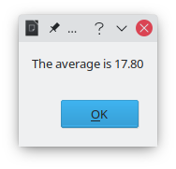
Basic Calc Functions
DAvg, DCount, DMax, DMin, DSum: Calls the following Calc functions:
Method | Calc function
DAvg | AVERAGE
DCount | COUNT
DMax | MAX
DMin | MIN
DSum | SUM
def calculate_average(args=None):
doc = CreateScriptService("Calc")
bas = CreateScriptService("Basic")
result = doc.DAvg("A1:E1")
bas.MsgBox("The average is {:.02f}".format(result))

Slide 19
Loading CSV Files
ImportFromCSVFile: Loads a CSV text file and places the contents into the destination cell
The input file encoding is UTF8.
The field separator is a comma, a semi-colon or a Tab character.
The string delimiter is the double quote (").
All lines are included.
Quoted strings are formatted as text.
def open_csv_file_v1(args=None):
doc = CreateScriptService("Calc")
doc.ImportFromCSVFile("/home/rafael/Documents/JobData_v1.csv", "A1")

Slide 20
Loading CSV Files
def open_csv_file_v3(args=None):
doc = CreateScriptService("Calc")
filter_option = "59,34,UTF-8,1"
doc.ImportFromCSVFile("/home/rafael/Documents/JobData_v2.csv",
"A1", filter_option)
Text delimiter = double quotes (34 in ASCII)
Number of first line
filter_option = "59,34,UTF-8,1"
Field separator = ‘;’ (59 in ASCII)
Character set

Slide 21
Thank you …
The team
    Jean-Pierre Ledure, Rafael Lima, Alain Romedenne
Documentation
    https://help.libreoffice.org/7.2/en-US/text/sbasic/shared/03/lib_ScriptForge.html?DbPAR=BASIC
Sources
    https://gitlab.com/LibreOfficiant/scriptforge
    Gerrit
Telegram groups
    ScriptForge
    LibreOffice Macros & Scripting
Finish

