Slide 1
Deriving insights from Brazilian investment funds via Data Science
Rafael Y. Imai

Slide 2
What are investment funds?
Pool of monies that belong to one or various shareholders
Each share correspond to na ideal fraction of the fund’s assets
E.g. stocks, bonds....
May be either closed-end (shares must be sold) or open-end (shares may be redeemed)
May adopt various strategies and trade several types of assets
Fixed income funds – commercial papers, debentures, bonds....
Stock funds – stock funds or derivatives related to stocks
Hedge funds – all of the above and another myriad of assets

Slide 3
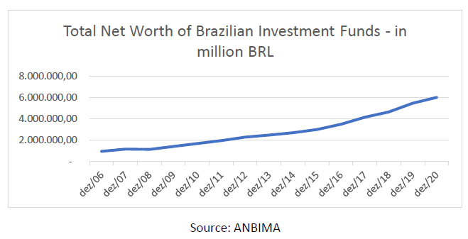
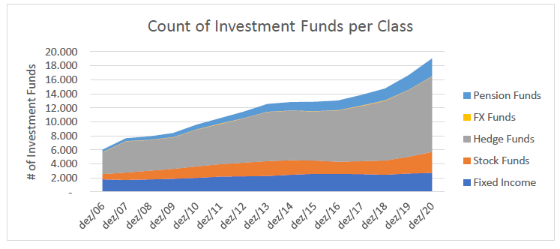
More and more assets in Brazil are managed via investment funds

Slide 4
How do fund shareholders behave according to changes on the markets?
How different funds can either attract or repel shareholders according to the same changes?

Slide 5
Data used on this project
List of investment funds registered in Brazil (available since the Early 90’s), published by CVM
Daily stats published by CVM between 2017 and 2020, with the fund net worth, share value, subscriptions and redemptions paid on the given day
IBOVESPA and SELIC daily values for the same time span

Slide 6
Methodology
Two sets of funds were chosen – fixed income funds and hedge funds
The daily stats of funds were filtered to avoid outliers and errors

Slide 7
Methodology
Correlations will be calculated between the # of shareholders and some relevant metrics
The correlations of each metric for each fund will be displayed on a histogram in order to derive insights about the fund class behavior towards the metric
Afterwards, clusterization will be used to test if such correlation sets can be used to separate funds into groups

Slide 8
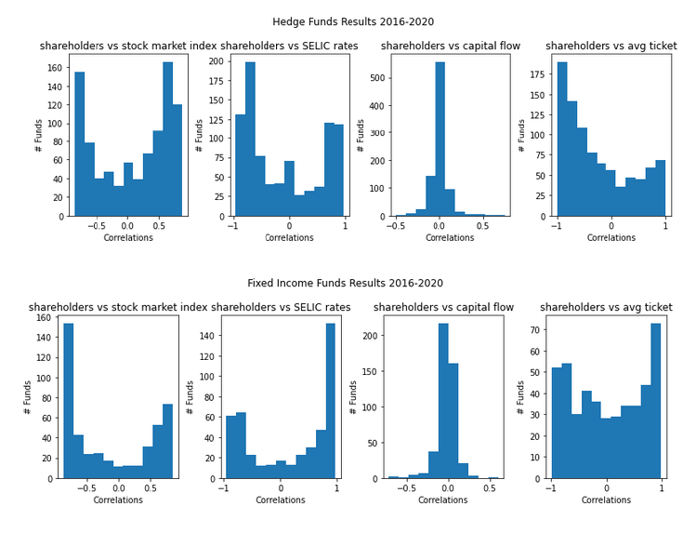
Results

Slide 9
Year by Year Analysis – Fixed Income Funds

Slide 10
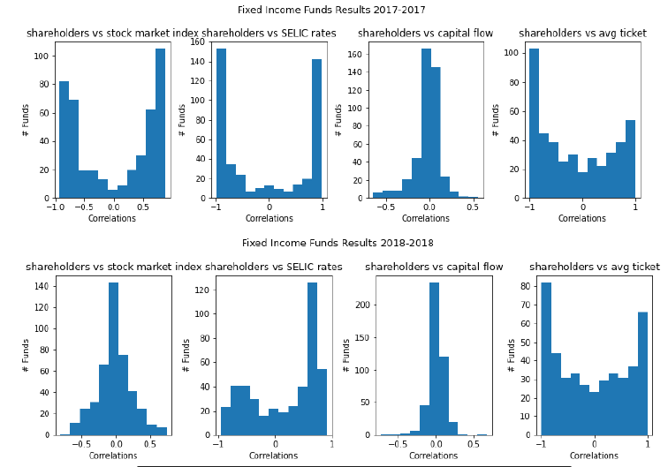

Slide 11
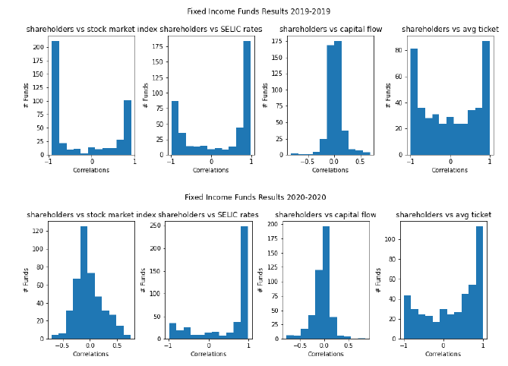

Slide 12
Year by Year Analysis – Hedge Funds

Slide 13
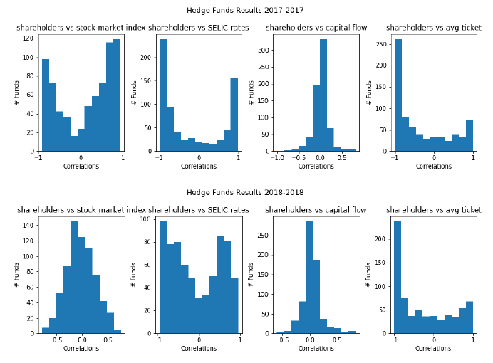

Slide 14
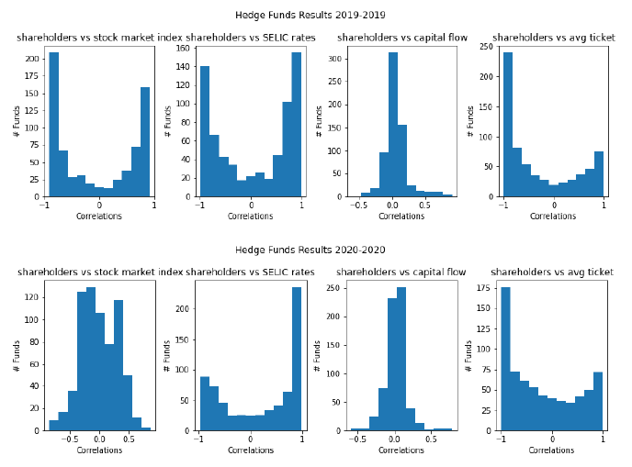

Slide 15
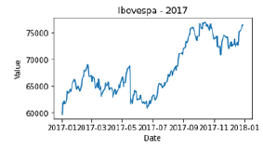
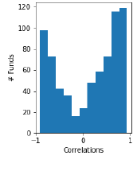
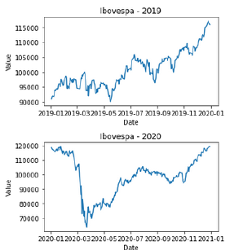
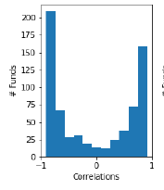
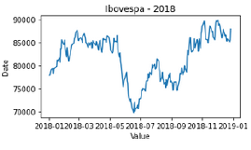
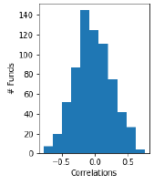
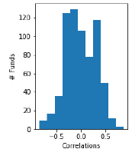
Shareholders vs IBOVESPA and IBOVESPA behavior – hedge funds

Slide 16
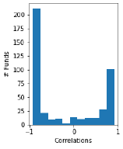
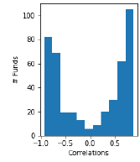
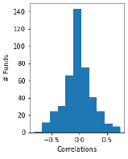
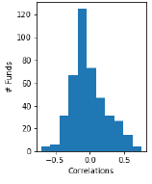
Shareholders vs IBOVESPA and IBOVESPA behavior – fixed income funds

Slide 17
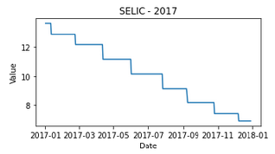
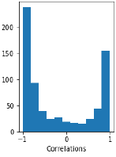
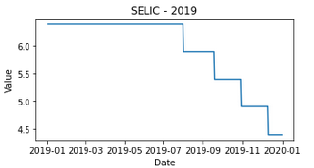
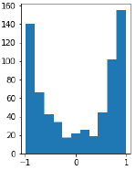
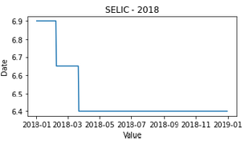
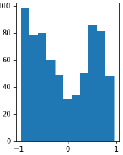
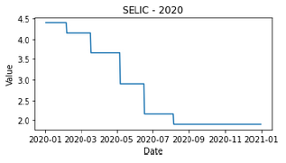
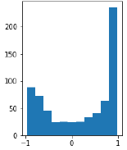
Shareholders vs SELIC and SELIC behavior – hedge funds

Slide 18
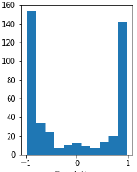
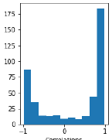
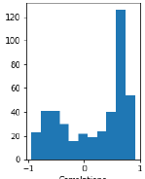
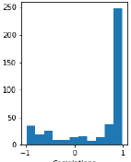
Shareholders vs SELIC and SELIC behavior – fixed income funds

Slide 19
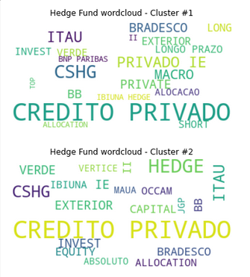
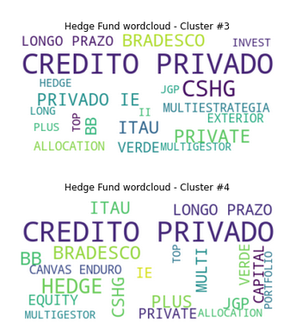
Clusterization outputs – Hedge Funds

Slide 20
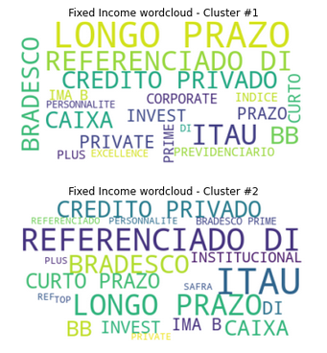
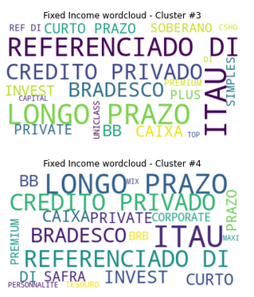
Clusterization outputs – Fixed Income Funds

Slide 21
Thanks!

