Slide 1
Deriving insights from Brazilian investment funds via Data Science
Rafael Y. Imai

Slide 2
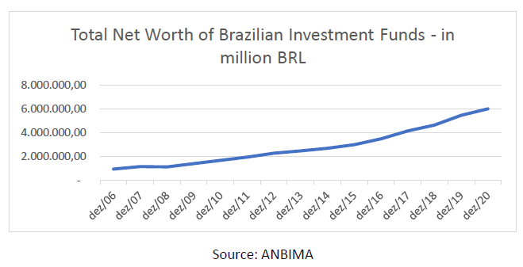
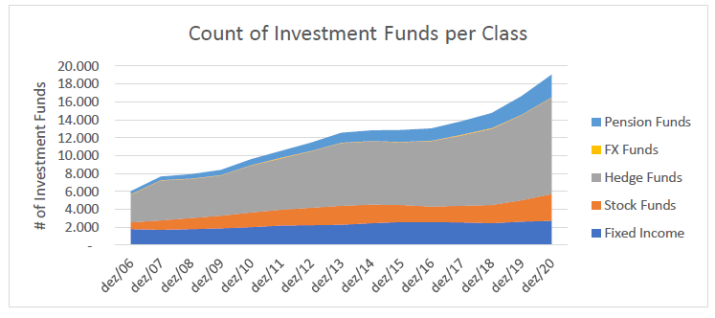
More and more assets are managed via investment funds

