Slide 1

Purpose
Test design
Measurement system and Procedures
Uncertainty Analysis

Slide 2
Purpose
Examine the surface pressure distribution and wake velocity profile on a Clark-Y airfoil
Compute the lift and drag forces acting on the airfoil
Specify the flow Reynolds number
Compare the results with benchmark data
Uncertainty analysis for
  Pressure coefficient
  Lift coefficient

Slide 3
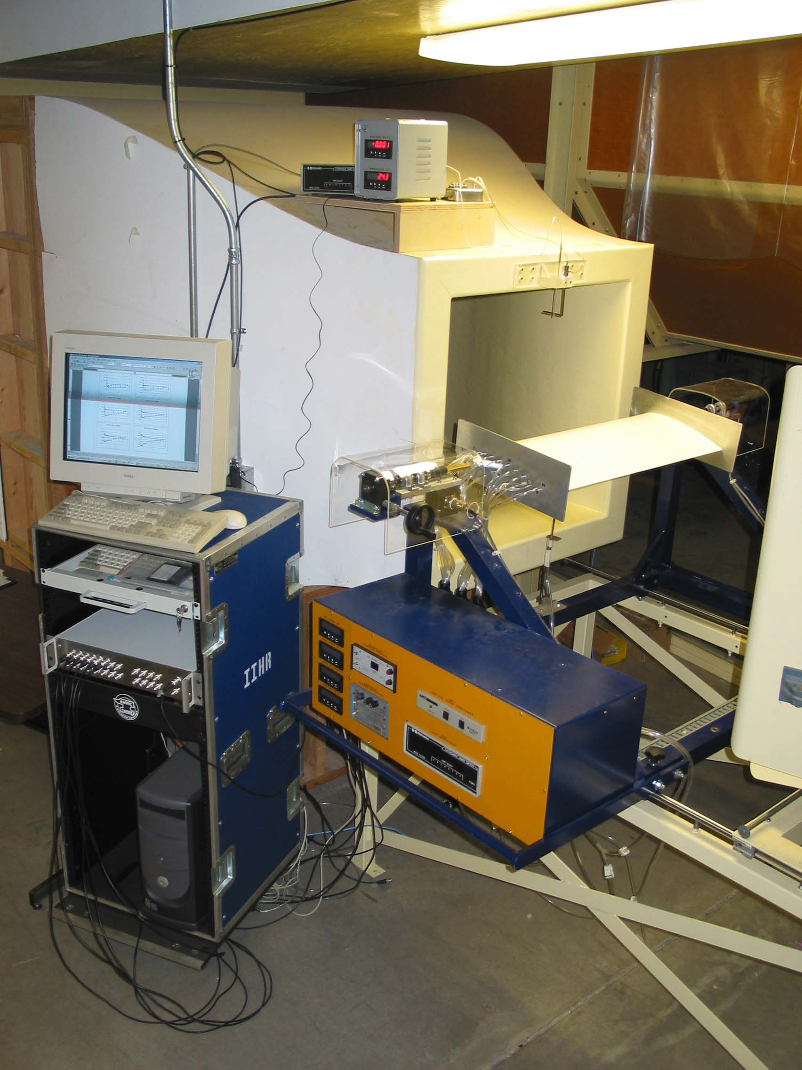
Facility consists of:
Closed circuit vertical
wind tunnel.
Airfoil
Temperature sensor
Pitot tubes
Load cell
Pressure transducer
Automated data acquisition
system

Slide 4
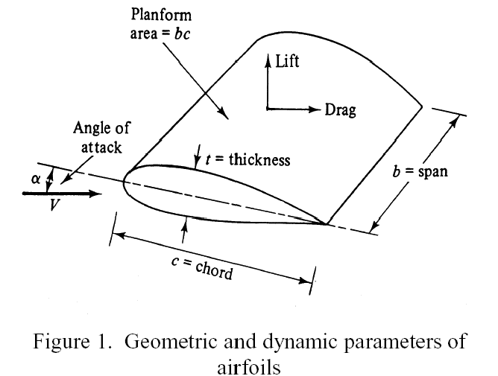
Test Design (contd.)
Airfoil (=airplane surface: as wing) is placed in test section of a wind tunnel with free-stream velocity of 15 m/s. This airfoil is exposed to:
  Forces acting normal to free stream = Lift
  Forces acting parallel to free stream = Drag
Only two dimensional airfoils are considered:
Top of Airfoil:
The velocity of the flow is greater than the free-stream.
The pressure is negative
Underside of Airfoil:
Velocity of the flow is less than the free-stream.
The pressure is positive
This pressure distribution contribute to the lift

Slide 5

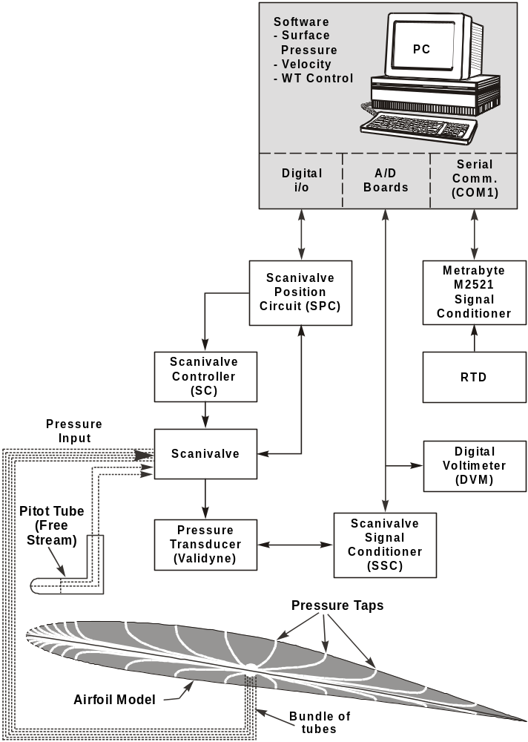
Instrumentation
Protractor – angle of attack
Resistance temperature detectors (RTD)
Pitot static probe – velocity
Vertical Pitot probe traverse
Scanning valve – scans pressure ports
Pressure transducer (Validyne)
Digital Voltmeter (DVM)
Load cell – lift and drag force

Slide 6
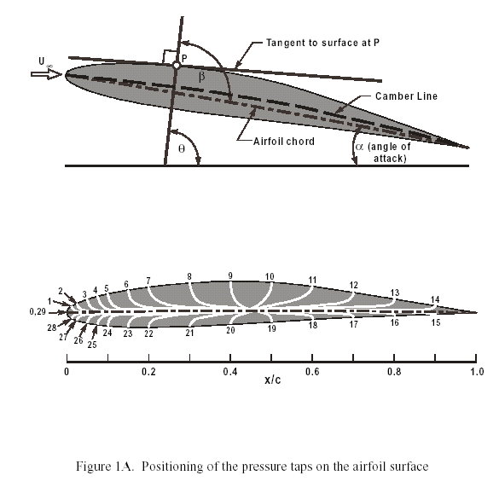
AOA, and Pressure taps positions

Slide 7
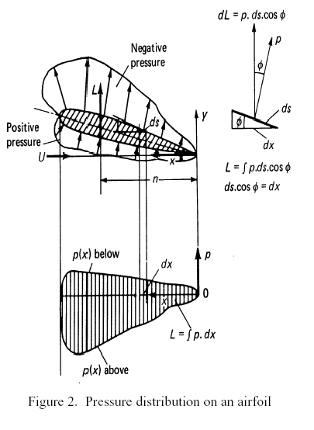
Data reduction
In this experiment, the lift force, L on the Airfoil will be determined by integration of the measured pressure distribution over the Airfoil’s surface. The figure shows a typical pressure distribution on an Airfoil and its projection .

Slide 8
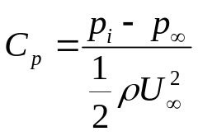
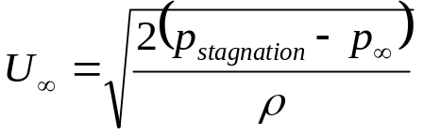
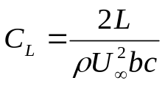

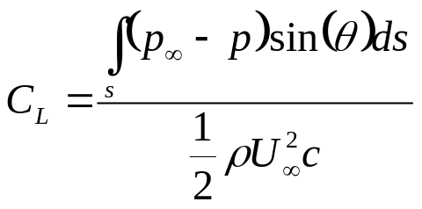
Data reduction
Calculation of lift force
The lift force L is determined by integration of the measured pressure distribution over the airfoil’s surface.
It is expressed in a dimensionless form by the pressure coefficient C_{p} where, p_{i} = surface pressure measured, = P pressure in the free-stream
The lift force is also measured using the load cell and data acquisition system directly.
U∞ = free-stream velocity, ρ = air density (temperature),
p_{stagnation} = stagnation pressure measured at the tip of the pitot tube, L = Lift force, b = airfoil span, c = airfoil chord

Slide 9
Data reduction
The drag force, D on the Airfoil will be determined by integration of the momentum loss found by measuring the axial velocity profile in the wake of the Airfoil. The figure shows how the wake of the airfoil affects the velocity profile.

Slide 10
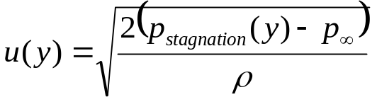
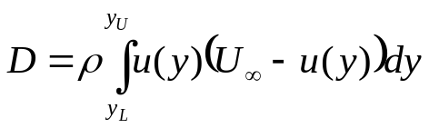
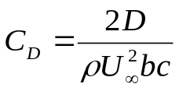
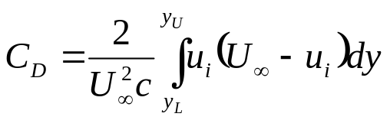
Data reduction
Calculation of drag force
The lift force D is determined by integration of the momentum loss found from the velocity profile measurement.
The velocity profile u(y) is approximated by measuring u_{i} at predefined locations
The drag force is also measured using the load cell and data acquisition system directly.
U∞ = free-stream velocity, ρ = air density (temperature),
p_{stagnation} = stagnation pressure measured at the tip of the pitot tube, D = Lift force, b = airfoil span, c = airfoil chord

Slide 11

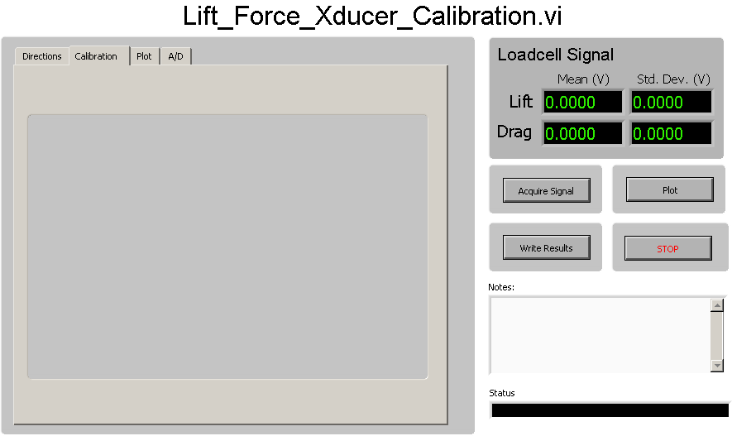
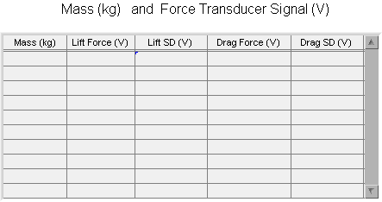
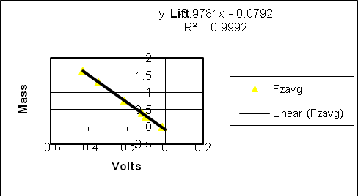
mass (kg)
Volts
0
-0.021
0.295
-0.1525
0.415
-0.203
0.765
-0.3565
1.31
-0.5935
1.635
-0.7385
Program output
Calibration program
Curve fitting method

Slide 12

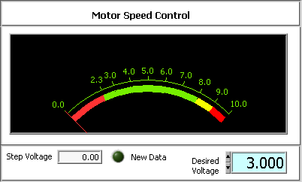
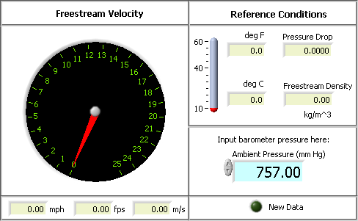
Setting up the initial motor speed
Visualization of wind tunnel conditions

Slide 13
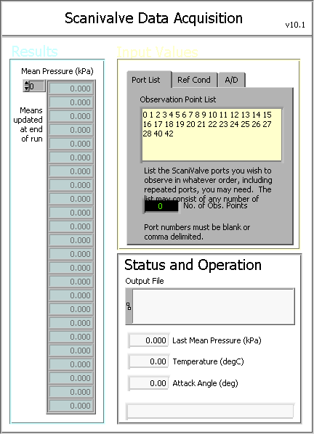
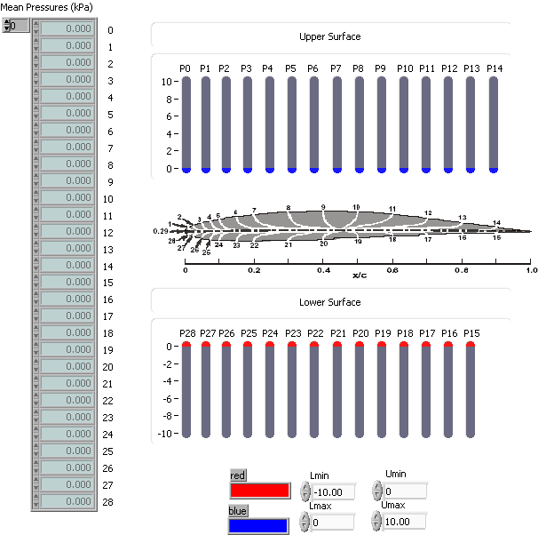
Data acquisition (contd.)
Data needed:
Observation point list
Sampling Rate
Settling Time
Length of each Sample
Angle of attack
Airfoil pressure visualization

Slide 14
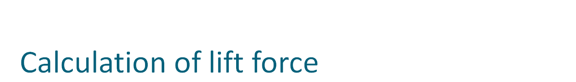
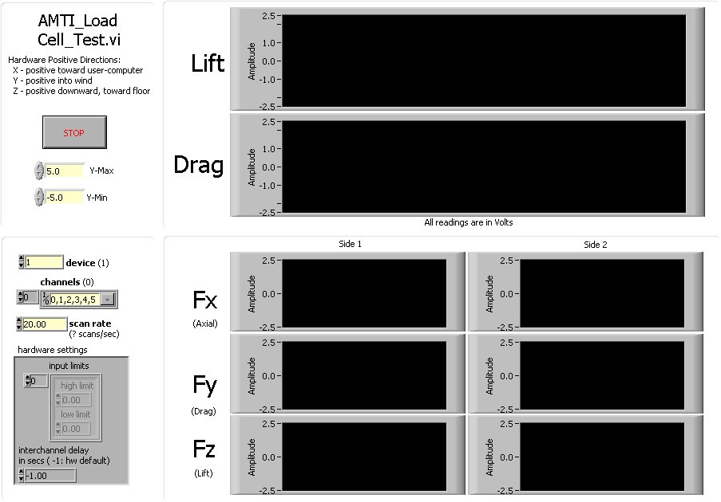
Program to measure lift force in volts

Slide 15
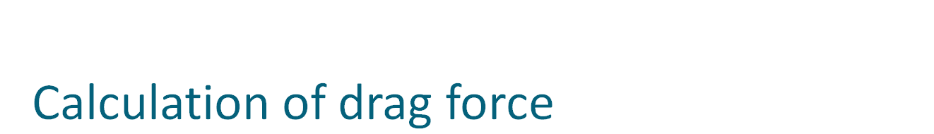
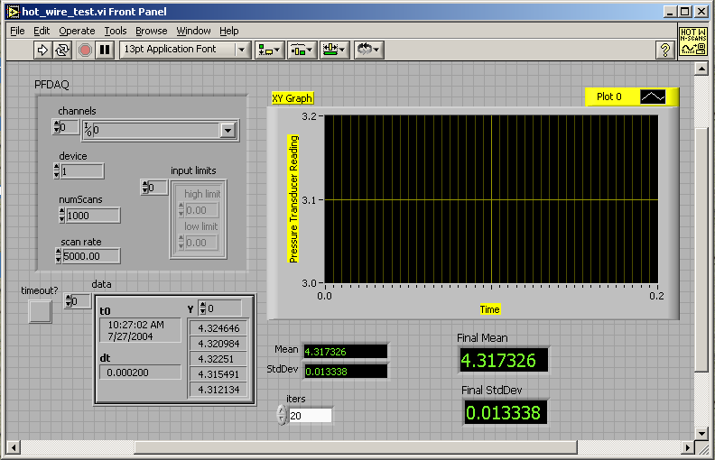
Program to measure velocity in volts

Slide 16
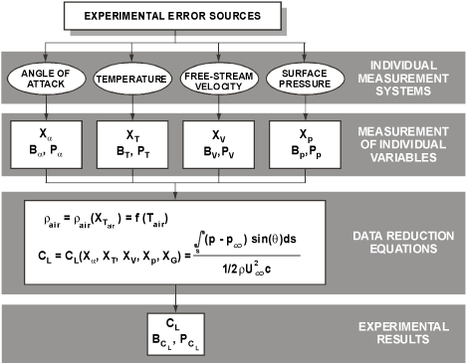
Uncertainty analysis

Slide 17





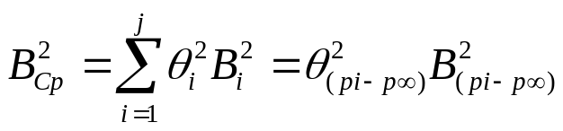
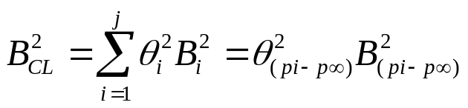
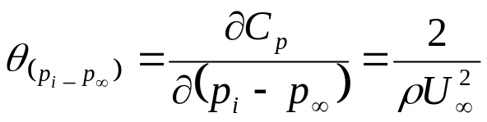
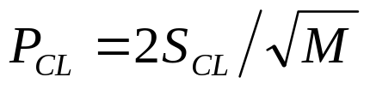
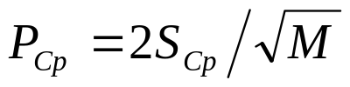
Pressure coefficient
Lift coefficient

Slide 18
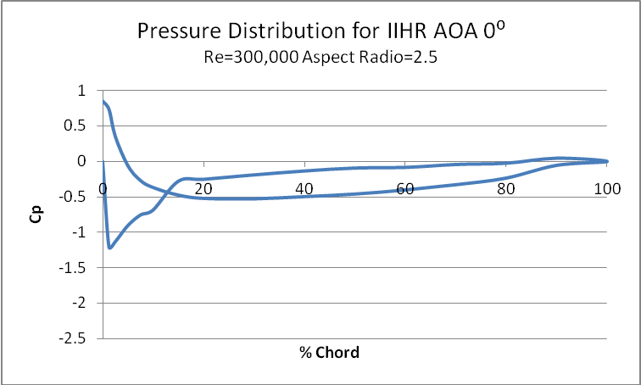
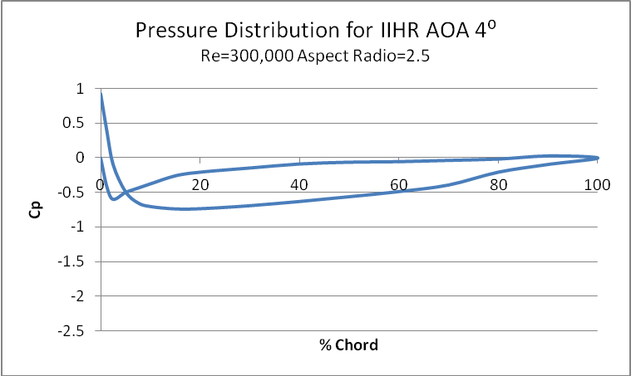
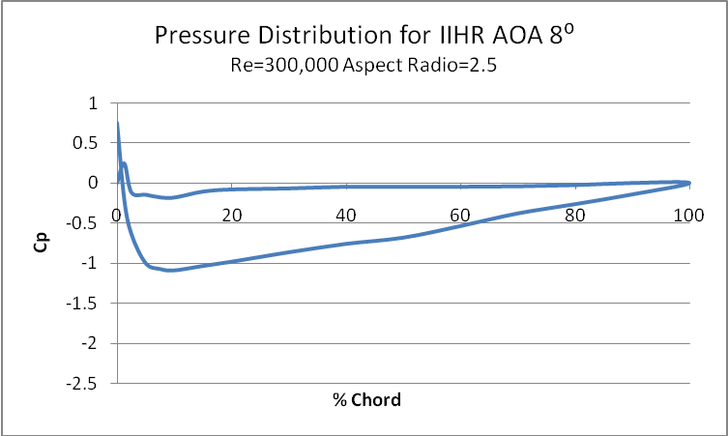
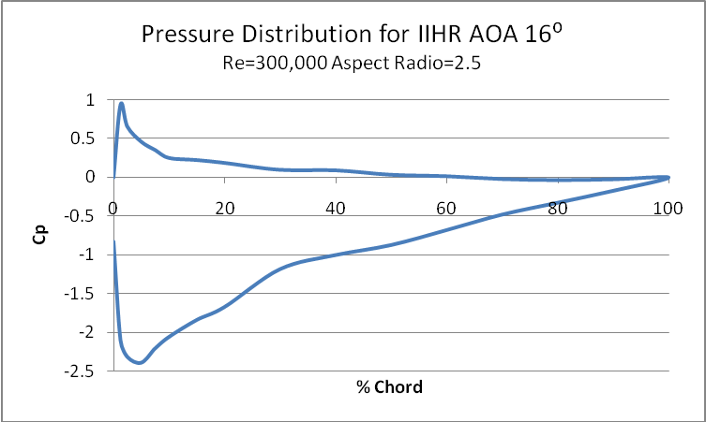
Benchmark data
Distribution of the pressure coefficients for
= 0°, 4°, 8°, 16° and Re = 300,000

Slide 19
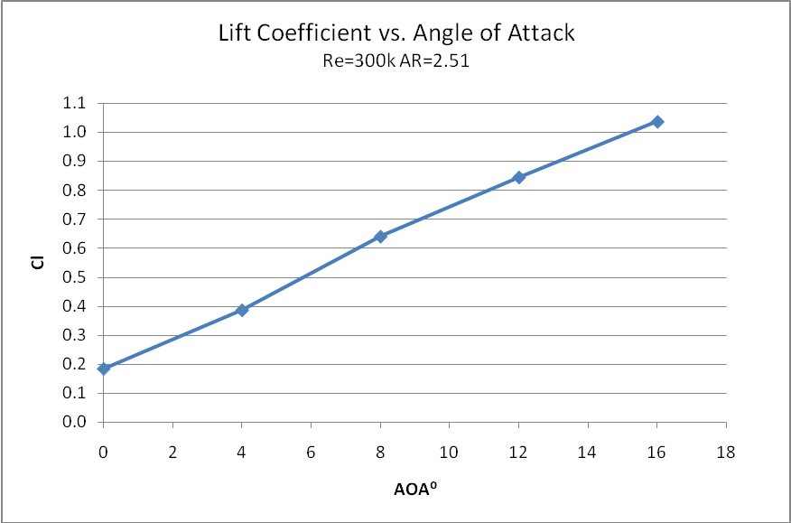
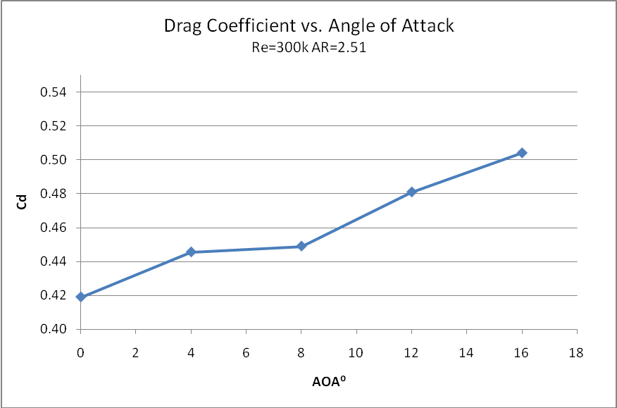
Benchmark data continued
Reference data for C_{L}
Reference data for C_{D}

Slide 20
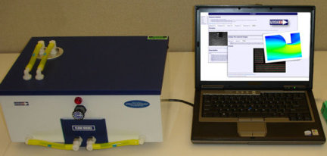
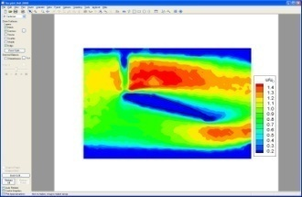
ePIV
Measurements of complete flow field with a small Clark-Y
Re≈1000
Chord length ≈ 20 mm
AoA of 0° and 16°
Plot the following
  Contour of velocity magnitude
  Vector field
  Streamlines
Two models: AoA 0° and 16°

Slide 21
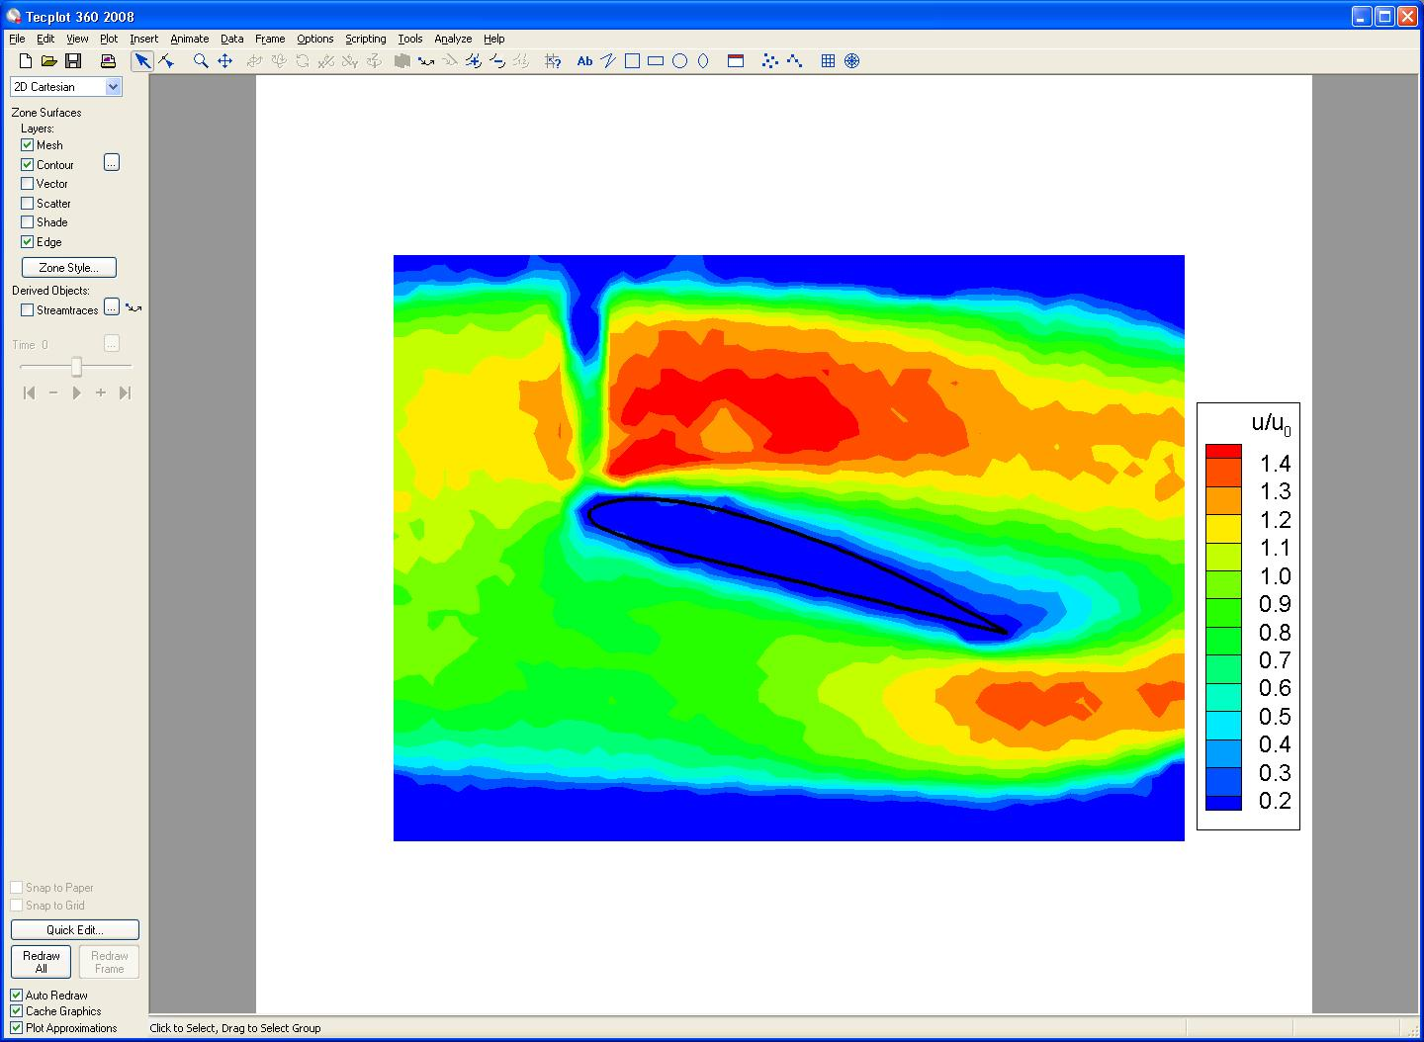
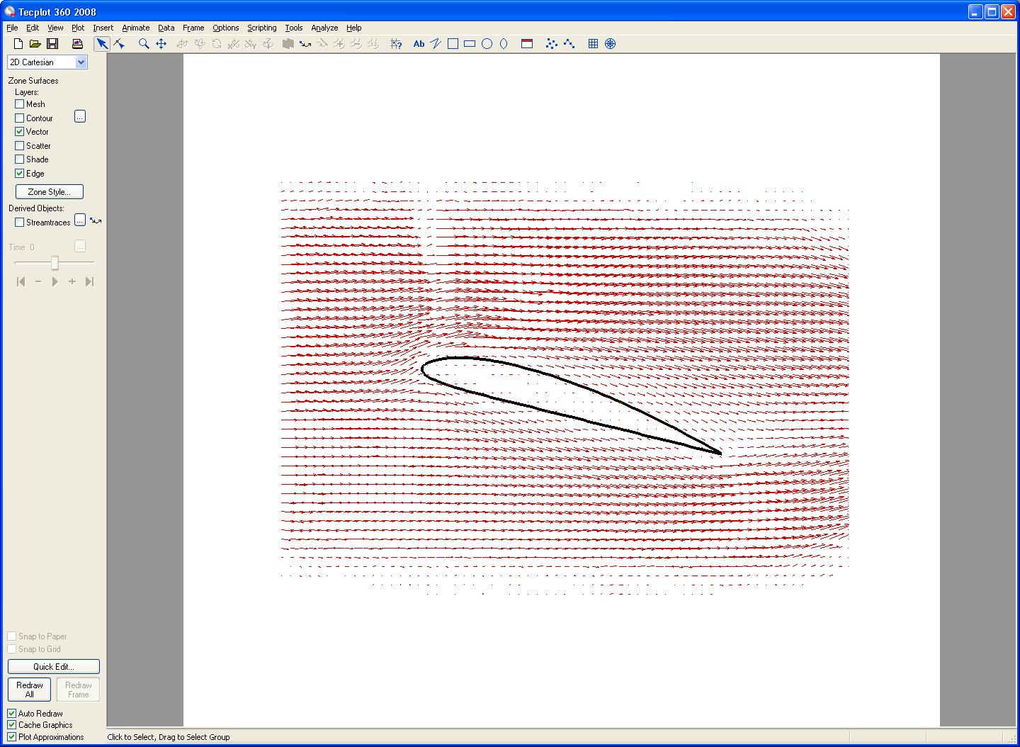
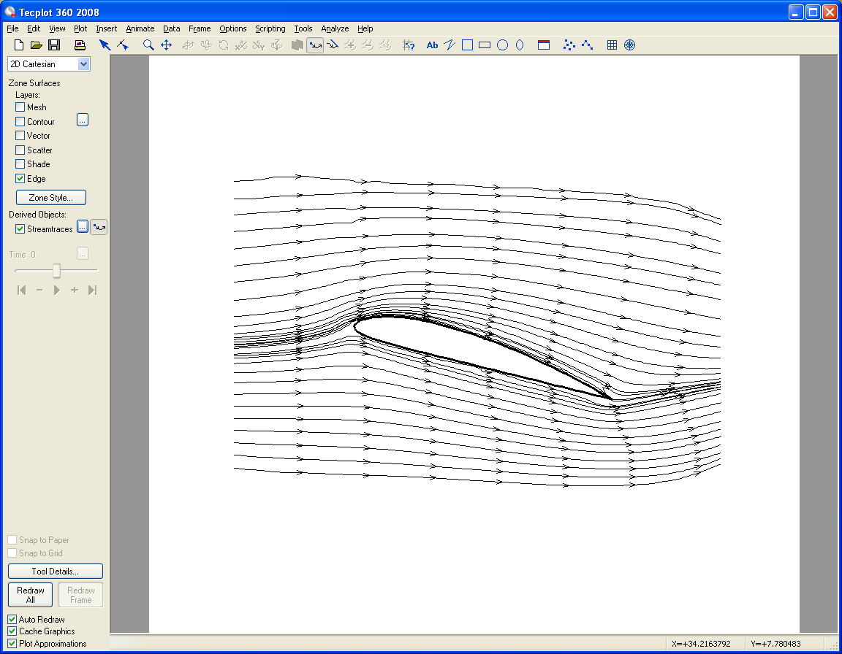
ePIV-Post Processing
Contour of velocity magnitude
Velocity vectors
Streamlines

Slide 22
ePIV – Post Processing continued
Flow conditions
Re ≈ 1000
AoA = 16°
PIV setting
Brightness = 35
Exposure = 100
Gain = 100
Frames = 9
Window size = 30
Shift size = 15
PIV pairs = 9
Wall
Airfoil
Wake
Flow
Wall

Slide 23
ePIV – Analysis
Flow features
Optical hindrance
Fast moving flow
Low pressure region
Stagnation points
Slow moving flow
High pressure region

Slide 24
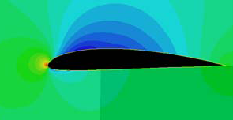
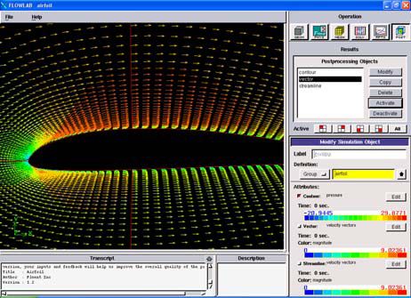
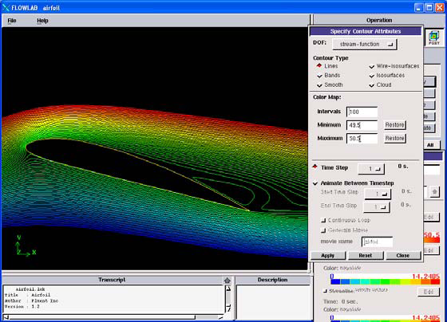
ePIV – CFD Comparison
ePIV
CFD

