Slide 1


Neural networks
and deep learning
Rafael Coelho Lopes de Sa
University of Massachusetts Amherst
Based on slides prepared by Michelle Kuchera
for the HSF-India event at IIT Madras
Neural networks and deep learning
Notes:
Source: Michelle Kuchera, Lecture1-NN.pdf, slide 1.

Slide 2
Lecture 1 topics
Computational graphs
Gradient-descent optimization
Logistic regression
Regression neural networks
Neural networks and deep learning
2
Notes:
Source: Michelle Kuchera, Lecture1-NN.pdf, slide 6.

Slide 3
Goals
Each of us learns something today
Stop me with any questions
Neural networks and deep learning
3
Notes:
Source: Michelle Kuchera, Lecture1-NN.pdf, slide 7.

Slide 4
Community
Each of you arrived here with your own backgrounds, specialty, and path in life
Your experience and expertise are valuable here, no matter what it is
If the activity is within your background, help others!
If you are totally (or a little) lost, ask for help!
It is our shared goal to have each of us leave with some new skill/knowledge/understanding
Neural networks and deep learning
4
Notes:
Source: Michelle Kuchera, Lecture1-NN.pdf, slide 8.

Slide 5
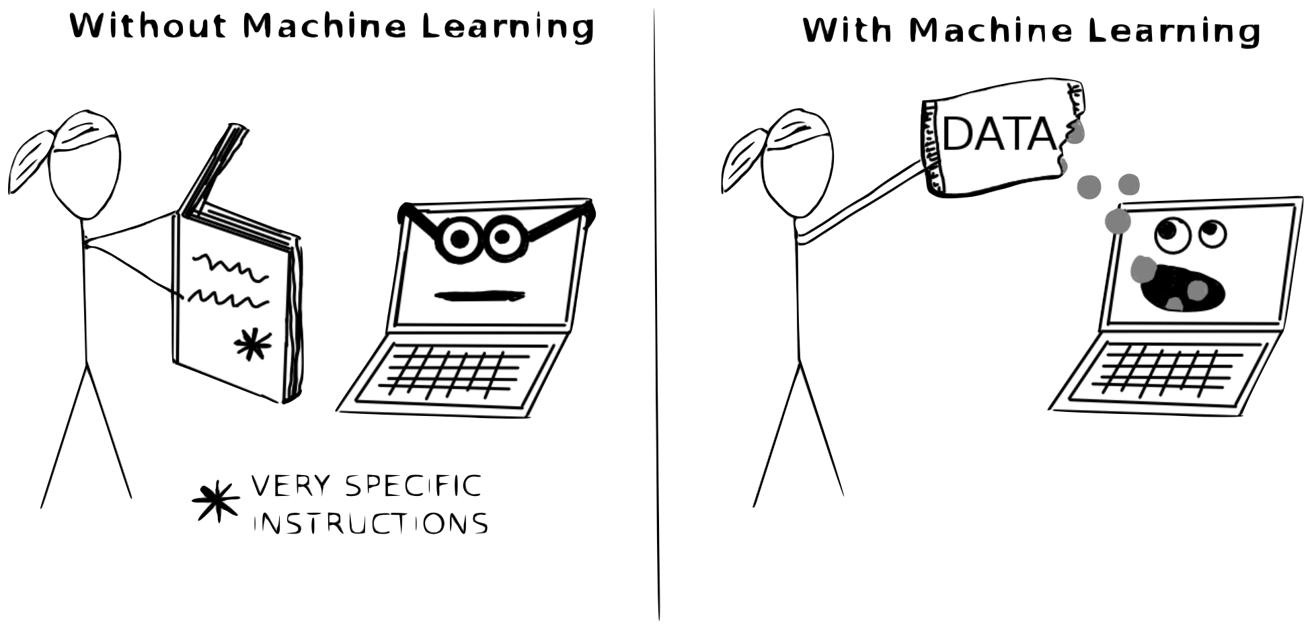
Machine learning: learning from data
Neural networks and deep learning
5
Notes:
Source: Michelle Kuchera, Lecture1-NN.pdf, slide 9.

Slide 6
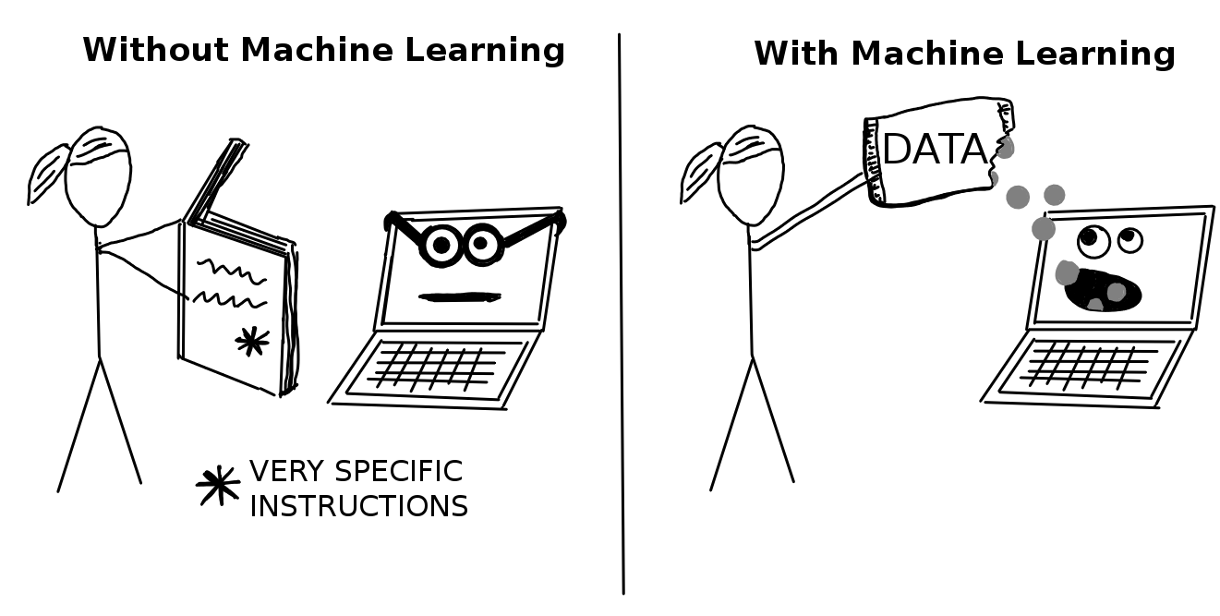
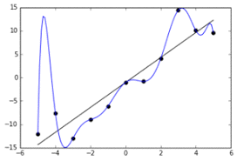
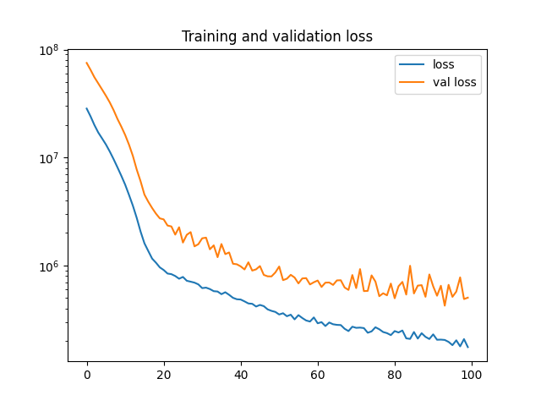
Learning from data was a paradigm shift
in thinking about predictive models
Neural networks and deep learning
6
Notes:
Source: Michelle Kuchera, Lecture1-NN.pdf, slide 10.

Slide 7
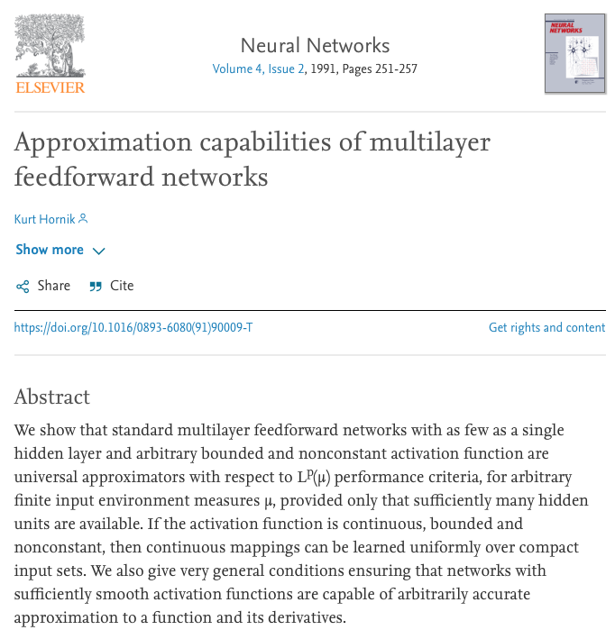
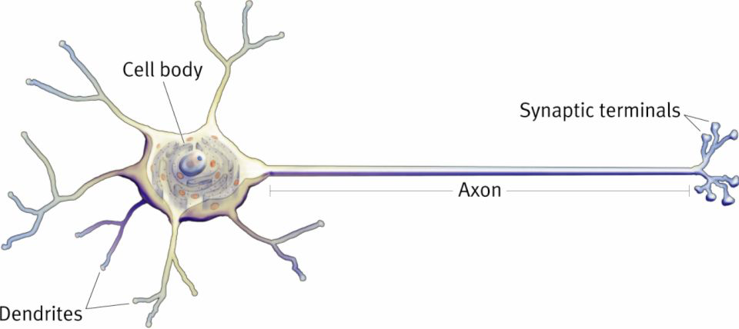
Neuron
Mathematics
Neural networks and deep learning
7
Notes:
Source: Michelle Kuchera, Lecture1-NN.pdf, slide 11.

Slide 8
Mathematics
Notes:
Source: Michelle Kuchera, Lecture1-NN.pdf, slide 12.

Slide 9
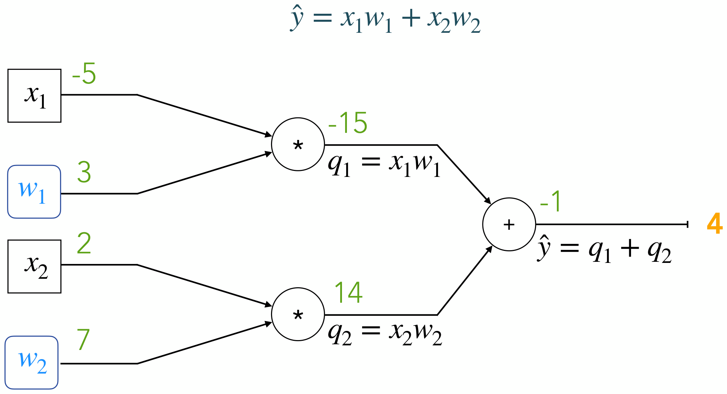
Computational graph
Neural networks and deep learning
9
Notes:
Source: Michelle Kuchera, Lecture1-NN.pdf, slide 13.

Slide 10
Machine learning
Notes:
Source: Michelle Kuchera, Lecture1-NN.pdf, slide 14.

Slide 11
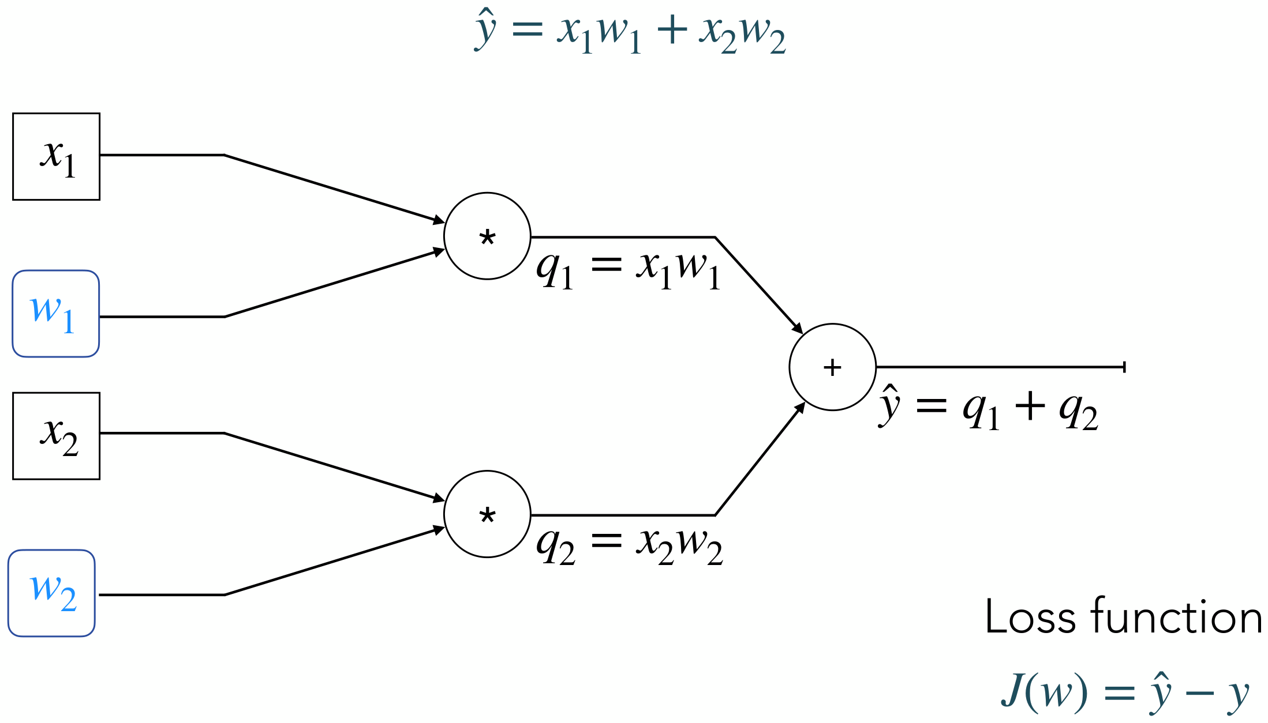
Regression
Neural networks and deep learning
11
Notes:
Source: Michelle Kuchera, Lecture1-NN.pdf, slide 15.

Slide 12
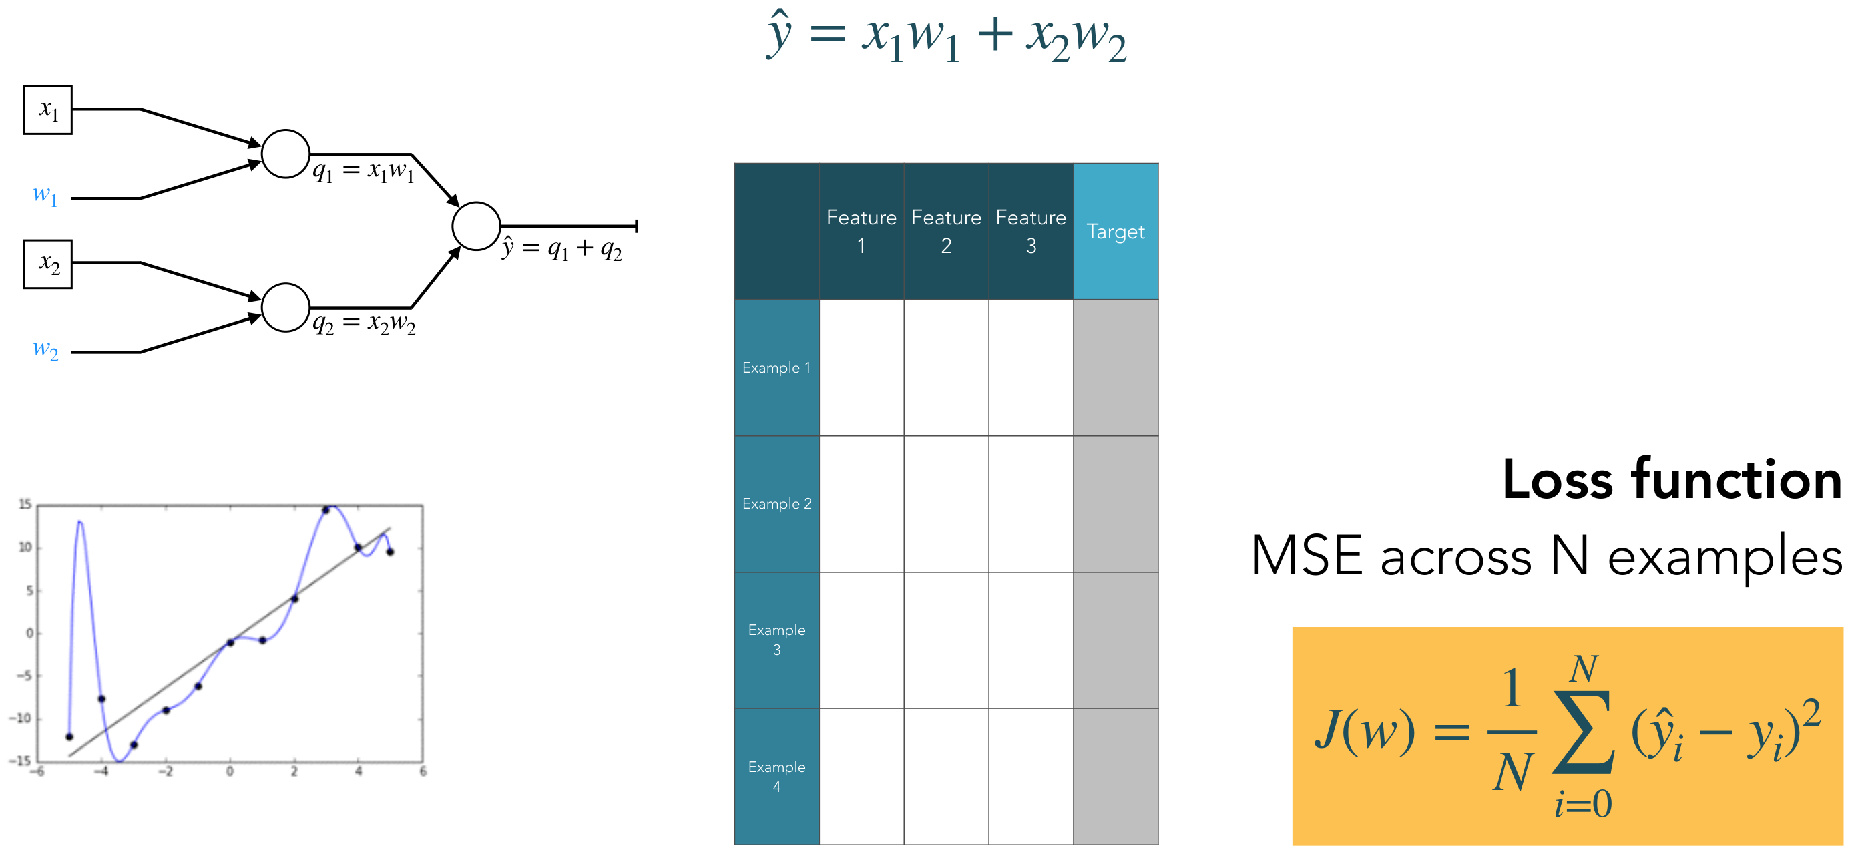
Supervised learning
Neural networks and deep learning
12
Notes:
Source: Michelle Kuchera, Lecture1-NN.pdf, slide 16.

Slide 13
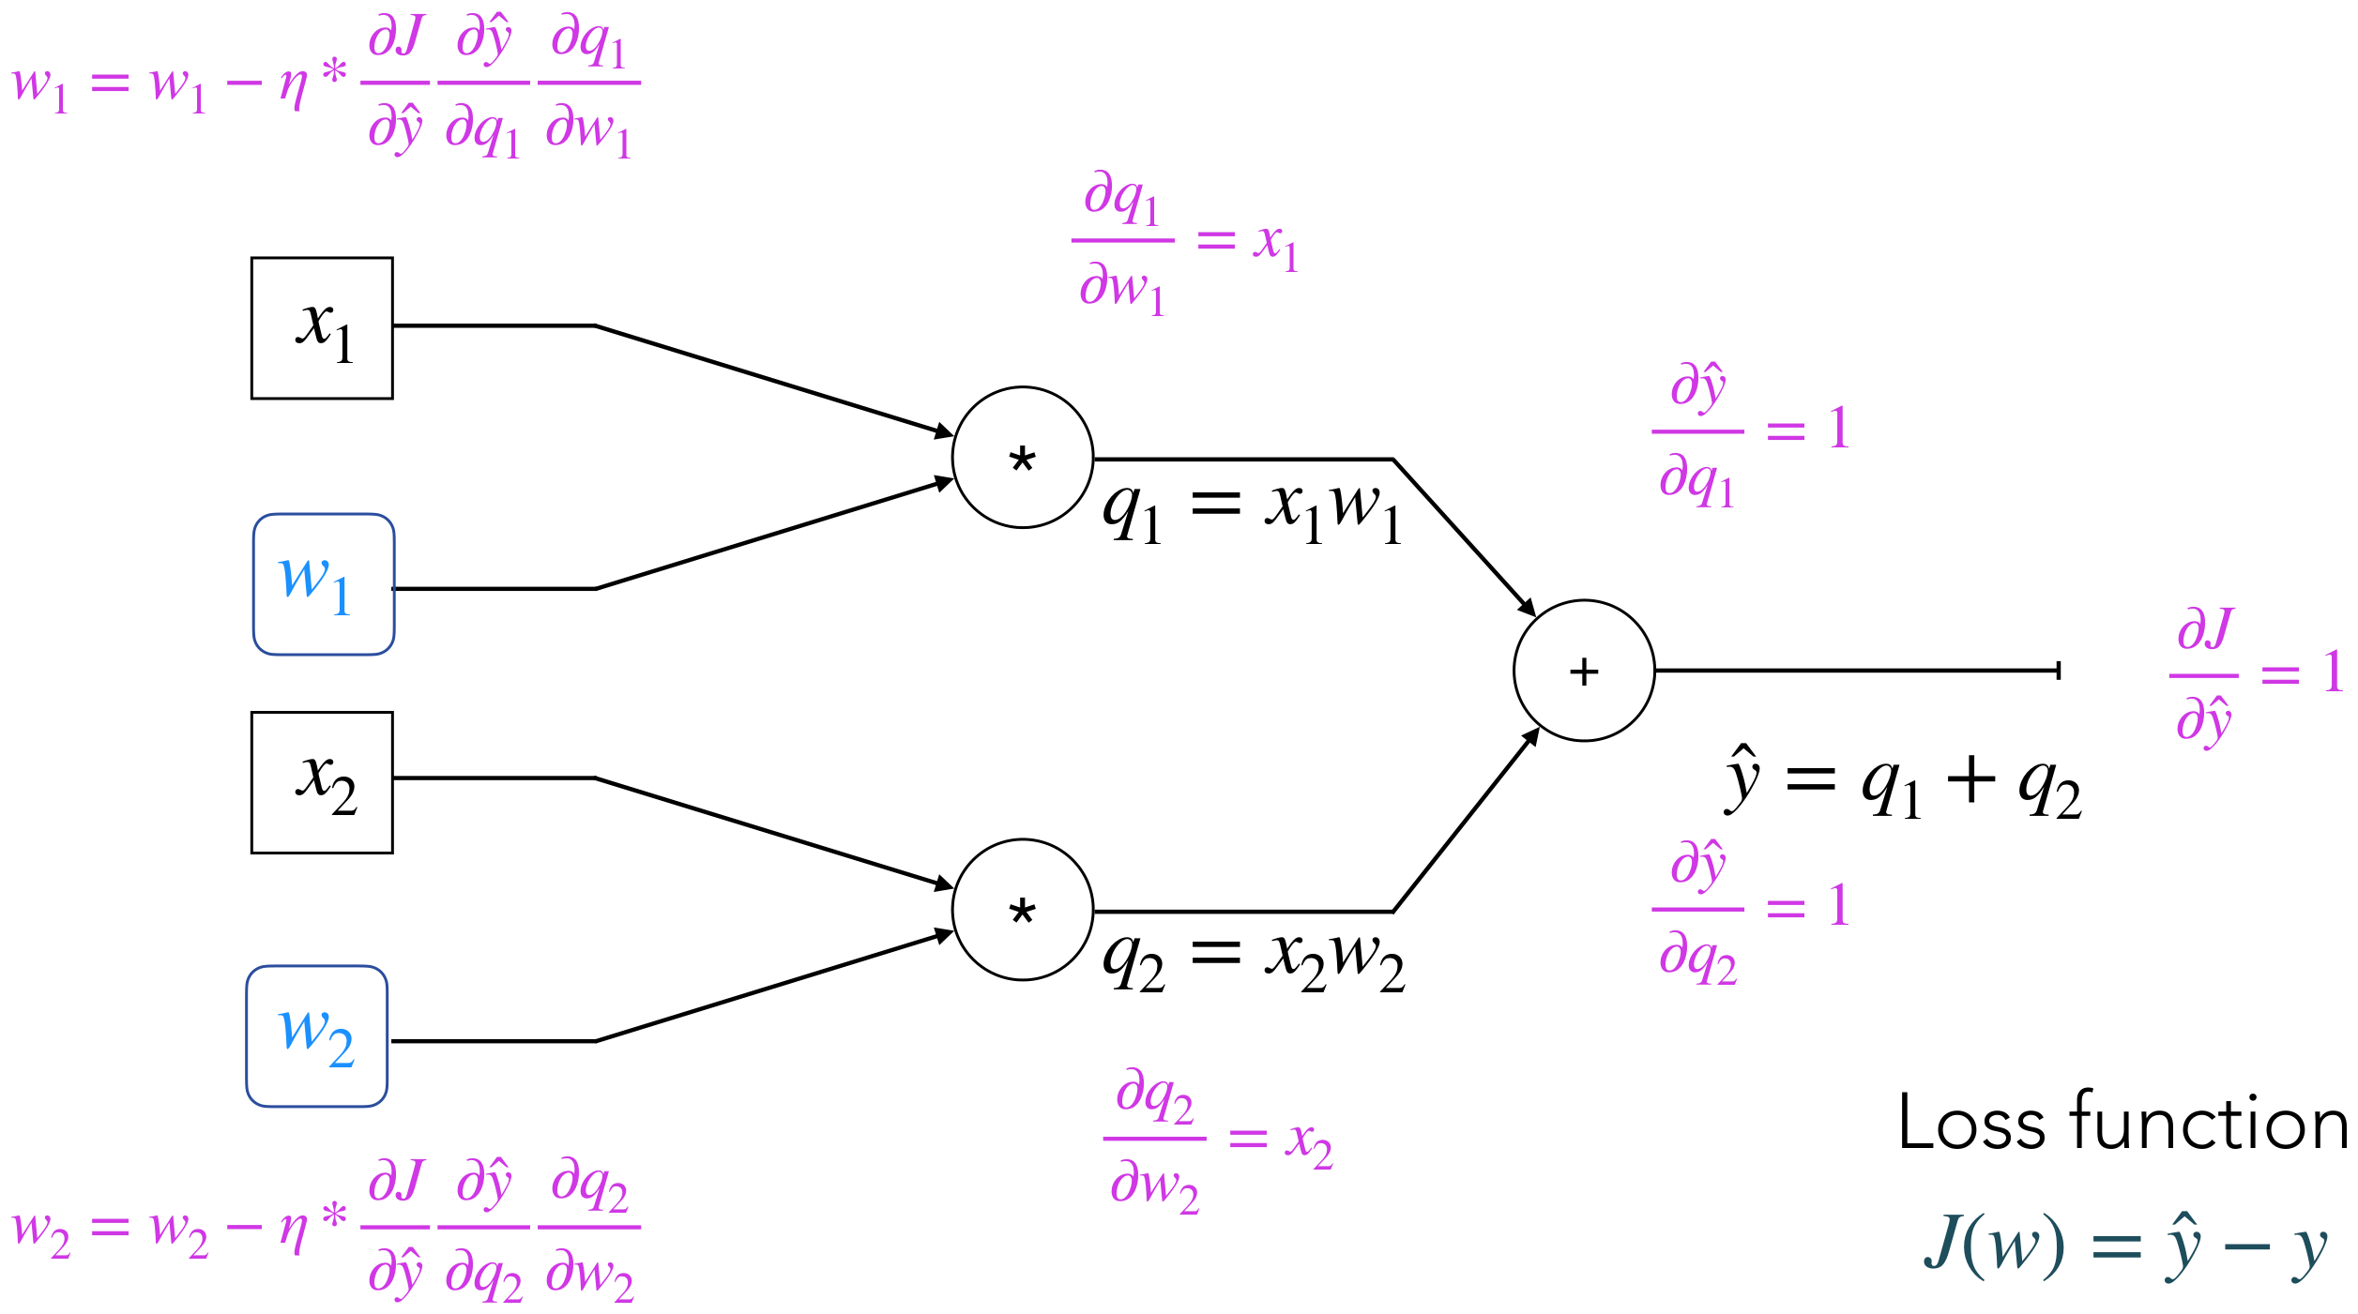
Backpropagation
Neural networks and deep learning
13
Notes:
Source: Michelle Kuchera, Lecture1-NN.pdf, slide 17.

Slide 14
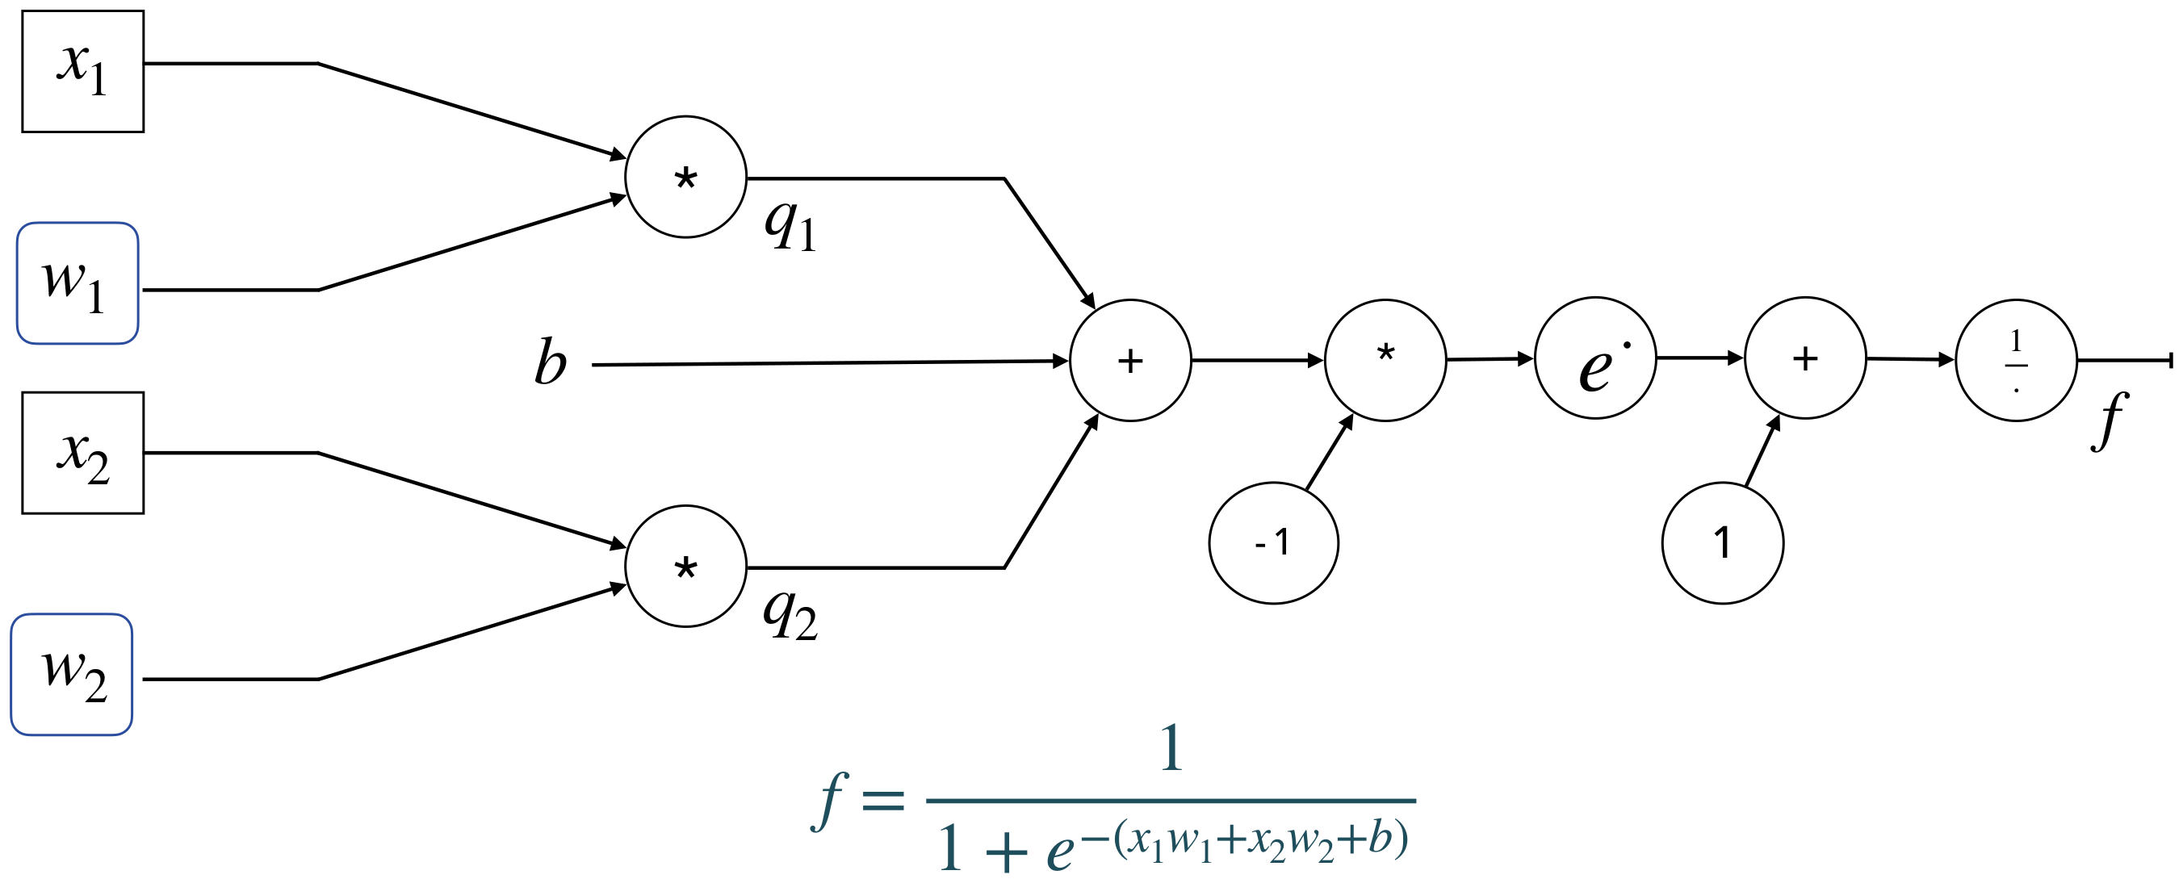
Logistic regression
Neural networks and deep learning
14
Notes:
Source: Michelle Kuchera, Lecture1-NN.pdf, slide 18.

Slide 15
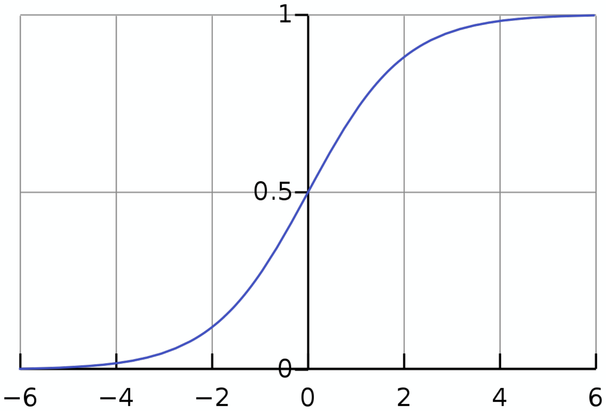
Logistic regression
Neural networks and deep learning
15
Notes:
Source: Michelle Kuchera, Lecture1-NN.pdf, slide 19.

Slide 16
Logistic regression
Neural networks and deep learning
16
Notes:
Source: Michelle Kuchera, Lecture1-NN.pdf, slide 21.

Slide 17
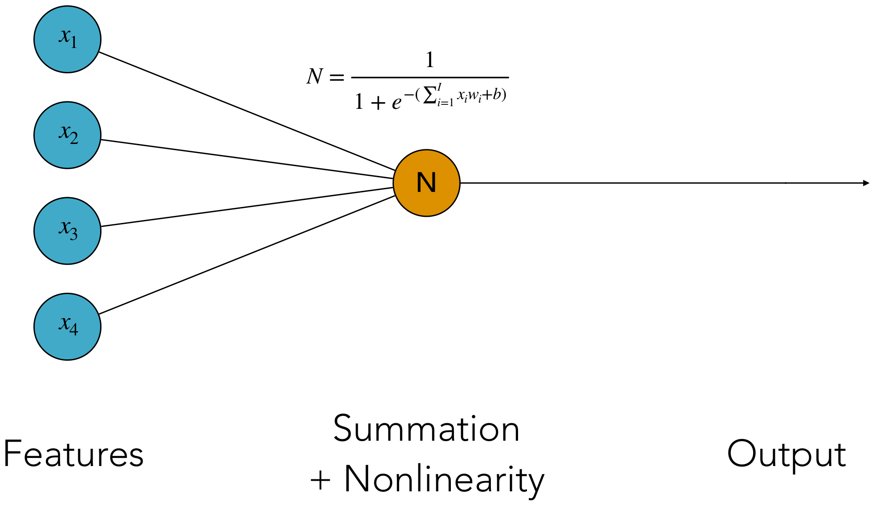
Neural networks and deep learning
17
Notes:
Source: Michelle Kuchera, Lecture1-NN.pdf, slide 22.

Slide 18

Check: How many trainable parameters?
Neural networks and deep learning
18
Notes:
Source: Michelle Kuchera, Lecture1-NN.pdf, slide 23.

Slide 19
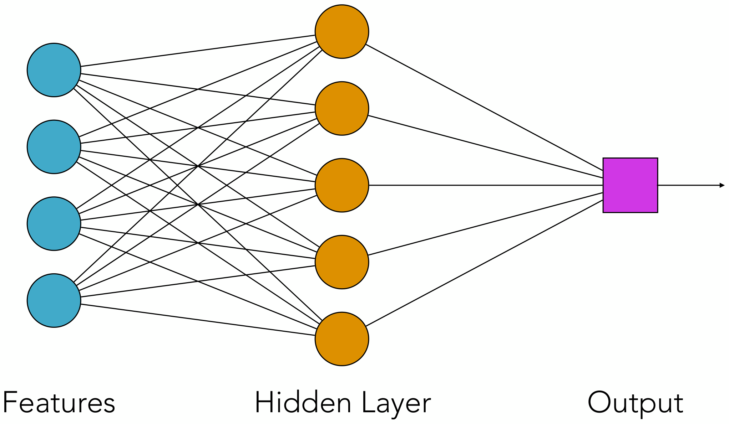
Neural networks and deep learning
19
Notes:
Source: Michelle Kuchera, Lecture1-NN.pdf, slide 24.

Slide 20
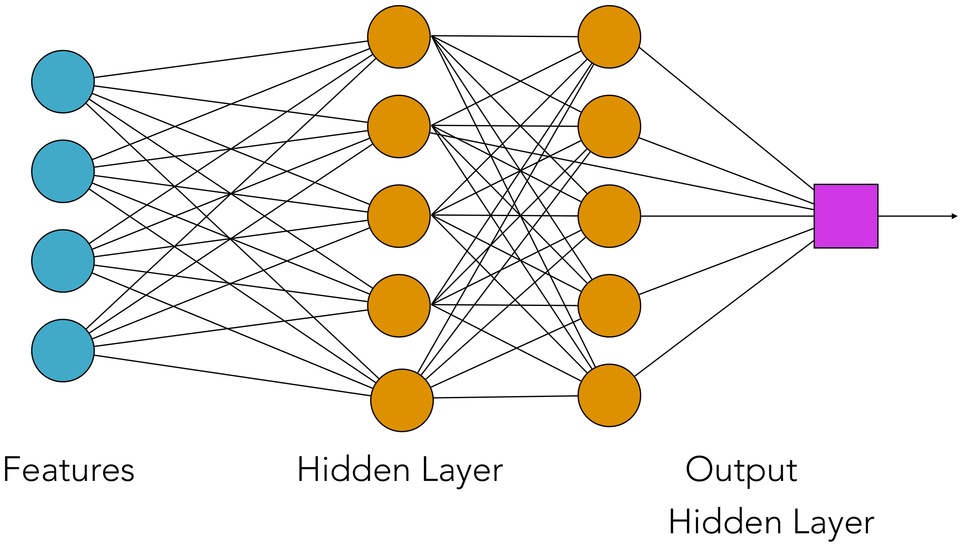
Neural networks and deep learning
20
Notes:
Source: Michelle Kuchera, Lecture1-NN.pdf, slide 25.

Slide 21
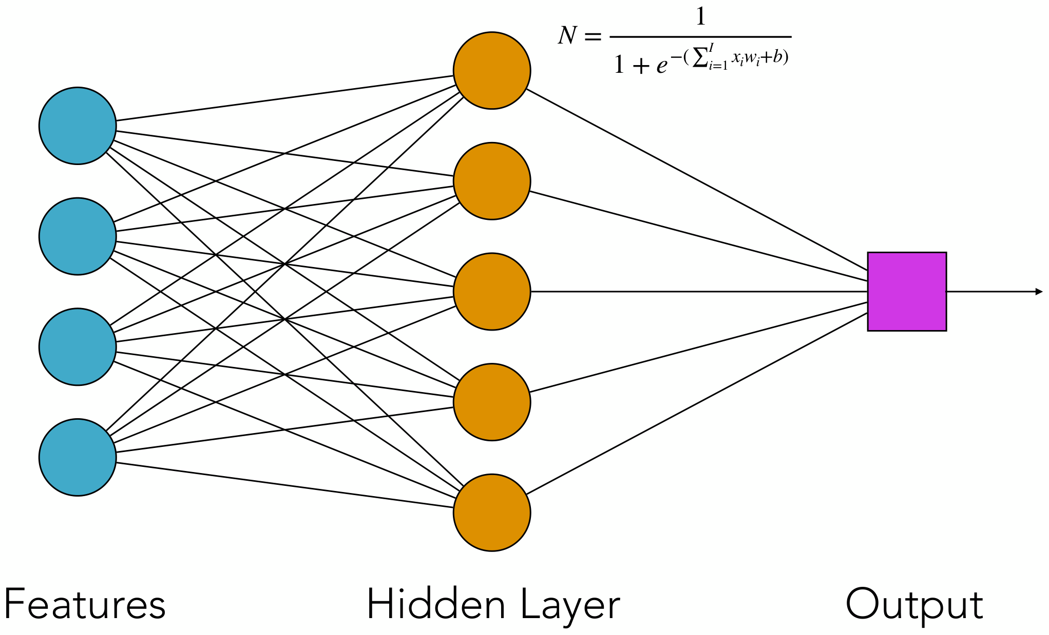
Check: How many trainable parameters?
Neural networks and deep learning
21
Notes:
Source: Michelle Kuchera, Lecture1-NN.pdf, slide 26.

Slide 22
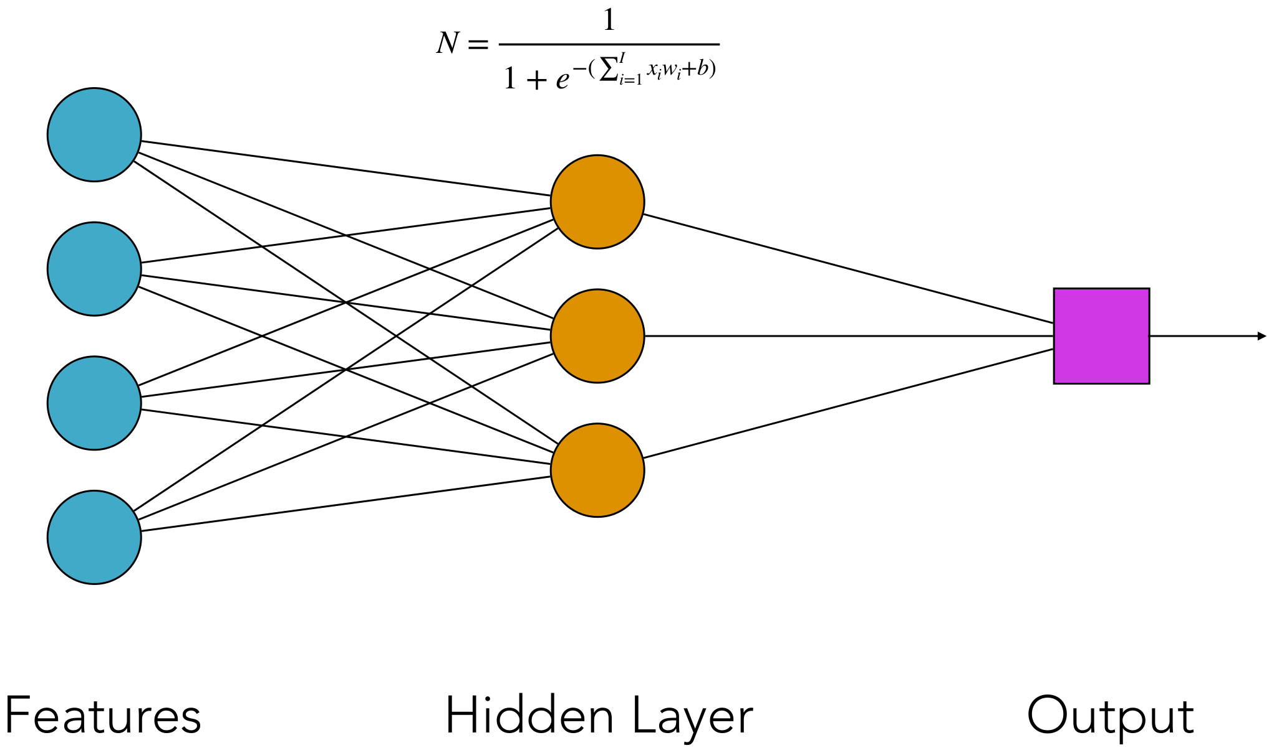
Check: How many trainable parameters?
Neural networks and deep learning
22
Notes:
Source: Michelle Kuchera, Lecture1-NN.pdf, slide 27.

Slide 23

Backpropagation
Neural networks and deep learning
23
Notes:
Source: Michelle Kuchera, Lecture1-NN.pdf, slide 28.

Slide 24
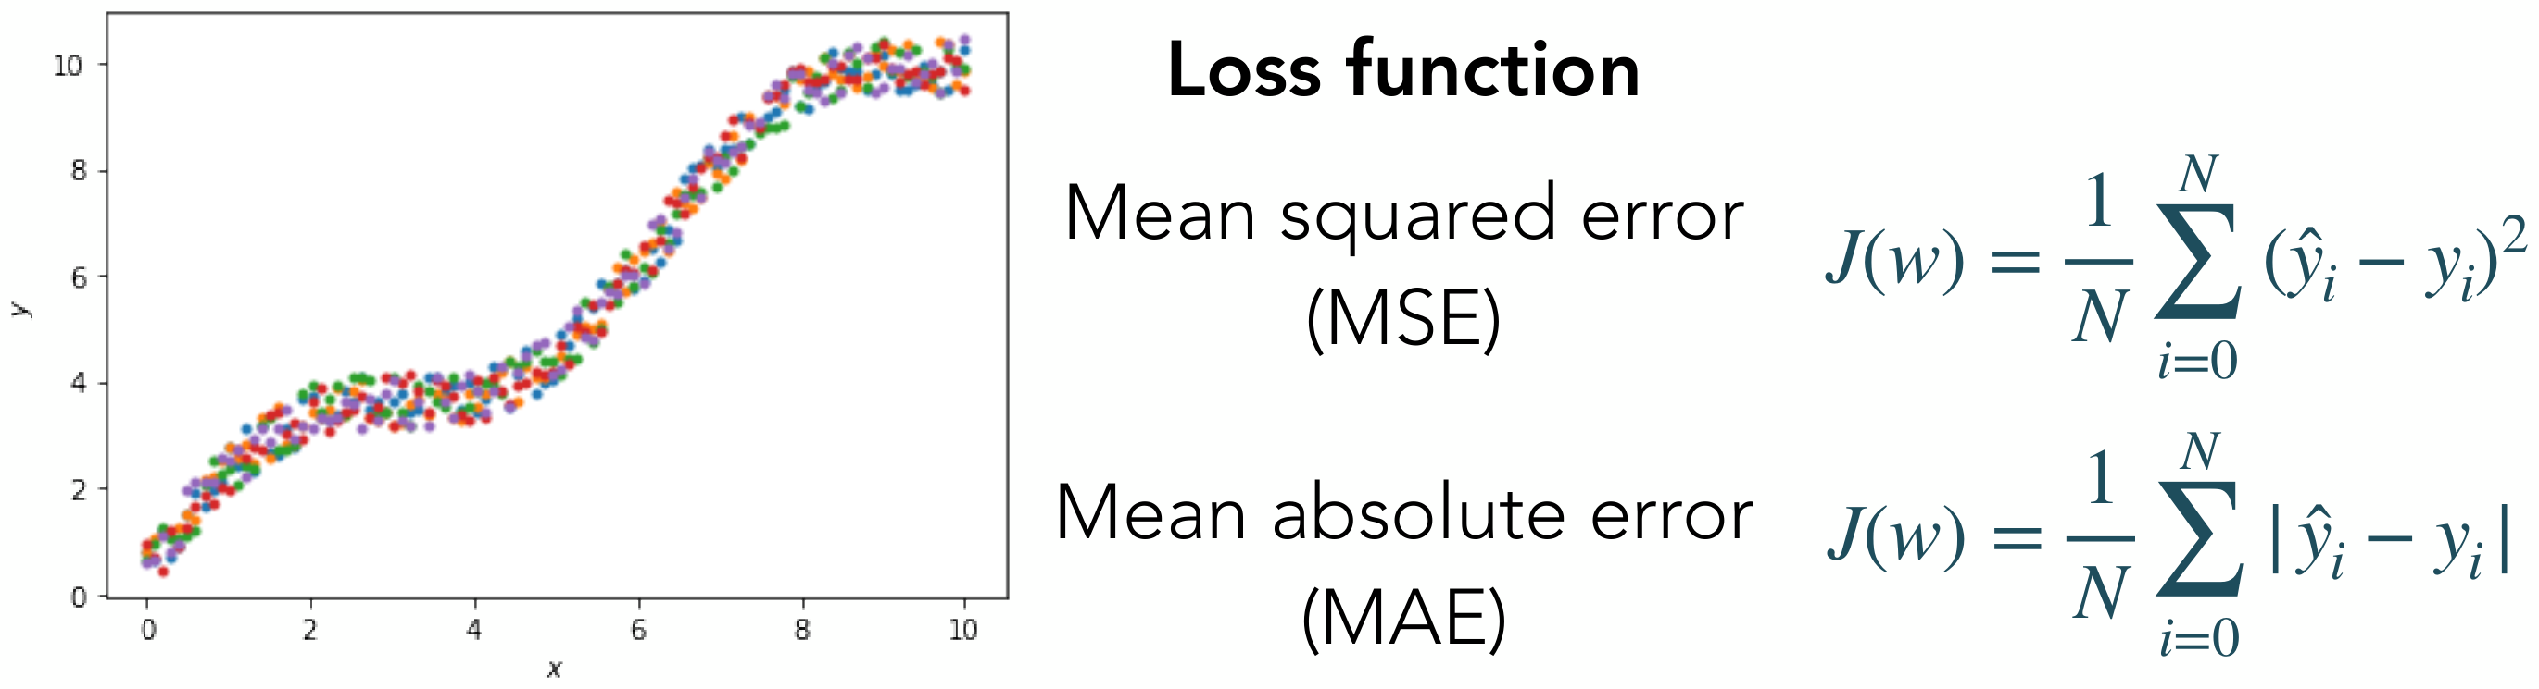
Loss functions
Neural networks and deep learning
24
Notes:
Source: Michelle Kuchera, Lecture1-NN.pdf, slide 29.

Slide 25
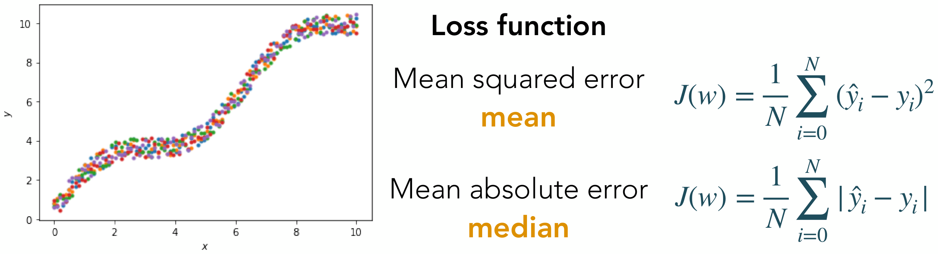
Loss functions
Neural networks and deep learning
25
Notes:
Source: Michelle Kuchera, Lecture1-NN.pdf, slide 30.

Slide 26
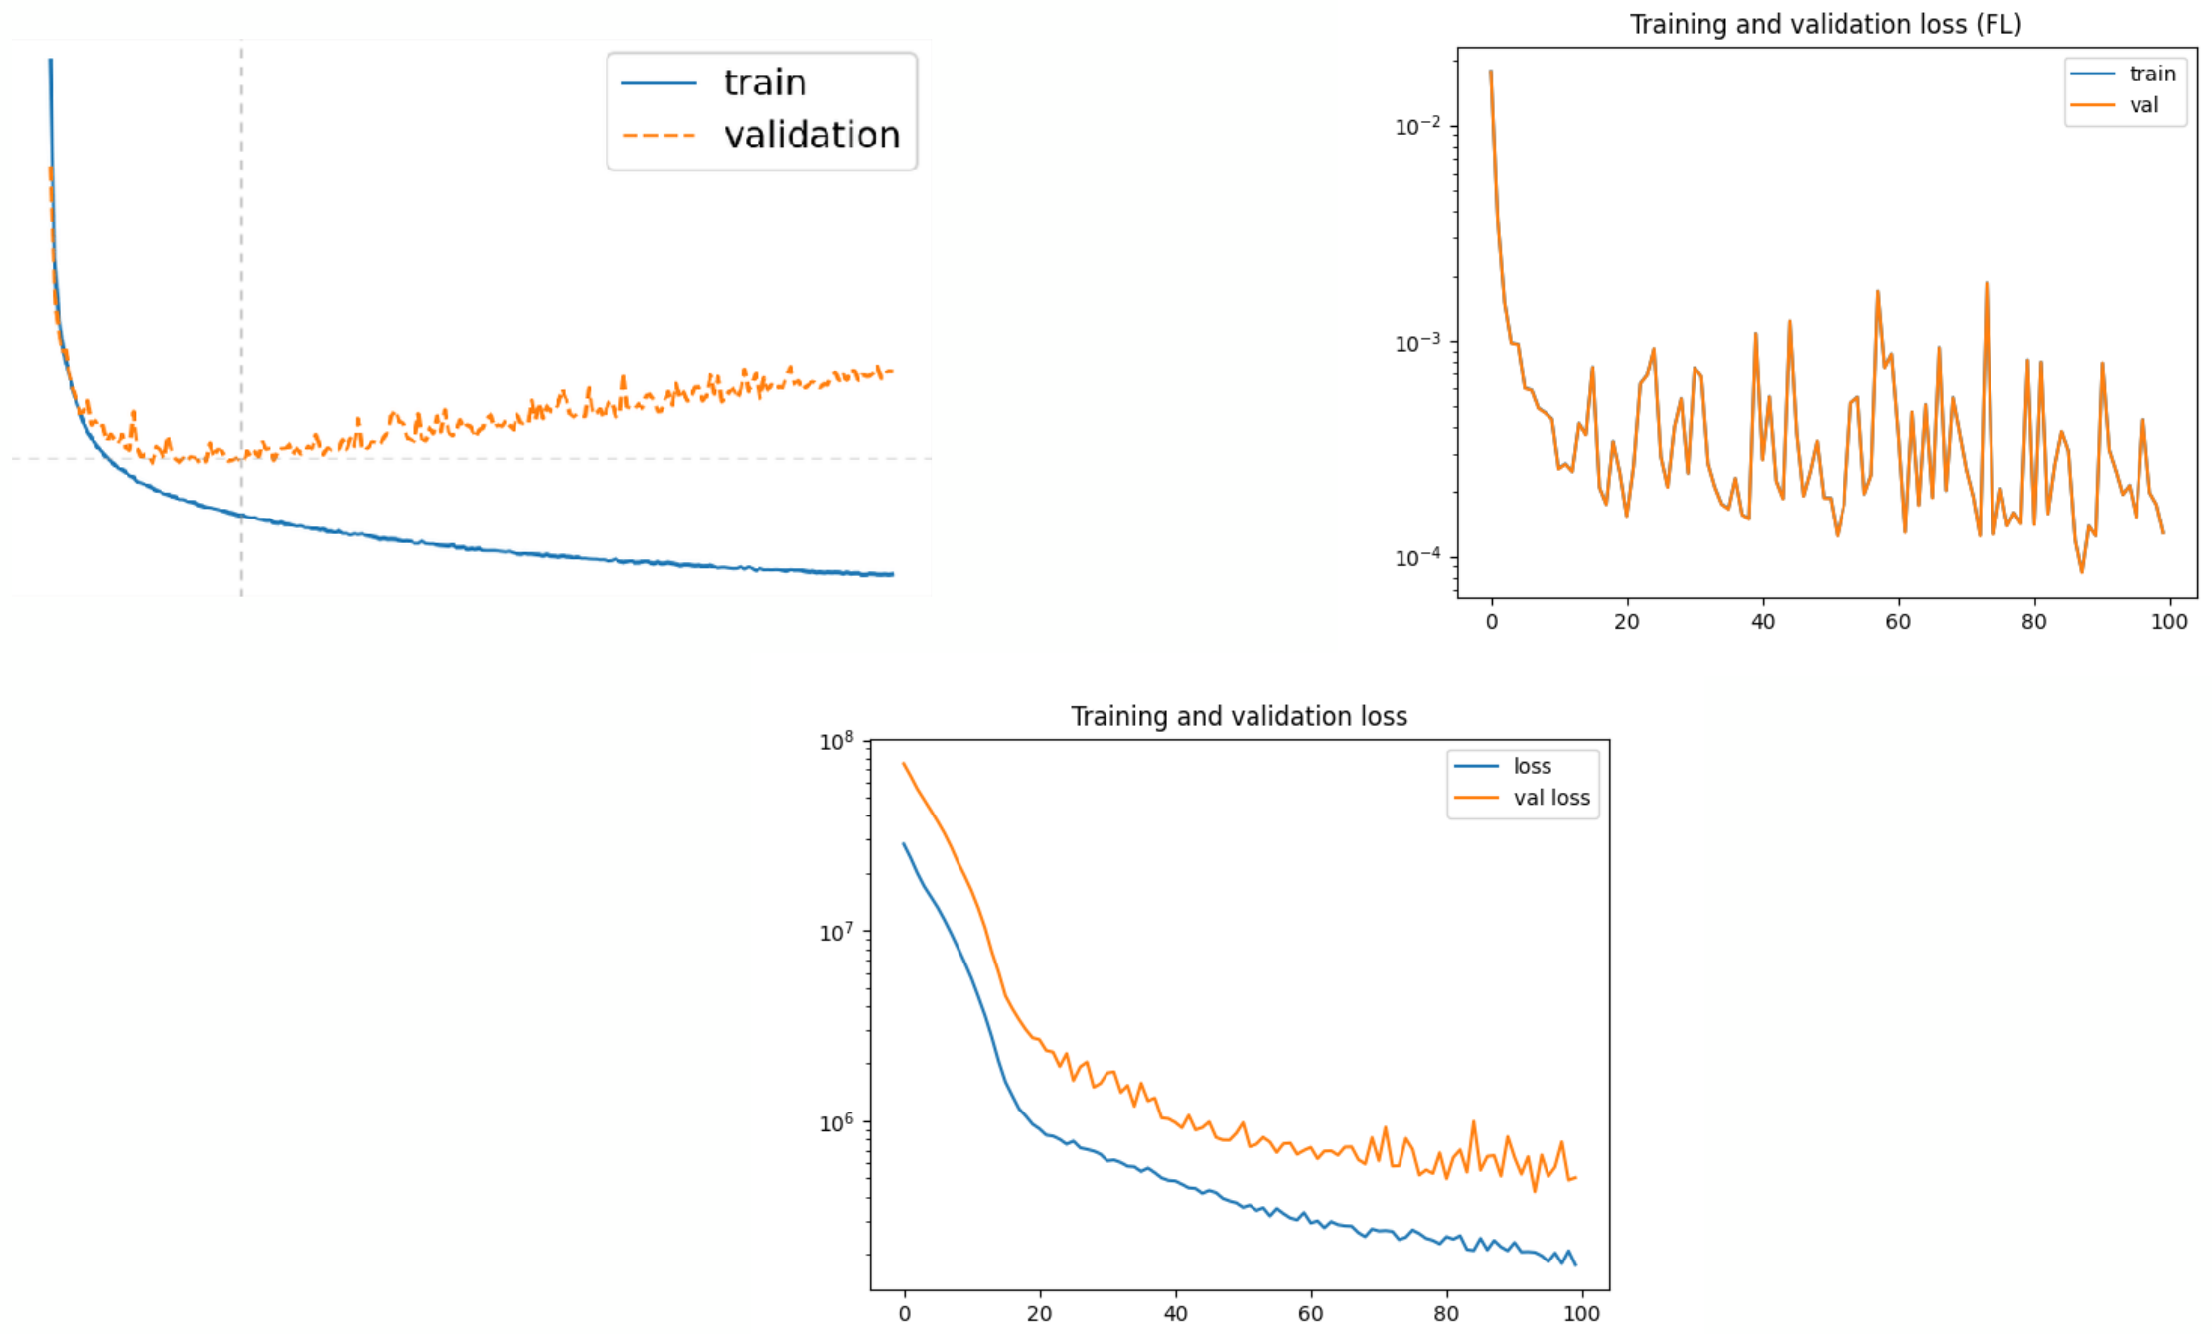
Learning (loss) curves
Neural networks and deep learning
26
Notes:
Source: Michelle Kuchera, Lecture1-NN.pdf, slide 31.

Slide 27
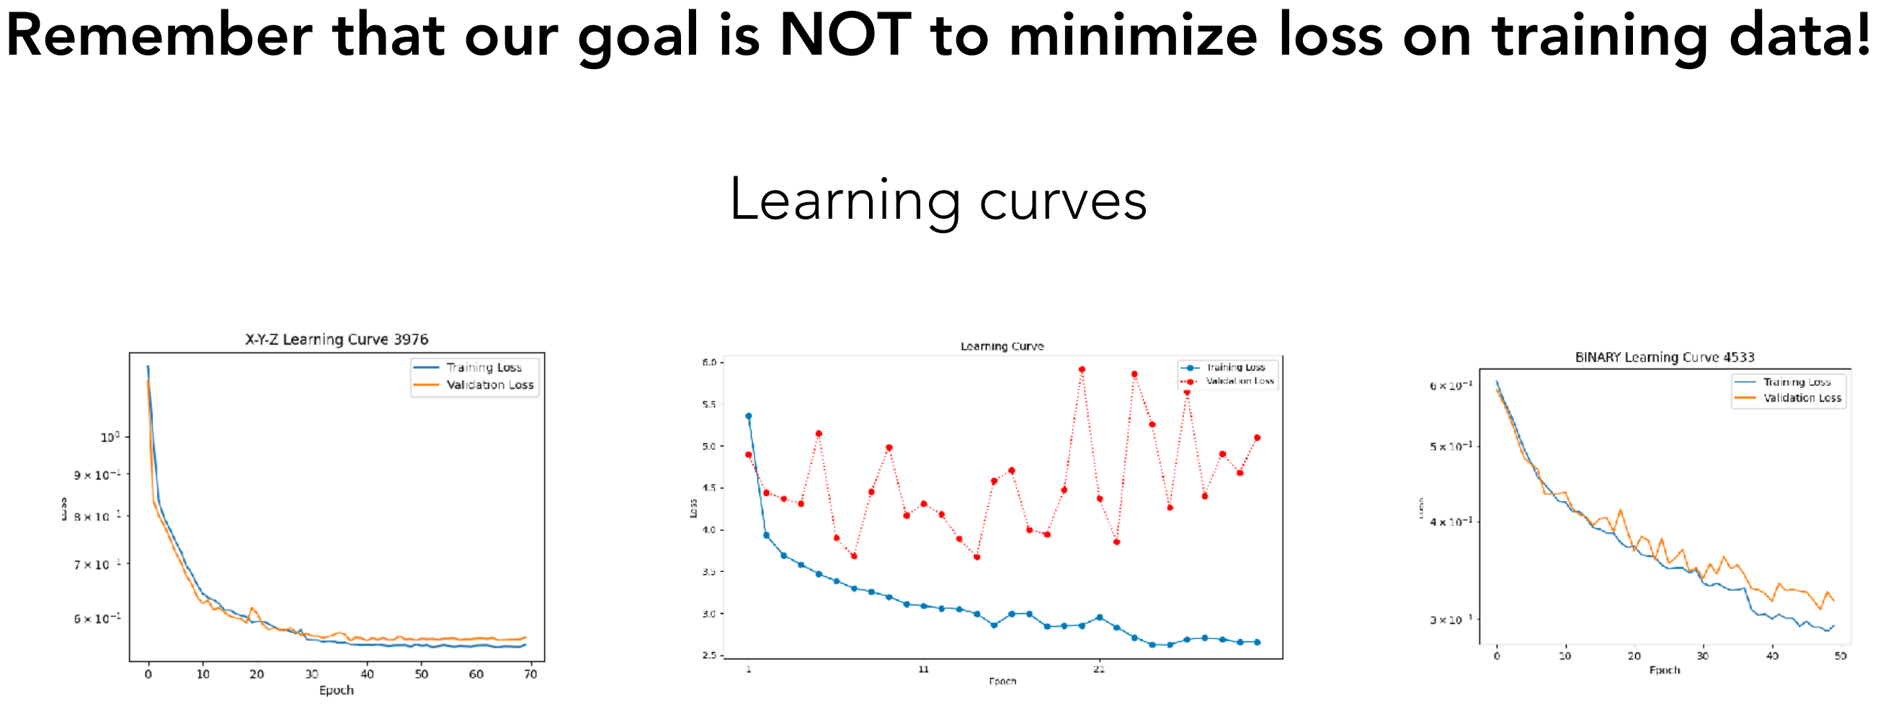
Training
Neural networks and deep learning
27
Notes:
Source: Michelle Kuchera, Lecture1-NN.pdf, slide 32.

Slide 28

Automatic differentiation
Neural networks and deep learning
28
Notes:
Source: Michelle Kuchera, Lecture1-NN.pdf, slide 33.

Slide 29
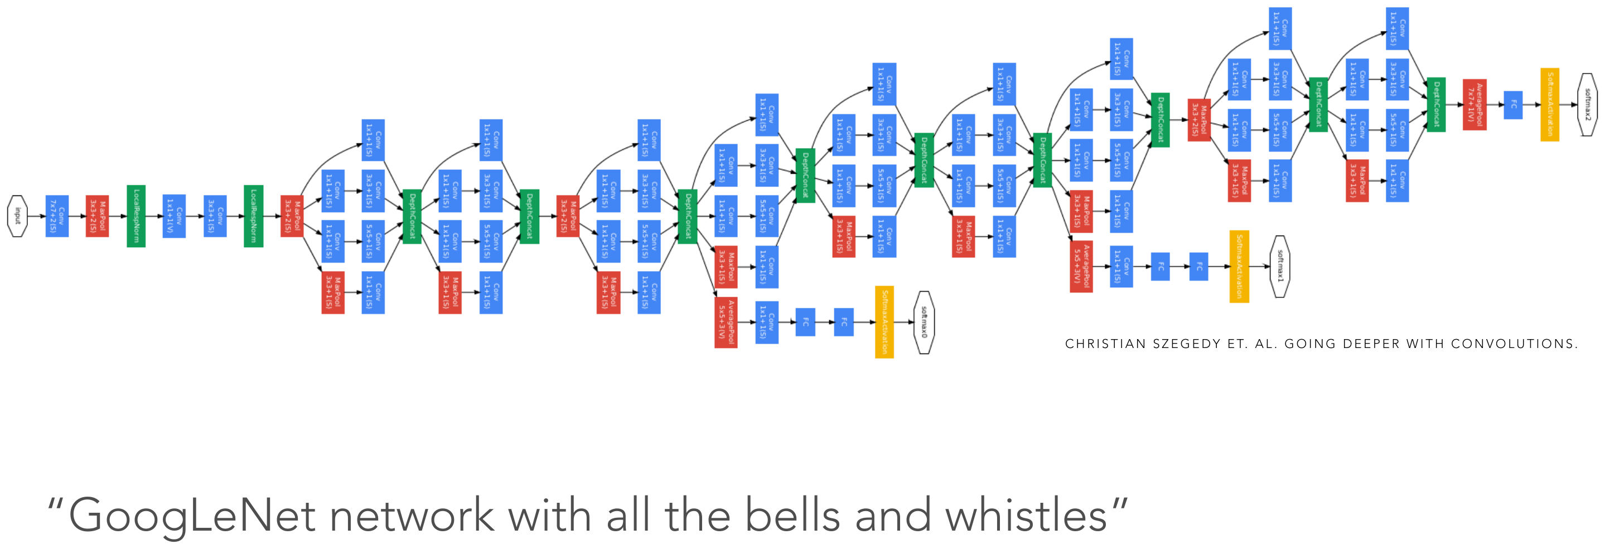
Modern neural network architectures
Neural networks and deep learning
29
Notes:
Source: Michelle Kuchera, Lecture1-NN.pdf, slide 34.

Slide 30
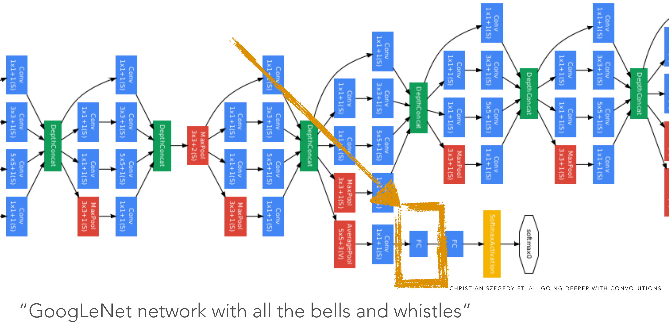
Modern neural network architectures
Neural networks and deep learning
30
Notes:
Source: Michelle Kuchera, Lecture1-NN.pdf, slide 35.

Slide 31
Practical tips for training models
Notes:
Source: Michelle Kuchera, Lecture1-NN.pdf, slide 36.

Slide 32
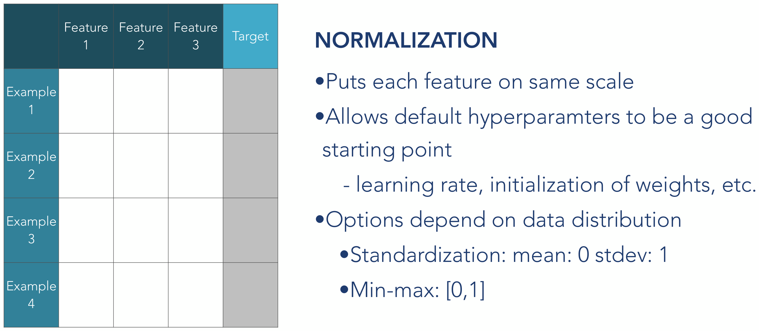
Data
Neural networks and deep learning
32
Notes:
Source: Michelle Kuchera, Lecture1-NN.pdf, slide 37.

Slide 33
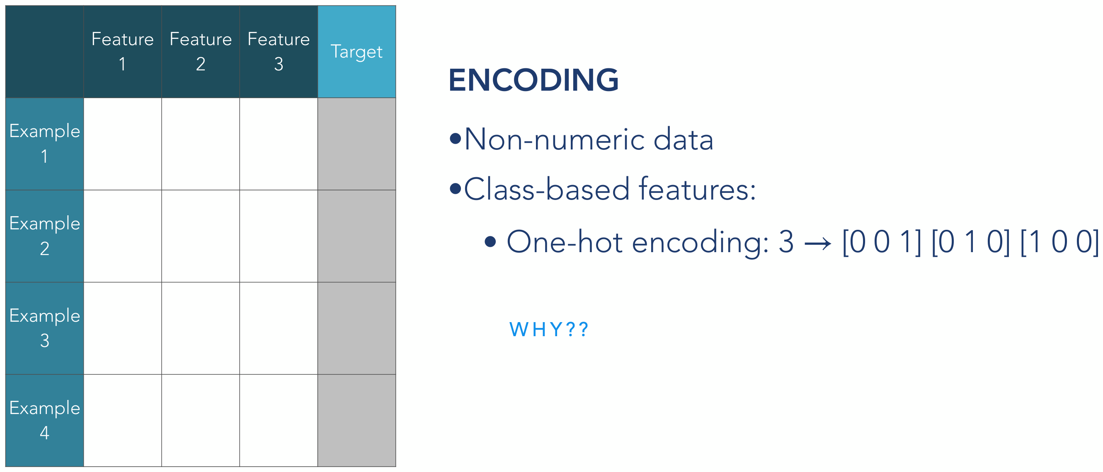
Data
Neural networks and deep learning
33
Notes:
Source: Michelle Kuchera, Lecture1-NN.pdf, slide 38.

Slide 34
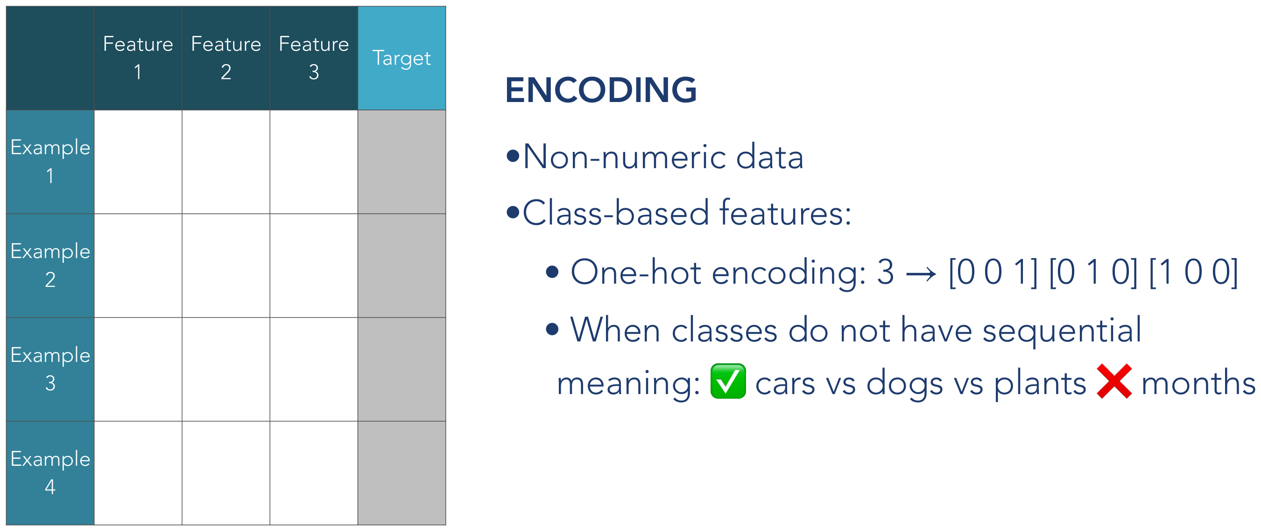
Data
Neural networks and deep learning
34
Notes:
Source: Michelle Kuchera, Lecture1-NN.pdf, slide 39.

Slide 35
Activity description
Simulating e+p collisions
Predicting particle-level invariant mass (regression)
Advanced: try a generative model (e.g. autoencoders)
Neural networks and deep learning
35
Notes:
Source: Michelle Kuchera, Lecture1-NN.pdf, slide 40.

Slide 36
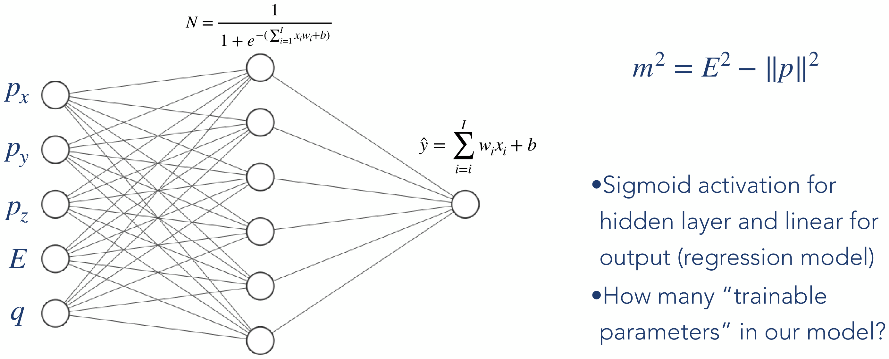
Activity description
Neural networks and deep learning
36
Notes:
Source: Michelle Kuchera, Lecture1-NN.pdf, slide 41.

Slide 37
Classification
Neural networks and deep learning
37
Notes:
Source: Michelle Kuchera, Lecture1-NN.pdf, slide 20.

Slide 38
Classification between two hypotheses
H₀: y = 0
H₁: y = 1
Given an event, which hypothesis better explains its measured features?
Overlap makes the answer probabilistic.
Illustrative distributions, each normalized to unit area
Neural networks and deep learning
38
Notes:
Classification sequence adapted from ML4HEP Lectures 1 and 2, slides 45–52. Source: https://github.com/JaySandesara/sbi-tutorial-ml4hep-2026/blob/main/ML4HEP_Lectures_1_and_2.pdf . The histogram and probability plots are illustrative, not experimental data.

Slide 39
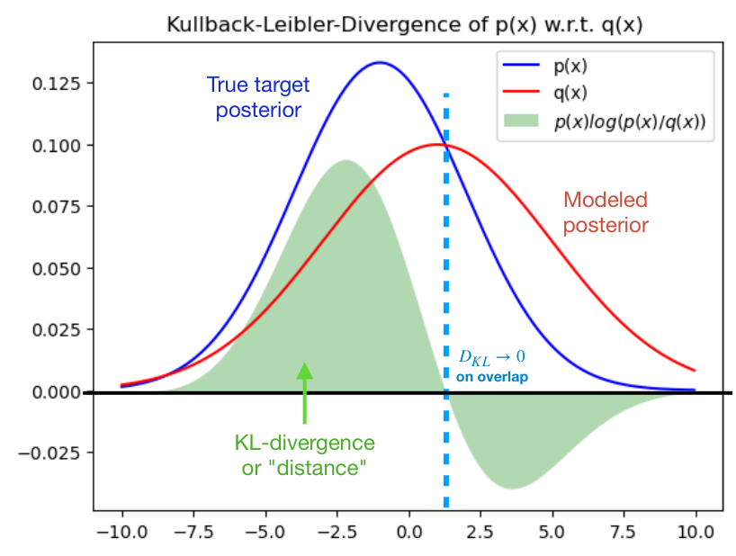
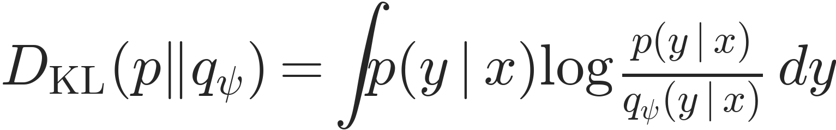
Kullback–Leibler (KL) Divergence
Compare the true probability distribution with its approximate surrogate model
$$p\left(y∣x\right) and q_{ψ}\left(y∣x\right)$$
KL divergence measures the information lost when the model approximates the true distribution.
$$D_{KL}\left(p‖q_{ψ}\right)=∫p\left(y∣x\right)log\frac{p\left(y∣x\right)}{q_{ψ}\left(y∣x\right)} dy$$
For a discrete label, replace the integral by a sum.
Neural networks and deep learning
1
Notes:
Adapted closely from ML4HEP Lectures 1 and 2, slide 45. Source: https://github.com/JaySandesara/sbi-tutorial-ml4hep-2026/blob/main/ML4HEP_Lectures_1_and_2.pdf . Uses the source notation p(y|x), q_psi(y|x), and psi. The empirical average is an estimate of the population expectation. KL is a divergence, not a symmetric metric. Any original graph is an illustrative continuous-density example; classification uses a sum over the binary label. See the matching teaching script for the spoken derivation.

Slide 40
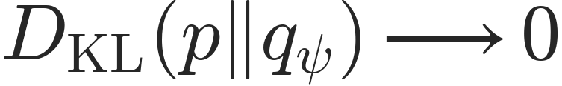
Kullback–Leibler (KL) Divergence
Goal: model the unknown distribution with the learned surrogate
$$p\left(y∣x\right) and q_{ψ}\left(y∣x\right)$$
Minimize the KL divergence between the learned model and the true distribution.
$$D_{KL}\left(p‖q_{ψ}\right)→0$$
$$D_{KL}\left(p‖q_{ψ}\right)=0 ⇔ p=q_{ψ}$$
Neural networks and deep learning
1
Notes:
Adapted closely from ML4HEP Lectures 1 and 2, slide 46. Source: https://github.com/JaySandesara/sbi-tutorial-ml4hep-2026/blob/main/ML4HEP_Lectures_1_and_2.pdf . Uses the source notation p(y|x), q_psi(y|x), and psi. The empirical average is an estimate of the population expectation. KL is a divergence, not a symmetric metric. Any original graph is an illustrative continuous-density example; classification uses a sum over the binary label. See the matching teaching script for the spoken derivation.

Slide 41
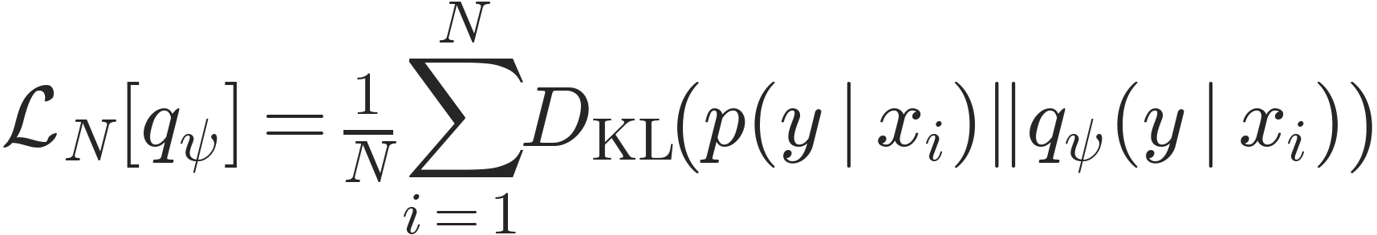
Classification - Cross-Entropy Loss
Find the network parameters that minimize the KL divergence between the true label distribution and the model.
$$L_{N}\left[q_{ψ}\right]=\frac{1}{N}\sum_{i=1}^{N}{D_{KL}}​\left(p\left(y∣x_{i}\right)‖q_{ψ}\left(y∣x_{i}\right)\right)$$
The sample average estimates the population objective
$$L\left[q_{ψ}\right]=E_{x∼p\left(x\right)}​\left[D_{KL}​\left(p\left(y∣x\right)‖q_{ψ}\left(y∣x\right)\right)\right]$$
Neural networks and deep learning
1
Notes:
Adapted closely from ML4HEP Lectures 1 and 2, slide 47. Source: https://github.com/JaySandesara/sbi-tutorial-ml4hep-2026/blob/main/ML4HEP_Lectures_1_and_2.pdf . Uses the source notation p(y|x), q_psi(y|x), and psi. The empirical average is an estimate of the population expectation. KL is a divergence, not a symmetric metric. Any original graph is an illustrative continuous-density example; classification uses a sum over the binary label. See the matching teaching script for the spoken derivation.

Slide 42
Classification - Cross-Entropy Loss
Find the network parameters that minimize the KL divergence between the true label distribution and the model.
$$L\left[q_{ψ}\right]=E_{x∼p\left(x\right)}​\left[D_{KL}​\left(p\left(y∣x\right)‖q_{ψ}\left(y∣x\right)\right)\right]$$
For the binary label, the KL divergence contains two terms
$$L\left[q_{ψ}\right]=E_{x∼p\left(x\right)}​\left[p\left(y=1∣x\right)log\frac{p\left(y=1∣x\right)}{q_{ψ}\left(y=1∣x\right)}+p\left(y=0∣x\right)log\frac{p\left(y=0∣x\right)}{q_{ψ}\left(y=0∣x\right)}\right]$$
Neural networks and deep learning
1
Notes:
Adapted closely from ML4HEP Lectures 1 and 2, slide 48. Source: https://github.com/JaySandesara/sbi-tutorial-ml4hep-2026/blob/main/ML4HEP_Lectures_1_and_2.pdf . Uses the source notation p(y|x), q_psi(y|x), and psi. The empirical average is an estimate of the population expectation. KL is a divergence, not a symmetric metric. Any original graph is an illustrative continuous-density example; classification uses a sum over the binary label. See the matching teaching script for the spoken derivation.

Slide 43
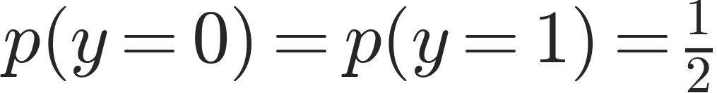
Classification - Cross-Entropy Loss
The frequency of the two hypotheses in the sampled events is chosen for training.
$$p\left(x\right)=p\left(y=0\right) p\left(x∣y=0\right)+p\left(y=1\right) p\left(x∣y=1\right)$$
A reasonable choice is to use balanced data
$$p\left(y=0\right)=p\left(y=1\right)=\frac{1}{2}$$
Neural networks and deep learning
1
Notes:
Adapted closely from ML4HEP Lectures 1 and 2, slide 48. Source: https://github.com/JaySandesara/sbi-tutorial-ml4hep-2026/blob/main/ML4HEP_Lectures_1_and_2.pdf . Uses the source notation p(y|x), q_psi(y|x), and psi. The empirical average is an estimate of the population expectation. KL is a divergence, not a symmetric metric. Any original graph is an illustrative continuous-density example; classification uses a sum over the binary label. See the matching teaching script for the spoken derivation.

Slide 44
Classification - Cross-Entropy Loss
Expand each logarithm of a ratio into a difference of logarithms
$$L\left[q_{ψ}\right]=E_{x∼p\left(x\right)}​\left[p\left(y=1∣x\right)log\frac{p\left(y=1∣x\right)}{q_{ψ}\left(y=1∣x\right)}+p\left(y=0∣x\right)log\frac{p\left(y=0∣x\right)}{q_{ψ}\left(y=0∣x\right)}\right]$$
$$L\left[q_{ψ}\right]=−E_{x∼p\left(x\right)}​\left[p\left(y=1∣x\right)logq_{ψ}\left(y=1∣x\right)+p\left(y=0∣x\right)logq_{ψ}\left(y=0∣x\right)\right]+c$$
The term c is independent of the network parameters
Neural networks and deep learning
1
Notes:
Adapted closely from ML4HEP Lectures 1 and 2, slide 49. Source: https://github.com/JaySandesara/sbi-tutorial-ml4hep-2026/blob/main/ML4HEP_Lectures_1_and_2.pdf . Uses the source notation p(y|x), q_psi(y|x), and psi. The empirical average is an estimate of the population expectation. KL is a divergence, not a symmetric metric. Any original graph is an illustrative continuous-density example; classification uses a sum over the binary label. See the matching teaching script for the spoken derivation.

Slide 45
Classification - Cross-Entropy Loss
The terms containing only the true distribution are
$$c=E_{x∼p\left(x\right)}​\left[p\left(y=1∣x\right)logp\left(y=1∣x\right)+p\left(y=0∣x\right)logp\left(y=0∣x\right)\right]$$
Changing the model parameters does not change c
We can minimize the remaining cross-entropy term and obtain the same optimum.
Neural networks and deep learning
1
Notes:
Adapted closely from ML4HEP Lectures 1 and 2, slide 49. Source: https://github.com/JaySandesara/sbi-tutorial-ml4hep-2026/blob/main/ML4HEP_Lectures_1_and_2.pdf . Uses the source notation p(y|x), q_psi(y|x), and psi. The empirical average is an estimate of the population expectation. KL is a divergence, not a symmetric metric. Any original graph is an illustrative continuous-density example; classification uses a sum over the binary label. See the matching teaching script for the spoken derivation.

Slide 46
Classification - Cross-Entropy Loss
Use the observed binary label to write an expectation over labeled events
$$L\left[q_{ψ}\right]=−E_{x∼p\left(x\right)}​\left[p\left(y=1∣x\right)logq_{ψ}\left(y=1∣x\right)+p\left(y=0∣x\right)logq_{ψ}\left(y=0∣x\right)\right]+c$$
$$L\left[q_{ψ}\right]=−E_{\left(x,y\right)∼p\left(x,y\right)}​\left[ylogq_{ψ}\left(y=1∣x\right)+\left(1−y\right)log\left(1−q_{ψ}\left(y=1∣x\right)\right)\right]+c$$
The model-dependent term is the binary cross-entropy loss
Neural networks and deep learning
1
Notes:
Adapted closely from ML4HEP Lectures 1 and 2, slide 50. Source: https://github.com/JaySandesara/sbi-tutorial-ml4hep-2026/blob/main/ML4HEP_Lectures_1_and_2.pdf . Uses the source notation p(y|x), q_psi(y|x), and psi. The empirical average is an estimate of the population expectation. KL is a divergence, not a symmetric metric. Any original graph is an illustrative continuous-density example; classification uses a sum over the binary label. See the matching teaching script for the spoken derivation.

Slide 47
Classification - Cross-Entropy Loss
For a finite training sample, average over the labeled examples
$${\hat{L}}_{BCE}\left[q_{ψ}\right]=−\frac{1}{N}\sum_{i=1}^{N}{\left[y_{i}logq_{ψ}\left(y=1∣x_{i}\right)+\left(1−y_{i}\right)log\left(1−q_{ψ}\left(y=1∣x_{i}\right)\right)\right]}$$
$$y_{i}=1: −logq_{ψ}\left(y=1∣x_{i}\right)$$
$$y_{i}=0: −log\left(1−q_{ψ}\left(y=1∣x_{i}\right)\right)$$
Confident wrong predictions receive a large penalty
Neural networks and deep learning
1
Notes:
Adapted closely from ML4HEP Lectures 1 and 2, slide 50. Source: https://github.com/JaySandesara/sbi-tutorial-ml4hep-2026/blob/main/ML4HEP_Lectures_1_and_2.pdf . Uses the source notation p(y|x), q_psi(y|x), and psi. The empirical average is an estimate of the population expectation. KL is a divergence, not a symmetric metric. Any original graph is an illustrative continuous-density example; classification uses a sum over the binary label. See the matching teaching script for the spoken derivation.

Slide 48
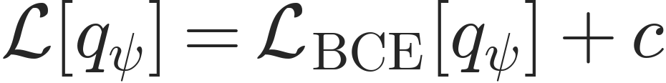
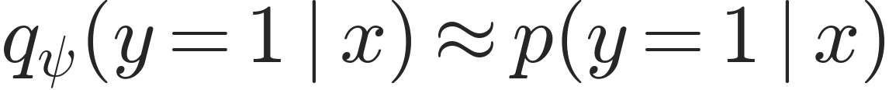
Classification - Cross-Entropy Loss
The parameters that minimize BCE also minimize the expected KL divergence.
$$L\left[q_{ψ}\right]=L_{BCE}\left[q_{ψ}\right]+c$$
The trained network approximates the true label probability
$$q_{ψ}\left(y=1∣x\right)≈p\left(y=1∣x\right)$$
Exact equality is the ideal population limit with a sufficiently flexible model.
Neural networks and deep learning
1
Notes:
Adapted closely from ML4HEP Lectures 1 and 2, slide 51. Source: https://github.com/JaySandesara/sbi-tutorial-ml4hep-2026/blob/main/ML4HEP_Lectures_1_and_2.pdf . Uses the source notation p(y|x), q_psi(y|x), and psi. The empirical average is an estimate of the population expectation. KL is a divergence, not a symmetric metric. Any original graph is an illustrative continuous-density example; classification uses a sum over the binary label. See the matching teaching script for the spoken derivation.

Slide 49
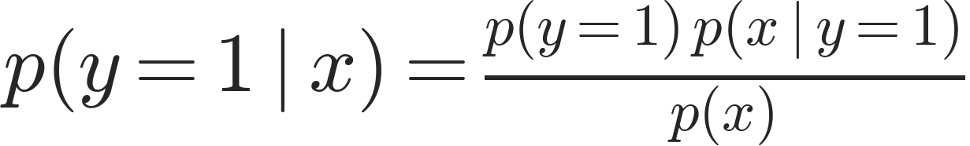
Density Ratio Estimation
The learned posterior can be expanded using Bayes’ rule
$$q_{ψ}\left(y=1∣x\right)≈p\left(y=1∣x\right)$$
$$p\left(y=1∣x\right)=\frac{p\left(y=1\right) p\left(x∣y=1\right)}{p\left(x\right)}$$
The class posterior combines the class frequency and the class-conditional density.
Neural networks and deep learning
1
Notes:
Adapted closely from ML4HEP Lectures 1 and 2, slide 52. Source: https://github.com/JaySandesara/sbi-tutorial-ml4hep-2026/blob/main/ML4HEP_Lectures_1_and_2.pdf . Uses the source notation p(y|x), q_psi(y|x), and psi. The empirical average is an estimate of the population expectation. KL is a divergence, not a symmetric metric. Any original graph is an illustrative continuous-density example; classification uses a sum over the binary label. See the matching teaching script for the spoken derivation.

Slide 50
Density Ratio Estimation
Expand the denominator as the mixture of the two hypotheses
$$p\left(x\right)=p\left(y=0\right) p\left(x∣y=0\right)+p\left(y=1\right) p\left(x∣y=1\right)$$
$$q_{ψ}\left(y=1∣x\right)≈\frac{p\left(y=1\right) p\left(x∣y=1\right)}{p\left(y=1\right) p\left(x∣y=1\right)+p\left(y=0\right) p\left(x∣y=0\right)}$$
Neural networks and deep learning
1
Notes:
Adapted closely from ML4HEP Lectures 1 and 2, slide 52. Source: https://github.com/JaySandesara/sbi-tutorial-ml4hep-2026/blob/main/ML4HEP_Lectures_1_and_2.pdf . Uses the source notation p(y|x), q_psi(y|x), and psi. The empirical average is an estimate of the population expectation. KL is a divergence, not a symmetric metric. Any original graph is an illustrative continuous-density example; classification uses a sum over the binary label. See the matching teaching script for the spoken derivation.

Slide 51
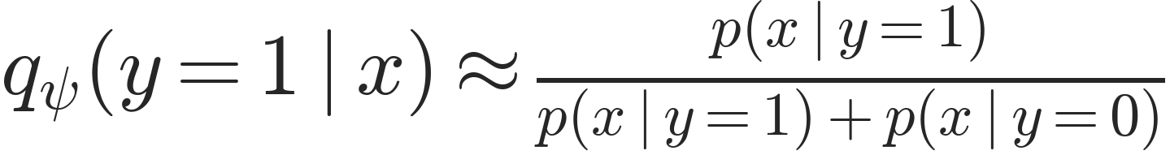
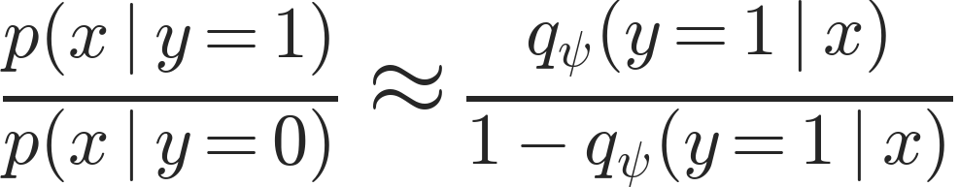
Density Ratio Estimation
With balanced training data, the class probabilities cancel
$$q_{ψ}\left(y=1∣x\right)≈\frac{p\left(x∣y=1\right)}{p\left(x∣y=1\right)+p\left(x∣y=0\right)}$$
Rearrange to obtain the ratio of the two hypothesis densities
$$\frac{p\left(x∣y=1\right)}{p\left(x∣y=0\right)}≈\frac{q_{ψ}\left(y=1∣x\right)}{1−q_{ψ}\left(y=1∣x\right)}$$
Classifier odds estimate the density ratio for balanced training.
Neural networks and deep learning
1
Notes:
Adapted closely from ML4HEP Lectures 1 and 2, slide 52. Source: https://github.com/JaySandesara/sbi-tutorial-ml4hep-2026/blob/main/ML4HEP_Lectures_1_and_2.pdf . Uses the source notation p(y|x), q_psi(y|x), and psi. The empirical average is an estimate of the population expectation. KL is a divergence, not a symmetric metric. Any original graph is an illustrative continuous-density example; classification uses a sum over the binary label. See the matching teaching script for the spoken derivation.

Slide 52
Community
Each of you arrived here with your own backgrounds, specialty, and path in life
Your experience and expertise are valuable here, no matter what it is
If the activity is within your background, help others!
If you are totally (or a little) lost, ask for help!
It is our shared goal to have each of us leave with some new skill/knowledge/understanding
Neural networks and deep learning
52
Notes:
Source: Michelle Kuchera, Lecture1-NN.pdf, slide 42.

