Slide 1


Applications in
particle physics
Rafael Coelho Lopes de Sa
University of Massachusetts Amherst
Based on the ML4HEP lectures at TIFR
by Jay Sandesara and Rafael Coelho Lopes de Sa
Lecture 2: Applications
Notes:
Lecture 2 connects neural likelihood-ratio estimation to particle-physics inference. We study simulation models, histogram-based likelihoods and sufficient summaries.
Source: Jay Sandesara and Rafael Coelho Lopes de Sa, Lectures on Simulation-Based Inference in HEP, ML4HEP School, TIFR, original slides 1–2. https://github.com/JaySandesara/sbi-tutorial-ml4hep-2026/blob/main/ML4HEP_Lectures_1_and_2.pdf . Original figures and diagrams retained as supplied. The first lecture provides the classifier-to-density-ratio derivation.

Slide 2
Lecture topics
Simulation and the particle-physics likelihood
Traditional inference with histograms
Neural simulation-based inference
Sufficient summaries and likelihood ratios
Lecture 2: Applications
2
Notes:
The sequence follows the earlier TIFR material. This section focuses on frequentist inference at the LHC.
Source: Jay Sandesara and Rafael Coelho Lopes de Sa, Lectures on Simulation-Based Inference in HEP, ML4HEP School, TIFR, original slides 1–39, excluding 31–37. https://github.com/JaySandesara/sbi-tutorial-ml4hep-2026/blob/main/ML4HEP_Lectures_1_and_2.pdf . Original figures and diagrams retained as supplied. The first lecture provides the classifier-to-density-ratio derivation.

Slide 3
Classifiers and likelihood ratios
Lecture 1: a classifier can estimate a likelihood ratio
$$D^{*}\left(x\right)=\frac{p_{S}\left(x\right)}{p_{S}\left(x\right)+p_{B}\left(x\right)} r\left(x\right)=\frac{p_{S}\left(x\right)}{p_{B}\left(x\right)}=\frac{D^{*}\left(x\right)}{1−D^{*}\left(x\right)}$$
For balanced signal and background training samples
How does this help us measure a physics parameter?
Lecture 2: Applications
3
Notes:
Recall the population optimum of binary cross-entropy for equal class priors. For unequal training priors, multiply D/(1-D) by pi_B/pi_S. The classifier is an approximation after finite training. We now explain the physics likelihood in which this ratio is useful, without repeating the derivation from Lecture 1.
Source: Jay Sandesara and Rafael Coelho Lopes de Sa, Lectures on Simulation-Based Inference in HEP, ML4HEP School, TIFR, original slides 38 and Lecture 1 conclusion. https://github.com/JaySandesara/sbi-tutorial-ml4hep-2026/blob/main/ML4HEP_Lectures_1_and_2.pdf . Original figures and diagrams retained as supplied. The first lecture provides the classifier-to-density-ratio derivation.

Slide 4
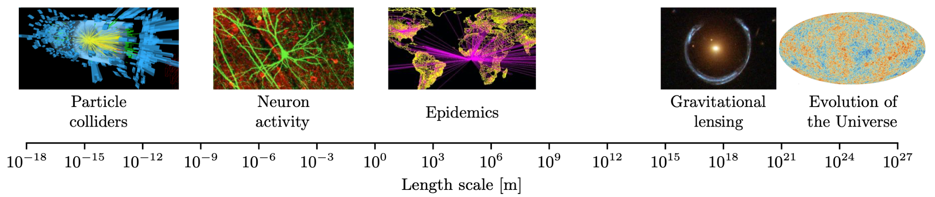
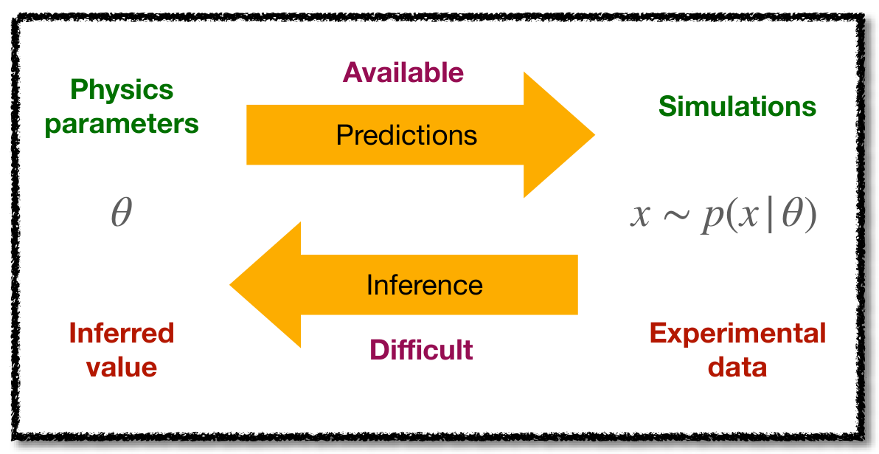
The scientific era of simulations
Across experimental energy and length scales:
High-fidelity simulations are available
Likelihoods can be difficult to calculate
Lecture 2: Applications
4
Notes:
The original lecture places particle physics in the wider context of simulation-based sciences. The shared problem is that forward simulation can be available even when a pointwise probability density is not tractable. The figure is reproduced from the supplied lecture without claiming a new attribution for its individual panels.
Source: Jay Sandesara and Rafael Coelho Lopes de Sa, Lectures on Simulation-Based Inference in HEP, ML4HEP School, TIFR, original slides 3. https://github.com/JaySandesara/sbi-tutorial-ml4hep-2026/blob/main/ML4HEP_Lectures_1_and_2.pdf . Original figures and diagrams retained as supplied. The first lecture provides the classifier-to-density-ratio derivation.

Slide 5
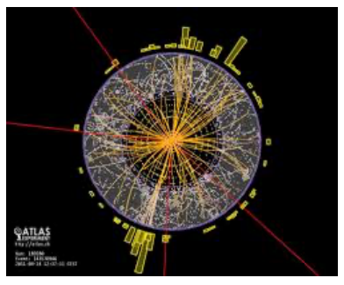
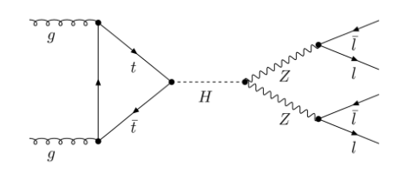
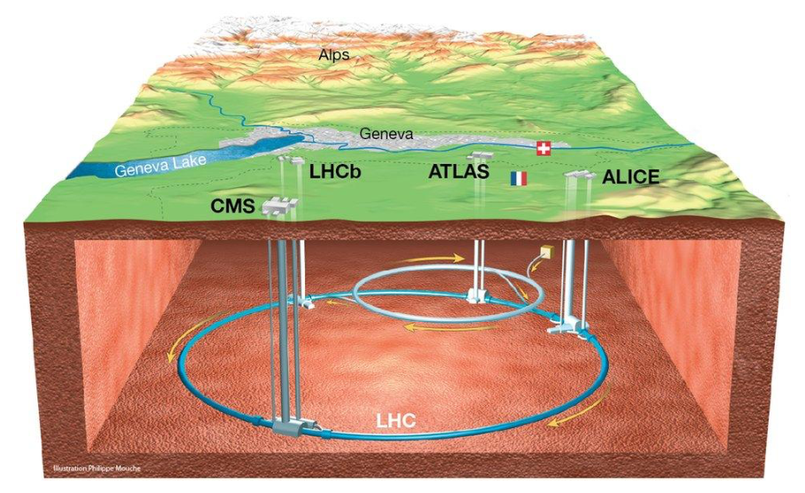
Particle physics at the LHC
The LHC lets us test the Standard Model with precision and search for new physics.
Lecture 2: Applications
5
Notes:
Use the accelerator, collision display and Higgs diagram to connect the general inverse problem to particle physics. The diagrams and images are the original source material from slide 4.
Source: Jay Sandesara and Rafael Coelho Lopes de Sa, Lectures on Simulation-Based Inference in HEP, ML4HEP School, TIFR, original slides 4. https://github.com/JaySandesara/sbi-tutorial-ml4hep-2026/blob/main/ML4HEP_Lectures_1_and_2.pdf . Original figures and diagrams retained as supplied. The first lecture provides the classifier-to-density-ratio derivation.

Slide 6
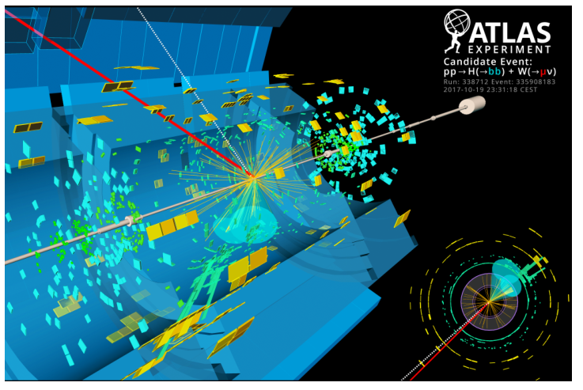
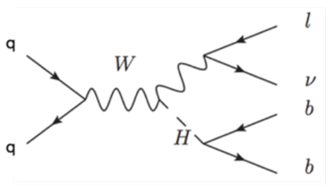
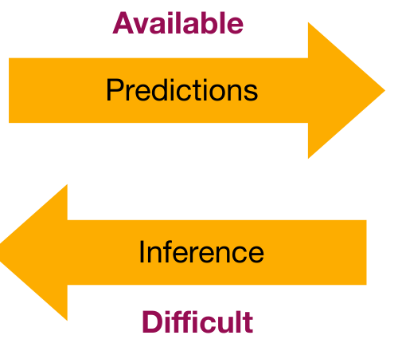
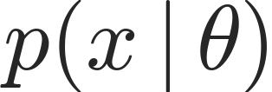
The LHC experiment
Theory: scattering amplitudes
Experiment: detector signals
Theory and data are connected by an implicit probability model
$$p\left(x∣θ\right)$$
Lecture 2: Applications
6
Notes:
We can simulate detector data x given theory parameters theta. Computing the probability density for a measured event requires summing or integrating over unobserved possibilities. This is the distinction between sampling from an implicit model and evaluating its likelihood.
Source: Jay Sandesara and Rafael Coelho Lopes de Sa, Lectures on Simulation-Based Inference in HEP, ML4HEP School, TIFR, original slides 5–6. https://github.com/JaySandesara/sbi-tutorial-ml4hep-2026/blob/main/ML4HEP_Lectures_1_and_2.pdf . Original figures and diagrams retained as supplied. The first lecture provides the classifier-to-density-ratio derivation.

Slide 7
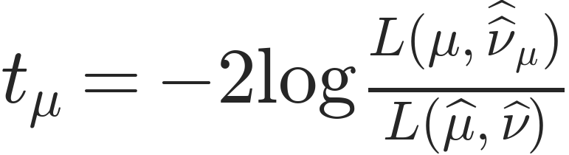
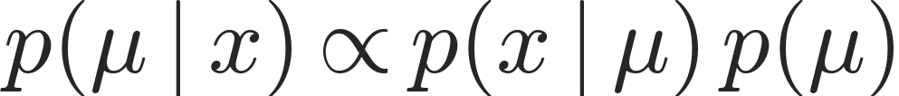
Bayesian and frequentist inference
Frequentist
Bayesian
Composite hypothesis tests
Posterior estimation
$$t_{μ}=−2log\frac{L\left(μ,{\hat{\hat{ν}}}_{μ}\right)}{L\left(\hat{μ},\hat{ν}\right)}$$
$$p\left(μ∣x\right)∝p\left(x∣μ\right) p\left(μ\right)$$
Confidence intervals with coverage over repeated experiments
Credible intervals from the posterior probability distribution
These lectures focus on frequentist inference at the LHC
Lecture 2: Applications
7
Notes:
Both approaches use the likelihood. The frequentist example is the two-sided profile-likelihood-ratio statistic, using the conventional factor of two. A one-sided discovery or upper-limit statistic requires a further definition. Nuisance parameters nu are profiled. The simplified Bayesian expression suppresses nuisance parameters; in a full Bayesian model they are assigned priors and marginalized. This combines source slides 7 and 8.
Source: Jay Sandesara and Rafael Coelho Lopes de Sa, Lectures on Simulation-Based Inference in HEP, ML4HEP School, TIFR, original slides 7–8. https://github.com/JaySandesara/sbi-tutorial-ml4hep-2026/blob/main/ML4HEP_Lectures_1_and_2.pdf . Original figures and diagrams retained as supplied. The first lecture provides the classifier-to-density-ratio derivation.

Slide 8
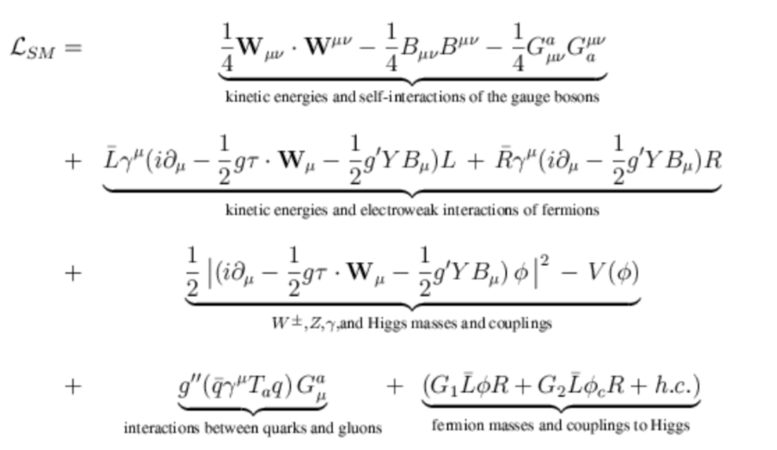
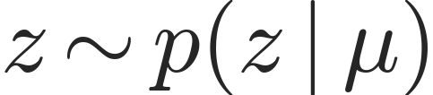
The statistical model: hard scattering
Hard scattering
$$z∼p\left(z∣μ\right)$$
The theory parameters determine a distribution of parton-level states z.
Lecture 2: Applications
8
Notes:
The hard-scattering state z contains latent parton-level information. Parameters of interest mu determine its distribution through the underlying theory. The Lagrangian and Feynman diagram are retained from original slide 9.
Source: Jay Sandesara and Rafael Coelho Lopes de Sa, Lectures on Simulation-Based Inference in HEP, ML4HEP School, TIFR, original slides 9. https://github.com/JaySandesara/sbi-tutorial-ml4hep-2026/blob/main/ML4HEP_Lectures_1_and_2.pdf . Original figures and diagrams retained as supplied. The first lecture provides the classifier-to-density-ratio derivation.

Slide 9
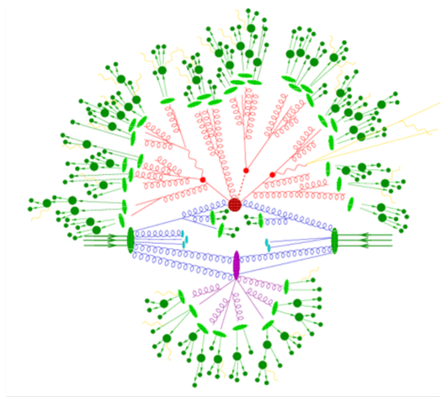
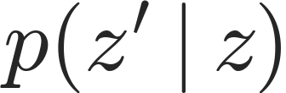
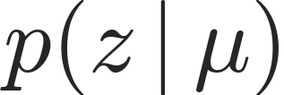
The statistical model: parton showering
Parton showering
Hard scattering
$$p\left(z^{′}∣z\right)$$
$$p\left(z∣μ\right)$$
$$p\left(z^{′},z∣μ\right)=p\left(z^{′}∣z\right) p\left(z∣μ\right)$$
Lecture 2: Applications
9
Notes:
The next latent state z-prime includes the showered final state. The conditional factorization separates the generation stages. Hadronization and underlying-event modeling are included in this schematic shower stage, as in the original lecture.
Source: Jay Sandesara and Rafael Coelho Lopes de Sa, Lectures on Simulation-Based Inference in HEP, ML4HEP School, TIFR, original slides 10. https://github.com/JaySandesara/sbi-tutorial-ml4hep-2026/blob/main/ML4HEP_Lectures_1_and_2.pdf . Original figures and diagrams retained as supplied. The first lecture provides the classifier-to-density-ratio derivation.

Slide 10
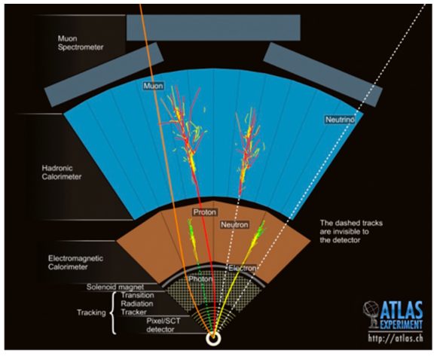
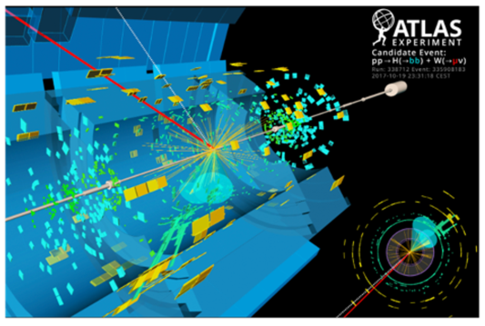
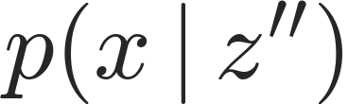
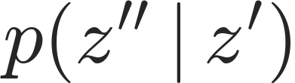
The statistical model: detector and observations
Observations
Detector interactions
Parton showering
Hard scattering
$$p\left(x∣z^{′′}\right)$$
$$p\left(z^{′′}∣z^{′}\right)$$
$$p\left(z^{′}∣z\right)$$
$$p\left(z∣μ\right)$$
$$p\left(x,z^{′′},z^{′},z∣μ\right)=p\left(x∣z^{′′}\right) p\left(z^{′′}∣z^{′}\right) p\left(z^{′}∣z\right) p\left(z∣μ\right)$$
Lecture 2: Applications
10
Notes:
Read the simulation chain from the hard scattering on the right to detector observations on the left, following the source deck. The observed x is generated through successive conditional distributions. This combines source slides 11 and 12 while keeping all four original images. Nuisance-parameter dependences are suppressed in this schematic.
Source: Jay Sandesara and Rafael Coelho Lopes de Sa, Lectures on Simulation-Based Inference in HEP, ML4HEP School, TIFR, original slides 11–12. https://github.com/JaySandesara/sbi-tutorial-ml4hep-2026/blob/main/ML4HEP_Lectures_1_and_2.pdf . Original figures and diagrams retained as supplied. The first lecture provides the classifier-to-density-ratio derivation.

Slide 11
The intractable likelihood
Observations
Detector interactions
Parton showering
Hard scattering
$$p\left(x∣z^{′′}\right)$$
$$p\left(z^{′′}∣z^{′}\right)$$
$$p\left(z^{′}∣z\right)$$
$$p\left(z∣μ\right)$$
$$p\left(x∣μ\right)=∫dz dz^{′} dz^{′′} p\left(x∣z^{′′}\right) p\left(z^{′′}∣z^{′}\right) p\left(z^{′}∣z\right) p\left(z∣μ\right)$$
A measured final state can arise from many different latent states.
Lecture 2: Applications
11
Notes:
To evaluate p(x|mu), integrate over every unobserved hard-scattering, shower and detector history. The integral is analytically intractable in realistic analyses. The key point is that we can sample the factors without being able to evaluate their marginal density.
Source: Jay Sandesara and Rafael Coelho Lopes de Sa, Lectures on Simulation-Based Inference in HEP, ML4HEP School, TIFR, original slides 13. https://github.com/JaySandesara/sbi-tutorial-ml4hep-2026/blob/main/ML4HEP_Lectures_1_and_2.pdf . Original figures and diagrams retained as supplied. The first lecture provides the classifier-to-density-ratio derivation.

Slide 12
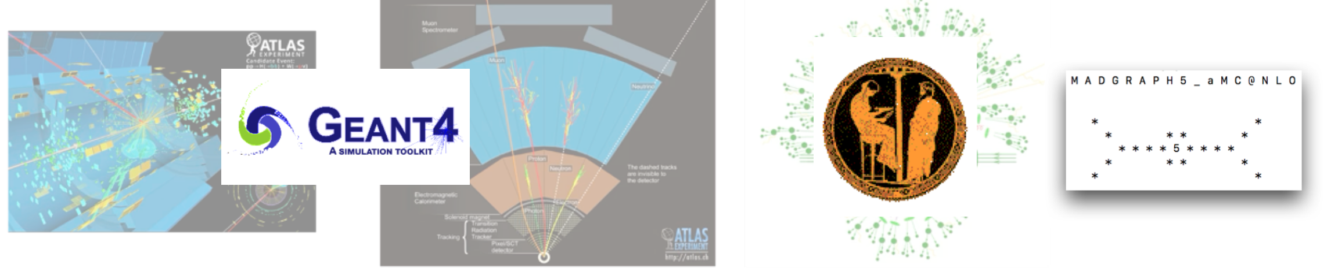
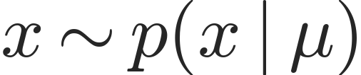
Monte Carlo simulations
Monte Carlo generators sample the simulation chain
$$x∼p\left(x∣μ\right)$$
An implicit model: we can generate events without evaluating p(x | μ).
Lecture 2: Applications
12
Notes:
Original slide 14 links the latent stages to Monte Carlo tools. MadGraph represents hard-process generation, Pythia the shower and hadronization, and Geant4 detector transport. The examples are illustrative, not a complete account of an experiment’s software. All original tool imagery is retained.
Source: Jay Sandesara and Rafael Coelho Lopes de Sa, Lectures on Simulation-Based Inference in HEP, ML4HEP School, TIFR, original slides 14. https://github.com/JaySandesara/sbi-tutorial-ml4hep-2026/blob/main/ML4HEP_Lectures_1_and_2.pdf . Original figures and diagrams retained as supplied. The first lecture provides the classifier-to-density-ratio derivation.

Slide 13
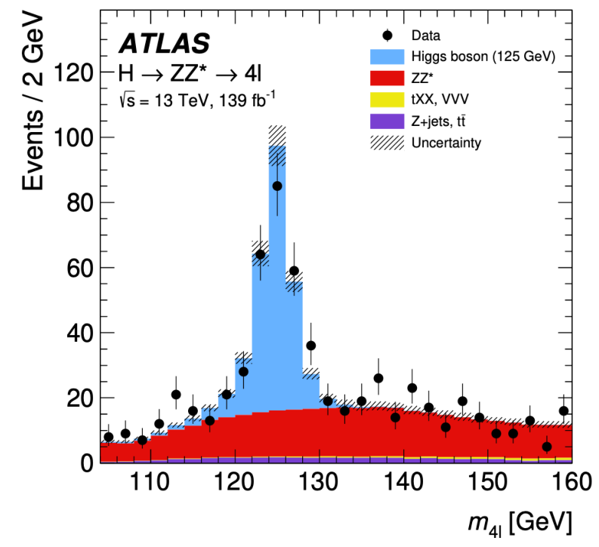
Traditional simulation-based inference
Traditional SBI uses simulated distributions of a small set of observables.
Choose a summary observable
Estimate its distribution with histograms
Fit the physics parameters
Lecture 2: Applications
13
Notes:
Traditional histogram-based analyses already are simulation-based inference. The source example is the four-lepton invariant mass around the Higgs boson. Preserve the published plot as evidence, including its event counts, luminosity, legend and uncertainties.
Source: Jay Sandesara and Rafael Coelho Lopes de Sa, Lectures on Simulation-Based Inference in HEP, ML4HEP School, TIFR, original slides 15,19–22. https://github.com/JaySandesara/sbi-tutorial-ml4hep-2026/blob/main/ML4HEP_Lectures_1_and_2.pdf . Original figures and diagrams retained as supplied. The first lecture provides the classifier-to-density-ratio derivation.

Slide 14
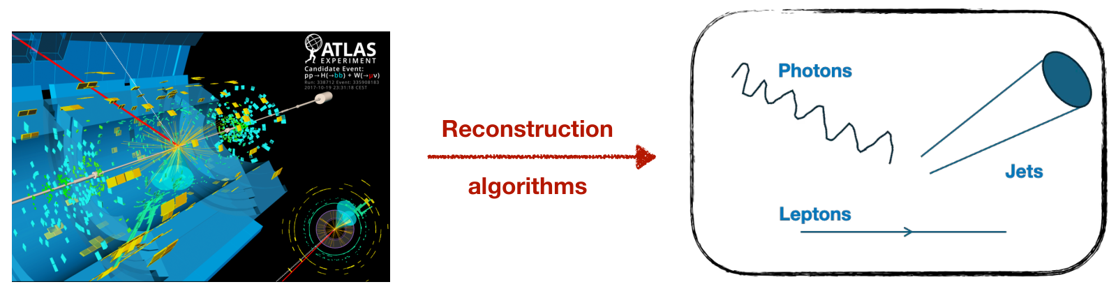
Reconstructed physics objects
Detector signals
Physics objects and momenta
O(100 million) detector channels
Typically O(10–100) event features
Lecture 2: Applications
14
Notes:
Reconstruction maps the very large detector output into objects such as leptons, photons and jets, and their momenta. The approximate dimensionalities come from the supplied lecture and are illustrative, since detector channels and the retained event representation vary by experiment and analysis.
Source: Jay Sandesara and Rafael Coelho Lopes de Sa, Lectures on Simulation-Based Inference in HEP, ML4HEP School, TIFR, original slides 16. https://github.com/JaySandesara/sbi-tutorial-ml4hep-2026/blob/main/ML4HEP_Lectures_1_and_2.pdf . Original figures and diagrams retained as supplied. The first lecture provides the classifier-to-density-ratio derivation.

Slide 15
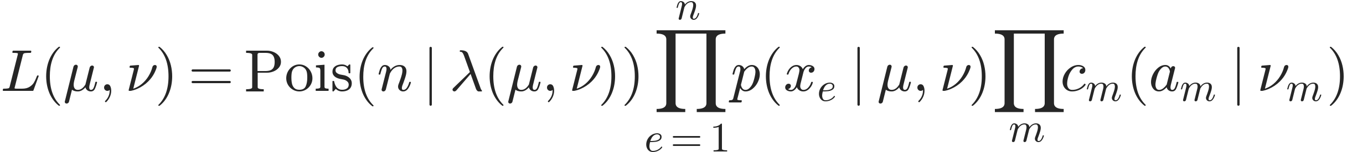
The full likelihood model
Lμ,ν=Pois​n∣λμ,νe=1npxe∣μ,νm​cmam∣νm
Event count
Event kinematics
Auxiliary measurements
n observed events
λ expected events
Density for each
reconstructed event xₑ
Constraint likelihoods
for nuisance parameters
μ: parameters of interest ν: nuisance parameters
Lecture 2: Applications
15
Notes:
The extended likelihood contains a Poisson rate term, a product of normalized per-event densities for conditionally independent events, and likelihood terms for auxiliary measurements a_m. The constraints carry information about nuisance parameters nu. The main intractable factor is the event density p(x|mu,nu). Global observable a_m is observed in an auxiliary experiment.
Source: Jay Sandesara and Rafael Coelho Lopes de Sa, Lectures on Simulation-Based Inference in HEP, ML4HEP School, TIFR, original slides 17. https://github.com/JaySandesara/sbi-tutorial-ml4hep-2026/blob/main/ML4HEP_Lectures_1_and_2.pdf . Original figures and diagrams retained as supplied. The first lecture provides the classifier-to-density-ratio derivation.

Slide 16
Low-dimensional summary observables
Replace the high-dimensional event by a summary
$$x↦s\left(x\right) \text{for example} s\left(x\right)=m_{4ℓ}\left(x\right)$$
$$p\left(x_{e}∣μ,ν\right)→p​\left(s\left(x_{e}\right)∣μ,ν\right)$$
Compression makes density estimation easier, but can discard information about the parameters.
Lecture 2: Applications
16
Notes:
This is a change of statistical representation: p(s|mu,nu) is the induced distribution of the summary. It is not the original density p(x|mu,nu) evaluated with fewer arguments. Unless the summary is sufficient for the parameter problem, the compressed analysis can lose sensitivity.
Source: Jay Sandesara and Rafael Coelho Lopes de Sa, Lectures on Simulation-Based Inference in HEP, ML4HEP School, TIFR, original slides 18. https://github.com/JaySandesara/sbi-tutorial-ml4hep-2026/blob/main/ML4HEP_Lectures_1_and_2.pdf . Original figures and diagrams retained as supplied. The first lecture provides the classifier-to-density-ratio derivation.

Slide 17
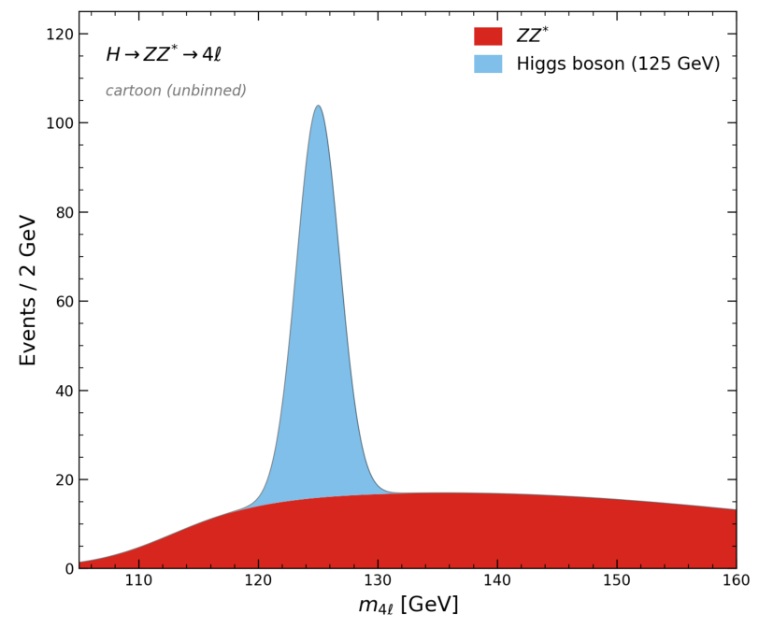
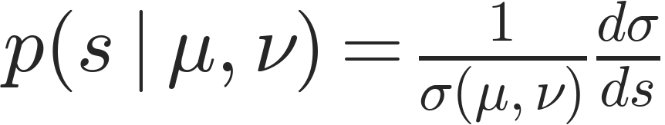
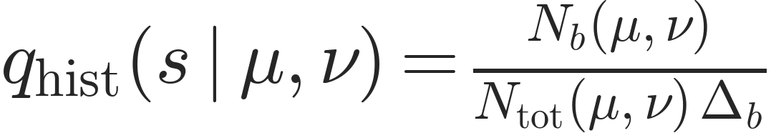
Histograms as density estimators
Continuous density
Histogram estimate
$$p\left(s∣μ,ν\right)=\frac{1}{σ\left(μ,ν\right)}\frac{dσ}{ds}$$
$$q_{hist}\left(s∣μ,ν\right)=\frac{N_{b}\left(μ,ν\right)}{N_{tot}\left(μ,ν\right) Δ_{b}}$$
Lecture 2: Applications
17
Notes:
For s in bin b, a histogram density equals the bin count divided by the total count and bin width. It is a density estimator, not just a way to display data. The two original figures from slide 19 are preserved, with no numerical digitization or invented data.
Source: Jay Sandesara and Rafael Coelho Lopes de Sa, Lectures on Simulation-Based Inference in HEP, ML4HEP School, TIFR, original slides 19. https://github.com/JaySandesara/sbi-tutorial-ml4hep-2026/blob/main/ML4HEP_Lectures_1_and_2.pdf . Original figures and diagrams retained as supplied. The first lecture provides the classifier-to-density-ratio derivation.

Slide 18
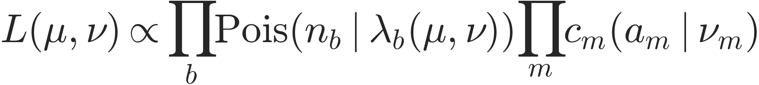
The binned Poisson likelihood
Using a histogram density gives the familiar likelihood
Lμ,ν∝b​Pois​nb∣λbμ,νm​cmam∣νm
Advantage
Limitation
Simple, inexpensive density estimation in a few dimensions
Compression and binning can lose information from the event
Lecture 2: Applications
18
Notes:
For fixed bins, the extended unbinned likelihood using a piecewise-constant histogram density is proportional to a product of Poisson terms for the bin counts. The omitted factors depend on the data and fixed bin widths, not on the model parameters. The expected bin yield is lambda_b. This combines the result of source slides 20 and 22.
Source: Jay Sandesara and Rafael Coelho Lopes de Sa, Lectures on Simulation-Based Inference in HEP, ML4HEP School, TIFR, original slides 20,22. https://github.com/JaySandesara/sbi-tutorial-ml4hep-2026/blob/main/ML4HEP_Lectures_1_and_2.pdf . Original figures and diagrams retained as supplied. The first lecture provides the classifier-to-density-ratio derivation.

Slide 19
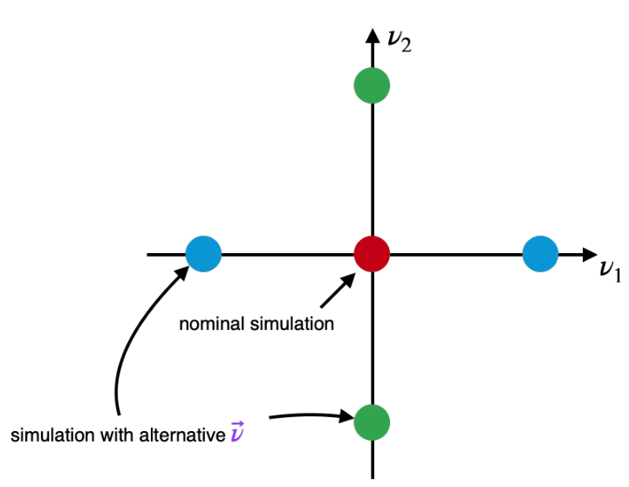
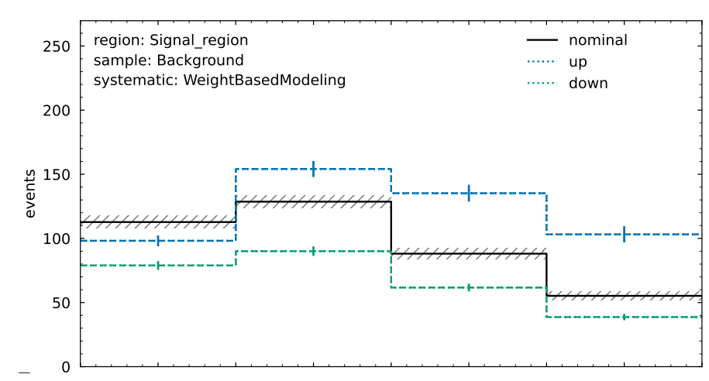
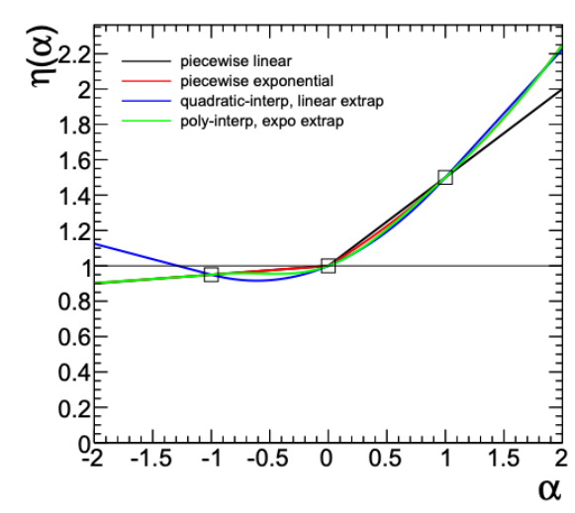
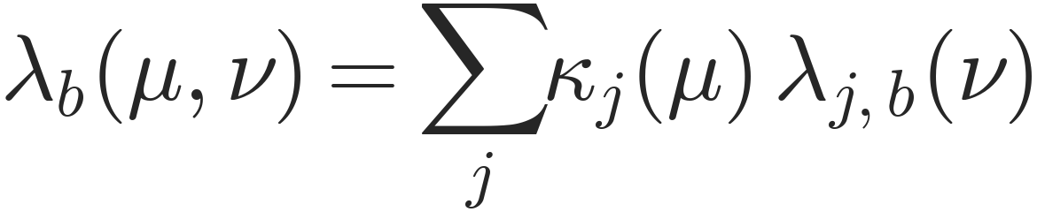
Systematic uncertainties
Expected bin yields must vary continuously with the parameters
λbμ,ν=j​κjμ λj,bν
HistFactory: interpolate simulated variations to model nuisance-parameter responses
Figure credit: Alex Held
Lecture 2: Applications
19
Notes:
Simulate nominal and varied templates, then interpolate their bin yields as functions of nuisance parameters. The rate is a sum over processes j with physics scaling kappa_j(mu); lambda_{j,b}(nu) denotes the complete nuisance-dependent template response. This avoids multiplying absolute yields for individual nuisance parameters. HistFactory can use factorized responses and analytic interpolation, with details depending on the modifier. Figure credit: Alex Held, as in original slide 21.
Source: Jay Sandesara and Rafael Coelho Lopes de Sa, Lectures on Simulation-Based Inference in HEP, ML4HEP School, TIFR, original slides 21. https://github.com/JaySandesara/sbi-tutorial-ml4hep-2026/blob/main/ML4HEP_Lectures_1_and_2.pdf . Original figures and diagrams retained as supplied. The first lecture provides the classifier-to-density-ratio derivation.

Slide 20
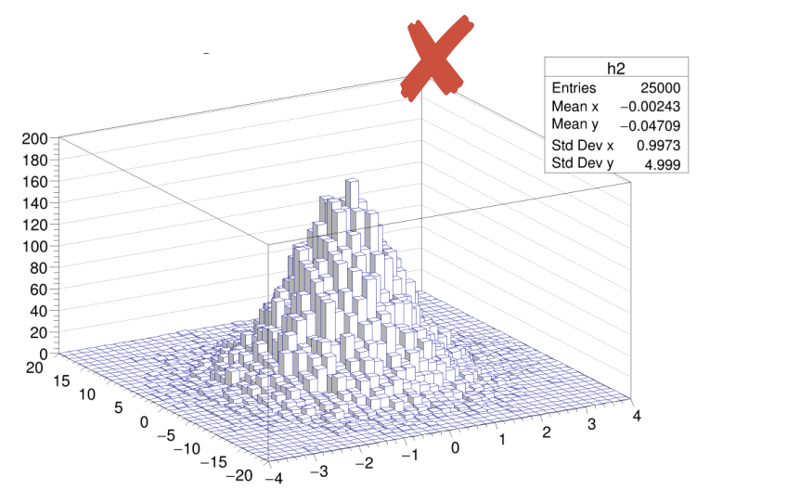
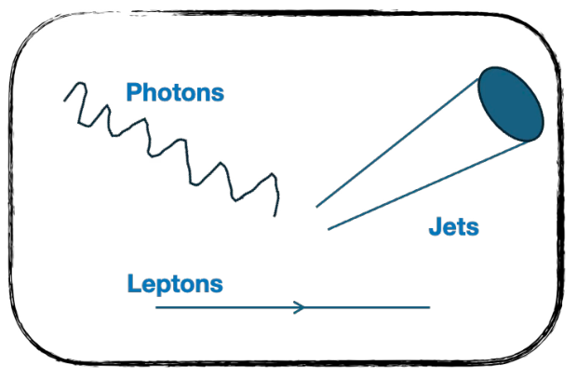
High-dimensional inference
$$q_{hist}\left(x∣μ,ν\right)≈p\left(x∣μ,ν\right)$$
Keeping all event features requires density estimation in many dimensions.
More dimensions require many more bins and far more simulated events.
Lecture 2: Applications
20
Notes:
The curse of dimensionality is the problem with estimating the full event density by a multidimensional histogram. A fixed number of bins along each variable gives an exponential number of bins as the dimension increases. Neural methods trade this explicit binning for a learned approximation. The histogram figure is illustrative, reproduced from original slide 24.
Source: Jay Sandesara and Rafael Coelho Lopes de Sa, Lectures on Simulation-Based Inference in HEP, ML4HEP School, TIFR, original slides 23–24. https://github.com/JaySandesara/sbi-tutorial-ml4hep-2026/blob/main/ML4HEP_Lectures_1_and_2.pdf . Original figures and diagrams retained as supplied. The first lecture provides the classifier-to-density-ratio derivation.

Slide 21
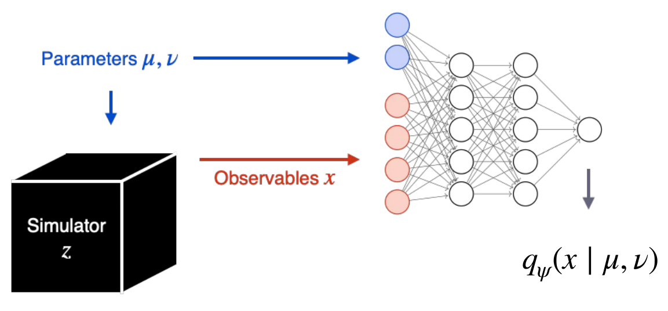
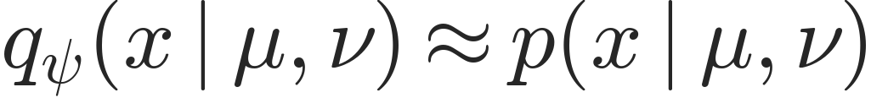
Neural simulation-based inference
Use a neural surrogate for the probability model
$$q_{ψ}\left(x∣μ,ν\right)≈p\left(x∣μ,ν\right)$$
ψ denotes the network parameters
Lecture 1 also gives us a way to estimate density ratios directly.
Lecture 2: Applications
21
Notes:
Use deep-learning surrogates for densities or density ratios. The simulator supplies training events at known parameter values. Density estimators require normalized model families, while a classifier can estimate a ratio as derived in Lecture 1. The diagram illustrates a parameterized neural density estimator.
Source: Jay Sandesara and Rafael Coelho Lopes de Sa, Lectures on Simulation-Based Inference in HEP, ML4HEP School, TIFR, original slides 25–26. https://github.com/JaySandesara/sbi-tutorial-ml4hep-2026/blob/main/ML4HEP_Lectures_1_and_2.pdf . Original figures and diagrams retained as supplied. The first lecture provides the classifier-to-density-ratio derivation.

Slide 22
The SBI landscape
Model | Event observables | Physics and nuisance parameters
Traditional SBI | Low-dimensional summaries and histograms | Analytic parameterizations and template interpolation
Neural SBI | Learned densities or density ratios | Parameter dependence can be learned by the network
Both approaches use simulation to connect model parameters to data.
Lecture 2: Applications
22
Notes:
Histogram models, analytic response functions and neural surrogates are different choices for representing the event distribution and parameter dependence. Traditional analyses typically use low-dimensional summaries with template interpolation. Neural estimators can represent a higher-dimensional density or ratio and can learn parameter dependence.
Source: Jay Sandesara and Rafael Coelho Lopes de Sa, Lectures on Simulation-Based Inference in HEP, ML4HEP School, TIFR, original slides 26. https://github.com/JaySandesara/sbi-tutorial-ml4hep-2026/blob/main/ML4HEP_Lectures_1_and_2.pdf . Original figures and diagrams retained as supplied. The first lecture provides the classifier-to-density-ratio derivation.

Slide 23
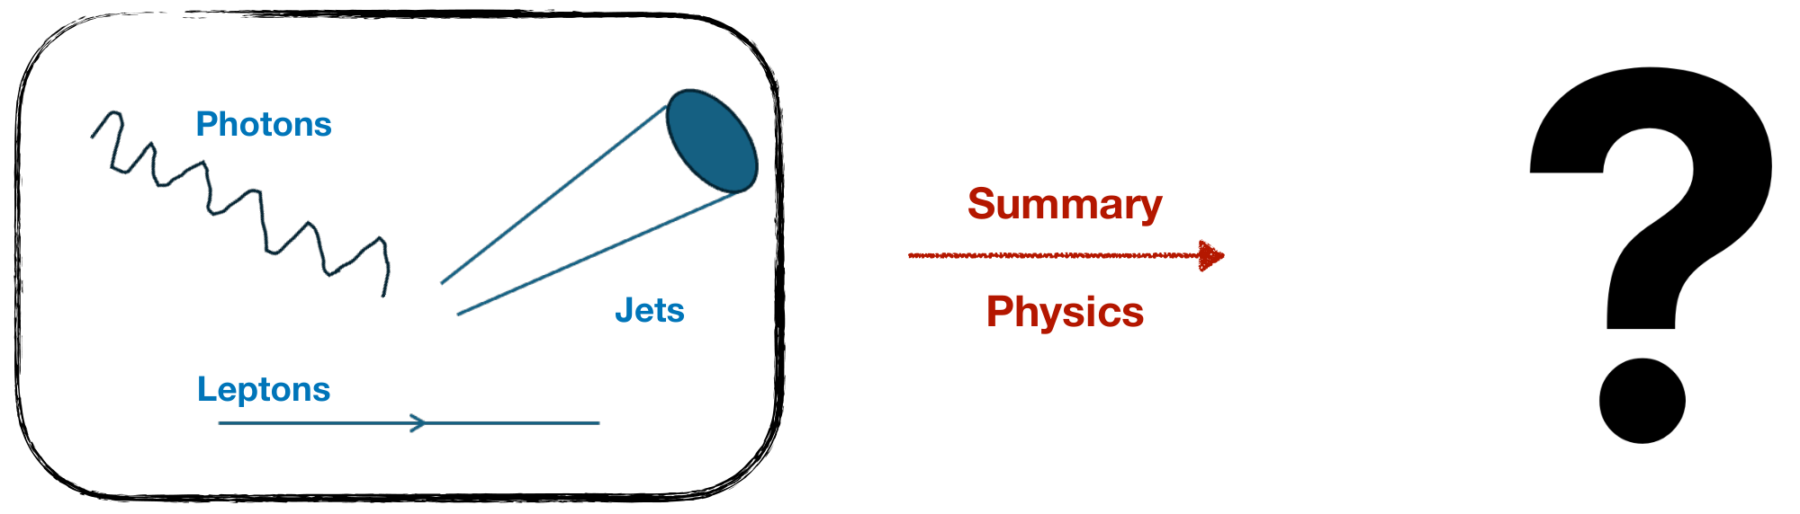
Sufficient summaries
$$T\left(x\right):R^{d_{x}}→R^{d_{T}} d_{T}≪d_{x}$$
A sufficient statistic retains all the information in the data about the model parameters.
Lecture 2: Applications
23
Notes:
The question is whether compression can preserve the relevant information. Sufficiency is a property relative to a specified family of probability models and parameters. The original source uses an example of many reconstructed features mapped to a few summary values.
Source: Jay Sandesara and Rafael Coelho Lopes de Sa, Lectures on Simulation-Based Inference in HEP, ML4HEP School, TIFR, original slides 27–28. https://github.com/JaySandesara/sbi-tutorial-ml4hep-2026/blob/main/ML4HEP_Lectures_1_and_2.pdf . Original figures and diagrams retained as supplied. The first lecture provides the classifier-to-density-ratio derivation.

Slide 24
The factorization criterion
A statistic T(x) is sufficient if the model factorizes as
$$p\left(x∣θ\right)=h\left(x\right) g\left(T\left(x\right);θ\right)$$
h(x) has no dependence on θ
All parameter dependence is carried by T(x)
Lecture 2: Applications
24
Notes:
This is the Fisher–Neyman factorization criterion under the usual regularity and domination assumptions. Use theta here for the full parameter vector. The factor h may depend on the observation, but not on the parameter being inferred.
Source: Jay Sandesara and Rafael Coelho Lopes de Sa, Lectures on Simulation-Based Inference in HEP, ML4HEP School, TIFR, original slides 29. https://github.com/JaySandesara/sbi-tutorial-ml4hep-2026/blob/main/ML4HEP_Lectures_1_and_2.pdf . Original figures and diagrams retained as supplied. The first lecture provides the classifier-to-density-ratio derivation.

Slide 25
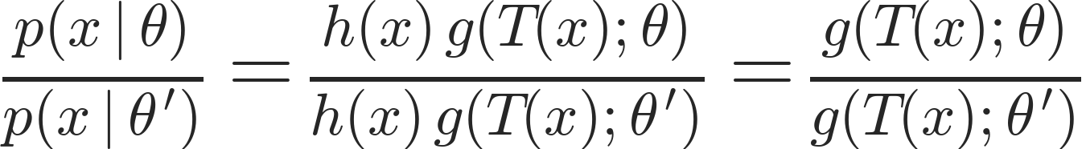
Sufficient summaries and likelihood ratios
$$\frac{p\left(x∣θ\right)}{p\left(x∣θ^{′}\right)}=\frac{h\left(x\right) g\left(T\left(x\right);θ\right)}{h\left(x\right) g\left(T\left(x\right);θ^{′}\right)}=\frac{g\left(T\left(x\right);θ\right)}{g\left(T\left(x\right);θ^{′}\right)}$$
The parameter-independent factor cancels in the likelihood ratio.
Events with the same T(x) give the same likelihood ratio for the hypotheses being compared.
Lecture 2: Applications
25
Notes:
This is the inference-preserving meaning of sufficiency. The induced density of T is not numerically equal to p(x|theta): the sample spaces and reference measures differ. What is preserved is parameter information, and the likelihood-ratio dependence on the observation.
Source: Jay Sandesara and Rafael Coelho Lopes de Sa, Lectures on Simulation-Based Inference in HEP, ML4HEP School, TIFR, original slides 30. https://github.com/JaySandesara/sbi-tutorial-ml4hep-2026/blob/main/ML4HEP_Lectures_1_and_2.pdf . Original figures and diagrams retained as supplied. The first lecture provides the classifier-to-density-ratio derivation.

Slide 26
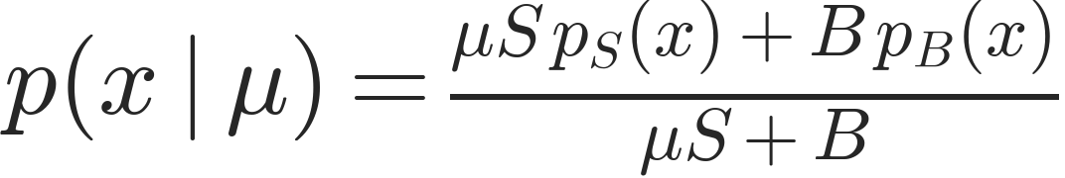
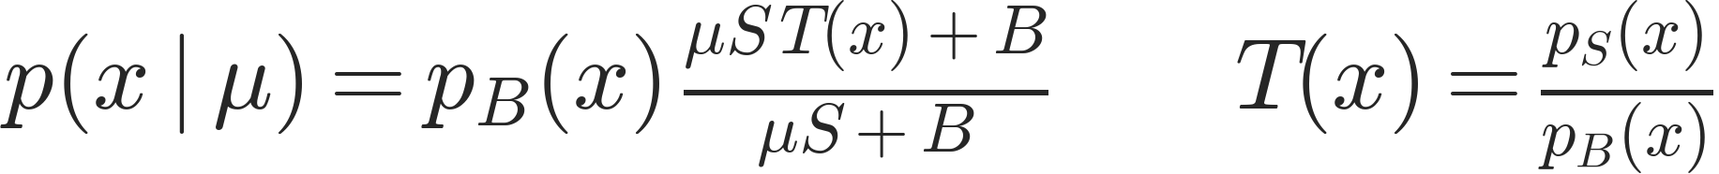
A signal-strength measurement
Signal and background with fixed kinematic shapes
$$p\left(x∣μ\right)=\frac{μS p_{S}\left(x\right)+B p_{B}\left(x\right)}{μS+B}$$
$$p\left(x∣μ\right)=p_{B}\left(x\right) \frac{μS T\left(x\right)+B}{μS+B} T\left(x\right)=\frac{p_{S}\left(x\right)}{p_{B}\left(x\right)}$$
The signal/background density ratio is sufficient for μ
S and B are expected yields; μ scales the signal contribution.
Lecture 2: Applications
26
Notes:
Assume normalized signal and background densities with shapes independent of mu, fixed nominal yields S and B, nonnegative physical mixture weights, and common support where the ratio is evaluated. Factorization shows that the per-event ratio T=p_S/p_B is sufficient for mu in the conditional shape model. For the extended model, retain the event count as well. Shape-changing nuisance parameters require separate treatment and can invalidate a single fixed ratio as a sufficient summary.
Source: Jay Sandesara and Rafael Coelho Lopes de Sa, Lectures on Simulation-Based Inference in HEP, ML4HEP School, TIFR, original slides 38. https://github.com/JaySandesara/sbi-tutorial-ml4hep-2026/blob/main/ML4HEP_Lectures_1_and_2.pdf . Original figures and diagrams retained as supplied. The first lecture provides the classifier-to-density-ratio derivation.

Slide 27
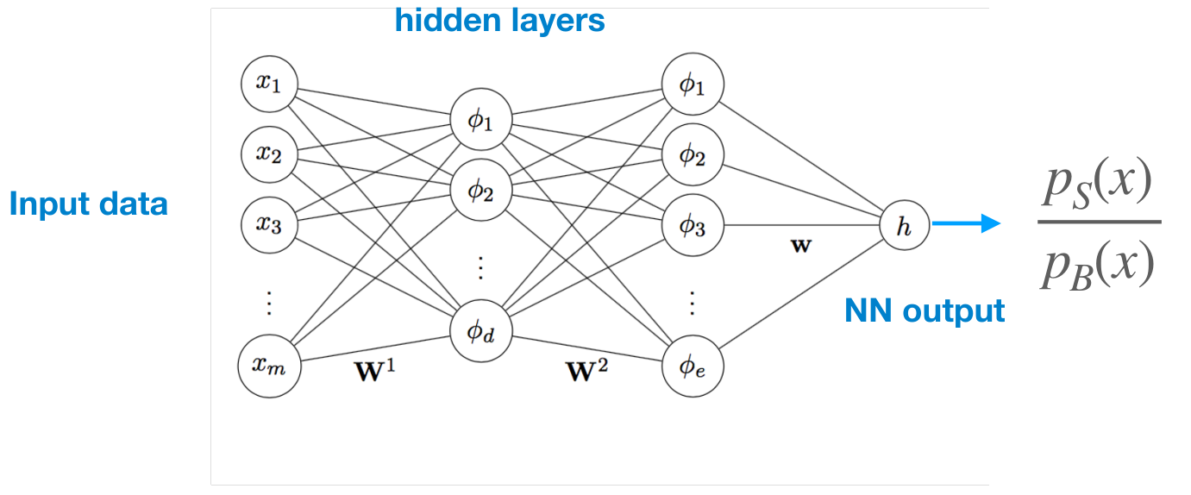
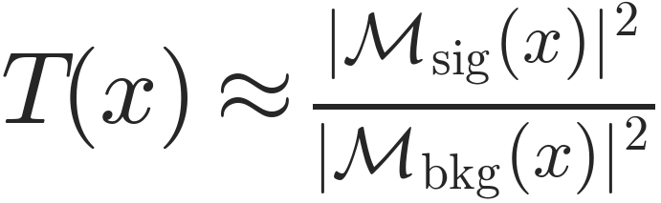
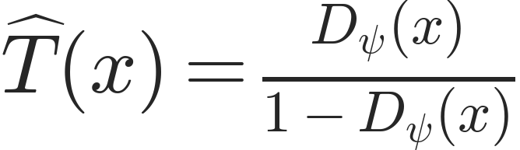
Estimating the sufficient summary
Classification neural network
Matrix-element ratios
$$T\left(x\right)≈\frac{{\left|M_{sig}\left(x\right)\right|}^{2}}{{\left|M_{bkg}\left(x\right)\right|}^{2}}$$
A physics-motivated approximation
$$\hat{T}\left(x\right)=\frac{D_{ψ}\left(x\right)}{1−D_{ψ}\left(x\right)}$$
Training on simulated detector-level events includes the simulated detector response.
Balanced training samples
Lecture 2: Applications
27
Notes:
The original slide presents neural ratios and matrix-element ratios as alternative summary constructions. The displayed matrix-element expression is schematic: an exact detector-level density ratio also involves phase-space factors, incoming-parton distributions, integration over latent histories, and detector effects. A network trained on detector-level simulated samples learns their detector-level density ratio in the ideal limit. The original network artwork denotes the ratio as its output; a sigmoid classifier requires the displayed odds transformation and class-prior correction if training is unbalanced.
Source: Jay Sandesara and Rafael Coelho Lopes de Sa, Lectures on Simulation-Based Inference in HEP, ML4HEP School, TIFR, original slides 38. https://github.com/JaySandesara/sbi-tutorial-ml4hep-2026/blob/main/ML4HEP_Lectures_1_and_2.pdf . Original figures and diagrams retained as supplied. The first lecture provides the classifier-to-density-ratio derivation.

Slide 28
Inference with a learned summary
Histogram the learned summary and build the usual likelihood
$$p\left(\hat{T}\left(x\right)∣μ,ν\right)≈q_{hist}\left(\hat{T}\left(x\right)∣μ,ν\right)$$
Lμ,ν∝b​Pois​nb∣λbμ,νm​cmam∣νm
Retain the event rate and the nuisance-parameter model.
Finite network accuracy and finite binning can reduce sensitivity.
Lecture 2: Applications
28
Notes:
Build nominal and varied templates of the learned summary and use the same frequentist likelihood machinery. The sufficient ideal ratio motivates the summary, but a trained network and finite binning are approximations. The Poisson count term contains rate information and must not be discarded. Nuisance-dependent template modeling remains necessary.
Source: Jay Sandesara and Rafael Coelho Lopes de Sa, Lectures on Simulation-Based Inference in HEP, ML4HEP School, TIFR, original slides 38. https://github.com/JaySandesara/sbi-tutorial-ml4hep-2026/blob/main/ML4HEP_Lectures_1_and_2.pdf . Original figures and diagrams retained as supplied. The first lecture provides the classifier-to-density-ratio derivation.

Slide 29
Scope and limitations
A single signal/background ratio can be sufficient for a simple signal-strength model
More parameters or shape-changing nuisances may require additional summaries
Validate the learned summary and its simulated distributions before inference
This motivates learning more general, parameter-dependent density ratios.
Lecture 2: Applications
29
Notes:
The dimensionality and form of a sufficient summary depend on the full model. One fixed signal/background ratio is not automatically sufficient for many physics parameters or nuisance parameters that alter event shapes. More general neural density-ratio models are a natural continuation for the next section.
Source: Jay Sandesara and Rafael Coelho Lopes de Sa, Lectures on Simulation-Based Inference in HEP, ML4HEP School, TIFR, original slides 39. https://github.com/JaySandesara/sbi-tutorial-ml4hep-2026/blob/main/ML4HEP_Lectures_1_and_2.pdf . Original figures and diagrams retained as supplied. The first lecture provides the classifier-to-density-ratio derivation.

