Slide 1
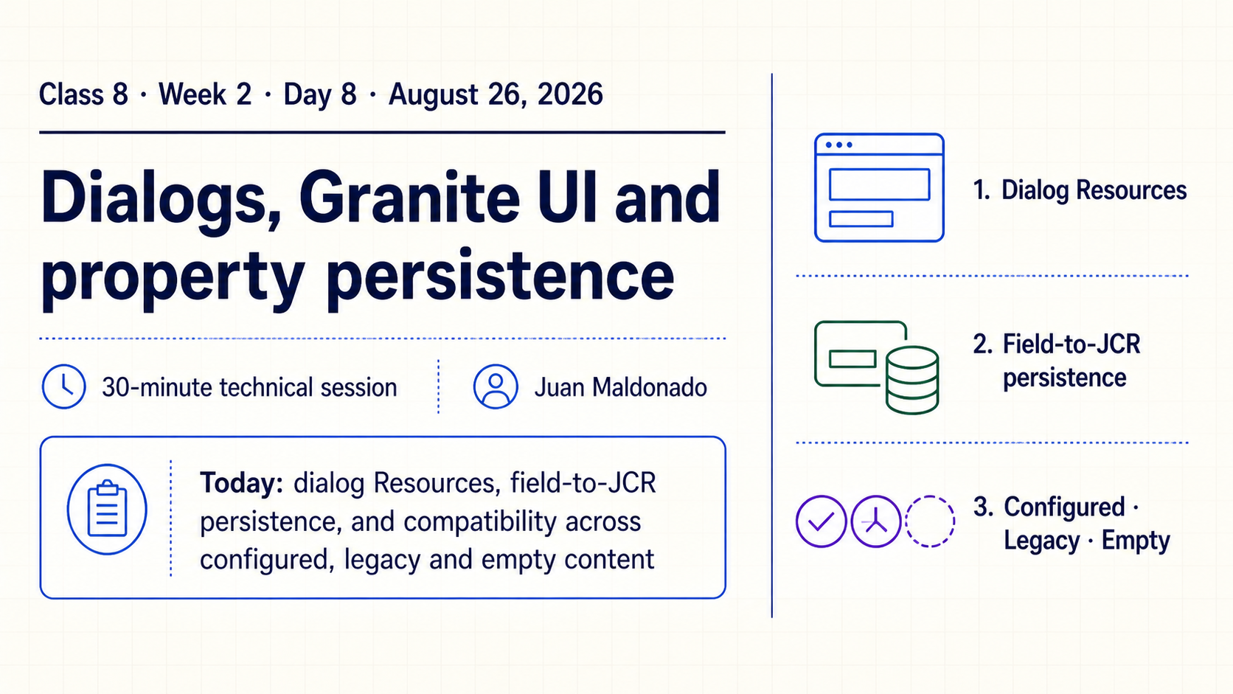
Notes:
- **What it means**
- Introduce the session’s three threads: Granite UI Resource trees, field-to-property persistence and safe evolution of stored content.
- Identify the class, date, presenter and 30-minute scope before following the technical trace.
- **How to present it**
- Preview one value moving from author input → Sling POST → JCR property → rendered output.
- Name the three topics without teaching the full pipeline yet.
- **Say explicitly**
- “The field label is presentation; the field name is storage behavior.”
- “A dialog that saves once is not enough evidence of a safe content contract.”
- **Ask the group**
- “Who will still depend on this property name two years from now?”
- **Common confusion**
- Do not treat the dialog definition itself as the runtime content source.
- **Transition**
- “First separate the three Resources involved.”

Slide 2
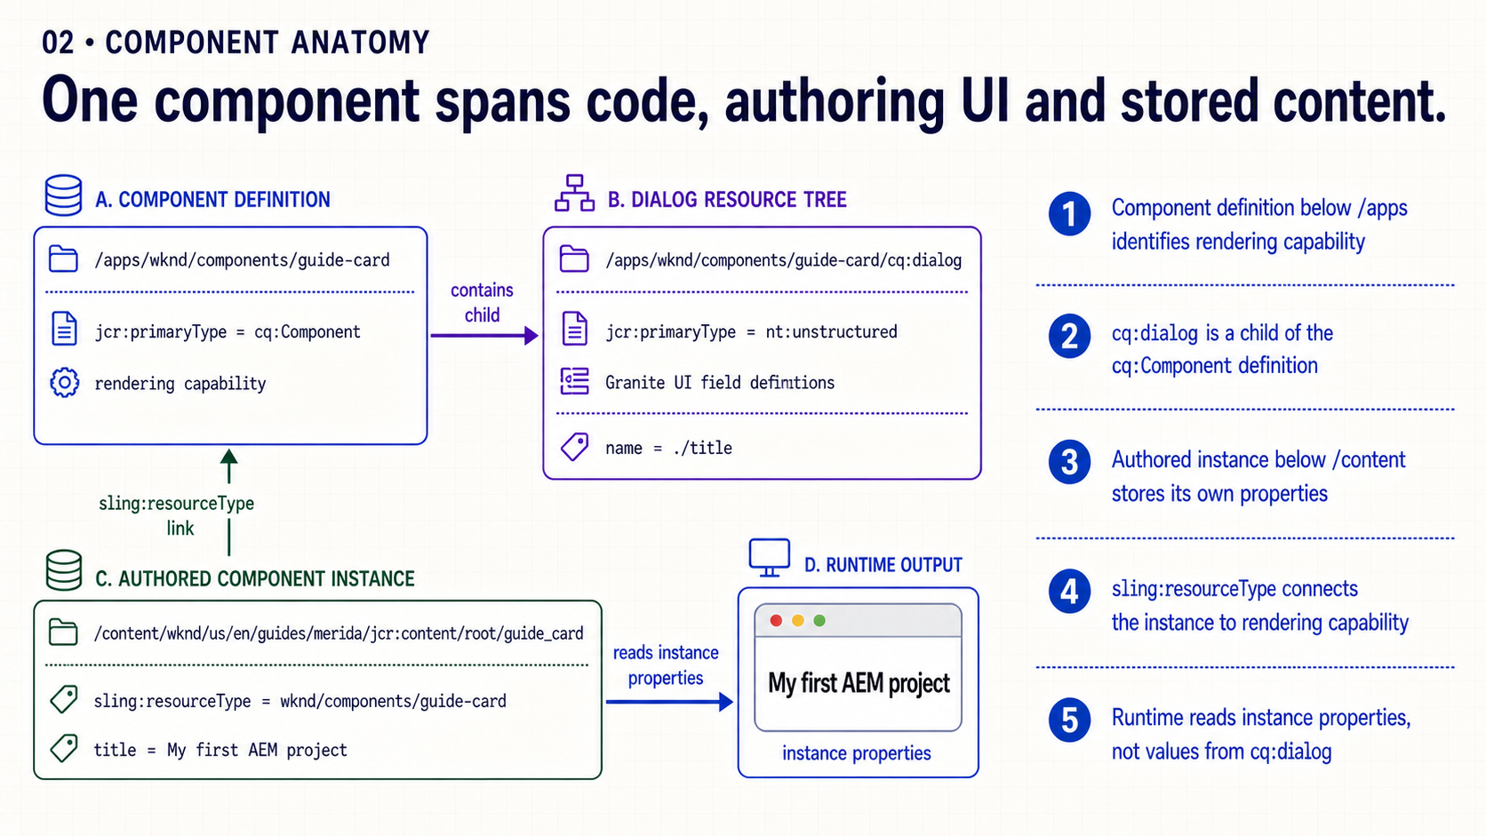
Notes:
- **What it means**
- `/apps/.../component` defines capability.
- `/apps/.../component/cq:dialog` defines the editor interface.
- `/content/.../instance` stores values for one authored use.
- **How to present it**
- Point to each path and ask who changes it: developer or author.
- Follow `sling:resourceType` from the content instance back to the implementation.
- **Say explicitly**
- “HTL reads the authored Resource; it does not read values from `cq:dialog`.”
- “The dialog controls submission, while stored content controls runtime behavior.”
- **Ask the group**
- “If the dialog label changes, should existing rendered pages change?”
- **Common confusion**
- `fieldLabel`, `required` and `emptyText` configure authoring UI; they are not automatically persisted as component values.
- **Transition**
- “The dialog itself is also rendered from a Sling Resource tree.”

Slide 3
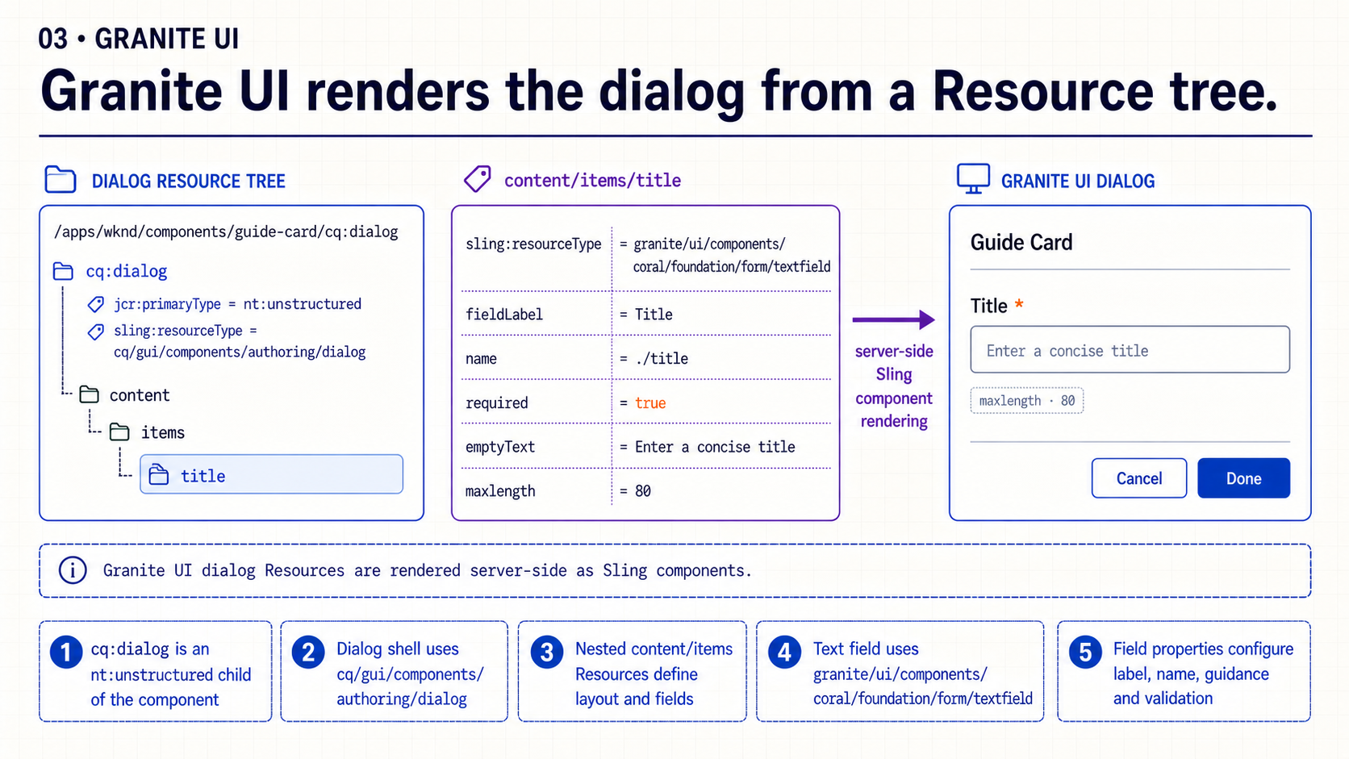
Notes:
- **What it means**
- Granite UI fields and containers are server-side components selected through `sling:resourceType`.
- Nested `content/items` nodes describe layout and controls.
- **How to present it**
- Read the tree from `cq:dialog` to the specific textfield.
- Separate the field’s component type from its configuration properties.
- **Say explicitly**
- “We configure a tree of authoring Resources; we do not hand-code the resulting Coral UI markup.”
- “The field resource type creates the control; properties configure that control.”
- **Ask the group**
- “Which property changes the stored target, and which property changes only the visible label?”
- **Common confusion**
- Avoid mixing Granite UI resource types with visitor-facing component resource types.
- **Transition**
- “The most consequential field property is `name`.”

Slide 4
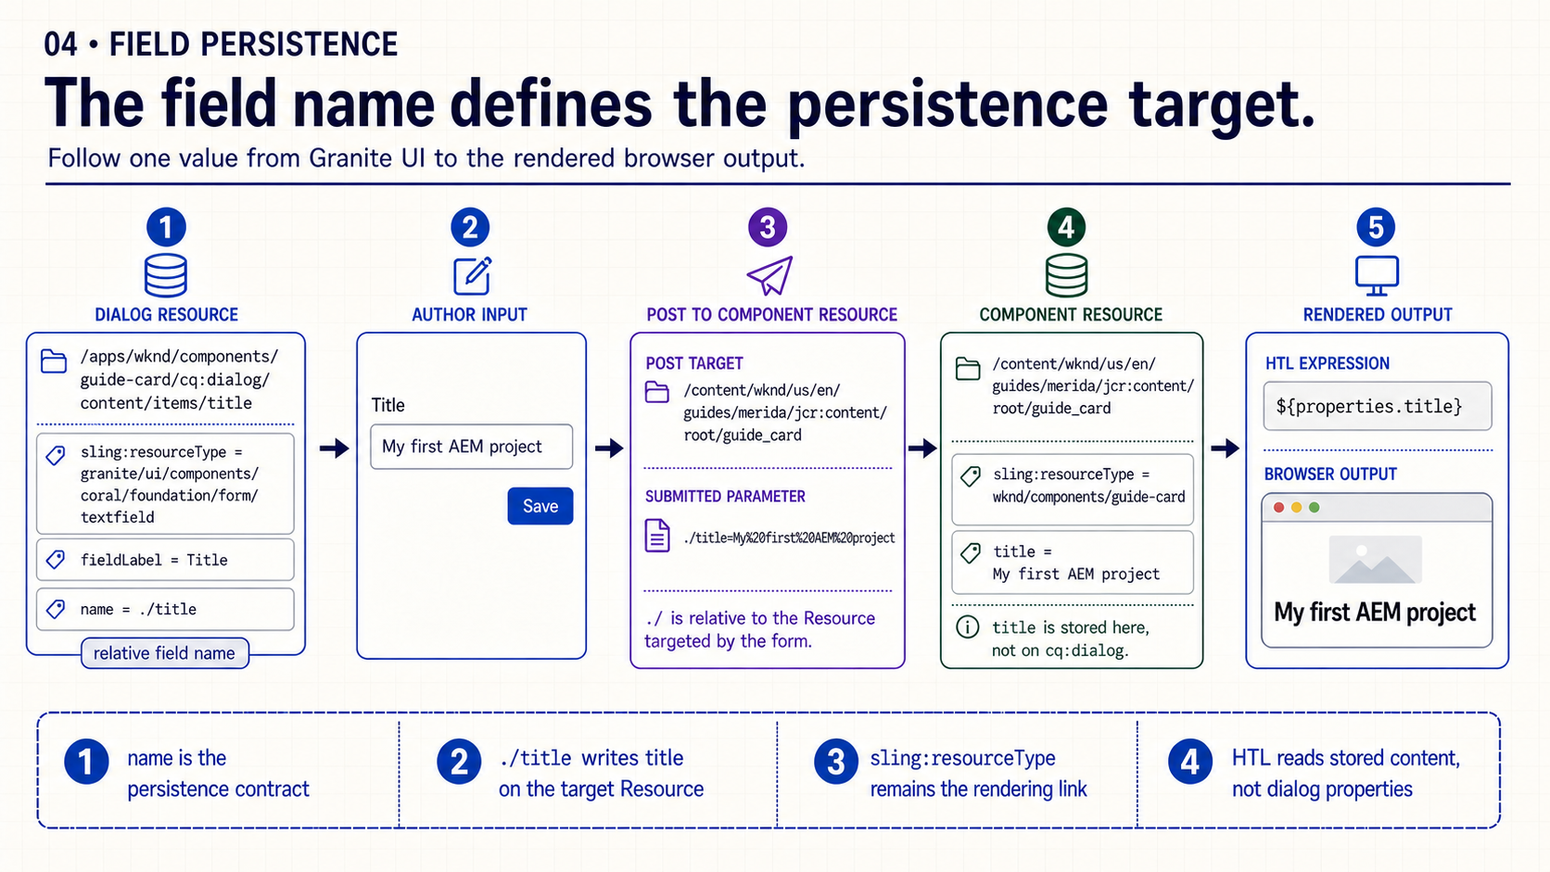
Notes:
- **What it means**
- `name="./title"` submits a property relative to the selected component Resource.
- Sling POST writes `title` on that instance below `/content`.
- **How to present it**
- Trace the exact string `./title` across dialog definition, request parameter, stored property and HTL expression.
- Show where the dot-slash resolves; do not describe it as a global repository path.
- **Say explicitly**
- “The name is relative to the form’s target Resource.”
- “The authored value is stored beside `sling:resourceType`, not under `/apps`.”
- **Ask the group**
- “What exact property should appear after saving ‘My first AEM project’?”
- **Evidence to show**
- Dialog field definition.
- POST parameter in Network tools when practical.
- JCR property on the instance.
- HTL or model consumer.
- **Transition**
- “Because code depends on that name, renaming it is a schema change.”

Slide 5
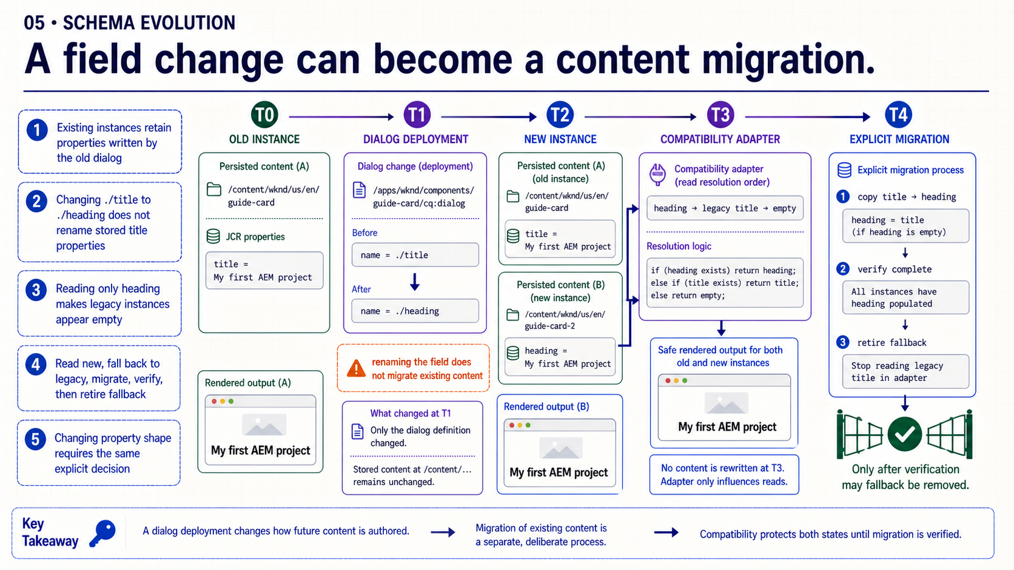
Notes:
- **What it means**
- Changing `./title` to `./heading` affects future saves only.
- Existing content continues storing `title` until explicitly migrated or re-authored.
- **How to present it**
- Compare Page A before and after deployment; keep the old property visible.
- Then show the safe sequence: read new → fallback old → migrate → remove fallback after verification.
- **Say explicitly**
- “Deploying a new dialog does not rewrite stored content.”
- “A silent field rename can make valid legacy content appear empty.”
- **Ask the group**
- “What would fail if the new HTL reads only `heading`?”
- **Common migration cases**
- Rename a property.
- Change scalar to multi-value.
- Move a property into a child Resource.
- Change the expected type or format.
- **Transition**
- “Dialog validation helps new authoring, but it cannot guarantee old content.”

Slide 6
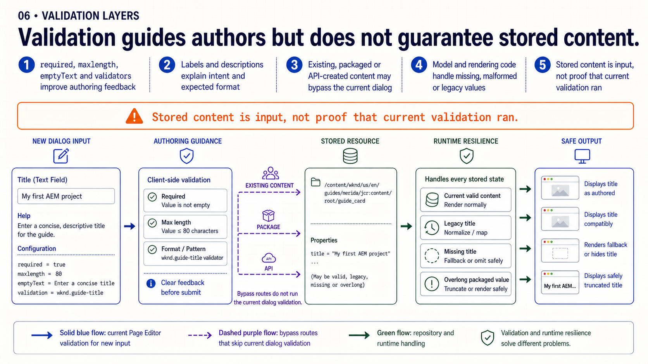
Notes:
- **What it means**
- `required`, `maxlength`, labels and validators improve the current authoring path.
- Stored content may bypass those controls or predate them.
- **How to present it**
- Separate authoring-time prevention from runtime resilience.
- Give three bypass examples: old content, package import and API/tooling.
- **Say explicitly**
- “Dialog validation is not a repository constraint.”
- “Authenticated author input is still runtime input and must be handled safely.”
- **Ask the group**
- “Can the runtime assume `required=true` has always been enforced?”
- **Common confusion**
- A mandatory UI field does not make model injection safely mandatory for every existing Resource.
- **Transition**
- “The acceptance cases must therefore include configured, legacy and empty content.”

Slide 7
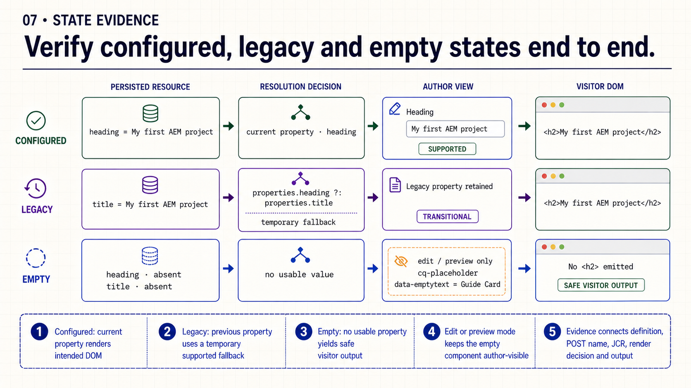
Notes:
- **What it means**
- Configured state uses the current property.
- Legacy state uses a temporary compatibility path.
- Empty state renders safe visitor output while remaining selectable in author mode.
- **How to present it**
- Walk one matrix row at a time from stored properties to rendered result.
- Ask the group to predict the output before revealing it.
- **Say explicitly**
- “Visitor safety and author usability are different empty-state requirements.”
- “A placeholder can appear in edit mode without leaking meaningless markup to Publish.”
- **Evidence to request**
- Stored current/legacy properties.
- Resolution or fallback rule.
- Author placeholder.
- Visitor DOM without empty heading or broken control.
- **Common confusion**
- Do not verify only the configured happy path.
- **Transition**
- “These states summarize the complete storage contract.”

Slide 8
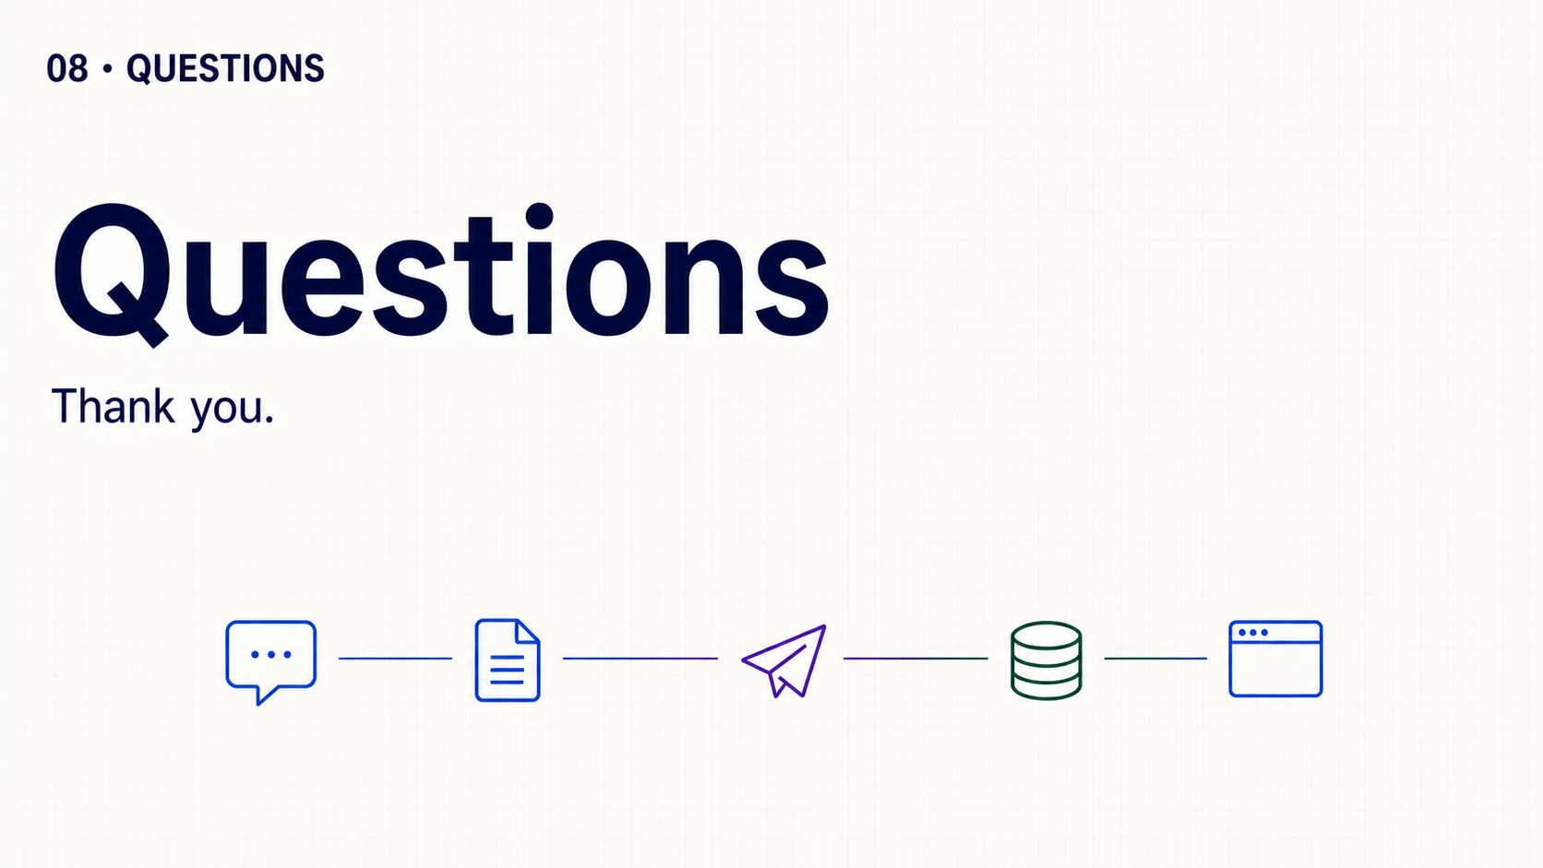
Notes:
That completes the session. Thank the audience and leave the floor open for questions they want to raise. Do not introduce review prompts or another exercise.

