Slide 1
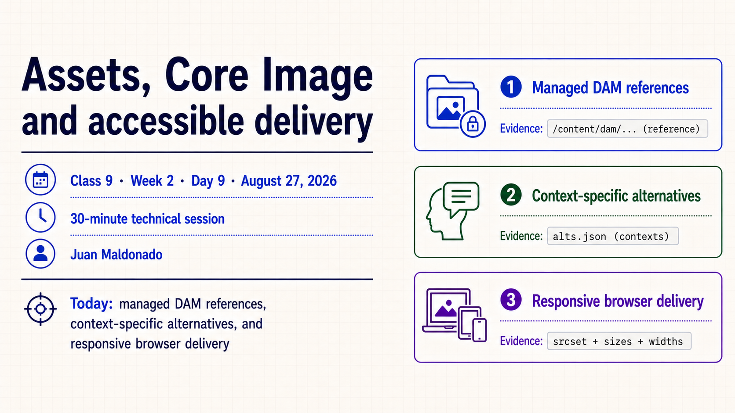
Notes:
- **What it means**
- Introduce the session’s three threads: managed DAM references, Core Image delivery and accessible meaning in context.
- Identify the class, date, presenter and 30-minute scope before examining evidence.
- **How to present it**
- Preview the pipeline: DAM asset → Image component → browser request → accessible DOM.
- Name the three topics without expanding the evidence matrix yet.
- **Say explicitly**
- “The image is not finished when it looks correct.”
- “We must verify what is referenced, what bytes were sent and what meaning was exposed.”
- **Ask the group**
- “Which of those three concerns can a screenshot prove?”
- **Common confusion**
- Do not combine the asset path, rendered URL and alternative text into one vague concept called ‘the image.’
- **Transition**
- “Start with ownership: the page references the asset; it does not own the binary.”

Slide 2
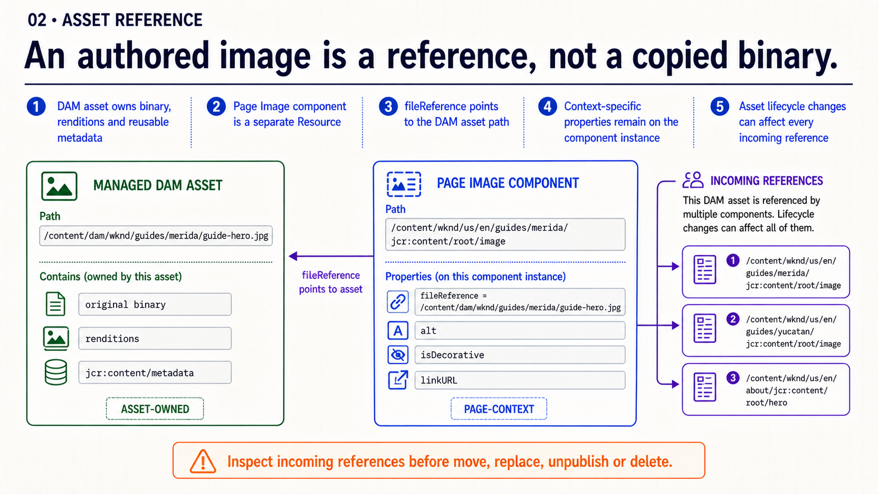
Notes:
- **What it means**
- `/content/dam/...` owns the original file, renditions and reusable metadata.
- The page component stores `fileReference` pointing to that asset.
- **How to present it**
- Point first to the DAM path, then to the component instance and its property.
- Explain the lifecycle consequence of one asset being referenced by many pages.
- **Say explicitly**
- “Replacing or moving the DAM asset can affect every incoming reference.”
- “The component instance stores a pointer, not another copy of the binary.”
- **Ask the group**
- “What should we inspect before deleting or moving this asset?”
- **Evidence to show**
- `fileReference` value.
- Asset existence and metadata.
- References view or known consuming pages.
- **Transition**
- “Once the reference is correct, use the existing delivery capability before writing custom markup.”

Slide 3
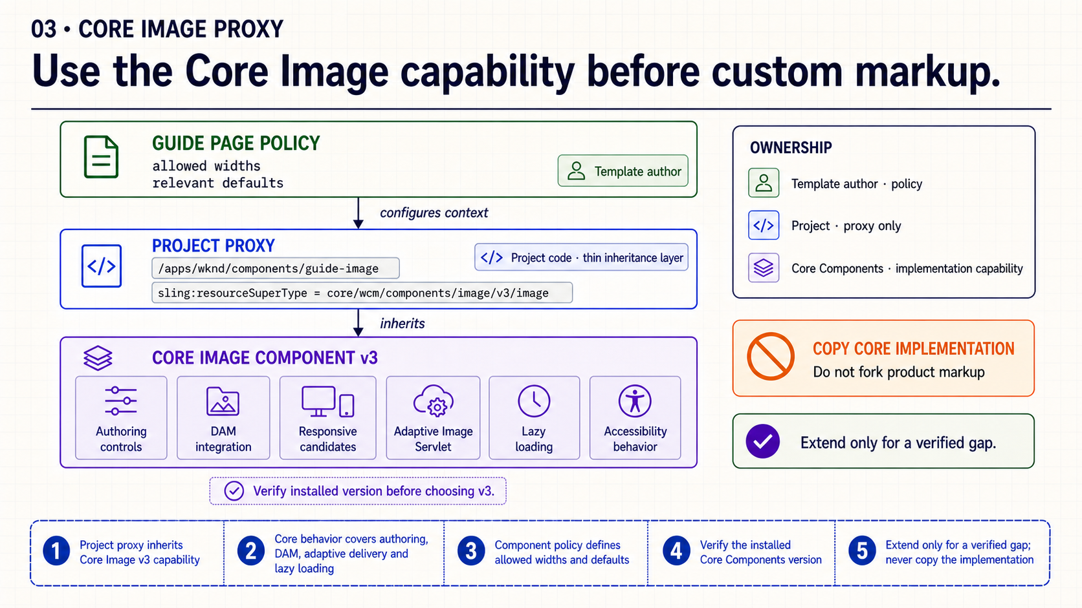
Notes:
- **What it means**
- A project proxy preserves site ownership while delegating delivery behavior to Core Image.
- Policy configures supported behavior such as widths without copying implementation.
- **How to present it**
- Trace project resource type → `sling:resourceSuperType` → installed Core Image version.
- Separate proxy identity, policy configuration and inherited implementation.
- **Say explicitly**
- “The project owns the proxy; Adobe’s Core Component owns the complex image behavior.”
- “Verify the installed version before selecting a versioned super type.”
- **Ask the group**
- “Which verified requirement cannot be met by Core Image and policy?”
- **Common confusion**
- Do not promise a feature because a documentation path exists; the dependency must be installed and compatible.
- Do not copy Core Image HTL merely to change a policy-controlled option.
- **Transition**
- “Delivery capability cannot decide what the image means in this page context.”

Slide 4
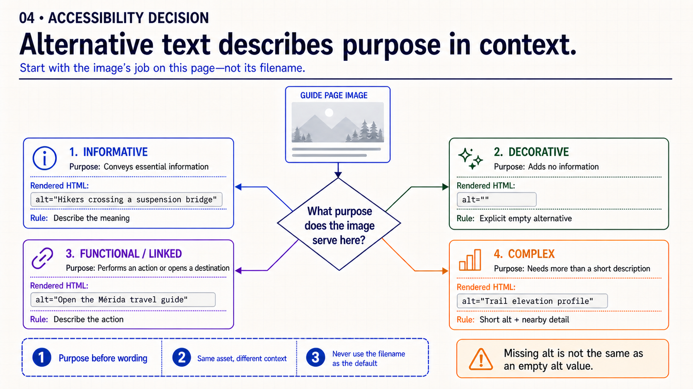
Notes:
- **What it means**
- Informative images need a concise equivalent of their essential meaning.
- Decorative images need an explicit empty alternative.
- Functional images need text describing the action or destination.
- Complex images need a short identifier plus a nearby detailed equivalent.
- **How to present it**
- Start with purpose, not with the pixels.
- Give the same image four contexts and ask how the alternative changes.
- **Say explicitly**
- “Missing `alt` and `alt=""` are not equivalent.”
- “Avoid filenames and ‘image of’; describe the useful meaning.”
- **Ask the group**
- “If this image is the only content in a link to the Guide, what should the accessible name communicate?”
- **Common confusion**
- Empty alternative is correct only when the image adds no information or function in that context.
- **Transition**
- “DAM metadata can suggest text, but it cannot know every page purpose.”

Slide 5
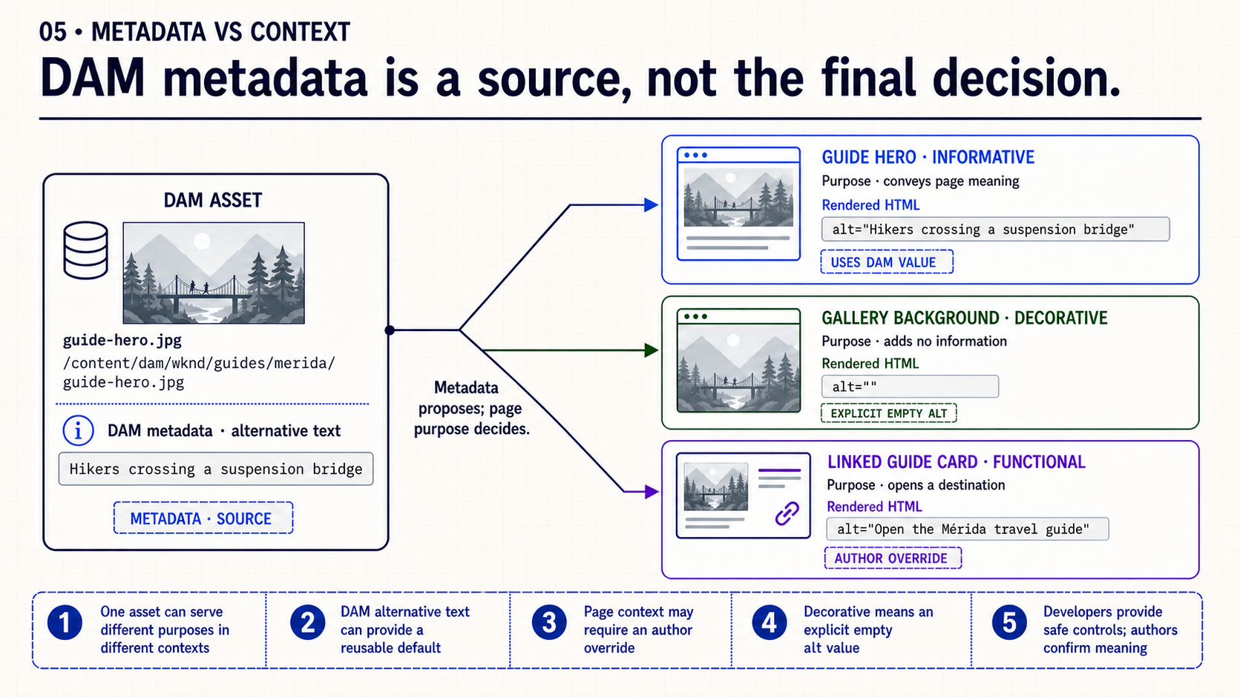
Notes:
- **What it means**
- Shared metadata can provide a reusable description.
- The authored page context determines whether that description is appropriate, empty or action-oriented.
- **How to present it**
- Reuse the same suspension-bridge asset in hero, decorative background and linked-card contexts.
- Emphasize that the binary and metadata remain unchanged while the required accessible result changes.
- **Say explicitly**
- “Metadata proposes; page purpose decides.”
- “A safe default reduces work but does not remove author responsibility.”
- **Ask the group**
- “Which of these three uses can safely inherit the DAM description unchanged?”
- **Responsibility split**
- Developer: safe component behavior.
- Template author: governed defaults and options.
- Content author: meaning in the current page.
- **Transition**
- “Now verify that the browser also receives appropriate bytes.”

Slide 6
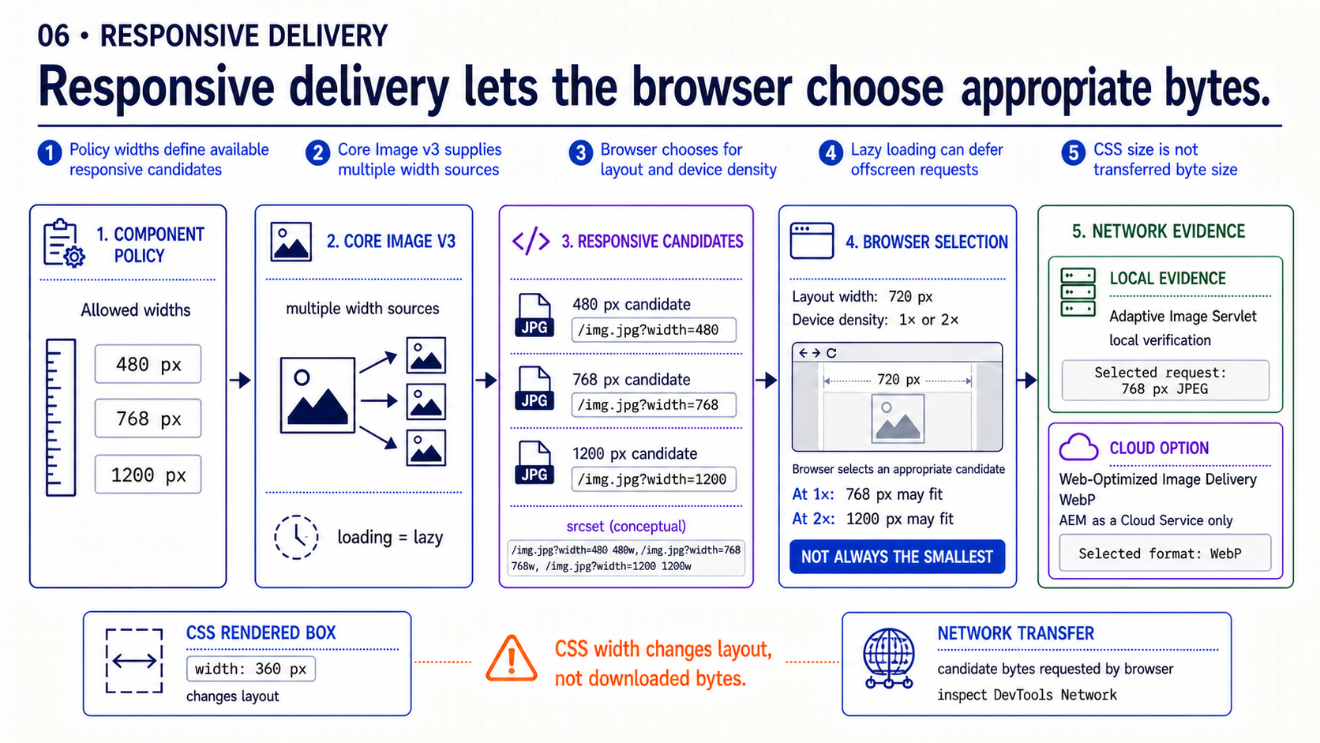
Notes:
- **What it means**
- Component policy defines useful candidate widths.
- Markup exposes candidates; the browser selects using layout and device density.
- Rendered CSS width and transferred source size are different measurements.
- **How to present it**
- Show the candidate widths first.
- Then compare rendered dimensions in Elements with the selected request in Network.
- Resize once and observe whether the selected candidate changes.
- **Say explicitly**
- “CSS can display a large downloaded image at a small size.”
- “Lazy loading changes when a request happens; responsive selection changes which source is requested.”
- **Ask the group**
- “What browser evidence proves we avoided transferring the largest rendition?”
- **Scope boundary**
- Use Adaptive Image Servlet and local browser evidence for the exercise.
- Mention Web-Optimized Image Delivery as cloud capability, not a requirement for the local lab.
- **Transition**
- “Combine repository, DOM and Network evidence in one review matrix.”

Slide 7
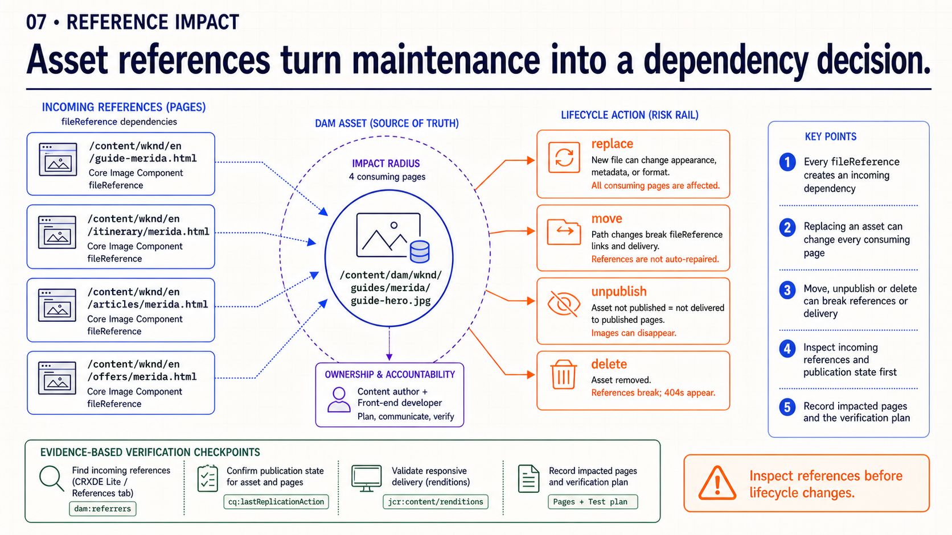
Notes:
- **What it means**
- Moving, replacing, unpublishing or deleting a DAM asset can affect every page that references it.
- Lifecycle decisions should begin with incoming-reference evidence and end with consumer verification.
- **How to present it**
- Follow the reference from one DAM asset to multiple Guide Pages.
- Compare the safe sequence—inspect, assess, change and verify—with a direct destructive change.
- **Say explicitly**
- “The asset path is a dependency contract, not just a filing location.”
- “Reference inspection reduces risk; consumer verification proves the change.”
- **Transition**
- “Now combine ownership, accessibility and delivery in one evidence matrix.”

Slide 8
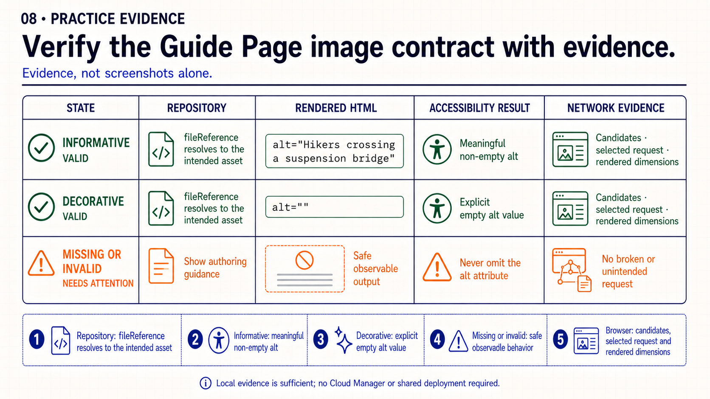
Notes:
- **What it means**
- Each state must connect stored reference, rendered alternative, browser-selected source and author behavior.
- **How to present it**
- Walk informative, decorative and missing/invalid rows separately.
- Require an artifact for every column instead of accepting “it looks right.”
- **Say explicitly**
- “A correct `fileReference` does not prove correct alternative text or efficient delivery.”
- “An Author preview does not prove the asset and required rendition are available on Publish.”
- **Evidence to request**
- Component `fileReference` and asset path.
- Rendered `alt` state.
- Selected image request and dimensions.
- Safe empty or invalid state.
- **Transition**
- “That completes the session. I’ll leave the final slide open for your questions.”

Slide 9
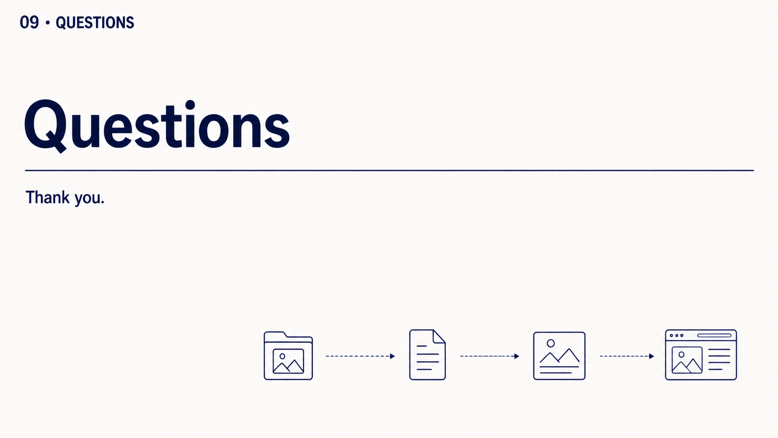
Notes:
That completes the session. Thank the audience and leave the floor open for questions they want to raise. Do not introduce review prompts or another exercise.

