Slide 1
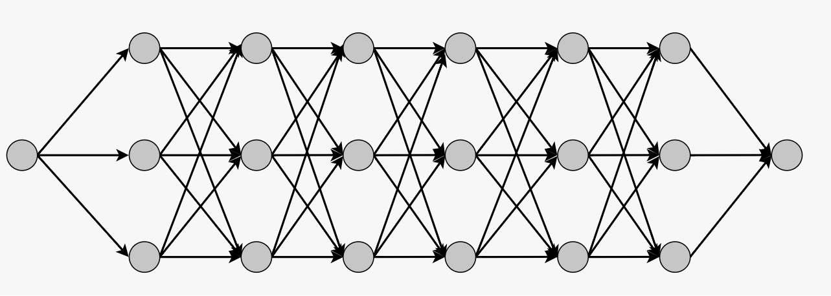




















$$v_{1}^{1}$$
$$v_{1}^{2}$$
$$v_{1}^{3}$$
$$v_{1}^{4}$$
$$v_{1}^{5}$$
$$v_{1}^{6}$$
$$v_{0}^{0}$$
$$v_{2}^{1}$$
$$v_{2}^{2}$$
$$v_{2}^{3}$$
$$v_{2}^{4}$$
$$v_{2}^{5}$$
$$v_{2}^{6}$$
$$v_{0}^{7}$$
$$v_{3}^{1}$$
$$v_{3}^{2}$$
$$v_{3}^{3}$$
$$v_{3}^{4}$$
$$v_{3}^{5}$$
$$v_{3}^{6}$$

Slide 2
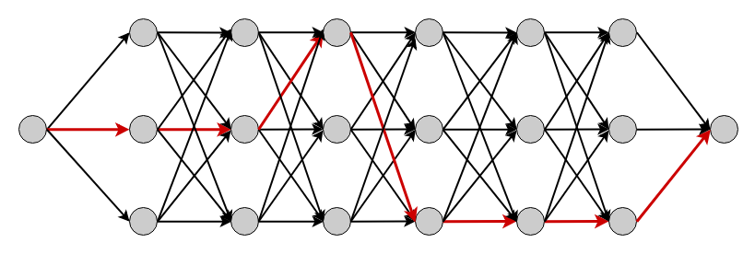




















$$v_{A}^{1}$$
$$v_{A}^{2}$$
$$v_{A}^{3}$$
$$v_{A}^{4}$$
$$v_{A}^{5}$$
$$v_{A}^{6}$$
$$v_{X}^{0}$$
$$v_{B}^{1}$$
$$v_{B}^{2}$$
$$v_{B}^{3}$$
$$v_{B}^{4}$$
$$v_{B}^{5}$$
$$v_{B}^{6}$$
$$v_{X}^{7}$$
$$v_{C}^{1}$$
$$v_{C}^{2}$$
$$v_{C}^{3}$$
$$v_{C}^{4}$$
$$v_{C}^{5}$$
$$v_{C}^{6}$$

