Slide 1
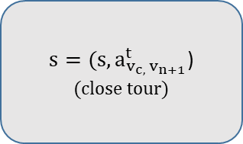
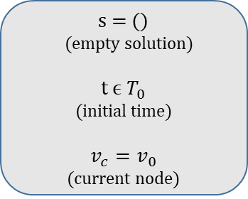
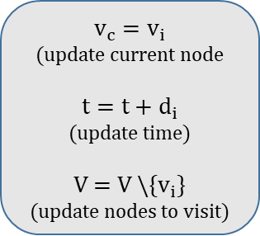
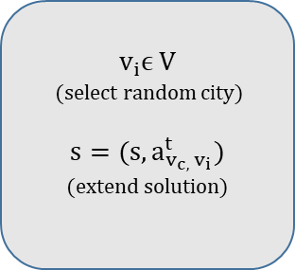
s = ()
(empty solution)
$$t \text{ϵ} T_{0}$$
(initial time)
$$v_{c}=v_{0}$$
(current node)
$$v_{i}\text{ϵ} \text{V}$$
(select random city)
$$s=(s, a_{v_{c, }v_{i}}^{t})$$
(extend solution)
$$v_{c}=v_{i}$$
(update current node
$$t=t+d_{i}$$
(update time)
V = V \{$v_{i}$}
(update nodes to visit)
V = {} ?
No
Yes
$s=(s, a_{v_{c, }v_{n+1}}^{t}$)
(close tour)

