Slide 1
Microproject
JavaScript Frameworks
Github link: https://github.com/rafaelmaub/Microproject

Slide 2
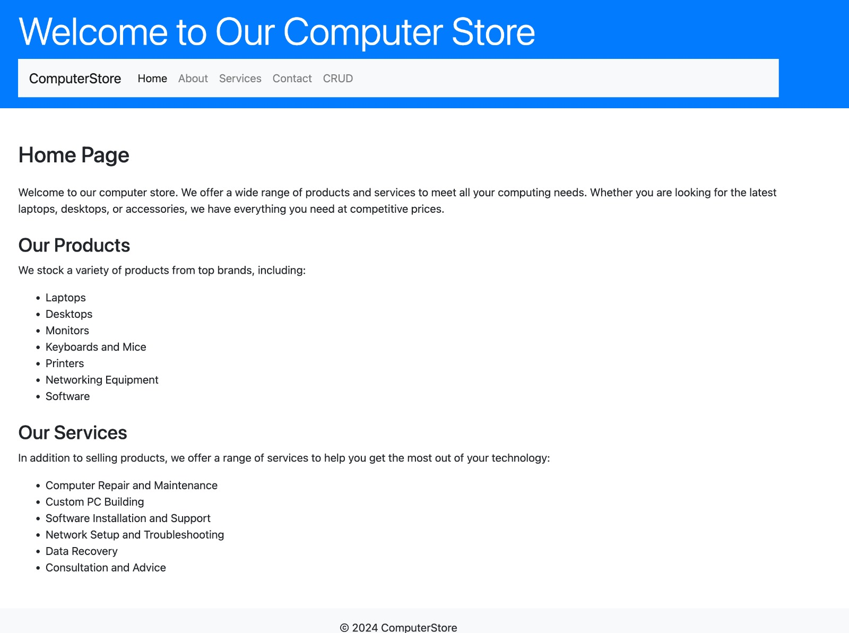
index.html

Slide 3
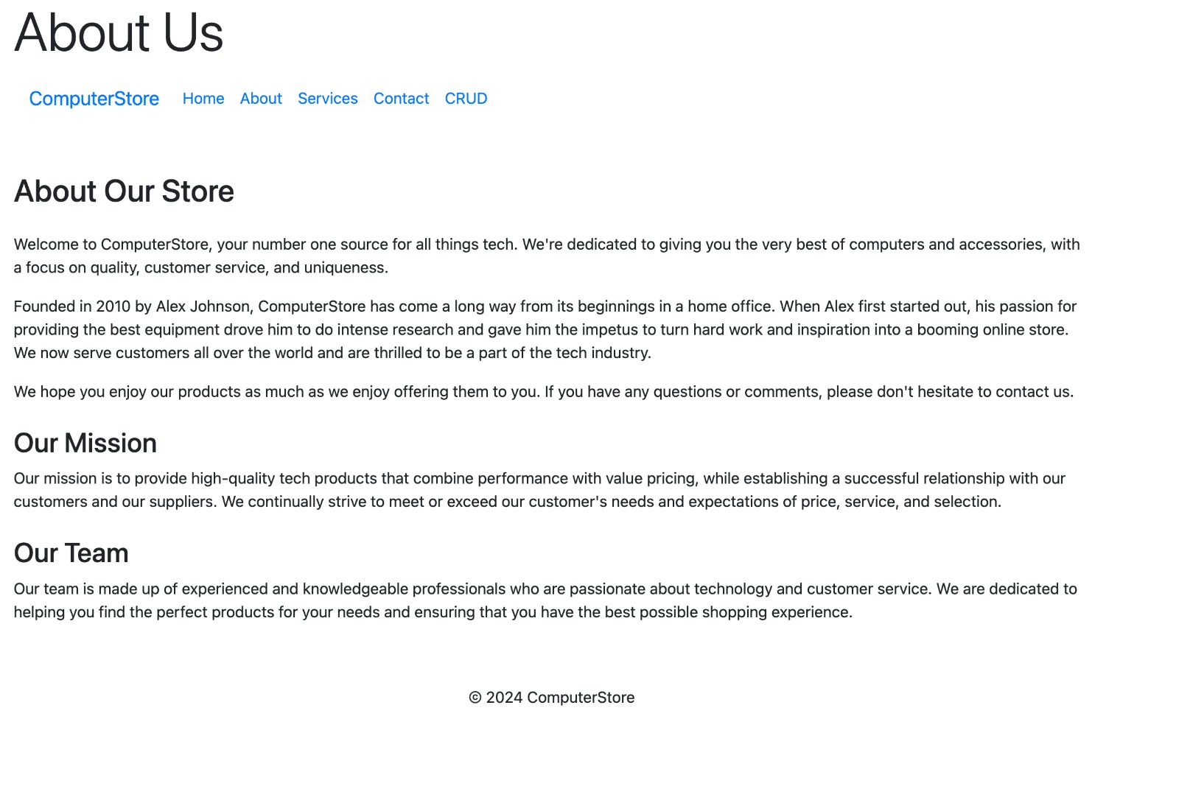
about.html

Slide 4
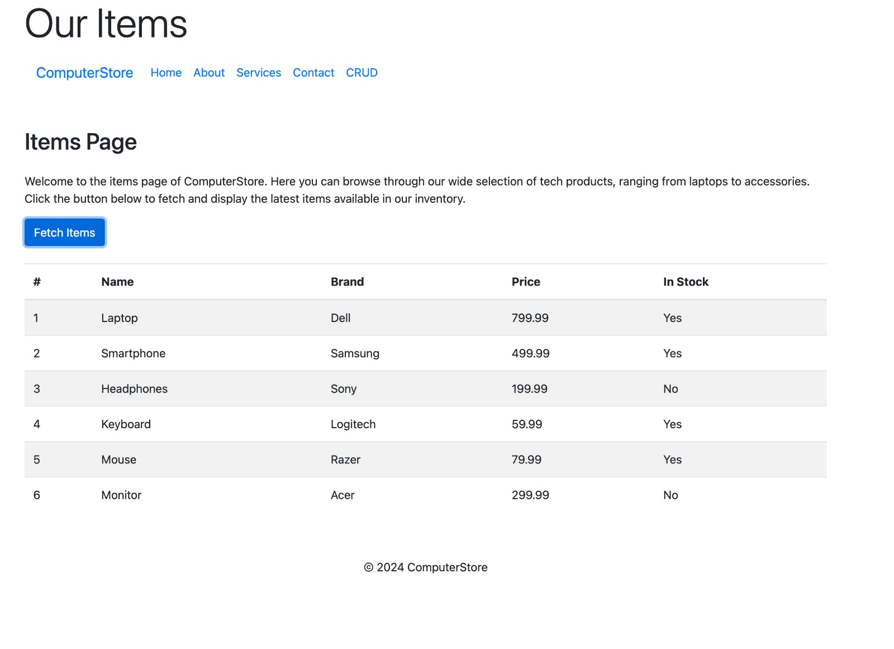
api.html

Slide 5
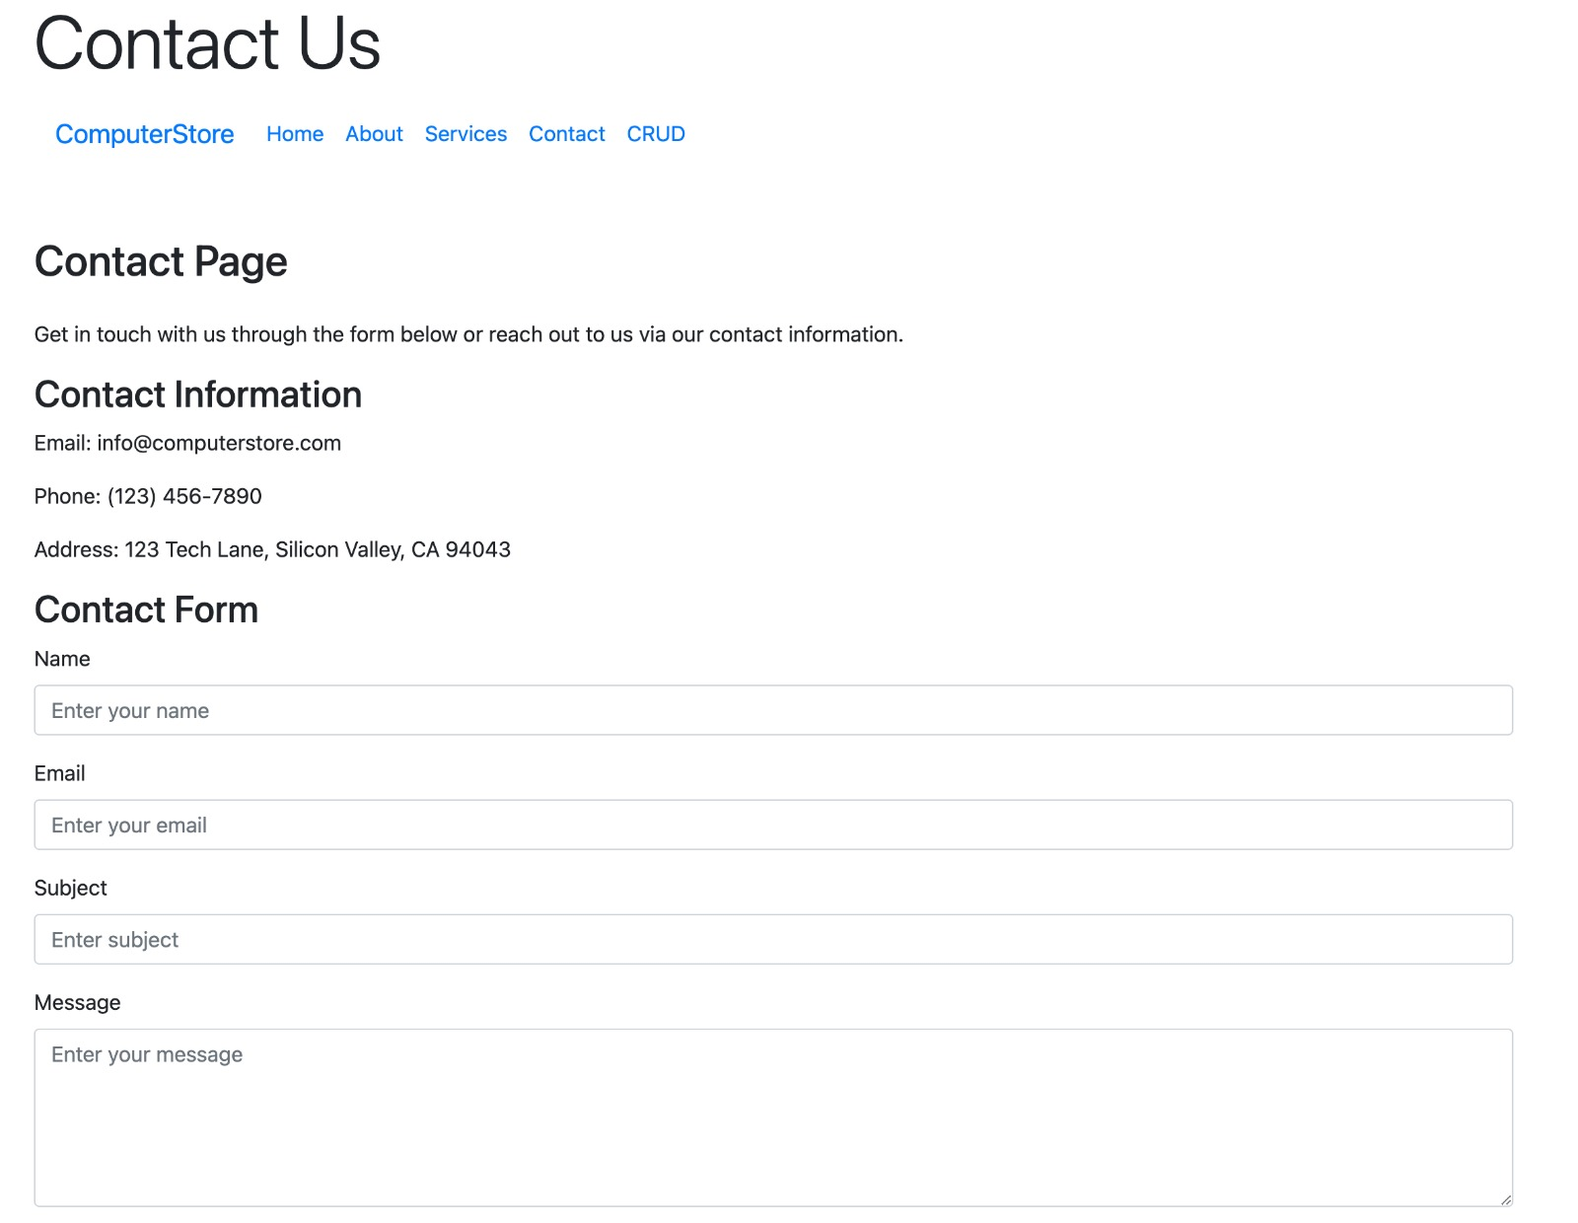
contact.html

Slide 6
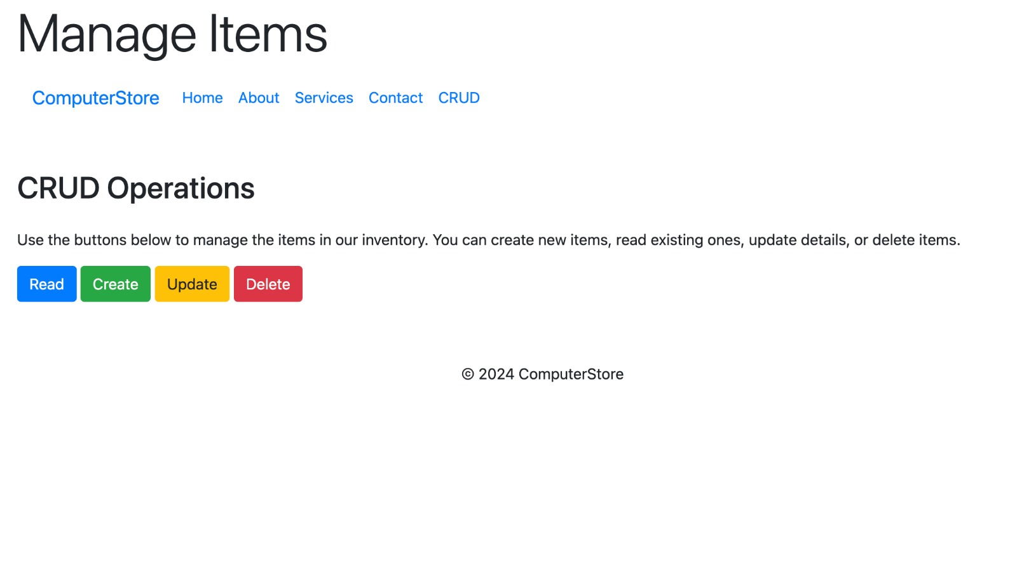
crud.html

Slide 7
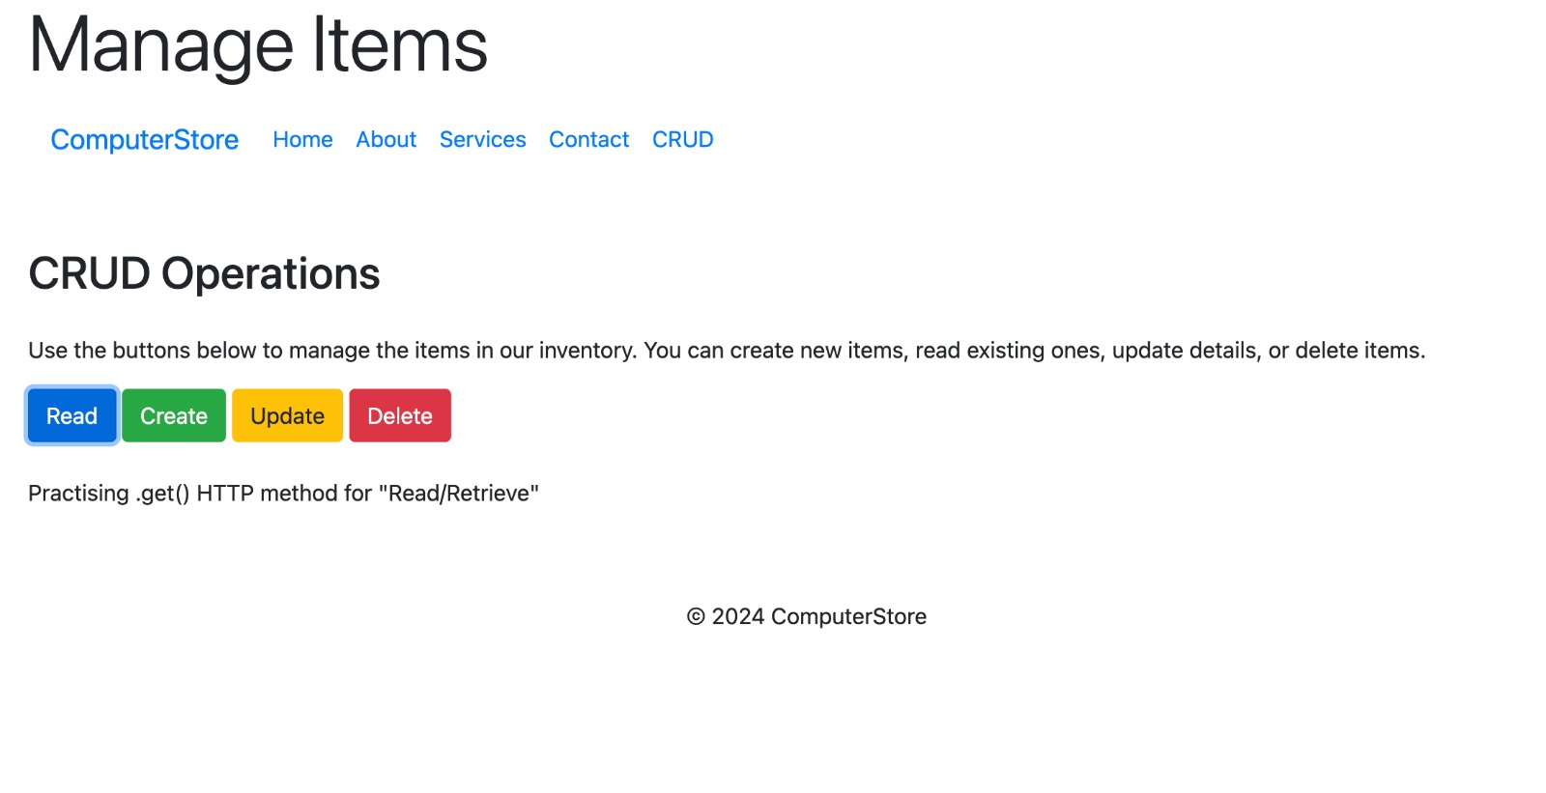
crud.html
Buttond

