Slide 1

Semi-Supervised Learning Applied to Soil Nutrient Estimation Using Earth Observation Data
Rafael Candeias, ist193748, MEIC IST

Slide 2
Presentation outline
Introduction
Background
Related Works
Research Methodology
Work Schedule
Conclusion

Slide 3
Introduction
Context.
Motivation.
Objectives and Contributions.

Slide 4
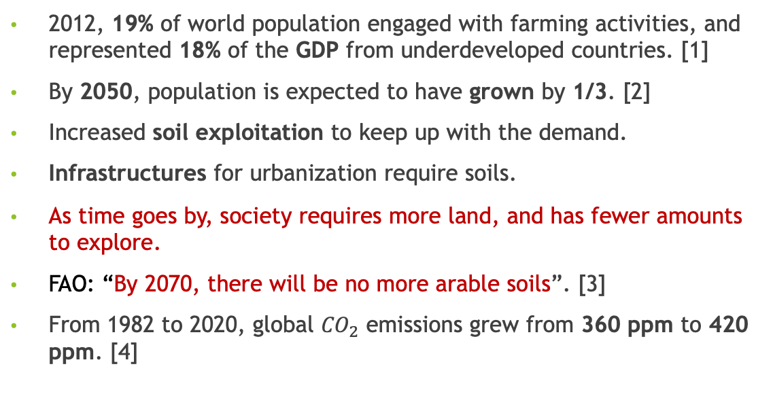
Introduction: Context
2012, 19% of world population engaged with farming activities, and represented 18% of the GDP from underdeveloped countries. [1]
By 2050, population is expected to have grown by 1/3. [2]
Increased soil exploitation to keep up with the demand.
Infrastructures for urbanization require soils.
As time goes by, society requires more land, and has fewer amounts to explore.
FAO: “By 2070, there will be no more arable soils”. [3]
From 1982 to 2020, global ${CO}_{2}$ emissions grew from 360 ppm to 420 ppm. [4]

Slide 5
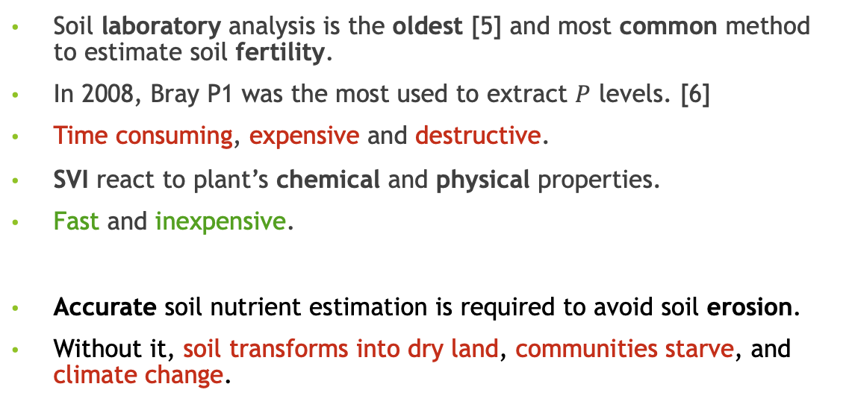
Introduction: Motivation
Soil laboratory analysis is the oldest [5] and most common method to estimate soil fertility.
In 2008, Bray P1 was the most used to extract $P$ levels. [6]
Time consuming, expensive and destructive.
SVI react to plant’s chemical and physical properties.
Fast and inexpensive.
Accurate soil nutrient estimation is required to avoid soil erosion.
Without it, soil transforms into dry land, communities starve, and climate change.

Slide 6
Introduction: Motivation
AI is one of the most studied areas in computer science.
Some papers used ML to estimate some soil nutrients from SVI.
These papers use Supervised Learning ML algorithms.
Not enough labelled data to properly train the agents.
Much bigger amounts of unlabelled data from EOS missions.
Exploring Semi-Supervised algorithms seems a natural approach.

Slide 7
Introduction: Objectives and Contributions
Our objective: Conduct and extensive study on SSL to estimate soil nutrients from satellite data.
Understanding soil fertility: Accumulation of knowledge.
Discovering or creating high-quality datasets: Investigate existing datasets, and create if necessary.
Explore SVI formulas: Get in touch with the literature.
Find the best SSL to solve our problem: Discover of state of the art, implementation and evaluation.
Contributing to AI community, as there is no SSL investigation for this problem,
And to our society, by reducing soil over exploration.

Slide 8
Background
Soil Fertility.
Satellite Data Acquisition and Interpretation.
Machine Learning.
Data Science.

Slide 9





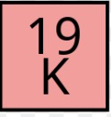



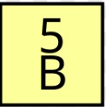
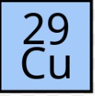

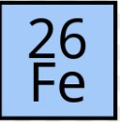
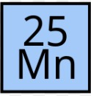
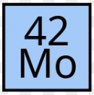
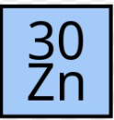
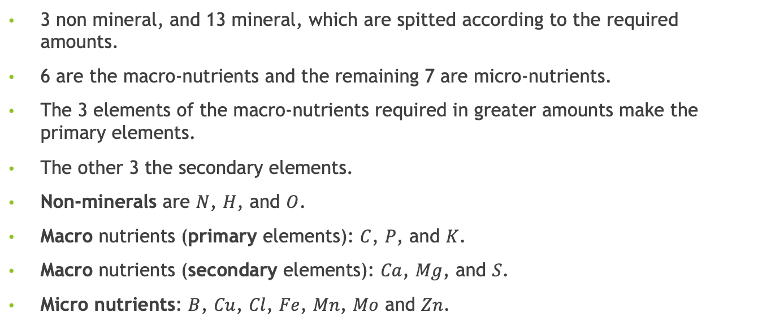
Soil fertility: Soil Nutrients for Fertility
3 non mineral, and 13 mineral, which are spitted according to the required amounts.
6 are the macro-nutrients and the remaining 7 are micro-nutrients.
The 3 elements of the macro-nutrients required in greater amounts make the primary elements.
The other 3 the secondary elements.
Non-minerals are $N$, $H$, and $O$.
Macro nutrients (primary elements): $C$, $P$, and $K$.
Macro nutrients (secondary elements): $Ca$, $Mg$, and $S$.
Micro nutrients: $B$, $Cu$, $Cl$, $Fe$, $Mn$, $Mo$ and $Zn$.

Slide 10
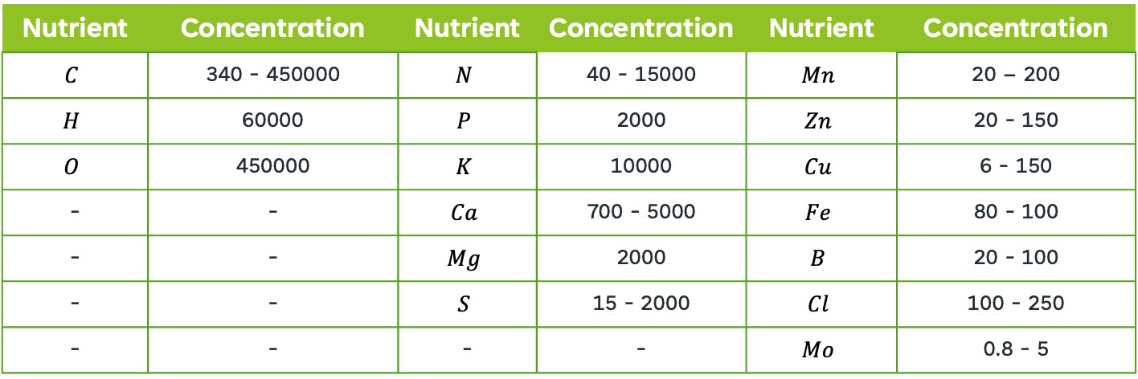
Soil fertility: Soil Nutrients for Fertility
Nutrient | Concentration | Nutrient | Concentration | Nutrient | Concentration
$$C$$ | 340 - 450000 | $$N$$ | 40 - 15000 | $$Mn$$ | 20 – 200
$$H$$ | 60000 | $$P$$ | 2000 | $$Zn$$ | 20 - 150
$$O$$ | 450000 | $$K$$ | 10000 | $$Cu$$ | 6 - 150
- | - | $$Ca$$ | 700 - 5000 | $$Fe$$ | 80 - 100
- | - | $$Mg$$ | 2000 | $$B$$ | 20 - 100
- | - | $$S$$ | 15 - 2000 | $$Cl$$ | 100 - 250
- | - | - | - | $$Mo$$ | 0.8 - 5
Optimal Nutrient Quantities for Soil Fertility in parts per million (ppm) [7] [8]

Slide 11
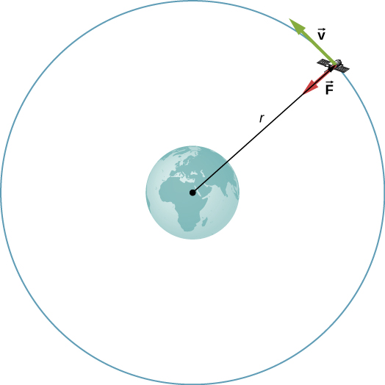
Satellite Data Acquisition and Interpretation: Satellite Concepts
Orbit is a regular repeating path that one object does around another. [9]
The object in orbit is called a satellite.
Artificial or natural.
Geostationary orbits (GO) at 37.015 km. 24 hour revisiting time.
Low Observation orbit (LEO) between 161 km to 332 km. 90 minutes orbit.
Medium Observation orbit (MEO) between 2000 km to 35000 km.
Sun Synchronous orbit are LEO orbits that make a 90º angle with the Equator.
Pass at the same time every day. [10]

Slide 12





Satellite Data Acquisition and Interpretation: Space Missions
LUCAS, from ESA, to provide information about land use and land cover in EU.
Constellations S1, S2, S3, S5P and S6. [11]
NASA with Landsat, since 1972. 9 satellites have taken part on it. Only Landsat 8 and 9 are active. [12]
JAXA contains the GGOS, ALOS, DAICHI, and GCOM. Study topography, land cover and vegetation. [13]
ISRO launched 3 missions with MS sensors, RESOURCESAT-2A, OCENASAT, and INSAT. [14]
CNSA powers the ZY-3A to map the Earth, FY-31 for moisture, and GF-3 to study oceans. [15]

Slide 13
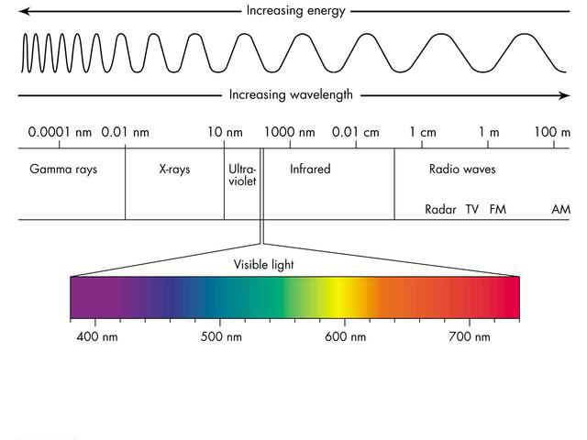
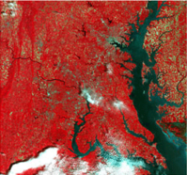
Satellite Data Acquisition and Interpretation: Data Acquisition
Electro magnetic spectrum represents all the rays wavelengths.
Remote sensing corresponds to gathering information from an object without physical contact.
MSI are sensors that can capture several bands from the EMS.
Humans can only sense rays from the RGB band.
For human perception, MSI outputs must go through False Colour methods. [10]

Slide 14
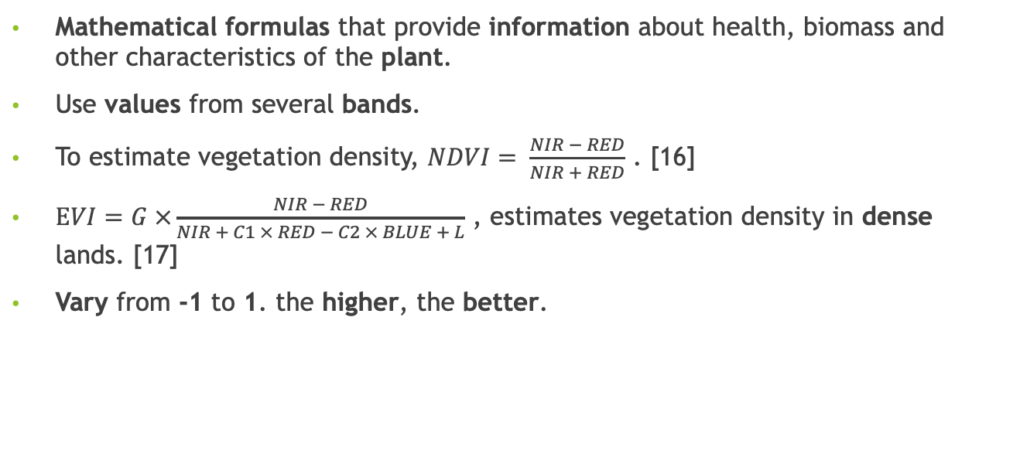
Satellite Data Acquisition and Interpretation: Spectral Vegetation Indices
Mathematical formulas that provide information about health, biomass and other characteristics of the plant.
Use values from several bands.
To estimate vegetation density, $NDVI= \frac{NIR − RED}{NIR + RED}$ . [16]
$EVI=G ×\frac{NIR − RED}{NIR + C1 × RED − C2 × BLUE + L}$ , estimates vegetation density in dense lands. [17]
Vary from -1 to 1. the higher, the better.

Slide 15
Related Works
Datasets.
Machine Learning and Soil Sensing.
Libraries and Toolkits.

Slide 16

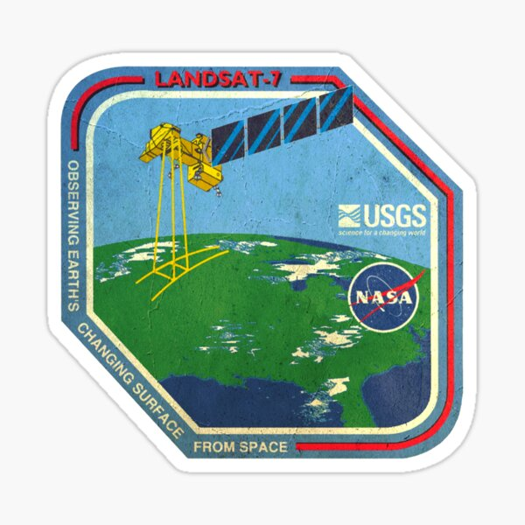


Datasets
ESDAC LUCAS Copernicus dataset was used in a previous research. 10% error. [10]
Agriculture-Vision dataset only uses RGB and NIR channels. [19]
BigEarthNet dataset has the 12 different bands from the S2 satellite. [20]
Both unlabelled, but the second might be used.
NCSS Soil Characterization database has good size, nutrient values from all USA. [21]
Used to train a Random Forest model that predicts soil bulk density.
RMSE of 0.13 g.cm-3. [22]

Slide 17





Datasets
Tomislav Hengl created a database from several other databases. [23]
Includes nutrient values, characteristics and multiple band values from all across Africa.
Some locations are missing on the labels.
It is heavily under representing tropical jungles.

Slide 18
Machine Learning and Soil Sensing:
Learning Features
Tomislav Hengl concluded during his investigation that some characteristics are more correlated.
pH levels, soil organic carbon quantities, clay content, rainfall, and land surface temperatures. [23]
B02 (BLUE), B04 (RED), B8A (NIR), B09 (Water vapour), B11 (SWIR1) and B12 (SWIR2). [23]
Other article used SVI to estimate egg plant yield concluded that SVI GI and GVI were the most important. [24]

Slide 19
Machine Learning and Soil Sensing:
Semi-Supervised Learning Algorithms
No papers that use SSL to predict soil nutrients were found.
Some used SL methods, others did not predict our objective.
One author used a SSL framework with a Deep-Learning algorithm to classify remote sensing images.
Average accuracy of 92%. [25]
Other author proved that SSL with little labelled datasets are better than SL models on sea ice classification.
On datasets with less than 100 labels, it had more 5% accuracy. [26]

Slide 20


Libraries and Toolkits
Libraries are a collection of pre-developed modules or variables that provide functionalities for software application.
Pytorch, and TensorFlow.
Toolkits are a collection of modules used for specific tasks.
Many exist, but none is related to SSL for soil nutrient estimation.
Our investigation group developed a toolkit, TerraSenseTK. [10]

Slide 21
Research Methodology
Data.
Model Development and Evaluation.
Integration in the TerraSenseTK.

Slide 22

Data:
Dataset Development
To the extend of our knowledge, there is no high-quality, reliable and big enough dataset.
It is required to create one new.
Extract all data from the previously mentioned datasets.
Verify if data is according to expected values
Average, median, minimum, maximum, data type, data dimension, and data distribution.
All extracted with the Python library Pandas.

Slide 23

Data:
Dataset Preparation for ML
Missing values are expected, as the author Tomislav Hengl had mentioned.
Evaluate the datasets balance.
Undersampling, oversampling and SMOTE sampling.
If required, create 3 different datasets.
It is indifferent if the model predicts incorrect values, as long as it respects the limits.
Two different solution algorithms. One will be a regression model, the other a classification model.
The intervals are labelled according to their impact on the soil.
Python scripts will be used to convert the values into classes.

Slide 24
Model Development and Evaluation:
Model Development
Python implementation of the discovered SSL models.
Ensures compatibility with TerraSenseTK.
Train the model according to the self-training method.
Ensemble methods, like bagging, to reinforce the investigation.

Slide 25
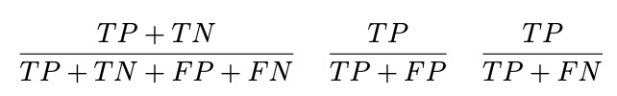
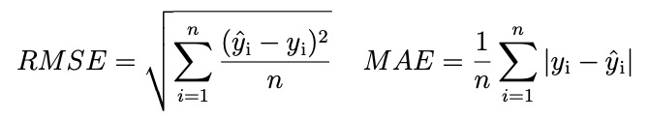
Model Development and Evaluation:
Model Selection
At this time, we will possess 3 x N trained models.
For the classifiers, we will rely on accuracy, precision and recall.
Whereas for the regression models, the RMSE and MAE.
Thorough assessment of each model to select the most adequate.

Slide 26
Model Development and Evaluation:
Model Benchmark
Implementation of a SL model through a Python script.
Such step is required to compare the SSL and SL performance.
Thus, by the end of the investigation, there is a clear difference.
Integration in the TerraSenseTK
Created dataset into the datasets module.
Append ML models in the algorithms models.
Evaluation scripts into the performance evaluation module.

Slide 27
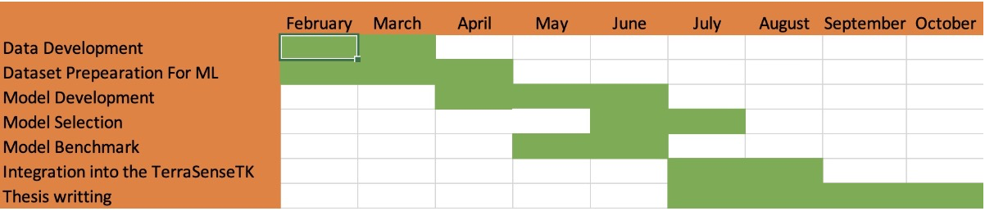
Work Schedule

Slide 28
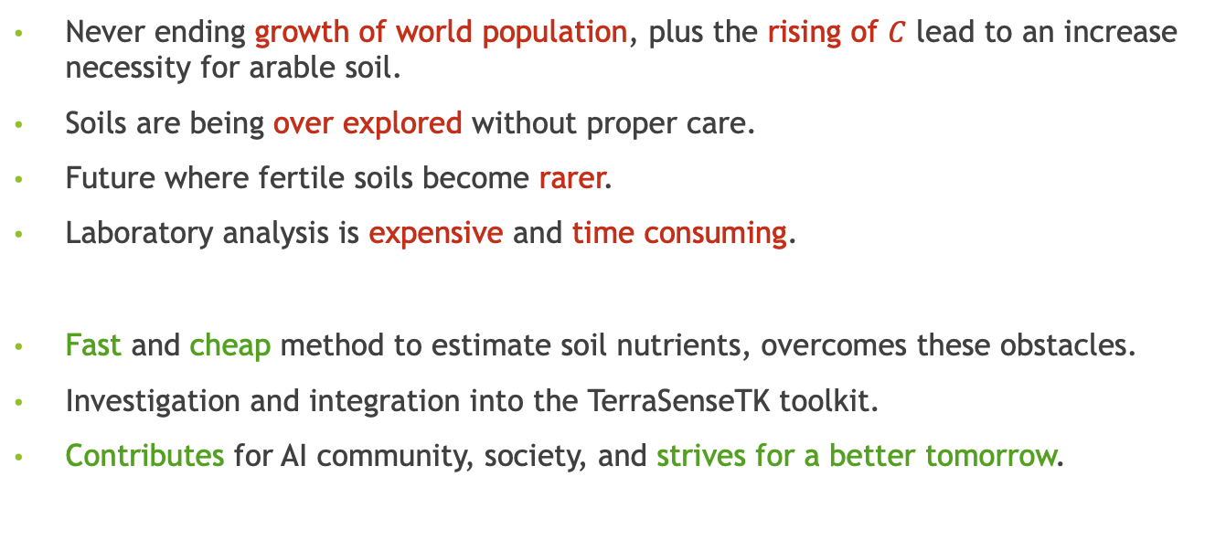
Conclusion
Never ending growth of world population, plus the rising of $C$ lead to an increase necessity for arable soil.
Soils are being over explored without proper care.
Future where fertile soils become rarer.
Laboratory analysis is expensive and time consuming.
Fast and cheap method to estimate soil nutrients, overcomes these obstacles.
Investigation and integration into the TerraSenseTK toolkit.
Contributes for AI community, society, and strives for a better tomorrow.

Slide 29
Thank you
Rafael Candeias, ist193748

Slide 30
References
Julian M. Alston and Philip G. Pardey. “Agriculture in the Global Economy”. In: Journal of Economic Perspectives 28.1 (Feb. 2014), pp. 121–46. doi: 10.1257/jep.28.1.121.
Nikos Alexandratos and Jelle Bruinsma. “World agriculture towards 2030/2050: the 2012 revision”. In: (2012).
https://tinyurl.com/2p9e9bnf
https://tinyurl.com/y3j8dd6d
J Dewis, F Freitas, et al. “Physical and chemical methods of soil and water analysis.” In: FAO soils Bulletin 10 (1970).
J. Benton Jones Jr. “Soil testing in the united states”. In: Communications in Soil Science and Plant Analysis 4.4 (1973), pp. 307–322. doi: 10.1080/00103627309366451.
John L Havlin. “Soil: Fertility and nutrient management”. In: Landscape and land capacity. CRC Press, 2020, pp. 251–265.
Steven C Hodges. “Soil fertility basics”. In: Soil Science Extension, North Carolina State University (2010).

Slide 31
References
https://tinyurl.com/2yahvhau
Manuel Pereira. “TerraSenseTK: A Toolkit for Remote Soil Nutrient Estimation”. MSc The- sis. Funchal, Portugal: Univesidade da Madeira, Nov. 2022.
https://tinyurl.com/srsaxc8m
https://tinyurl.com/36rzevw8
https://tinyurl.com/22vddw6s
https://tinyurl.com/yxt3j982
https://tinyurl.com/yxxd47tp
Mert Dedeog ̆lu et al. “Assessment of the vegetation indices on Sentinel-2A images for pre- dicting the soil productivity potential in Bursa, Turkey”. In: Environmental Monitoring and Assessment 192.1 (2020), pp. 1–16.
https://tinyurl.com/48v9ebjh
Arman Naderi et al. “Assessment of spatial distribution of soil heavy metals using ANN-GA, MSLR and satellite imagery”. In: Environmental monitoring and assessment 189.5 (2017), pp. 1–16.

Slide 32
References
Mang Tik Chiu et al. “Agriculture-vision: A large aerial image database for agricultural pattern analysis”. In: Proceedings of the IEEE/CVF Conference on Computer Vision and Pattern Recognition. 2020, pp. 2828–2838.
Gencer Sumbul et al. “Bigearthnet: A large-scale benchmark archive for remote sensing image understanding”. In: IGARSS 2019-2019 IEEE International Geoscience and Remote Sensing Symposium. IEEE. 2019, pp. 5901–5904.
https://tinyurl.com/37ujj49m
Amanda Ramcharan et al. “A soil bulk density pedotransfer function based on machine learning: A case study with the NCSS soil characterization database”. In: Soil Science Society of America Journal 81.6 (2017), pp. 1279–1287.
Tomislav Hengl et al. “African soil properties and nutrients mapped at 30 m spatial resolution using two-scale ensemble machine learning”. In: Scientific Reports 11.1 (2021), pp. 1–18.
Sevda Ta ̧san et al. “Estimation of eggplant yield with machine learning methods using spec- tral vegetation indices”. In: Computers and Electronics in Agriculture 202 (2022), p. 107367.

Slide 33
References
Wei Han et al. “A semi-supervised generative framework with deep learning features for high- resolution remote sensing image scene classification”. In: ISPRS Journal of Photogrammetry and Remote Sensing 145 (2018), pp. 23–43.
Francesco Staccone. “Deep learning for sea-ice classification on synthetic aperture radar (SAR) images in earth observation. Classification using semi-supervised generative adversar- ial networks on partially labeled data”. In: (2020).

