Slide 1
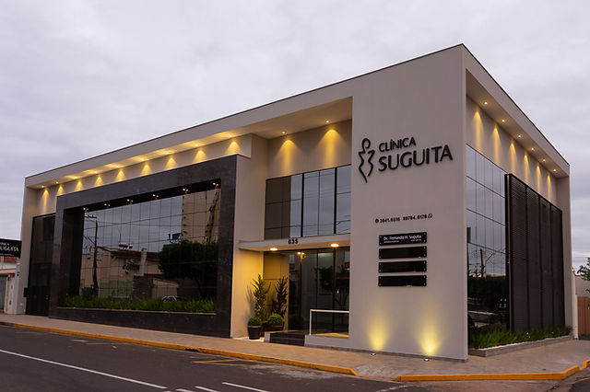

C
VM
CLINICA
VITALIS MEDICA

Slide 2
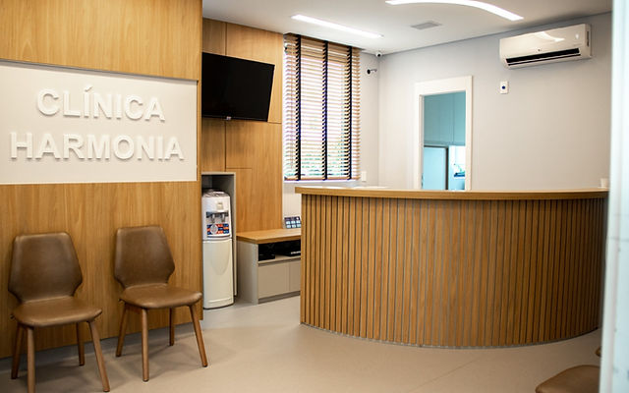

CLINICA
VITALIS MEDICA

Slide 3

CLINICA
VITALIS MEDICA

