Slide 1
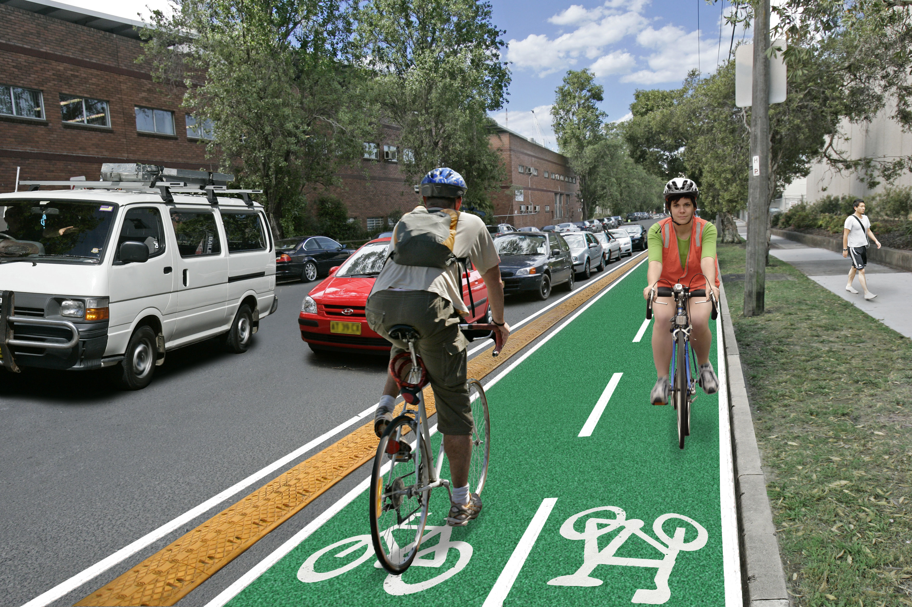
HappyBike a startup company
Be healthy
Be sustainable
Enjoy your happy day
Rafael Mori – Data Engineer
June/2018

Slide 2
HappyBike
The HappyBike startup company is a service to make your life quality better!
This service connects bikers, bikes, electric bikes and make passenger commitments life easier, healthier and more productive.
As soon as you arrive close to the place you want, you can take a bike in some physical locations or request a biker by our platform.
The closest bikers meets you after request.
The passenger commitments will be charged after get a bike, request an electric biker or biker.

Slide 3
HappyBike - Data Architecture Diagram Scalable, high available, cost efficient and fault tolerant

Slide 4
HappyBike - Data Architecture
Data architecture - What do we want?
Scalability
High availability
Mostly serverless services
If not serverless, as much as possible automated
Any kind of data format
Avoid cloud lock-in
Multi-cloud
Devices/Sources
IOS/Android
Desktop and mobile website
Data ingestion/Pipeline/ETL
AWS Data Pipeline or Glue
Sources of data
AWS RDS PostgreSQL for the relational database (multi a-z enabled)
AWS RDS PostgreSQL Read Replicas
Cloudtrail logs (api)
Payload requests
Batch Layer/Data lake/Data Processing
Data ingestion to EMR or S3
Speed Layer/Data lake/Data Processing
AWS Kinesis getting important real-time events and invoking aws lambda functions
Speed Layer/Data lake/Data Processing
AWS Kinesis getting important real-time events and invoking aws lambda functions (eg: fraud incidents)
Serving layer/Views
Mostly S3 parquet files to save cost (compression)
Spectrum to query data from S3
Redshift
Tableau
Additional information
AWS Cloud Watch
Cloud formation
Terraform
AWS Auto Scaling

