Slide 1


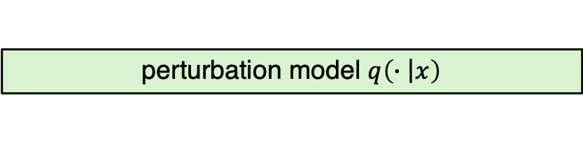
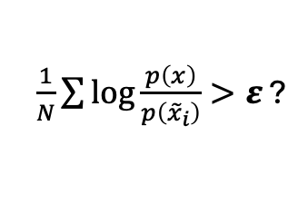






input example
$$x=“\text{The} \text{quick} \text{brown} \text{fox}”$$
perturbation model $q\left(∙\left|x\right.\right)$
${\tilde{x}}_{1}=$“A quick brown fox”
${\tilde{x}}_{2}=$ “The small brown fox”
${\tilde{x}}_{3}=$“The quick cheetah”
source (scoring) model
$$p_{θ}\left({\tilde{x}}_{1}\right)$$
$$p_{θ}\left({\tilde{x}}_{2}\right)$$
$$p_{θ}\left({\tilde{x}}_{3}\right)$$
$$p_{θ}\left(x\right)$$
$\frac{1}{N}\sum{\log{\frac{p\left(x\right)}{p\left({\tilde{x}}_{i}\right)}}}>ε$ ?
LLM generated?
YES
NO

Slide 2
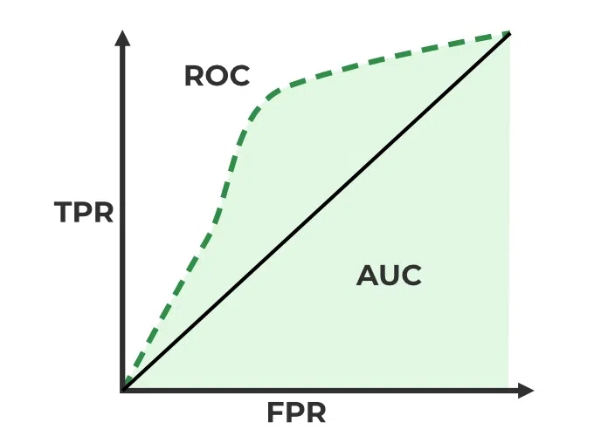


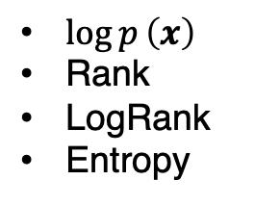



1) Creation of testing data
2) Baseline evaluation
Corpus
Testing dataset
0-shot baselines
eval
Human
LLM
$\log{p}\left(x\right)$
Rank
LogRank
Entropy
…
human-written $x^{(i)}$
$$x_{\text{human}}^{(i)}$$
$$x_{\text{llm}}^{(i)}$$
…
eval
Generator model $P_{θ}$
DetectGPT
3) DetectGPT evaluation

Slide 3
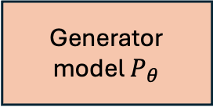

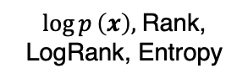


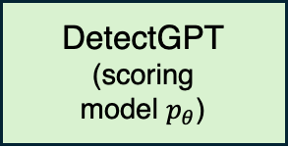
Corpus
Generator
model $P_{θ}$
human-written $x^{(i)}$
Testing dataset
Human
LLM
$$x_{\text{human}}^{(i)}$$
$$x_{\text{llm}}^{(i)}$$
0-shot baselines
DetectGPT
(scoring
model $p_{θ}$)
$\log{p}\left(x\right),$Rank, LogRank, Entropy
AUROC

Slide 4
input example
$$x=“\text{The} \text{quick} \text{brown} \text{fox}”$$
perturbation model $q\left(∙\left|x\right.\right)$
${\tilde{x}}_{1}=$“A quick brown fox”
${\tilde{x}}_{2}=$ “The small brown fox”
${\tilde{x}}_{3}=$“The quick cheetah”
source (scoring) model
$$p_{θ}\left({\tilde{x}}_{1}\right)$$
$$p_{θ}\left({\tilde{x}}_{2}\right)$$
$$p_{θ}\left({\tilde{x}}_{3}\right)$$
$$p_{θ}\left(x\right)$$
$\frac{1}{N}\sum{\log{\frac{p\left(x\right)}{p\left({\tilde{x}}_{i}\right)}}}>ε$ ?
LLM generated?
YES
NO

