Slide 1
Easy Embed
Rafael Almeida

Slide 2
Problem Statement
Motivation
Development
Demo
Future

Slide 3
Problem Statement
Motivation
Development
Demo
Future

Slide 4
Introduction
Semantic search
Popular
Embeddings
Query
Documents
Similarity
Rerankers?

Slide 5
Problem Statement
Expensive
Complex
Have privacy concerns

Slide 6
Problem Statement
Self-hosted
Open-source model
Simple
Sufficient for small tasks
Well documented
Fast!

Slide 7
Problem Statement
Motivation
Development
Demo
Future

Slide 8
Motivation
Overwhelming UIs
FAQs
Product pages
Content search

Slide 9
Problem Statement
Motivation
Development
Demo
Future

Slide 10
Development
Massive Text Embedding Benchmark (MTEB)
Model API?
Project APIs?
Capabilities
Customization
Integration

Slide 11
Problem Statement
Motivation
Development
Demo
Future

Slide 12
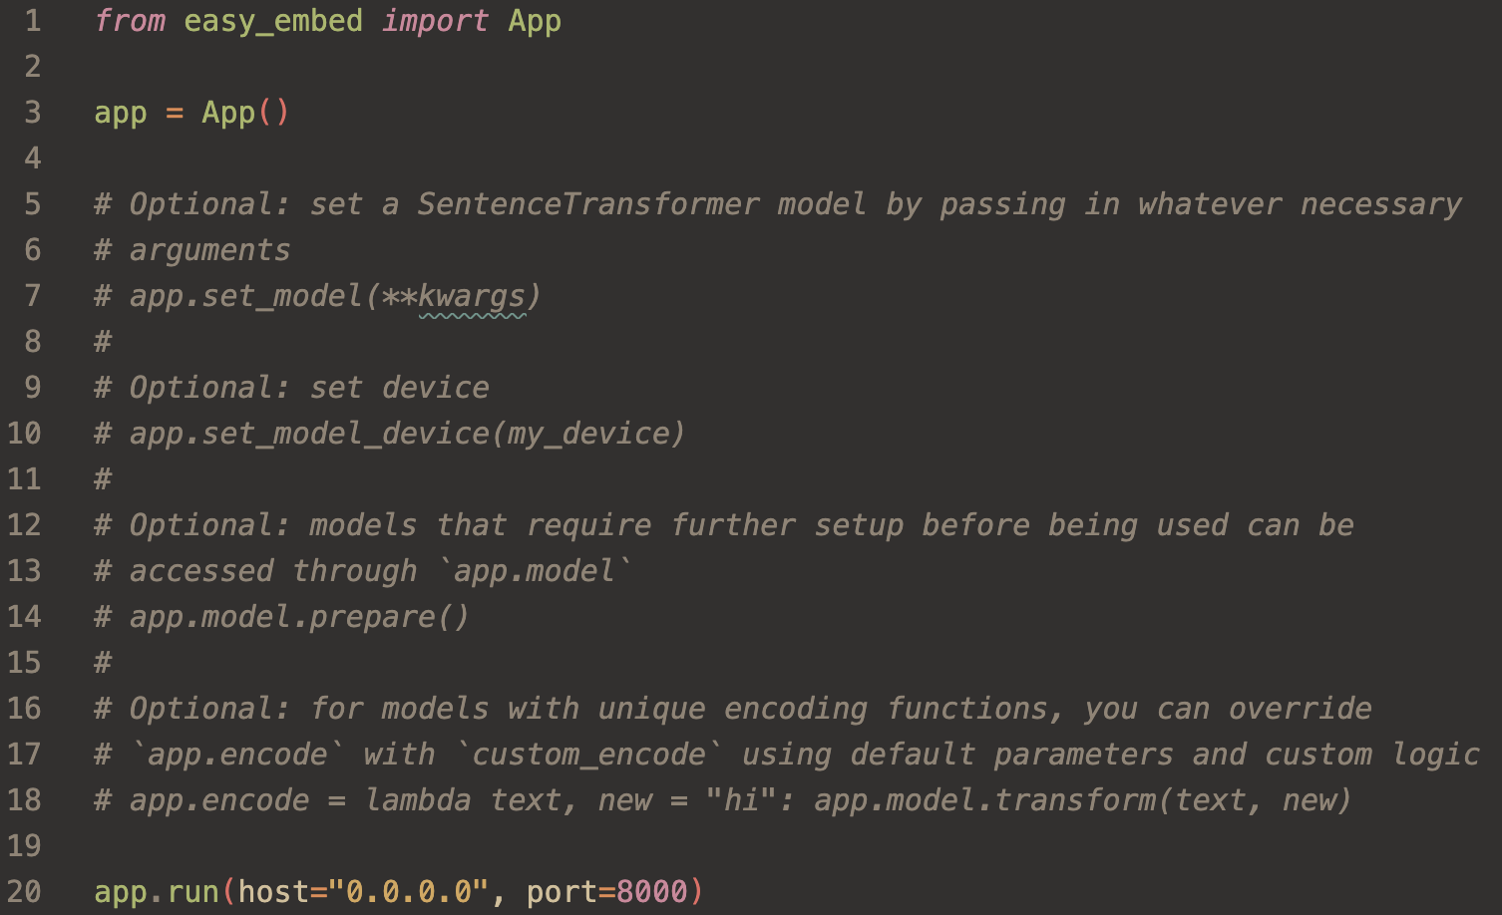

Slide 13
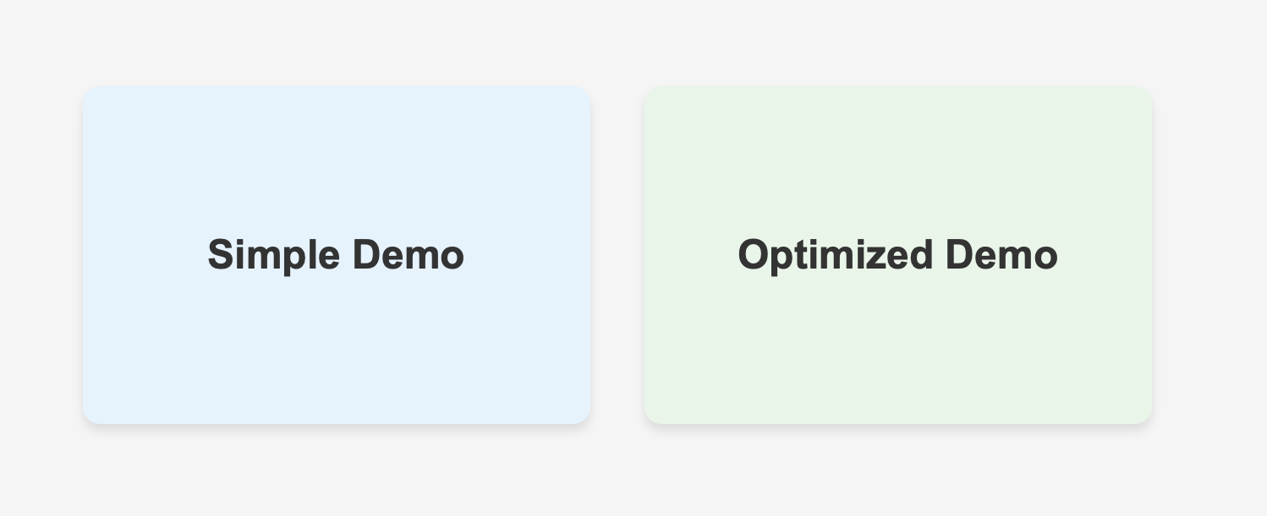
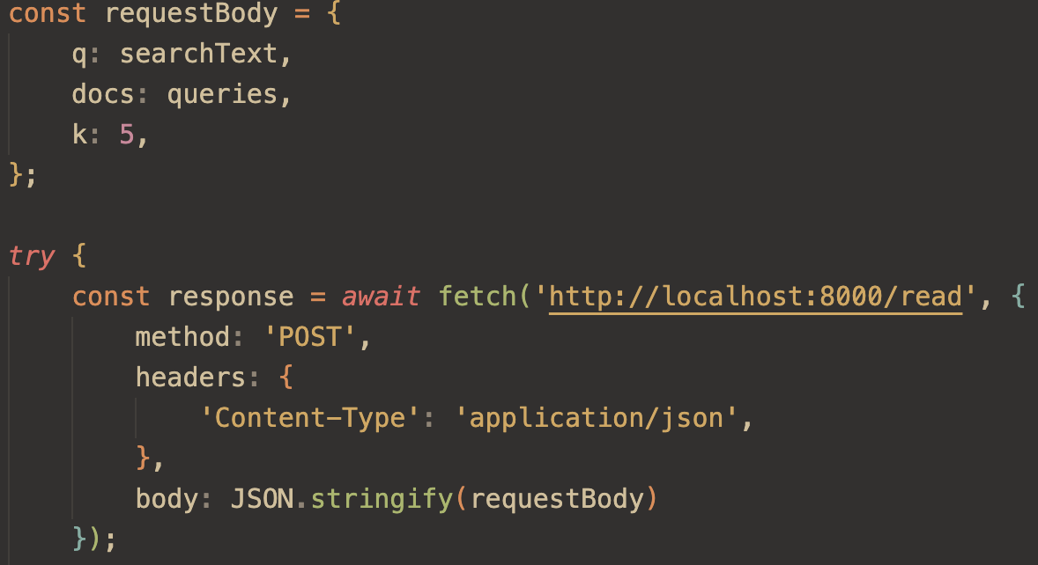
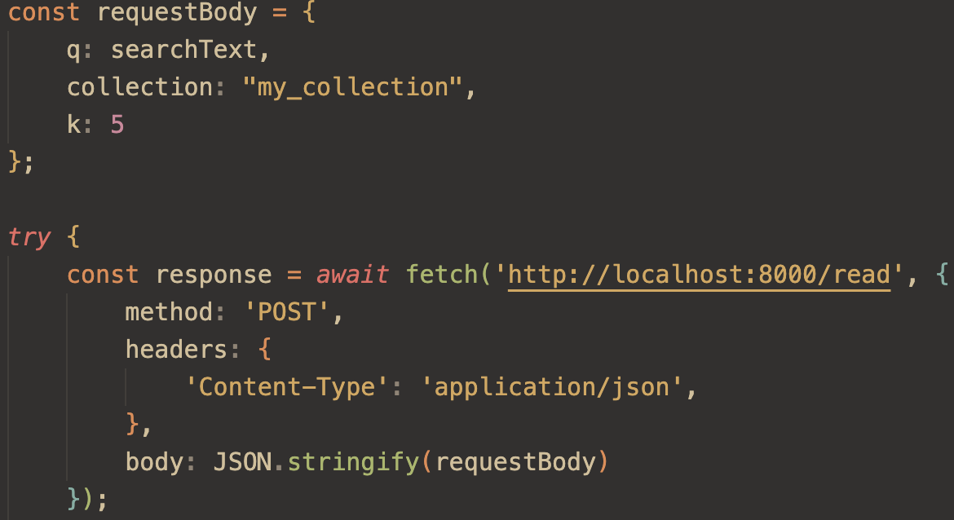

Slide 14
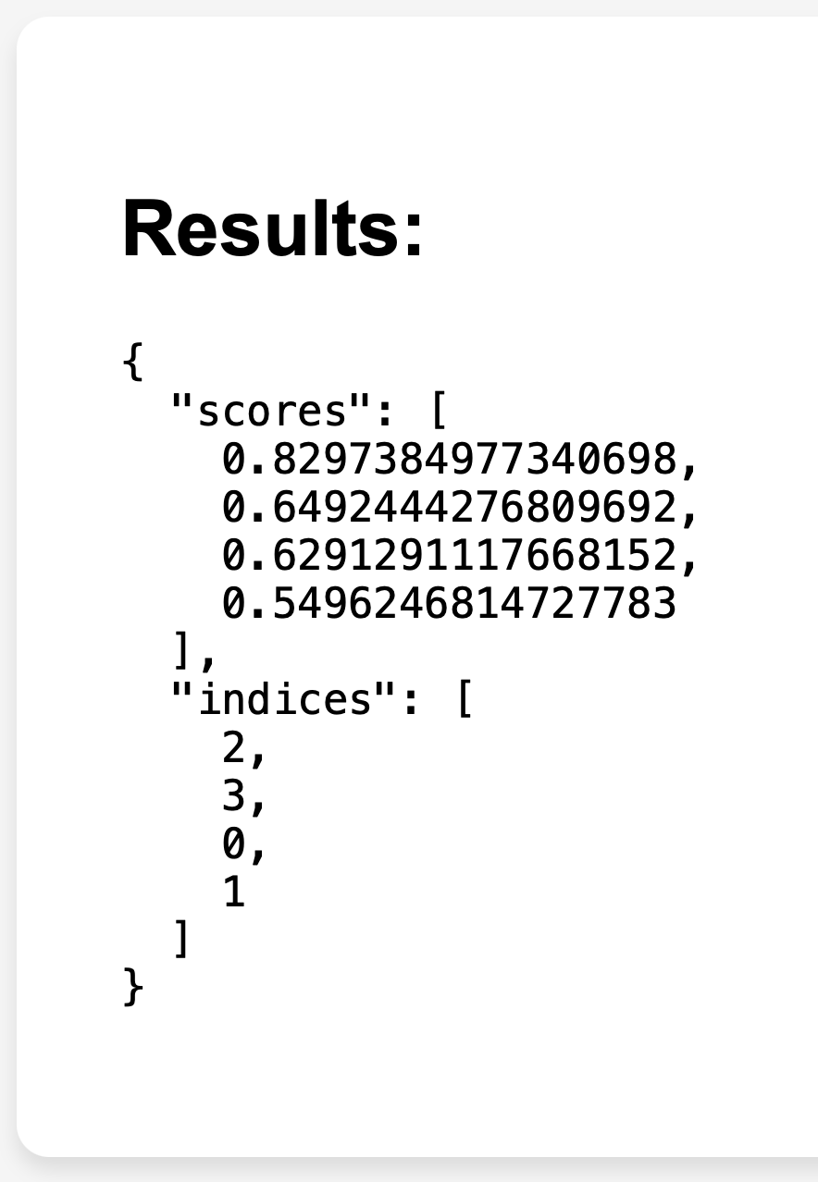
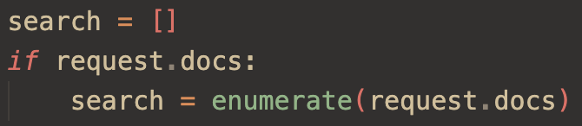

Slide 15
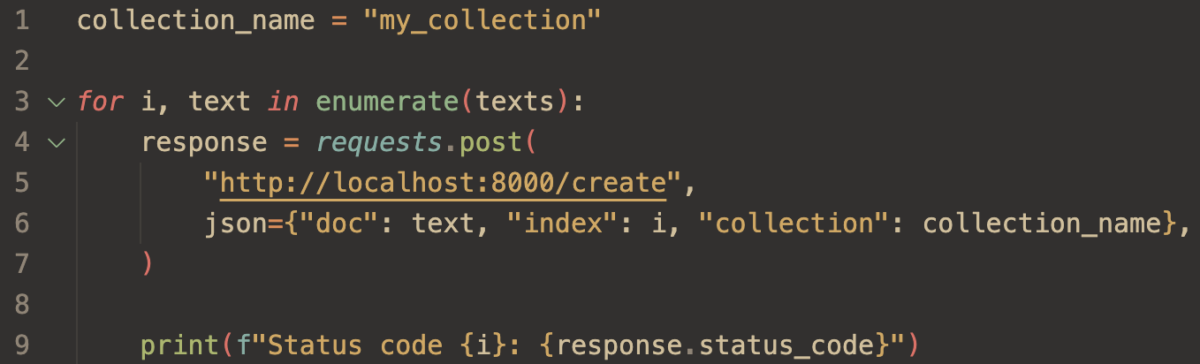

Slide 16
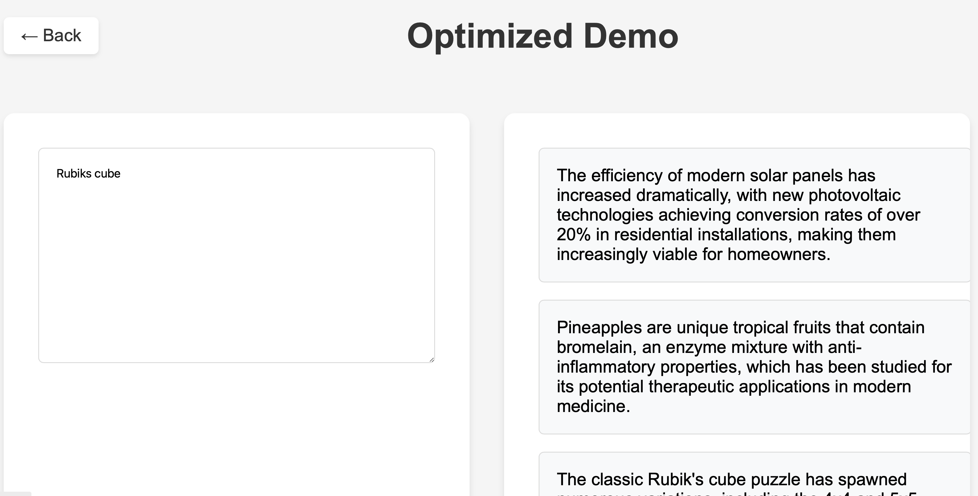
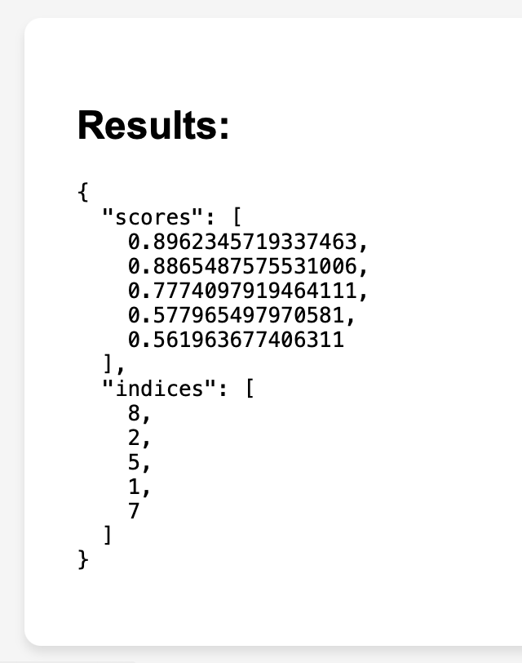
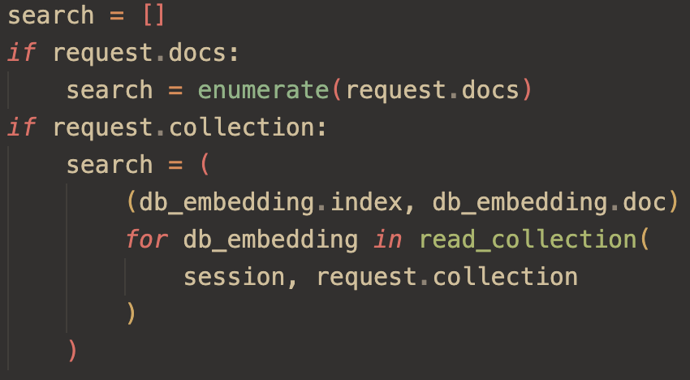

Slide 17
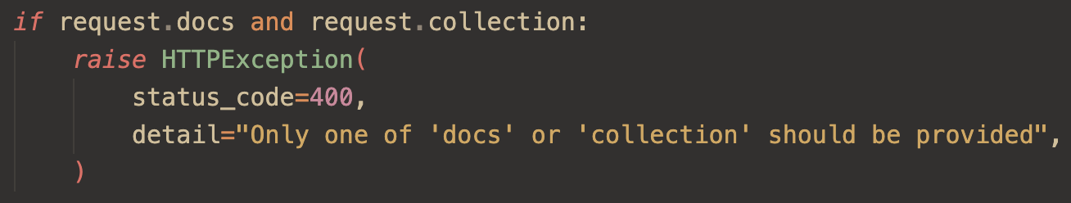
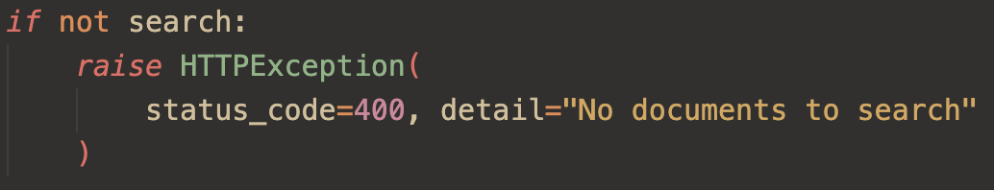

Slide 18
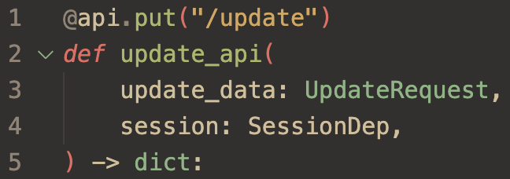
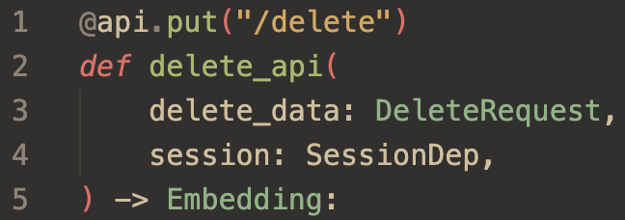

Slide 19
Problem Statement
Motivation
Development
Demo
Future

Slide 20
Future
Image to text
Hierarchical Navigable Small World
Approximate nearest neighbor
More capabilities
More customization

