Slide 1
SDM
Storage NUI

Slide 2

Objetivo
Storage
8081
Storage Web Interface
9000
C++/Prolog/RN
Mongoose/6.7
NUI
8181
C#
1
2
3
Notes:
Dizer 3 post query, 2 processa manda para 1 que faz.

Slide 3
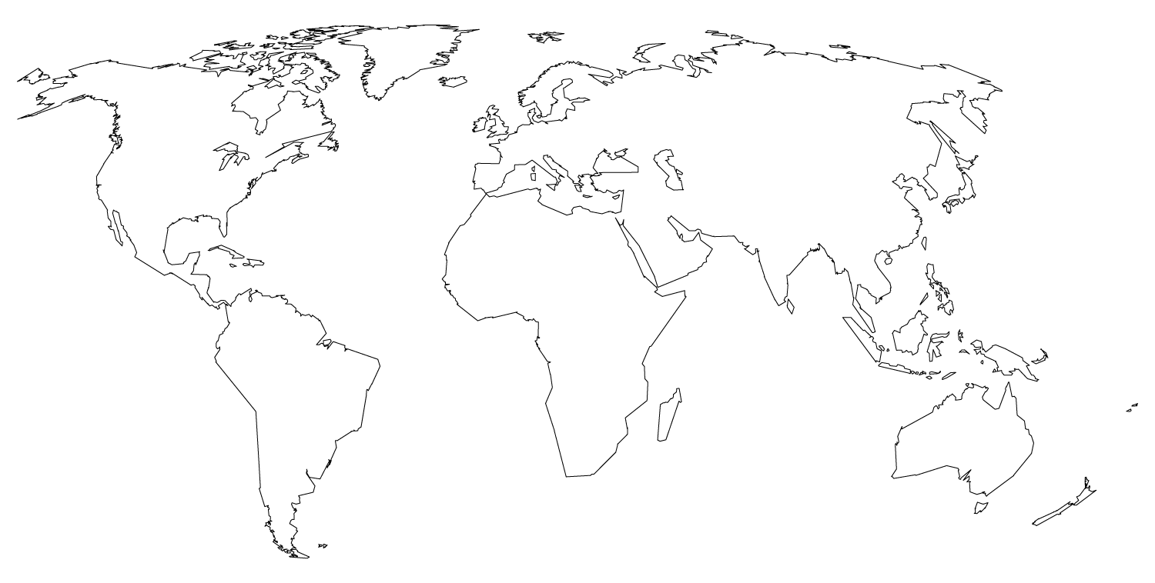
MAPS
our office

Slide 4

Kinect Web Server

Slide 5
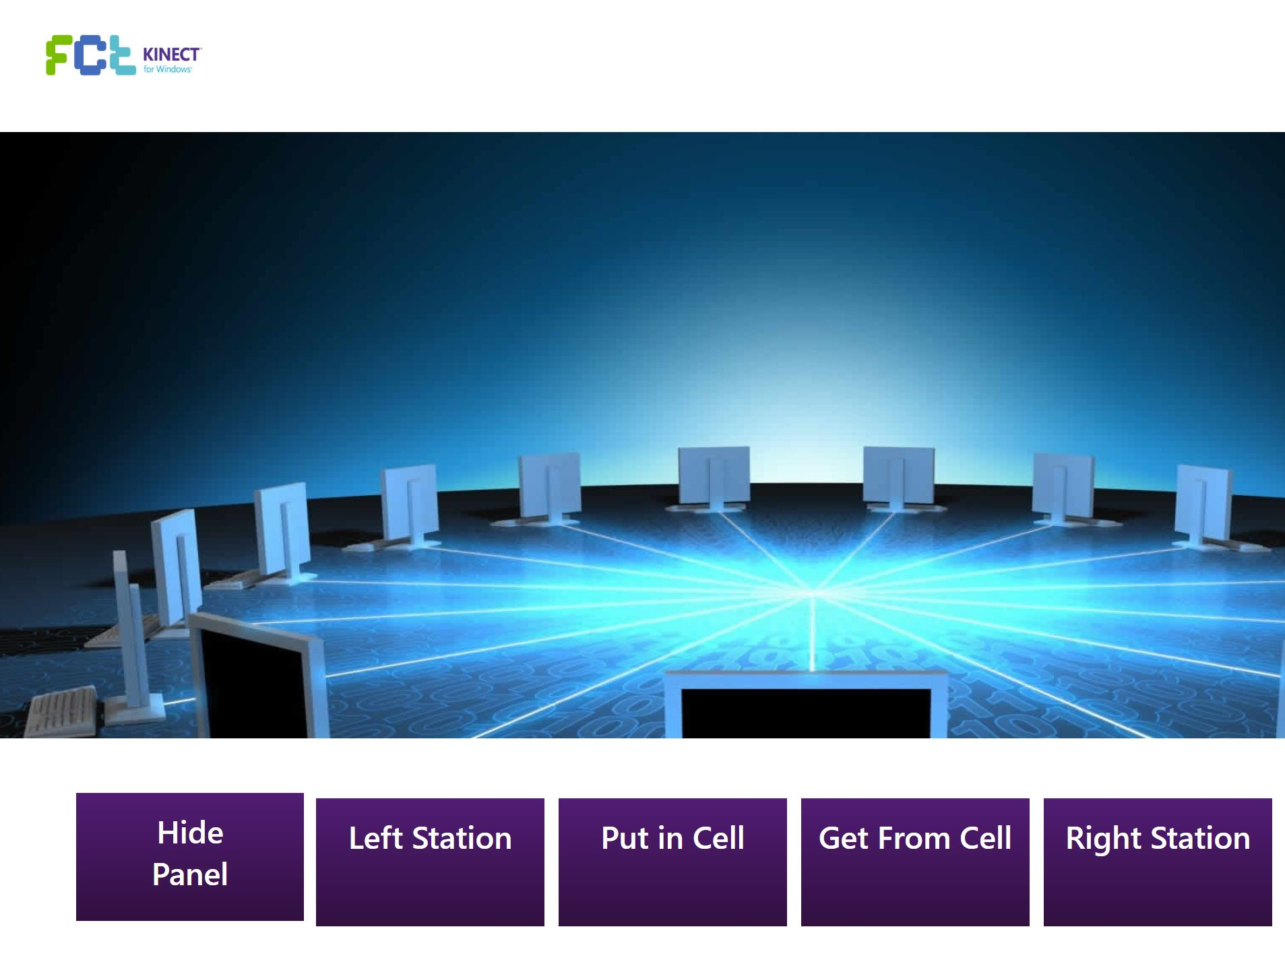
Kinect Web Server

Slide 6
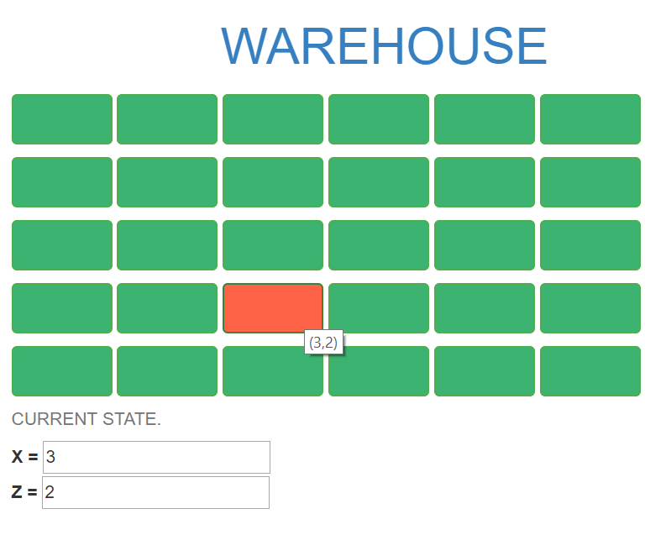
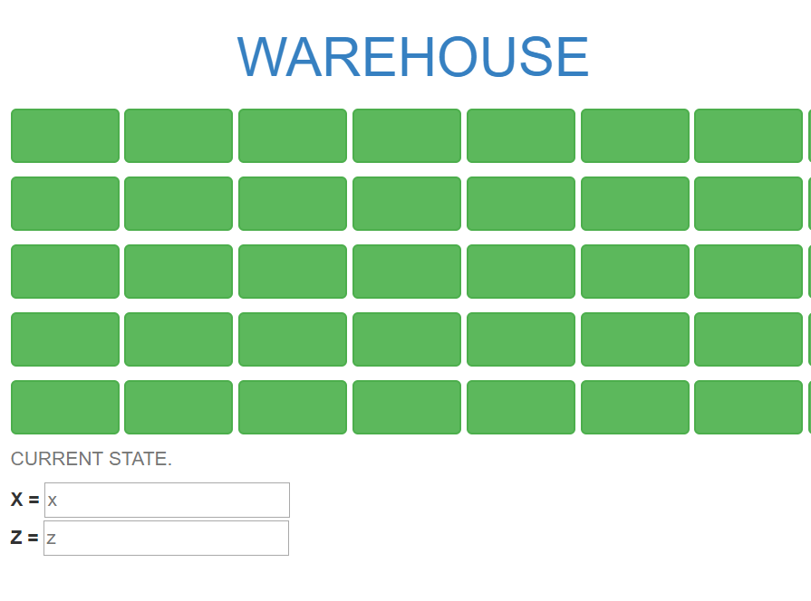
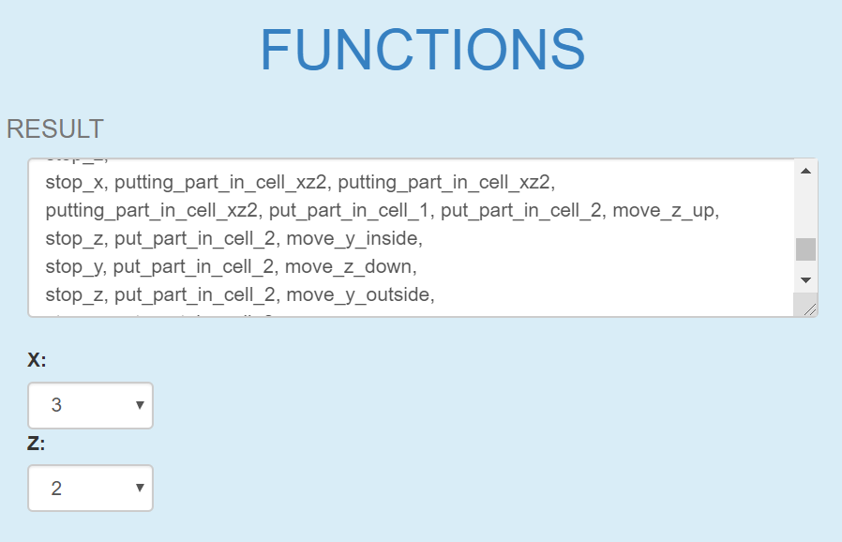
Storage Web Interface

Slide 7
THANKS!
Any questions?

