Slide 1

Lecture 8
Introduction to Latex

Slide 2
Introduction
TeX is essentially a Markup Language (like HTML, XML and RTF)
TeX written by Donald Knuth in 70´s
  A revolution in typesetting
Latex is an extension of TeX
  Macro packages to make TeX easier to use
presentaion is based on Troy D. Milner and Simon Cuce slides)

Slide 3
Latex vs. Word Processors
High typeset quality
Easy to include math formulas
Source file format is not bounded to a particular OS or platform
Latex implementations exists for all platforms (DOS, Windows, Unices,..)
Latex is free

Slide 4
Latex vs. Word Processors
De facto standard for scientific publishing
Very few bugs
Good for large documents
Can run even on 386 PC
Not very easy to learn

Slide 5
Example of Latex document
\documentclass{article}
\title{Simple Example}
\author{Andrei Gurtov}
\date{March 2000}
\begin{document}
\maketitle
Hello world!
\end{document}

Slide 6
Creating Latex Files
Your Latex File
(a text file)
Your Bibtex File
Latex compile x3
Bibtex compile x2
Latex compile x3
Device independent
output .dvi
dvips compile x1
Your Postscript File

Slide 7
Latex File Structure
Document Class
    Predefined Formats (article, report, book,..).
Packages used
    Added Functionality (graphics, reference style,...).
Main Body
    Text and Bibliography References.

Slide 8
The Basics
Document Class
    \documentclass[options]{class}
    options = a4paper, 11pt, 12pt, 10pt, twocolumn, landscape,...
    class = article, report, book,...
Packages
    \usepackage{package name}
    epsfig = insert PS pictures into the document
    fancyhdr = easy definition of footer and header

Slide 9
Body of Text
Start with \begin{document}
End with \end{document}
Typesetting Text
  \\ or \newline and \newpage
  Quotations
  Bold \textbf{……………} or \bf
  Italics \emph{…………} or \textit{………} or \it
  Underline \underline{…………} or \ul

Slide 10
Body of Text cont…
Including Multiple Files
  \input{filename.tex}

Slide 11
Format
Sections
  \section{…} = 1. Latex is Great
  \subsection{…} = 1.1 Why Latex is Great
  \subsubsection{…} = 1.1.1 Reason One
  \appendix - changes numbering scheme
  \chapter{…} - To be used with book and report document classes
Titles, Authors and others
  \title{…} \author{…}
  \footnote{…}

Slide 12
Format Contd.
\maketitle - Display Title and Author
\tableofcontents - generates TOC
\listoftables - generates LOT
\listoffigures - generates LOF
Labels
  \label{marker} - Marker in document.
  \pageref{marker} - Displays page no. of marker.
  \ref{marker} - Displays section location of marker.
Itemize
  Use either enumerate, itemize or description.
  see handout for example.

Slide 13
Lists
Source
  \begin{itemize}
  \item Apple
  \item Orange
  \end{itemize}
Result
  Apple
  Orange

Slide 14
Lists
Enumerate instead of itemize gives a numbered list
Lists can be recursive

Slide 15
Environment
Something between
  \begin{name}
  \end{name}
Many command, for example \bf affect the text until the end of environment
Environments can be recursive
Examples:
  itemize, center, abstract

Slide 16
Group
Group is some text between { and }
Many commands work until the end of the group
Code
  put {one word \bf in bold} here
Result
  put one word in bold here

Slide 17
Alignment
Environments center, flushleft, flushright
Example
  \begin{flushright}
  Right aligned
  \end{flushright}
Result
Right aligned

Slide 18
Font size
\tiny \scriptsize \footnotesize
\small \normalsize
\large \Large
\LARGE \huge
\Huge

Slide 19
Example of Latex document
\documentclass{article}
\title{Simple Example}
\author{Andrei Gurtov}
\date{March 2000}
\begin{document}
\maketitle
Hello world!
\end{document}

Slide 20
Tabular
Columns
  \begin{tabular}{|…|…|}
  \end{tabular}
Rows
  & - Split text into columns
  \\ - End a row
  \hline - Draw line under row
  e.g. 123123 & 34.00\\ \hline
Two Columns
l = automatically adjust
size, left justify
r = automatically adjust
size, right justify
p = set size
e.g p{4.7cm}
c = centre text

Slide 21
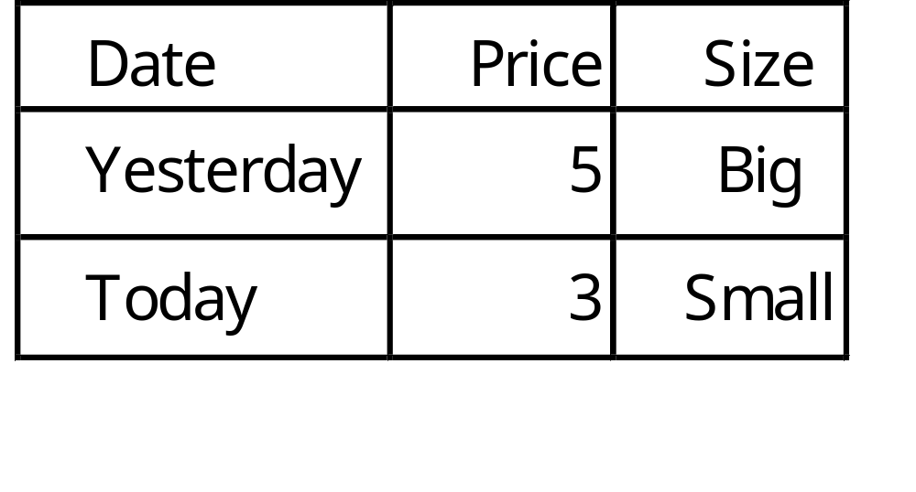
Example of table
\begin{tabular}{|l|r|c|} \hline
Date & Price & Size \\ \hline
Yesterday & 5 & big \\ \hline
Today & 3 & small \\ \hline
\end{tabular}

Slide 22
Floating Objects
Floating objects can stop splitting of tables and images over pages.
  \begin{figure}[options]
  \end{figure}
  \begin{table}[options]
  \end{table}
They will now appear in the
  List of Figures (LOF) and
  List of Tables (LOT).
Options (recommendations)
h = place table here
t = place at top of page
b = place at bottom of page

Slide 23
Example of floating figure
\begin{figure}[ht]
\centering\epsfig{file=uni.ps, width=5cm}
\caption{University of Helsinki}
\label{uni}
\end{figure}
Figure~\ref{uni} shows...

Slide 24
Images
Use epsfig package
\usepackage{epsfig}
Including images in main body
\epsfig{file=filename.eps, width=10cm, height=9cm, angle=90}
Creating EPS - Use xv and/or xfig.
MS Power Point, save as GIF and convert to EPS.

Slide 25
Bibliography by hand
\begin{thebibliography}{}
\bibitem[Come95]{Come95} Comer,
D. E., {\it Internetworking with TCP/IP:
Principles, Protocols and Architecture},
volume 1, 3rd edition. Prentice-Hall,
1995.
\end{thebibliography}

Slide 26
Bibliography using Bibtex
Bibliography information is stored in a *.bib file, in Bibtex format.
Include chicago package
  \usepackage{chicago}
Set referencing style
  \bibliographystyle{chicago}
Create reference section by
  \bibliography{bibfile with no extension}

Slide 27
Bibliography using Bibtex
@book{Come95,
author=“D. E. Comer”,
title={Internetworking with TCP/IP: Principles, Protocols and Architecture},
publisher=“Prentice-Hall”,
year=1995,
volume=1,
edition=“Third”}

Slide 28
Bibliography contd.
Citing references in text
  \cite{cuc98} = (Cuce 1998)
  \citeN{cru98} = Crud (1998)
  \shortcite{tom98} = (Tom, et. al. 1998)
Creating Bibtex Files
  Use Emacs with extensions.
  or copy Bibtex entries from bibliography database.

Slide 29
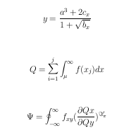
Some Math
\begin{center}
{\large
$$ y=\frac{a^3+2c_{x}}{1+\sqrt{b_{x}}} $$ \\
\vspace{0.2in}
$$ Q=\sum_{i=1}^{j}\int_{\mu}^{\infty}f(x_{j})dx $$ \\
\vspace{0.2in}
$$ \Psi = \oint_{- \infty}^{\infty}f_{xy}({\frac{\partial
Qx}{\partial Qy}})^{\Im_{\pi}^ \prime} $$ \\ }

Slide 30
Tools
UNIX based systems
  xdvi, ghostview, fixps, emacs with latex/bibtex support.
Windows 98/NT
  Ghostview, Acrobat Distiller, Acrobat Reader, Scientific Workplace (not the best), the Bibtex viewer is good. Paint Shop Pro, Latex and Emacs

Slide 31
Conclusions
Latex is optimal for master and phd thesis?
Mathematical formulae are easy.
Use bibtex search engines
Consider converting Postscript files to PDF (more widespread in Windows world) and to conserve space.

