Slide 1
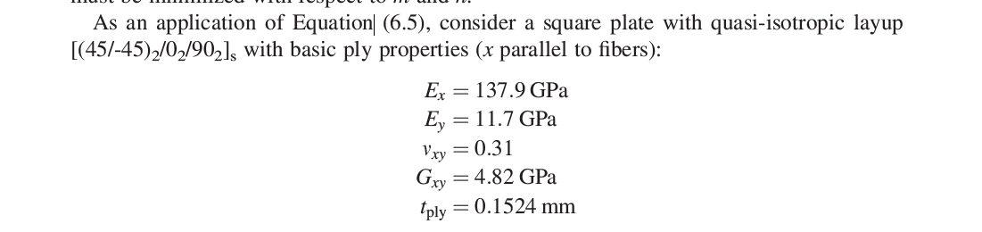
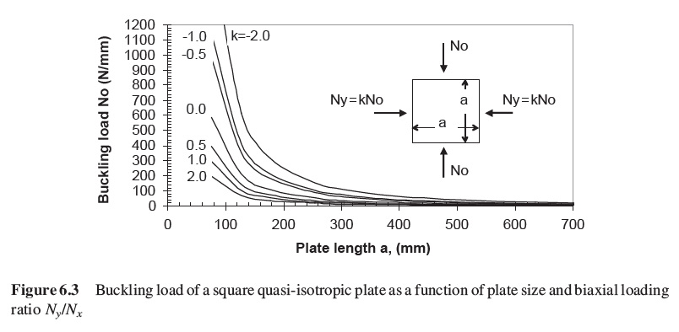
Case 1: Biaxial
Page 121 kassapouglou
Choices:
a = b = 100mm
k = 0.5
Buckling load =~230 N/mm

Slide 2
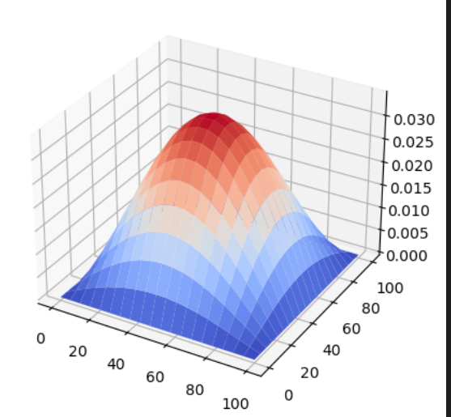
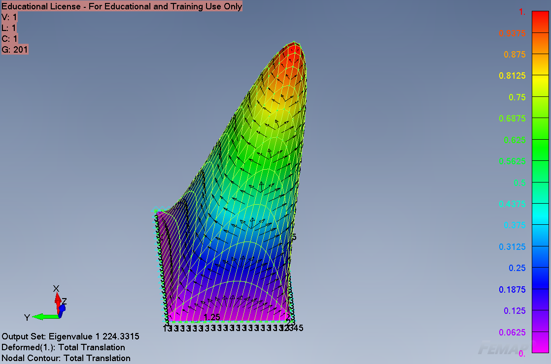


Case 1: verification
Eigenvalue = $225.86 N/mm$

Slide 3
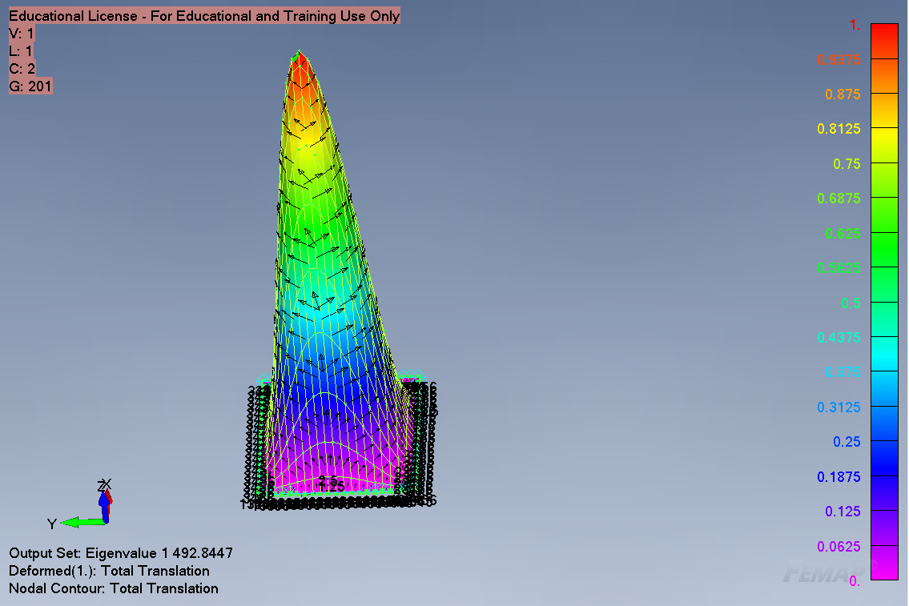

Case 2: biaxial clamped

Slide 4
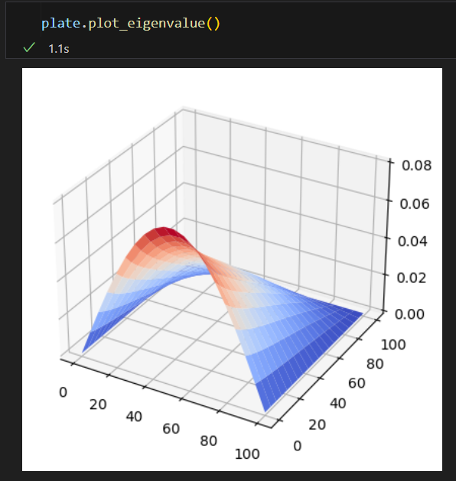
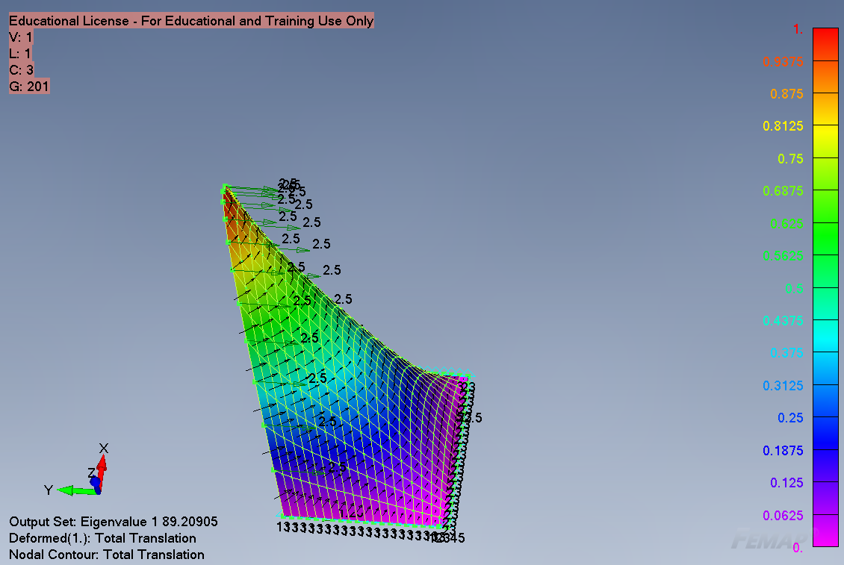

Case 2: biaxial SSSF

