Slide 1
Information Systems Analysis and Design
Topic - 10
Deploying the New System
Dr. Dina Fitria Murad, S.Kom., M.Kom

Slide 2
LEARNING OUTCOMES
LO 4
Evaluate system development, project management, and object-oriented design, and deploy a new system

Slide 3
OUTLINE
Testing
Deployment Activities
Managing Implementation, Testing, and Deployment

Slide 4
Testing

Slide 5
Testing
Testing activities are a key part of implementation and deployment activities, although different kinds of tests are used in each core process.
Testing is the process of examining a component, subsystem, or system to determine its operational characteristics and whether it contains any defects.
To conduct a test, developers must have well-defined specifications for both functional and nonfunctional requirements. From the requirements specifications, test developers develop precise definitions of expected operational characteristics.
The developers can test software by designing and building the software, exercising its function, and examining the results. If the results indicate a shortcoming or defect, then the project team cycles back through earlier implementation or deployment activities until the shortcoming is remedied or the defect is eliminated.

Slide 6
Testing (cont…)
An important part of developing tests is specifying test cases and data.
A test case is a formal description of the following:
A starting state or condition
One or more events to which the software must respond
The expected response or ending state
The starting and ending states and the events are represented by a set of test data.

Slide 7
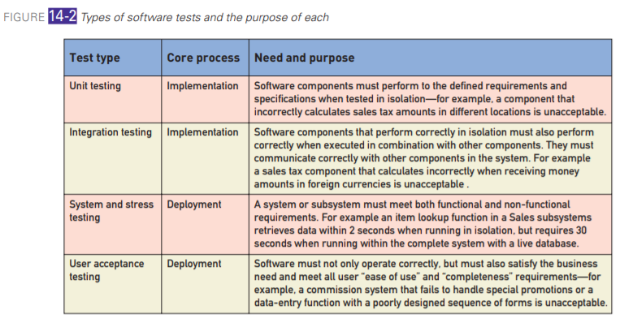
Type of Software Test
Figure 10-1
Source: Satzinger, John W., Jackson, Robert B., Burd, Stephen D. (2016)

Slide 8
Unit Testing
Unit Testing
Unit testing is the lowest level of and the earliest testing for a new software system.
The concept and approach to unit testing is not consistent across all development teams and, in fact, it has changed over the years as programming methods and languages have changed.
Unit test is a test of an individual method, class, or component before it is integrated with other software. The primary purpose of doing unit testing is to test a small piece of the code in isolation to make sure that it functions correctly before it is integrated into a larger program. Stated another way, its purpose is to make sure that the unit is error-free before being integrated into the larger program.

Slide 9
Unit Testing
Unit Testing
There are three primary characteristics of a unit test:
It is done in isolation.
The test data and the test are done by the programmer who wrote the code.
It is done quickly without a large requirement for other resources.

Slide 10
Integration Testing
Integration Testing
An integration test evaluates the functional behavior of a group of classes or components when they are combined together.
The purpose of an integration test is to identify errors that weren’t or couldn’t be detected by unit testing.
There are two types of results that can be tested. The first type of test is to test the interface itself between the components. Such errors may result from a number of problems, including the following:
Interface incompatibility
Parameter values
Unexpected state interactions

Slide 11
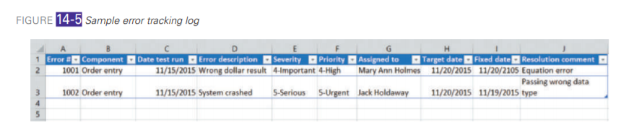
Integration Testing
Integration Testing
Several procedures must be put in place:
Building the component for the integration test
Creating test data
Conducting the integration test
Evaluating the results
Logging test results
Correcting the code and retesting

Slide 12
System, Performance, and Stress Testing
System, Performance, and Stress Testing
A system test is a comprehensive integration test of the behavior of an entire system or independent subsystem.
Integration testing is normally associated with the implementation core process, and system testing is normally associated with the deployment core process.
System testing often is used to verify the nonfunctional requirements, such as response time and throughput.
The line separating integration testing from system testing is fuzzy, as is the line between implementation and deployment activities. The important differences are scope and timing.
Integration tests are performed more frequently and on smaller component groups. System tests are performed less frequently on entire systems or subsystems. In addition, there are various kinds of system tests that test various functional and nonfunctional aspects of the new system.
Figure illustrates the types of tests that can be included in system testing

Slide 13
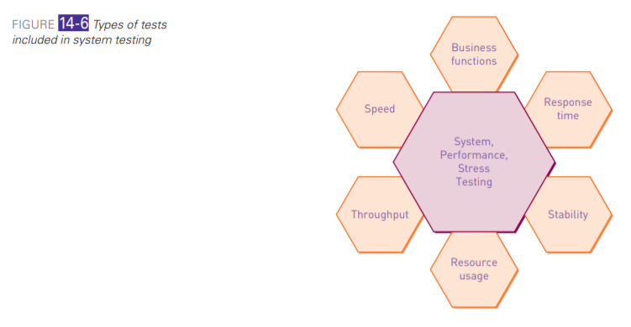
Type of Test
Figure 10-2
Source: Satzinger, John W., Jackson, Robert B., Burd, Stephen D. (2016)

Slide 14
User Acceptance Testing (UAT)
User Acceptance Testing (UAT)
A user acceptance test (UAT) is comprehensive system testing to determine whether the system fulfills user requirements and can support all business and user scenarios.
The UAT is normally the final stage in testing the system. Although the primary focus is usually on the functional requirements, the nonfunctional requirements are often also verified.
In some cases, UAT is a formal milestone, and requires completion and signoff by the client. Details of acceptance tests may even be included in a request for proposal (RFP) and procurement contract when a new system is built by or purchased from an external party

Slide 15
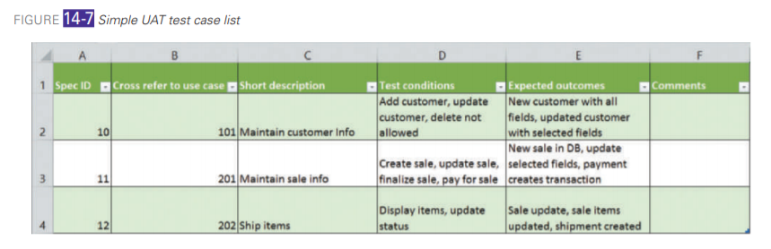
User Acceptance Testing (UAT)
User Acceptance Testing (UAT)
UAT covers these areas:
Planning the UAT
Preparation and Pre-UAT Activities
Management and Execution of the UAT
Figure 10-3

Slide 16
Deployment Activities

Slide 17
Deployment Activities
Once a new system has been developed and tested, it must be placed into operation.
Deployment activities (see Figure) involve many conflicting constraints, including cost, the need to maintain positive customer relations, the need to support employees, logistical complexity, and overall risk to the organization.
User acceptance and other test types were described in the previous section.
Multiple types of tests are often performed concurrently because later project iterations typically include implementation and deployment activities.

Slide 18
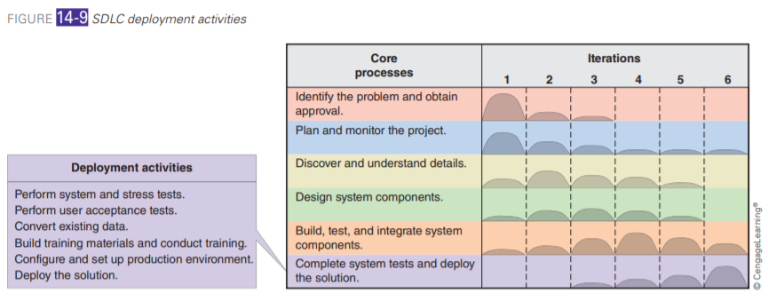
SDLC Deployment Activities
Figure 10-4
Source: Satzinger, John W., Jackson, Robert B., Burd, Stephen D. (2016)

Slide 19
Reloading Database
Reloading Databases
More complex changes to database structure may require creating an entirely new database and copying and converting data from the old database to the new database.
The middle of Figure shows a more complex approach that uses an export utility, an import utility, and a temporary data store. This approach might be employed when the source and target databases employ different database technologies; no utility exists that can directly translate from one to the other, but a “neutral” format exists that can serve as a bridge.

Slide 20
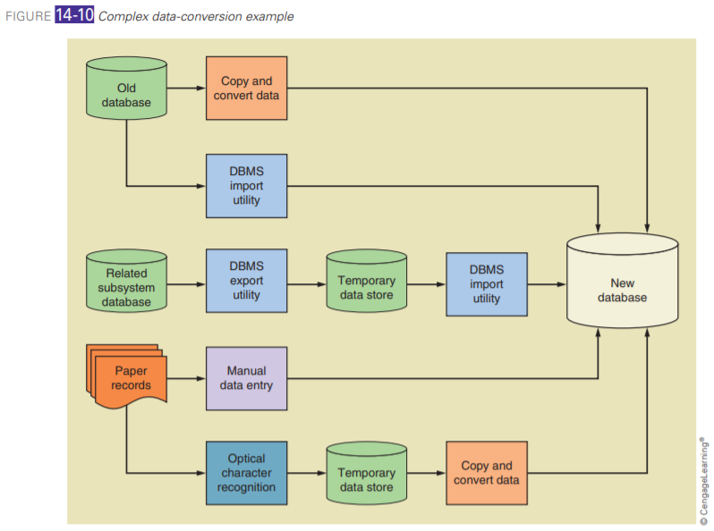
Complex data-Conversion
Figure 10-5
Source: Satzinger, John W., Jackson, Robert B., Burd, Stephen D. (2016)

Slide 21
Deployment Activities (cont…)
Training Users
Training two classes of users—end users and system operators—is an essential part of any system deployment project.
End users are people who use the system from day to day to achieve the system’s business purpose.
System operators are people who perform administrative functions and routine maintenance to keep the system operating.
Figure shows representative activities for each role. In smaller systems, a single person may fill both roles. In larger organizations, the technical support staff may already be prepared to handle the system operator responsibilities. In that case, only some documentation or basic instructions may be all that is needed.

Slide 22
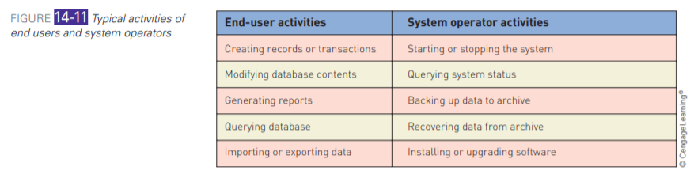
Typical Activities of End user and System Operators
Figure 10-6
Source: Satzinger, John W., Jackson, Robert B., Burd, Stephen D. (2016)

Slide 23
System Documentation
System Documentation
System documentation serves one primary purpose: providing information to developers and other technical personnel who will build, maintain, and upgrade the system.
System documentation is generated throughout the SDLC by each core process and many development activities.
System documentation developed during early project iterations guides activities in later iterations, and documentation developed throughout the SDLC guides future system maintenance and upgrades.

Slide 24
User Documentation
User Documentation
User documentation provides ongoing support for end users of the system. It primarily describes routine operation of the system, including such functions as data entry, output generation, and periodic maintenance.
Topics typically covered include the following:
Software start-up and shutdown
Keystroke, mouse, or command sequences required to perform specific functions
Program functions required to implement specific business procedures (e.g., the steps followed to enter a new customer order)
Common errors and ways to correct them

Slide 25
Configuring the Production Environment
Configuring the Production Environment
Modern applications are built from software components based on interaction standards
Each standard defines specific ways in which components locate and communicate with one another.
Each standard also defines a set of supporting system software to provide needed services, such as maintaining component directories, enforcing security requirements, and encoding and decoding messages across networks and other transport protocols.
The exact system software, its hardware, and its configuration requirements vary substantially among the component interaction standards.

Slide 26
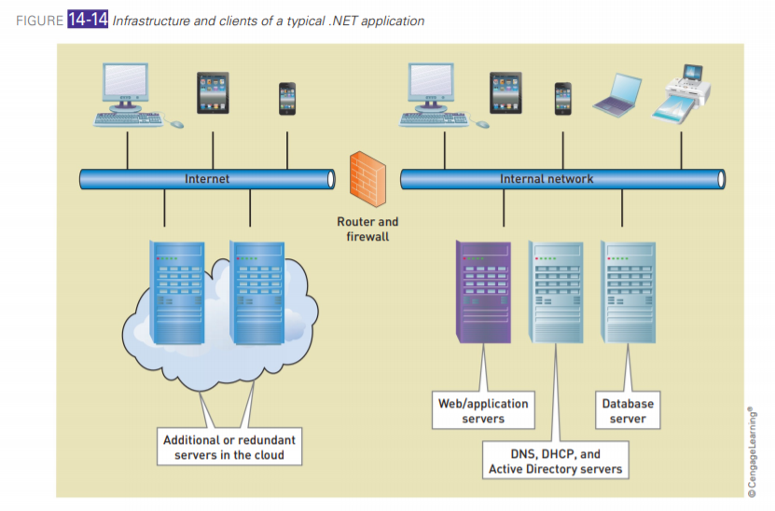
Configuring the Production Environment
Figure 10-7
Source: Satzinger, John W., Jackson, Robert B., Burd, Stephen D. (2016)

Slide 27
Managing Implementation, Testing, and Deployment

Slide 28
Managing Implementation, Testing, and Deployment
This section concentrates on issues that impact all those activities as well other core processes, including project planning and monitoring, analysis, and design.
In an iterative development project, activities from all core processes are integrated into each iteration and the system is analyzed, designed, implemented, and deployed incrementally. But how does the project manager decide which portions of the system will be worked in early iterations and which in later iterations? And how does he or she manage the complexity of so many models, components, and tests?

Slide 29
Development Order
Development Order
A development order can be based directly on the structure of the system itself and its related issues, such as use cases, testing, and efficient use of development staff.
Several orders are possible, including the following:
Input, process, output
Top-down
Bottom-up
Use-case driven
Each project must adapt one or a combination of these approaches to specific project requirements and constraints.

Slide 30
Source Code Control
Source Code Control
Development teams need tools to help coordinate their programming tasks.
A source code control system (SCCS) is an automated tool for tracking source code files and controlling changes to those files.
An SCCS stores project source code files in a repository, and it acts the way a librarian would—that is, implements check-in and checkout procedures, tracks which programmer has which files, and ensures that only authorized users have access to the repository.

Slide 31
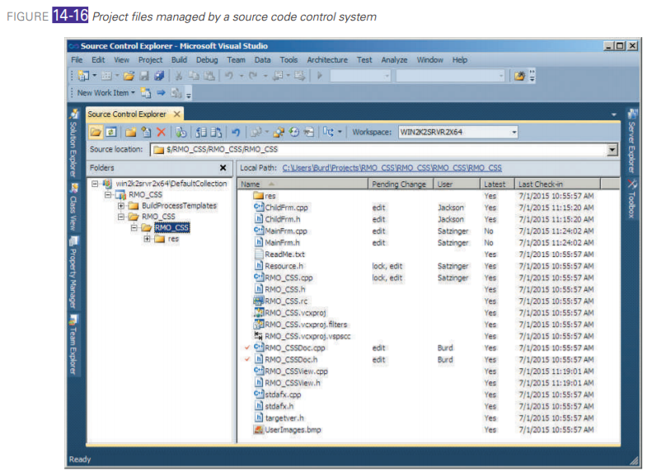
Source Code Control
Figure 10-8

Slide 32
Packaging, Installing, and Deploying Components
Packaging, Installing, and Deploying Components
As with the other disciplines discussed in this chapter, deployment activities are highly interdependent with activities of the other disciplines.
In short, a system or subsystem can’t be deployed until it has been implemented and tested. If a system or subsystem is large and complex, it is typically deployed in multiple stages or versions, thus necessitating some formal method of configuration and change management.

Slide 33
Packaging, Installing, and Deploying Components
Packaging, Installing, and Deploying Components
Important issues to consider when planning deployment include the following:
Incurring costs of operating both systems in parallel
Detecting and correcting errors in the new system
Potentially disrupting the company and IS operations
Training personnel and familiarizing customers with new procedures

Slide 34
Packaging, Installing, and Deploying Components
Packaging, Installing, and Deploying Components
Different approaches to deployment represent different trade-offs among cost, complexity, and risk. The most commonly used deployment approaches are:
Direct deployment
Parallel deployment
Phased deployment
Each approach has different strengths and weaknesses, and no one approach is best for all systems. Each approach is discussed in detail in the following sections.

Slide 35
Support Activities after Deployment
Support Activities after Deployment
The objective of the support activities is to keep the system running productively during the years following its initial deployment.
They begin only after the new system has been installed and put into production, and they last throughout the productive life of the system. Most business systems are expected to last for years.
During the support activities, upgrades or enhancements may be carried out to expand the system’s capabilities, and these will require their own development projects.
Three major activities occur during support:
Maintaining the system
Enhancing the system
Supporting the users

Slide 36
Change and Version Control
Change and Version Control
Change and version control tools and processes handle the complexity associated with testing and supporting a system through multiple versions.
Tools and processes are typically incorporated into implementation activities from the beginning and continue throughout the life of a system.
Most organizations use a common set of tools and procedures for all their systems.

Slide 37
Versioning
An alpha version is a test version that is incomplete but ready for some level of rigorous integration or usability testing. Multiple alpha versions may be built depending on the size and complexity of the system. The lifetime of an alpha version is typically short—days or weeks. A beta version is a test version that is stable enough to be tested by end users over an extended period of time.
A beta version is produced after one or more alpha versions have been tested and known problems have been corrected. End users test beta versions by using them to do real work. Thus, beta versions must be more complete and less prone to disastrous failures than alpha versions. Beta versions are typically tested over a period of weeks or months

Slide 38
Submitting Error Reports and Change Requests
Submitting Error Reports and Change Requests
To manage the risks associated with change, most organizations adopt formal control procedures for all systems under development and in operation.
Formal controls are designed to ensure that potential changes are adequately described, considered, and planned before being implemented and deployed.
Typical change control procedures include these:
Standard reporting methods
Review of requests by a project manager or change control committee
For operational systems, extensive planning for design and implementation

Slide 39
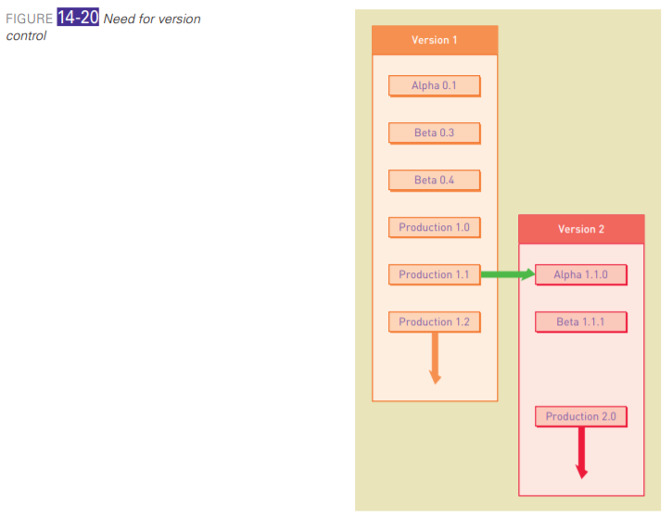
Need for Version Control
Figure 10-9
Source: Satzinger, John W., Jackson, Robert B., Burd, Stephen D. (2016)

Slide 40
Implementing a Change
Implementing a Change
Change implementation follows a miniature version of the SDLC.
Most of the SDLC activities are performed, although they may be reduced in scope or sometimes completely eliminated.
In essence, a change for a maintenance release is an incremental development project in which the user and technical requirements are fully known in advance.
Analysis activities are typically skimmed or skipped, design activities are substantially reduced in scope, and the entire project is typically completed in one or two short iterations.

Slide 41
Implementing a Change
Planning for a change includes these activities:
Identify what parts of the system must be changed.
Secure resources (such as personnel) to implement the change.
Schedule design and implementation activities.
Develop test criteria and a testing plan for the changed system.

Slide 42
references
Satzinger, John W., Jackson, Robert B., Burd, Stephen D. (2016). System Analysis and Design in a Changing World. 7th Edition. Cengage Learning, Boston USA. ISBN: 978-1-305-11720-4. Part 3, Chapter 14
February 2023

Slide 43
Thank you
Deploying the New System
February 2023

