Slide 1

Neural Networks for Liver Disease Prediction
Rafael Sêco
Disclosure: some variable names from images might be in portuguese

Slide 2
Contents
01
04
02
05
03
Introduction
Discussion
Methods
Conclusion
Results

Slide 3
01
Introduction

Slide 4

Introduction
The liver disease
Use of diferent models or algorithms when predicting
neuralnet
nnet
Support Vector Machine
Extreme Learning Machine
Gradient Boosting Machine

Slide 5
02
Methods

Slide 6



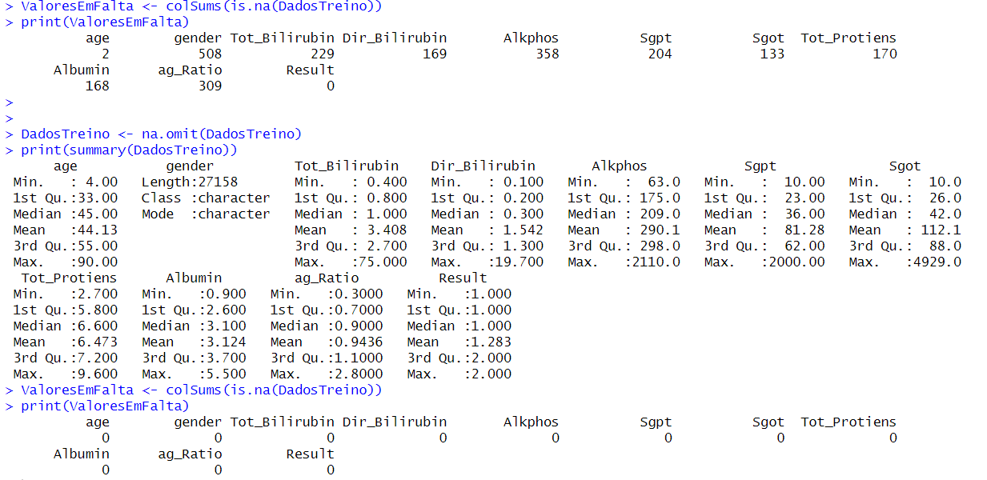


Methods – Dataset Cleaning

Slide 7
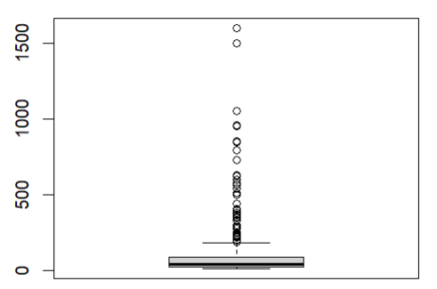


Methods – Dataset Cleaning

Slide 8

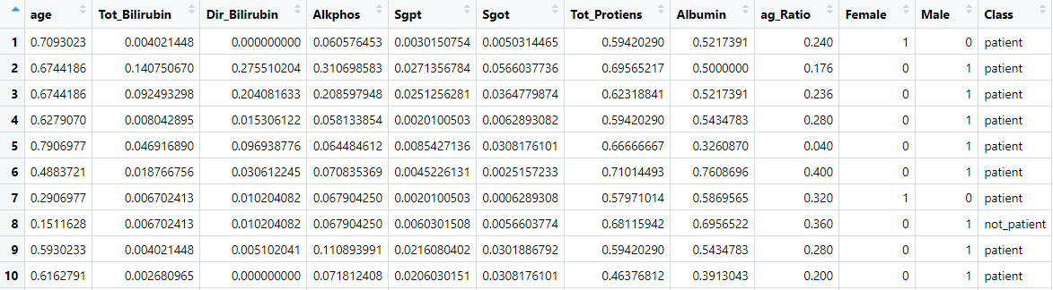

Methods – Dataset Cleaning

Slide 9
Evaluation Methods
Cross-validation:
Testing Set with 20% of the data
Training Set with 80% of the data, whereas 10% of this data is for the validation phase and the rest for training in each iteration

Slide 10
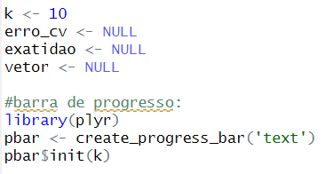
Evaluation Methods

Slide 11
03
Results

Slide 12
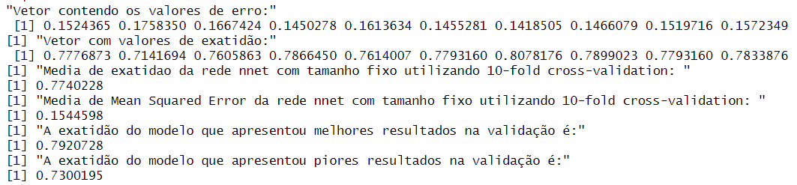
Results
1) 10-fold cross-validation with nnet model with variable hidden layer
Accuracy: 79,69 %
MSE
2) 10-fold cross-validation with nnet model with non-variable hidden layer
Accuracy: 79,2 %
MSE

Slide 13
Results
3) 10-fold cross-validation with nnet model, plus variable decay
Accuracy: 79,53 %
Better decay: 0,02
4) 10-fold cross-validation with neuralnet model
Accuracy: 71,47 %
MSE

Slide 14
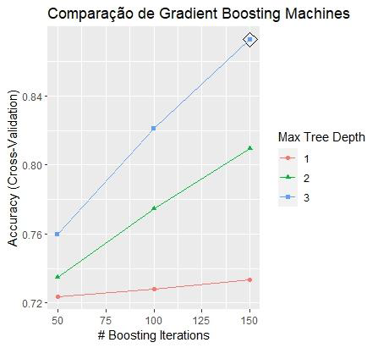

Results
5) Repeated 10-fold cross-validation with Support Vector Machine
Accuracy: 71 %
6) 10-fold cross-validation with a Gradient Boosting Machine model
Accuracy: 86,7 %

Slide 15
Results
7) Algorithm Extreme Learning Machine with cross-validation
Accuracy: 78,95 % with 2000 neurons

Slide 16
Results – Feature elimination to improve the results obtained
Accuracy comparison with cross-validation (in %)
 | Before | After
neuralnet | 71,47 | 73,35
nnet | 79,20 | 81,16
Support Vector Machine | 71,00 | 69,66
Gradient Boosting Machine | 86,70 | 87,40
Extreme Learning Machine | 78,95 | 82,84

Slide 17
04
Discussion

Slide 18
05
Conclusion

Slide 19
Thanks!

