Slide 1
Linux 101:
The Essentials of Linux and Open Source
By
Jon “maddog” Hall
Linux International
Updates by Rafael Zago
(rafaelvzago.github.io)

Slide 2
Trademarks
Linux is a trademark of Linus Torvalds
Unix is a trademark of X/Open
Micro$oft would like to own everything else

Slide 3
The Newspaper
And the Audience For This Talk
Who
When
Where
What
Why
How
There is no way I can tell you everything in this one or two hour talk.

Slide 4
Who,When and Where
1969
  DECUS
  Unix – AT&T Bell Laboratories, NJ, USA
    Ken Thompson
    Dennis Ritchie
    et. al.
  Linus Torvalds, Helsinki, Finland
1984 – GNU
  Richard Stallman (et. al.) - Cambridge, MA, USA

Slide 5
Who, When and Where (Cont.)
1991
  FSF incorporated (Cambridge)
  Linus starts kernel project (Helsinki)
1994 – V1.0 of kernel (Worldwide)
1998 – Industry notices
  Databases port
  Start of commercial support by large companies
2000 - “Year of Linux”
2001 – Linux mainstream

Slide 6
What Is An Operating System
Distribution?
An Operating System is:
  Kernel (More on what a kernel does later)
  Libraries (Math, I/O, Windowing, etc.)
  Command Interpreters (shell)
  Compilers (Gnu suite, others)
  Utilities (sort, search, format, convert)
  Applications and Application packages
A way to install the code – Package Manager
Documentation

Slide 7

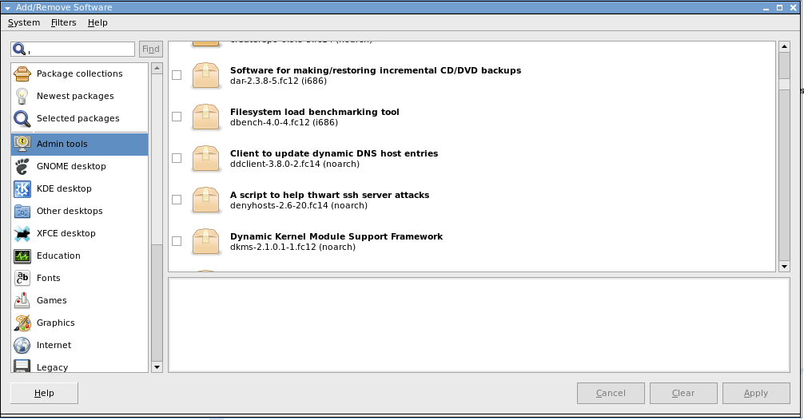
Distributions
Packages = Collections of programs related to a specific project or set of applications
Package types
  RPM
  DEB
Package Managers
  depends on distribution
  Handle dependencies

Slide 8
Choosing A Distribution
Commercial and Non-Commercial Distributions and “Spins”
  Redhat, Novell, Mandriva, Asianux,
  Debian, Fedora, CentOS, OpenSuSE, Gentoo
  Scientific Linux, Poseidon Linux
  Dyna:bolic, UbuntuStudio
Choosing a distribution is largely about support and function
  Very small distributions
  “Emergency and security” distributions
  Multimedia distributions

Slide 9
Mega Projects
“Mega Projects” many small projects come together
  Foundations like Apache, Eclipse
  Projects like GNOME and KDE desktops, MythTV
  Company-centered ecosystems like MySQL
Can be blessing and curse
  Can solve larger business problems with integration
  Not all components will be equal
  Make conscious decisions!

Slide 10
What Is A Kernel?
Controls and Schedules hardware
  Memory
  I/O
Controls and Schedules processes and tasks
Sends messages between subsystems

Slide 11
Linux (as a kernel) is:
Multi
  User
  Tasking
  CPU
  Architecture – why is this important?
    Intel 32/64, Alpha, SPARC, Motorola, StrongARM, Hitashi, MIPS, R6000, IBM 390, AS400, Transmeta Caruso
32 or 64 bit demand-paged virtual memory
  If hardware supports
Multiple network stacks

Slide 12
Linux (as a kernel) has:
Many networking stacks
  X.25
  uucp
  TCP/IP
  DECnet
Many file systems
  Log-based
  Journaled
  Distributed (NFS, SAMBA)

Slide 13
Linux (as a kernel) is:
SMP
Modular
Loadable device drivers
Soft real time (mostly)
Hard real time (with a little help from its friends)

Slide 14
Linux (as a kernel) is:
Highly Available
OpenMosix
  Single system image
  Live migration and balancing of processes
Secure
Stable
....and free

Slide 15
The Problem with “Free”
Livre vs Gratis
Software Freedom
  Freedom to inspect source code
  Freedom to change source code
  Freedom to redistribute changes
  Freedom to use code for any reasons
Many “Open” licenses
  BSD
  GPL – restricts freedom to restrict others

Slide 16
Open Source
A reaction to the reaction around “free”
Many different licenses
  BSD
  GPL
  Apache
  Artistic
Some not so “Open” as others
Definitions at www.ossi.org

Slide 17
Open Source and the Economy
Trade off of Intellectual Property and tailoring
Allows new companies to form
  Lowers barriers to entry
  Allows for minorities
Encourages competition
Encourages local jobs

Slide 18
Open Source Repositories
www.github.com
49M+ projects
27M+ developers registered

Slide 19
Not “Just” Linux or *BSD:
Also Apple and “That other OS”
Audio & Video
Business &Enterprise
Communications
Development
Home & Education
Games
Science & Engineering
Security & Utilities
System Administration

Slide 20
Not Just “Whole Programs”
Use parts of programs to build your own solution
Why re-invent the wheel, or pay for just the axle?
Good programmers write good code, great programmers “steal” good code.

Slide 21
A Word About “Shared Source”
Limited in freedoms
  Only can read source
  Can not change source
  Can not redistribute source
Limited in audience
  60 countries (not 200)
  1000 “Top Research Universities” (not colleges)
  1000 “Best customers” (Oracle?)
If you are not completely open, you are more than completely closed.

Slide 22
It Is All Right To Charge Money
You are charging for service, not Intellectual Property (IP)
You can not restrict rights of others to redistribute changes
Example: GPLed Distribution
  Service
    Putting code onto CDROM and distributing it
    Answering questions
    Printing documentation
  IP – code that is on the CDROM – many copies

Slide 23
Why Do People Give This Away?
Why do amateur artists paint?
Why do amateur athletes compete?
You “scratch your own itch”
Linus only wanted a nice desktop system....

Slide 24
Internet Service Providers (ISP):
The Perfect Operating System
TCP/IP
FTP
Gopher
Apache
Shell accounts
Multi (user, tasking, cpu, architecture)
Stable
Secure
Inexpensive (both software and hardware)

Slide 25
File and Print Servers
Samba (SMB)
Appletalk
NFS
Mount different file systems
  FAT, FAT32, NTFS
  BSD
  EXT2
  Journaled file systems

Slide 26
And You Got the Source Code
(who cares?)
Mean Time Between Failures (MTBF) - stability
Mean Time To Recovery (MTTR)
  Binary vs Open Source
What is “Service”?
  Infoworld Magazine 1997, 1998

Slide 27
Those Little Annoying Things
Bugs
Feature requests (enhancements)

Slide 28
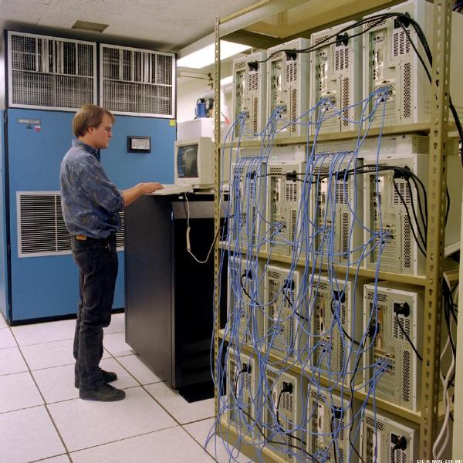
Super Computers
Beowulf systems
  Lots of COTS
  High speed networking
  Parallelizing code
Dr. Donald Becker and Dr. Thomas Sterling
Supercomputer performance at 1/40th of the price – Pat Goda

Slide 29
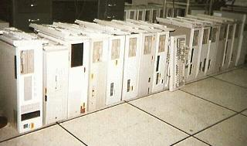
Super Computers
Oakridge National Labs – Tennessee, USA
Discarded Hardware
  48 CPUs
  10 Mbps ETHERNET
Lots of Elbow Grease

Slide 30
Super Computer Distributions
Rocks
Oscar

Slide 31
Embedded Systems:
From big to little
Talking toasters – washing machines that inform
  Big Applications
  Sophisticated Operating Systems
Constantly needed:
  Device drivers
  Network stacks
  Porting of code
An 800 lb gorilla – lots of little chimps
  Lots of work
  Different Interfaces

Slide 32
Linux Has...
Lots of device drivers
Lots of network stacks
Modular kernel
Loadable device drivers
Source code availability
Low cost
  No royalty cost per unit

Slide 33
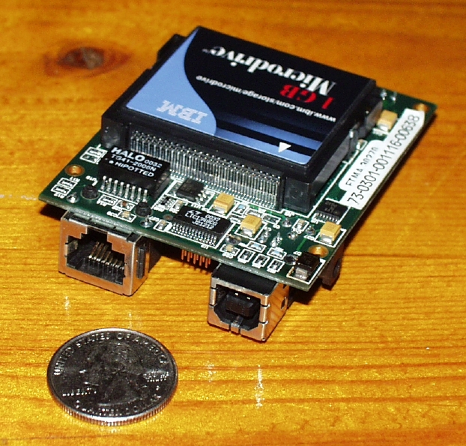
Even More Powerful
StrongARM processor
  2 Mbytes of Flash
  32 Mbytes of RAM
  ETHERNET
  USB
  Serial line
  Parallel line
  LCD
  Compaq Flash
5 Watts peak draw

Slide 34
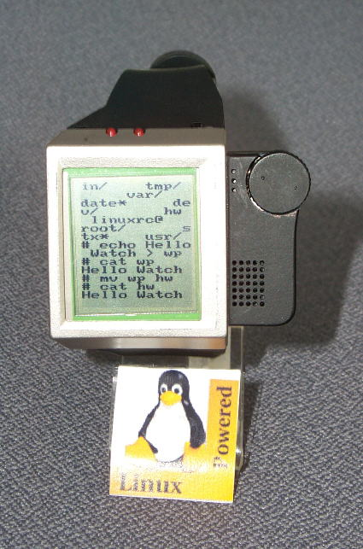
Still Not Convinced?
2 Mbtyes Flash
8 Mbytes RAM
Scroll wheel
Touch sensitive screen
IR and RF networking

Slide 35
The Desktop
(Remember Linus' Desktop?)
GNOME, KDE, xfce, Unity and other desktops
  Basic File Finder Interface
  Additional personal use office products
Open and Libre Office
Red Flag Office (Chinese)
Hancom Office (Korean)

Slide 36
Interesting Desktop Configurations
Volkscomputer
One system box
Multiple video cards/Monitors
Multiple keyboards and mice
Larger amount of memory
Disk
Shared printer

Slide 37
Interesting Desktop Configuration (Cont.)
LTSP - Thin client
  System box
  Video card
  Diskless
  ETHERNET computer
  Little memory
  Application works on server, displays on client
Smart client – (diskless workstation)
  Like thin client, but more memory
  Application works on client, draws data from server

Slide 38
More Applications Coming
4500+ commercial applications (IBM)
  Database and 4GL
Emulators
  Dosemu
  WINE – Codeweavers
  ARDI – macintosh
  IBSC2
  JAVA
Internally built applications
A lot more in Open Source

Slide 39
Standards
Improvements inside and under standards
  Not like a certain company....
Free Standards Group (FSG)
  Linux Filesystem Hierarchy Standard
  Linux Standards Base (LSB)
  Linux Internationalization (Li18nux)

Slide 40
Certifications
Linux Professional Institute (LPI)
  Level I
  Level II
  Level III (Security, Databases, Mixed Systems)
  DevOps
CompTIA
Distribution Specific
  Red Hat
  SuSE

Slide 41
Support Organizations
Most major computer vendors
Independent support organizations
Newsgroups and mailing lists
Web sites

Slide 42
Other Topics
Copyright and Licensing
  Creative Commons – licensing for sharing
Open formats
  Published
  Non-royalty bearing (Ogg)
Open standards
Open business practices

Slide 43
How To Get Started
Gather Knowledge
Book Store
  Book on GNU/Linux
Web sites
  www.distrowatch.com
  www.freshmeat.net
  www.github.net
Local User Groups (LUGs)
Universities

Slide 44
How To Get Started
Select Hardware
The Microsoft and Apple Illusion:
  No end user ever installs their system
  If the hardware/software does not work, you don't see it
Most “generic” hardware works with Linux
Search for the name of the hardware and “Linux” to be sure
Hardware compatibility lists

Slide 45
How To Get Started
Get Distribution
Web site of Distribution
  Live CD/DVD
    Choose ISO for your machine
      Architecture
      32/64 bit (32 bit works on both)
    Download ISO
    Burn ISO or load onto Flash
Boot Live to:
  test hardware
  start to explore

Slide 46
How To Get Started
Installation to Persistent USB
Get “reasonably sized” USB
Make LIVE DVD image on DVD

Slide 47
How To Get Started
Installation to Hard Disk
BACK UP CURRENT SYSTEM!
Install GNU/Linux on:
  Old machine
    Pentium I or above
    1 Gbyte of RAM recommended
    4 GB of disk
  Spare Disk
  Spare Partition
    GNU/Linux will allow you to repartition
    BACK UP CURRENT SYSTEM!
  Boot loader will be installed

Slide 48
Other Methods For Installation
Virtual Machine
  VMWare
  Virtual Box
Ubuntu has “Wubi”
Here at Campus Party

Slide 49
How To Get Started:
Add More Functionality
Distributions have “repositories”
  Thousands of programs online
  Organized by category
Search engines are our friend!

Slide 50
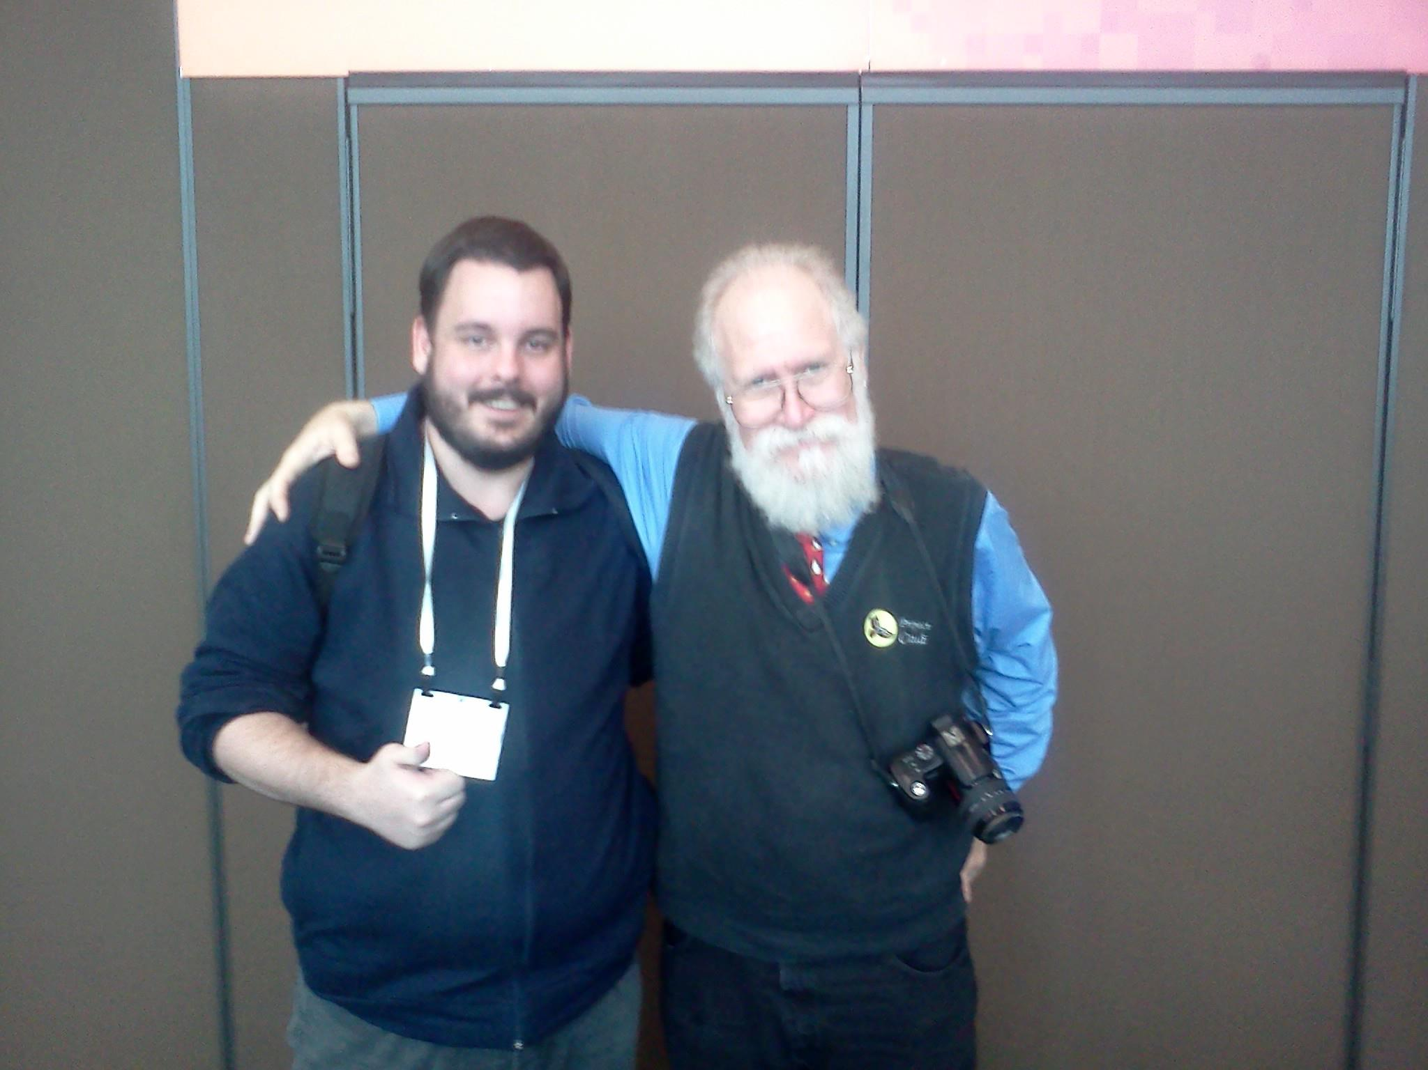
Who are they?

Slide 51
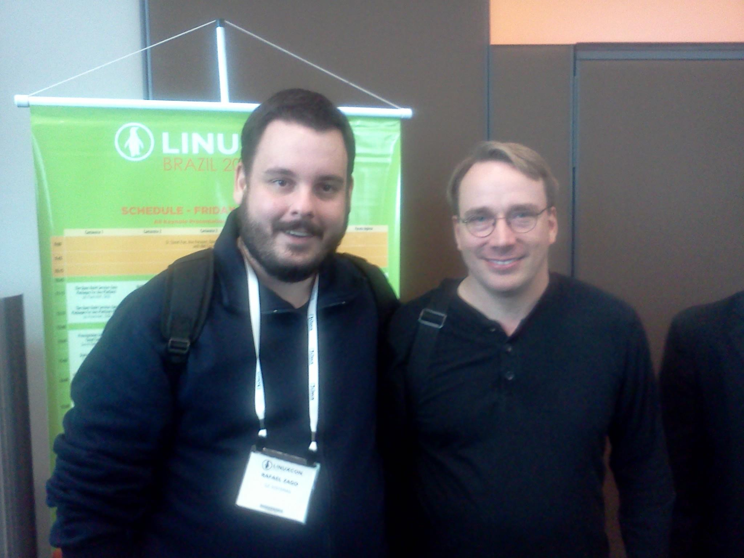
Who are they?

Slide 52
Questions?

