Slide 1
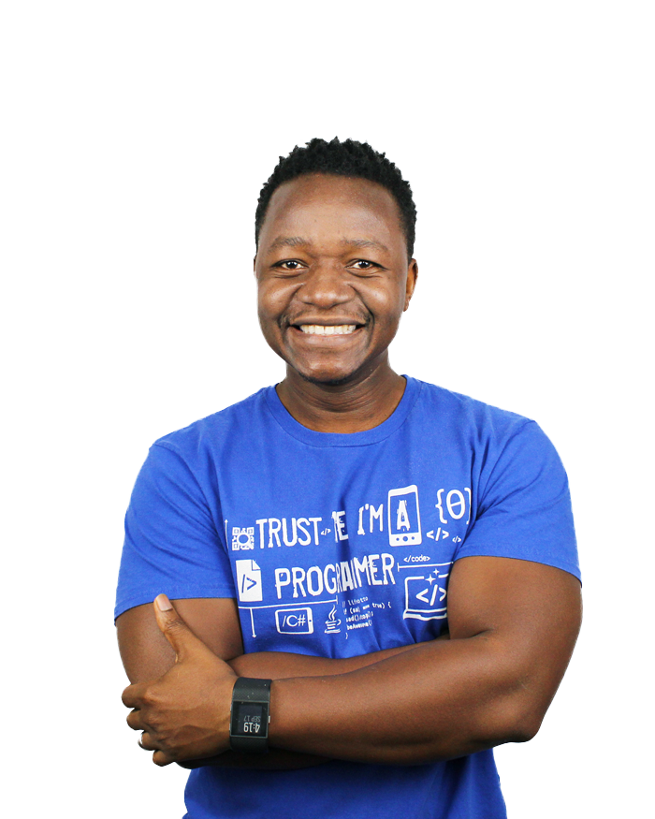
Who Am I?
Paulo Dichone
Software, Cloud, AI Engineer
and Instructor
Notes:
Lesson 2

Slide 2
What Is This Course About?
Knowledge Graphs & RAG -
Fundamentals of Knowledge Graphs
Implement Knowledge Graphs to Improve RAG Systems
Optimization and Best Practices

Slide 3
Who Is This Course For
Entrepreneurs
Open minded learners :)
Developers
Project
Managers
Data Scientists
Data Professionals
Business
Analysts

Slide 4
Course Prerequisites
Know Programming (highly preferred… at least the basics)
There will be Python code
Basics of LangChain, LLM, AI
This is not a programming course
Willingness to learn :)

Slide 5
Course Structure
Theory (Fundamental Concepts)
Mixture of both
Hands-on

Slide 6
Development Environment setup
Python
VS Code (or any other code editor)
OpenAI API Account and API Key

Slide 7
Set up OpenAI API Account
** Please note that you will need an API key to use OpenAI services, and there may be some costs associated with using the API. However, these costs should be minimal.

Slide 8
OpenAI API - Dev Environment Setup
Python (Win, Mac, Linux)
https://kinsta.com/knowledgebase/install-python/
Notes:
https://kinsta.com/knowledgebase/install-python/

Slide 9
Knowledge Graphs
Deep Dive
What are they?
Why (motivation)?
Advantages
Key concepts
Structure
Components
Use cases
Advantages & Challenges
Notes:
Fundamentals of Knowledge Graphs
Introduction
A knowledge graph is a structured representation of facts and relationships within a specific domain, which enables machines to understand and reason about the world in a way similar to humans. Knowledge graphs are used in various applications like search engines, recommendation systems, and artificial intelligence (AI) for enhanced data integration, management, and retrieval.
Key Concepts
Entities: These are the primary nodes or vertices in a knowledge graph, representing objects or concepts. Examples include people, places, organizations, and events.
Relationships: These are the edges or links connecting entities, representing how entities are related to each other. For example, a relationship might connect "Albert Einstein" (entity) to "Physics" (entity) with the relationship "studied".
Attributes: These are properties or characteristics of entities. For example, the entity "Albert Einstein" might have attributes like birth date, nationality, and profession.
Triples: The basic building block of knowledge graphs, consisting of a subject, predicate, and object. For instance, ("Albert Einstein", "studied", "Physics") is a triple.
Structure
Graph-based Structure: Knowledge graphs use graph data structures with nodes (entities) and edges (relationships) to model real-world knowledge.
Ontology: This is a schema that defines the types of entities, relationships, and attributes within a knowledge graph. Ontologies provide a formal framework to ensure consistency and enable reasoning over the graph.
Taxonomy: A hierarchical classification of entities within the graph, often part of the ontology, representing "is-a" relationships (e.g., a "dog" is a type of "animal").
Components
Nodes: Represent entities or instances.
Edges: Represent relationships between entities.
Labels: Tags or names assigned to nodes and edges to define their types.
Properties: Additional information or attributes about nodes and edges.
Construction
Manual Curation: Experts manually input data into the graph, ensuring accuracy and reliability.
Automated Extraction: Using algorithms and natural language processing (NLP) to extract information from unstructured data sources like text, documents, and databases.
Crowdsourcing: Leveraging the input from a large number of people to populate and refine the graph.
Technologies and Languages
RDF (Resource Description Framework): A standard model for data interchange on the web, using triples to represent knowledge.
SPARQL (SPARQL Protocol and RDF Query Language): A query language for retrieving and manipulating data stored in RDF format.
OWL (Web Ontology Language): A language for defining and instantiating Web ontologies.
Applications
Search Engines: Enhance search capabilities by understanding the context and relationships of search terms (e.g., Google's Knowledge Graph).
Recommendation Systems: Provide personalized recommendations by understanding user preferences and relationships between products or services.
Data Integration: Combine data from diverse sources into a unified framework, enabling more effective analysis and decision-making.
AI and Machine Learning: Enhance machine understanding and reasoning by providing structured knowledge.
Advantages
Enhanced Data Interoperability: Enables integration of heterogeneous data sources.
Improved Data Quality and Consistency: Ensures accuracy through well-defined ontologies and taxonomies.
Facilitates Advanced Querying: Allows complex queries about the relationships between entities.
Supports Inference and Reasoning: Enables machines to infer new knowledge from existing data.
Challenges
Data Quality: Ensuring the accuracy and reliability of the data.
Scalability: Managing and processing large-scale knowledge graphs efficiently.
Complexity: Developing and maintaining comprehensive ontologies and taxonomies.
Data Privacy: Protecting sensitive information while utilizing knowledge graphs.
Conclusion
Knowledge graphs are a powerful tool for structuring and reasoning about complex data. They enhance the capabilities of AI systems, improve search and recommendation engines, and facilitate data integration and analysis across various domains. By understanding the fundamentals of knowledge graphs, one can leverage their potential to create smarter, more intuitive systems.

Slide 10
Knowledge Graphs
A KG is a structured representation of facts and relationships within a specific domain…
Math
Albert E.
Interested
studied
Physics
played
violin
Notes:
A knowledge graph is a structured representation of facts and relationships within a specific domain, which enables machines to understand and reason about the world in a way similar to humans. Knowledge graphs are used in various applications like search engines, recommendation systems, and artificial intelligence (AI) for enhanced data integration, management, and retrieval.

Slide 11
Key concepts
Albert E.
studied
Physics
Entity
Edge/Relationship
Entity
Notes:
Key Concepts
Entities: These are the primary nodes or vertices in a knowledge graph, representing objects or concepts. Examples include people, places, organizations, and events.
Relationships: These are the edges or links connecting entities, representing how entities are related to each other. For example, a relationship might connect "Albert Einstein" (entity) to "Physics" (entity) with the relationship "studied".
Attributes: These are properties or characteristics of entities. For example, the entity "Albert Einstein" might have attributes like birth date, nationality, and profession.
Triples: The basic building block of knowledge graphs, consisting of a subject, predicate, and object. For instance, ("Albert Einstein", "studied", "Physics") is a triple.

Slide 12
Key concepts
Albert E.
studied
Physics
Attributes:
Birth data
Nationality
profession
Entity
Edge/Relationship
Entity
Notes:
Key Concepts
Entities: These are the primary nodes or vertices in a knowledge graph, representing objects or concepts. Examples include people, places, organizations, and events.
Relationships: These are the edges or links connecting entities, representing how entities are related to each other. For example, a relationship might connect "Albert Einstein" (entity) to "Physics" (entity) with the relationship "studied".
Attributes: These are properties or characteristics of entities. For example, the entity "Albert Einstein" might have attributes like birth date, nationality, and profession.
Triples: The basic building block of knowledge graphs, consisting of a subject, predicate, and object. For instance, ("Albert Einstein", "studied", "Physics") is a triple.

Slide 13
Key concepts
Albert E.
studied
Physics
Triples
Subject (Albert)
Predicate (studied)
Object (Physics)
Attributes:
Birth data
Nationality
profession
Notes:
Key Concepts
Entities: These are the primary nodes or vertices in a knowledge graph, representing objects or concepts. Examples include people, places, organizations, and events.
Relationships: These are the edges or links connecting entities, representing how entities are related to each other. For example, a relationship might connect "Albert Einstein" (entity) to "Physics" (entity) with the relationship "studied".
Attributes: These are properties or characteristics of entities. For example, the entity "Albert Einstein" might have attributes like birth date, nationality, and profession.
Triples: The basic building block of knowledge graphs, consisting of a subject, predicate, and object. For instance, ("Albert Einstein", "studied", "Physics") is a triple.

Slide 14
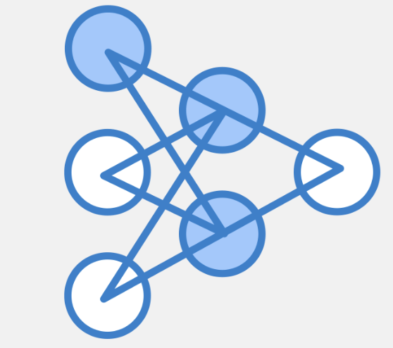
Structure
Graph-based Structure: nodes, edges, to model real-world knowledge
Ontology: schema that defines the types of entities, relationships and attributes
Taxonomy: Hierarchical classification of entities in the graph
Notes:
Structure
Graph-based Structure: Knowledge graphs use graph data structures with nodes (entities) and edges (relationships) to model real-world knowledge.
Ontology: This is a schema that defines the types of entities, relationships, and attributes within a knowledge graph. Ontologies provide a formal framework to ensure consistency and enable reasoning over the graph.
Taxonomy: A hierarchical classification of entities within the graph, often part of the ontology, representing "is-a" relationships (e.g., a "dog" is a type of "animal").

Slide 15
Structure
Nodes: represent entities or instances
Edges: relationships between entities
Labels: tags assigned to nodes and edges to define their types
Properties: additional information or attribute about nodes and edges
Notes:
Components
Nodes: Represent entities or instances.
Edges: Represent relationships between entities.
Labels: Tags or names assigned to nodes and edges to define their types.
Properties: Additional information or attributes about nodes and edges.

Slide 16
KG construction
Manual curation: manual input of data into graph
Automated Extraction: using algos and NLP to extract information from unstructured data sources (txt, docs, DBs…)
Crowdsourcing: input from a large number of sources to populate and refine the graph.
Notes:
Construction
Manual Curation: Experts manually input data into the graph, ensuring accuracy and reliability.
Automated Extraction: Using algorithms and natural language processing (NLP) to extract information from unstructured data sources like text, documents, and databases.
Crowdsourcing: Leveraging the input from a large number of people to populate and refine the graph.

Slide 17
KG applications
Search engines: enhance search capabilities
Recommendation systems: provide personalized recommendations
Data Integration: combine data from various sources into one framework
AI and Machine Learning: enhance machine understanding
Notes:
Applications
Search Engines: Enhance search capabilities by understanding the context and relationships of search terms (e.g., Google's Knowledge Graph).
Recommendation Systems: Provide personalized recommendations by understanding user preferences and relationships between products or services.
Data Integration: Combine data from diverse sources into a unified framework, enabling more effective analysis and decision-making.
AI and Machine Learning: Enhance machine understanding and reasoning by providing structured knowledge.

Slide 18
KG Advantages
Enhanced data interoperability: good for integrating heterogeneous data sources
Improved data quality and Consistency: ensures accuracy (well-defined ontologies and taxonomies)
Facilitate Advanced Querying: allows complex queries
Supports Inference and Reasoning: machines can infer new knowledge from existing data easily
Notes:
Advantages
Enhanced Data Interoperability: Enables integration of heterogeneous data sources.
Improved Data Quality and Consistency: Ensures accuracy through well-defined ontologies and taxonomies.
Facilitates Advanced Querying: Allows complex queries about the relationships between entities.
Supports Inference and Reasoning: Enables machines to infer new knowledge from existing data.

Slide 19
KG challenges
Data quality: accuracy and reliability of the data is challenging
Scalability: managing and processing large-scale KGs efficiently
Complexity: developing and maintaining complex ontologies and taxonomies
Data Privacy: securing sensitive data while utilizing KGs
Notes:
Challenges
Data Quality: Ensuring the accuracy and reliability of the data.
Scalability: Managing and processing large-scale knowledge graphs efficiently.
Complexity: Developing and maintaining comprehensive ontologies and taxonomies.
Data Privacy: Protecting sensitive information while utilizing knowledge graphs.

Slide 20
Conclusion
KGs: a powerful tool for structuring and reasoning about complex data
Scalability: enhance capabilities of AI systems (improve search and recommendation engines…)
Data integration: facilitate data integration and analysis across various domains
Notes:
Knowledge graphs are a powerful tool for structuring and reasoning about complex data. They enhance the capabilities of AI systems, improve search and recommendation engines, and facilitate data integration and analysis across various domains. By understanding the fundamentals of knowledge graphs, one can leverage their potential to create smarter, more intuitive systems.

Slide 21
Knowledge Graphs
Deep Dive
neo4j
Building a Knowledge Graph
Introduction to neo4j
Relationships
Entities
hands -on

Slide 22
Building a Knowledge Graph
Albert E.
(studied)
(born in)
Physics
Germany
won
(died in)
Nobel Prize in Physics
USA
Notes:
Step 1: Define Entities and Relationships
We'll create a simple knowledge graph with the following entities and relationships:
Entities:
Albert Einstein
Physics
Nobel Prize in Physics
Germany
USA
Relationships:
Albert Einstein studied Physics
Albert Einstein won Nobel Prize in Physics
Albert Einstein was born in Germany
Albert Einstein died in the USA

Slide 23
Technologies and Languages
RDF ( Resource Description Framework)
SPARQL (SPARQL Protocol and RDF Query Language)
OWL (Web Ontology Language)
Neo4j
Notes:
We have different technologies and languages to represent kgs in code:
Technologies and Languages
RDF (Resource Description Framework): A standard model for data interchange on the web, using triples to represent knowledge.
SPARQL (SPARQL Protocol and RDF Query Language): A query language for retrieving and manipulating data stored in RDF format.
OWL (Web Ontology Language): A language for defining and instantiating Web ontologies.
But we will use neo4j for this! And Cypher (query language for the neo4j graph database)

Slide 24
Albert E.
(studied)
(born in)
Physics
Germany
won
(died in)
Nobel Prize in Physics
USA
(a:Person)-[:STUDIED]->(p:Physics)
(a:Person)-[:WON]->(n:NobelPrize)
(a:Person)-[:DIED_IN]->(u:USA)
Notes:
We have different technologies and languages to represent kgs in code:
Technologies and Languages
RDF (Resource Description Framework): A standard model for data interchange on the web, using triples to represent knowledge.
SPARQL (SPARQL Protocol and RDF Query Language): A query language for retrieving and manipulating data stored in RDF format.
OWL (Web Ontology Language): A language for defining and instantiating Web ontologies.
But we will use neo4j for this! And Cypher (query language for the neo4j graph database)

Slide 25
Neo4j graph database
Neo4j
A leading graph database management system that provides an ACID-compliant transactional backend for applications
Key concepts:
Nodes
Relationships
Properties
Labels
Cypher - the query language for interacting with the graph data
Notes:
Download neo4j app locally: https://neo4j.com/download/
Guide: https://neo4j.com/download-thanks-desktop/?edition=desktop&flavour=osx&release=1.6.0&offline=false#installation-guide
Introduction
Neo4j is a leading graph database management system that provides an ACID-compliant transactional backend for applications. It uses the property graph model to represent data, where nodes and relationships can have properties (key-value pairs).
Go through creating an account first and all that and then maybe use langchain wrapper of neo4j to make this easy!
Go over the GUI in neo4j site (workplace) first and create the einstein simple graph
Then use python locally to do the same thing:
Copy code
from neo4j import GraphDatabase
uri = "bolt://localhost:7687"
user = "neo4j"
password = "password"
driver = GraphDatabase.driver(uri, auth=(user, password))
def close():
driver.close()
Creating Nodes and Relationships
python
Copy code
def create_entities(tx):
tx.run("CREATE (:Person {name: 'Albert Einstein', born: 1879, died: 1955})")
tx.run("CREATE (:Country {name: 'Germany'})")
tx.run("CREATE (:Country {name: 'USA'})")
tx.run("CREATE (:NobelPrize {name: 'Nobel Prize in Physics'})")
tx.run("CREATE (:Subject {name: 'Physics'})")
def create_relationships(tx):
tx.run("""
MATCH (a:Person {name: 'Albert Einstein'}), (b:Country {name: 'Germany'})
CREATE (a)-[:BORN_IN]->(b)
""")
tx.run("""
MATCH (a:Person {name: 'Albert Einstein'}), (c:Country {name: 'USA'})
CREATE (a)-[:DIED_IN]->(c)
""")
tx.run("""
MATCH (a:Person {name: 'Albert Einstein'}), (s:Subject {name: 'Physics'})
CREATE (a)-[:STUDIED]->(s)
""")
tx.run("""
MATCH (a:Person {name: 'Albert Einstein'}), (n:NobelPrize {name: 'Nobel Prize in Physics'})
CREATE (a)-[:WON]->(n)
""")
def build_knowledge_graph():
with driver.session() as session:
session.write_transaction(create_entities)
session.write_transaction(create_relationships)
build_knowledge_graph()
close()
Step 5: Querying with Python
python
Copy code
def query_knowledge_graph():
with driver.session() as session:
result = session.run("""
MATCH (a:Person {name: 'Albert Einstein'})-[:STUDIED]->(s:Subject)
RETURN a.name, s.name
""")
for record in result:
print(f"{record['a.name']} studied {record['s.name']}")
query_knowledge_graph()
close()
Conclusion
This crash course provides a quick overview of Neo4j, covering installation, basic operations, and interaction using Python. Neo4j's powerful graph-based approach is ideal for representing complex relationships and structures, making it a valuable tool for various applications. By mastering these basics, you can start building and querying your own knowledge graphs with Neo4j.

Slide 26
Summary
Neo4j set up
Account
Create a graph database
Neo4j browser
Visual KGs
Create a KG programmatically
Querying the KG
Notes:
Download neo4j app locally: https://neo4j.com/download/
Guide: https://neo4j.com/download-thanks-desktop/?edition=desktop&flavour=osx&release=1.6.0&offline=false#installation-guide
Introduction
Neo4j is a leading graph database management system that provides an ACID-compliant transactional backend for applications. It uses the property graph model to represent data, where nodes and relationships can have properties (key-value pairs).
Go through creating an account first and all that and then maybe use langchain wrapper of neo4j to make this easy!
Go over the GUI in neo4j site (workplace) first and create the einstein simple graph
Then use python locally to do the same thing:
Copy code
from neo4j import GraphDatabase
uri = "bolt://localhost:7687"
user = "neo4j"
password = "password"
driver = GraphDatabase.driver(uri, auth=(user, password))
def close():
driver.close()
Creating Nodes and Relationships
python
Copy code
def create_entities(tx):
tx.run("CREATE (:Person {name: 'Albert Einstein', born: 1879, died: 1955})")
tx.run("CREATE (:Country {name: 'Germany'})")
tx.run("CREATE (:Country {name: 'USA'})")
tx.run("CREATE (:NobelPrize {name: 'Nobel Prize in Physics'})")
tx.run("CREATE (:Subject {name: 'Physics'})")
def create_relationships(tx):
tx.run("""
MATCH (a:Person {name: 'Albert Einstein'}), (b:Country {name: 'Germany'})
CREATE (a)-[:BORN_IN]->(b)
""")
tx.run("""
MATCH (a:Person {name: 'Albert Einstein'}), (c:Country {name: 'USA'})
CREATE (a)-[:DIED_IN]->(c)
""")
tx.run("""
MATCH (a:Person {name: 'Albert Einstein'}), (s:Subject {name: 'Physics'})
CREATE (a)-[:STUDIED]->(s)
""")
tx.run("""
MATCH (a:Person {name: 'Albert Einstein'}), (n:NobelPrize {name: 'Nobel Prize in Physics'})
CREATE (a)-[:WON]->(n)
""")
def build_knowledge_graph():
with driver.session() as session:
session.write_transaction(create_entities)
session.write_transaction(create_relationships)
build_knowledge_graph()
close()
Step 5: Querying with Python
python
Copy code
def query_knowledge_graph():
with driver.session() as session:
result = session.run("""
MATCH (a:Person {name: 'Albert Einstein'})-[:STUDIED]->(s:Subject)
RETURN a.name, s.name
""")
for record in result:
print(f"{record['a.name']} studied {record['s.name']}")
query_knowledge_graph()
close()
Conclusion
This crash course provides a quick overview of Neo4j, covering installation, basic operations, and interaction using Python. Neo4j's powerful graph-based approach is ideal for representing complex relationships and structures, making it a valuable tool for various applications. By mastering these basics, you can start building and querying your own knowledge graphs with Neo4j.

Slide 27
Knowledge Graphs & RAG
Graph retrieval-augmented generation (GraphRAG)
A powerful addition to traditional vector search retrieval methods
Notes:
We can use KG in RAG systems to improve vector search and retrieval …
What is RAG (let’s see a quick overview…)
Source: https://medium.com/neo4j/enhancing-the-accuracy-of-rag-applications-with-knowledge-graphs-ad5e2ffab663

Slide 28
RAG Overview
query
Documents…
Chunk 1
Chunk 2
Chunk 3
Embedding LLM
Emb 1
Emb 2
Emb 3
Embedding
Most similar
Gen. LLM
response
Notes:
This illustrate RAG - The generated response is augmented by the data I retrieved (from documents, in our case)
USE this article to deeply explain above figures: https://blog.demir.io/hands-on-with-rag-step-by-step-guide-to-integrating-retrieval-augmented-generation-in-llms-ac3cb075ab6f
Use this basic information to explain the above: 1. Advanced Retrieval-Augmented Generation (RAG) Pipeline: An Overview
A basic RAG workflow can be divided into three steps: indexing, retrieval, and generation. During the indexing phase, the text is converted into embeddings, which are then stored in a vector database to create a searchable index. In the retrieval step, the user’s query is also converted into an embedding. This embedding is used to search the vector database for the most relevant text data. Finally, in the generation step, the query is augmented with the relevant documents retrieved earlier, and a large language model uses this enhanced prompt to generate an answer to the user’s question.
Source: https://blog.demir.io/advanced-rag-implementing-advanced-techniques-to-enhance-retrieval-augmented-generation-systems-0e07301e46f4

Slide 29
Knowledge Graph & RAG - Steps
Unstructured data
Extraction
Data Integration
Generate K Graph

Slide 30
Knowledge Graph & RAG - Overview
Knowledge graph
Graph search
prompt
question
Combined sources
User
LLM
Relevant context
Keyword search
Vector store
query
Vector search
response
RAG retriever
Documents of unstructured text
Notes:
Explain this diagram
The diagram illustrates a retrieval process beginning with a user posing a question, which is then directed to an RAG retriever. This retriever employs keyword and vector searches to search through unstructured text data and combines it with the information it collects from the knowledge graph. Since Neo4j features both keyword and vector indexes, you can implement all three retrieval options with a single database system. The collected data from these sources is fed into an LLM to generate and deliver the final answer.

Slide 31
GraphRAG
Hand-on
Build a Knowledge Graph and a
Hybrid Retrieval for RAG
Notes:
Go over the whole process using:
https://medium.com/neo4j/enhancing-the-accuracy-of-rag-applications-with-knowledge-graphs-ad5e2ffab663
First step:
set up neo4j environment (already done)
Make sure we have the openai api key (done)
Data integration (use langchain loaders to fetch and split the documents from sources like wikipedia or pdf files etc…)
Construct a graph based on the retrieved documents - use LLMGraphTransformer module that significantly simplifies constructing and storing a kg in a graph database
Show the graph in the Neo4j Browser
Hybrid Retrieval for RAG
Unstructured data retriever
In this case, use Neo4jVector.from_existing_graph method to add both keyword and vector retrieval to documentsThis method configures keyword and vector search indexes for a hybrid search approach, targeting nodes labeled Document. Additionally, it calculates text embedding values if they are missing.
Graph retrieval

Slide 32
Graph Retriever - Flow
User
identify
flatten
query
LLM extracting entities
results
Relevant nodes with their
neighborhoods
… that can be passed to an LLM
Notes:
On the other hand, configuring a graph retrieval is more involved but offers more freedom. This example will use a full-text index to identify relevant nodes and return their direct neighborhood.

Slide 33
Hands-on - The Roman Empire RAG System
Enhance the accuracy of RAG application with Knowledge Graphs
Unstructured data
Extraction
Data Integration
Generate K Graph
Unstructured data retrieval (vector store, keyword search, vector search)
Graph Retrieval ( more involved, but offers more freedom)

Slide 34
Hands-on - The Roman Empire RAG System
Enhance the accuracy of RAG application with Knowledge Graphs
Pull text/docs from wikipedia about the Roman Empire
Extraction
Data Integration
Generate K Graph

Slide 35
Congratulations!
You made it to the end!
Next steps…

Slide 36
Course Summary
Knowledge Graphs for RAG (GraphRAG)
Fundamentals of Knowledge Graphs
Key characteristics
How they work
Deep dive into Building Knowledge Graphs
Built first simple KG
Basics Cypher Query Language
The Neo4J Graph database
GraphRAG Hands on
Using framework to extract, embed unstructured text
Full on real-world use case scenarios

Slide 37
Wrap up - Where to Go From Here?
Keep learning
Extend the projects we worked on in this course
Implement your own knowledge Graphs and RAG
Challenge yourself to keep learning new skills!

Slide 38
Thank you!

